Slide 1
Body mass of Palmer penguins by species and sex
A worked example of the analysis project template

Slide 2
How much heavier are males, and does it depend on the species?
Penguins measured | 344 penguins of three species, Palmer Archipelago, Antarctica, 2007 to 2009
Analysed | 333 with every measurement and a recorded sex; left out: 6 Adelie and 5 Gentoo
Data | datasets::penguins, shipped with R since 4.5; Gorman, Williams and Fraser (2014)

Slide 3
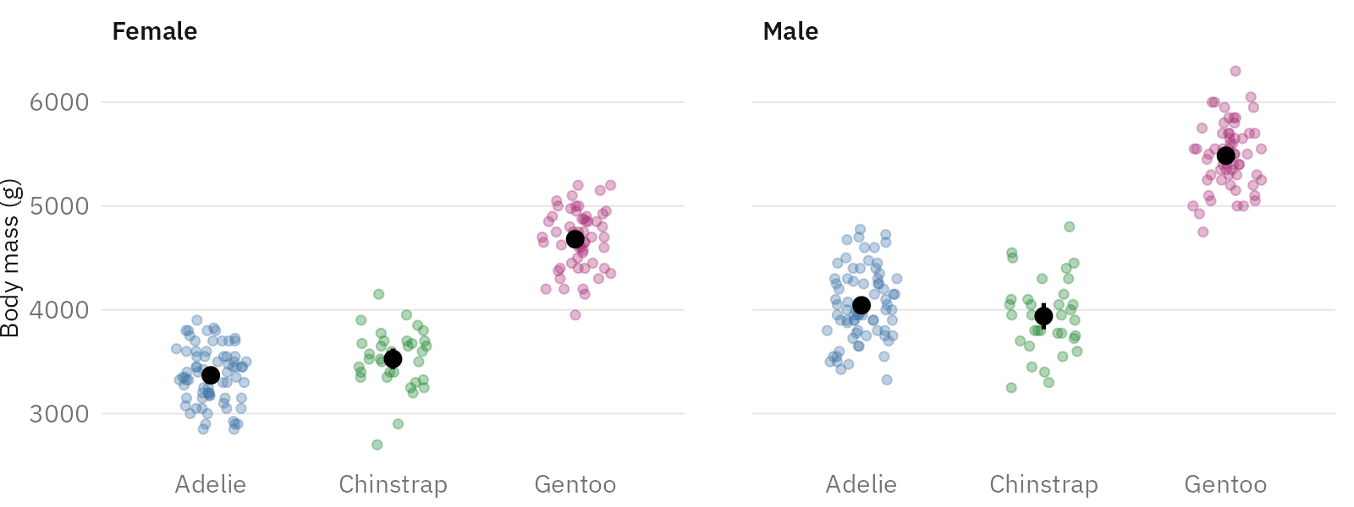
Males are heavier in every species
333 penguins. Points: individual penguins. Black: means with 95% confidence intervals.

Slide 4
The difference is largest in Gentoo penguins
 | Adelie | Chinstrap | Gentoo
Difference (g) | 675 | 412 | 805
95% CI (g) | 573 to 776 | 254 to 570 | 697 to 913
Penguins | 146 | 68 | 119
Male minus female mean body mass within each species, with a Welch confidence interval (CI).

Slide 5
Adjusted for species, males are heavier by 668 g
Comparison | Difference (g) | 95% CI (g)
Males vs females | 668 | 599 to 736
Chinstrap vs Adelie | 27 | −65 to 118
Gentoo vs Adelie | 1378 | 1301 to 1455
Linear model of body mass on species and sex; 333 penguins; R² 0.85. Chinstrap and Adelie penguins of the same sex do not clearly differ. The model assumes one difference for all species, while within species it ranges from 412 to 805 g.

