Slide 1
Body mass of Palmer penguins by species and sex
A worked example of the R analysis project template

Slide 2
Question and data
Question | How much heavier are male penguins than females, and does the difference depend on the species?
Penguins measured | 344 penguins of three species, Palmer Archipelago, Antarctica, 2007 to 2009
Analysed | 333 with every measurement and a recorded sex; left out: 6 Adelie and 5 Gentoo
Data | datasets::penguins, shipped with R since 4.5; Gorman, Williams and Fraser (2014)

Slide 3
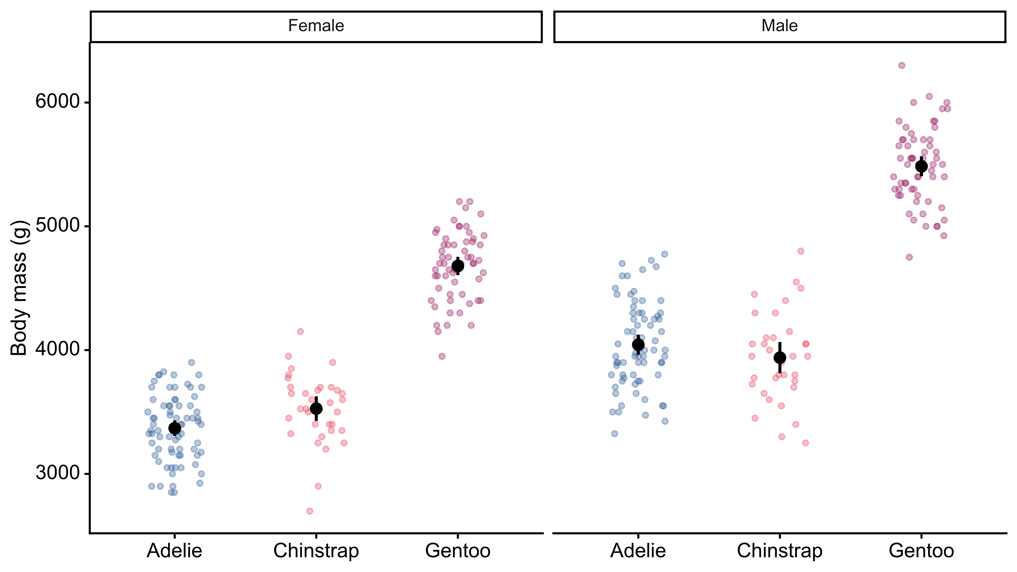
Males are heavier in every species
Points: individual penguins. Black: means with 95% confidence intervals.

Slide 4
Male minus female body mass
 | Adelie | Chinstrap | Gentoo
Difference (g) | 675 [573, 776] | 412 [254, 570] | 805 [697, 913]
Penguins | 146 | 68 | 119
Difference in means within each species, with its Welch confidence interval at 95%.

Slide 5
Adjusted for species
Males heavier by 668 [599, 736] g
Gentoo heavier than Adelie of the same sex, by 1378 [1301, 1455] g
Chinstrap and Adelie: 27 [−65, 118] g, no clear difference
Model: body mass on species and sex, 333 penguins, R² 0.85

Slide 6
Caveats
One difference for all species: the model assumes it; the within-species differences range from 412 to 805 g
Complete records only: 11 penguins without a recorded sex are left out

