Slide 1
Data Science Final Project
\
Phone Rate Prediction
Shir Zimer & Sofi Eliazarov

Slide 2
Introduction
The chosen topic is predicting the cost/benefit ratio for cellular devices based on different parameters. This topic is highly intriguing because if we succeed in accurately predicting user ratings for a phone, phone companies can utilize our work to build the ultimate cellular device by selecting precise parameters for their target audience. It is highly likely that customers will appreciate and rate it highly.

Slide 3
Data Acquistion
Crawled the data using BS4.
Filtered the data to be relevant.
Carried out by the use of Python libraries.
Save Data as excel file.
Data Source: https://www.kimovil.com/en/compare-smartphones
Data source contain the smartphone informations. All smartphone lists be crawled using BS4 and used only smartphone features which produced 2 years ago.

Slide 4
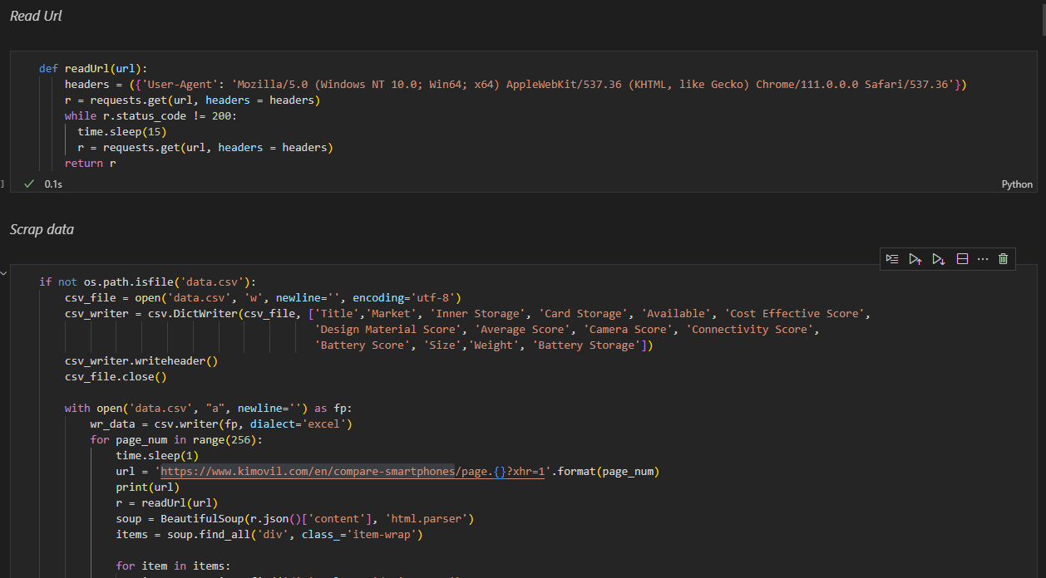
Data crawling

Slide 5
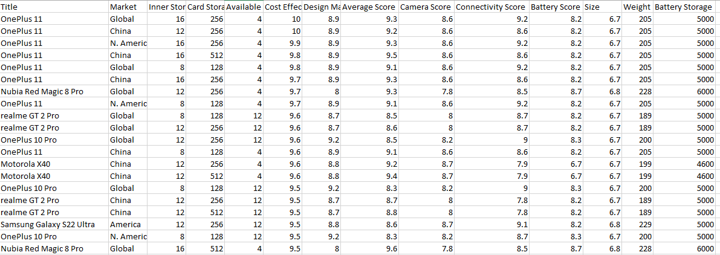
Data crawling

Slide 6
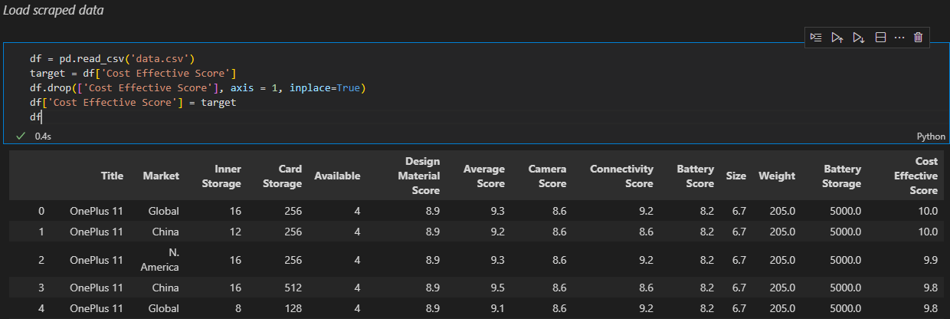
Explanatory Data Analysis

Slide 7
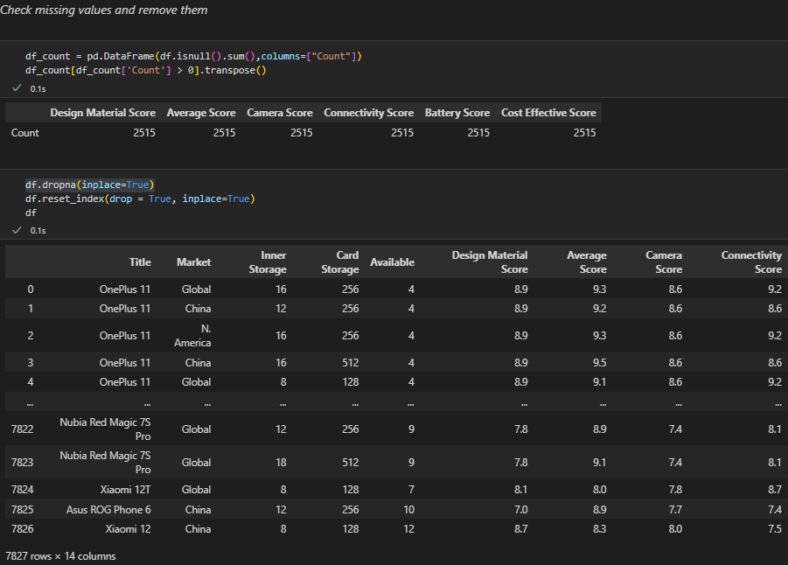
Explanatory Data Analysis
The table show the number of missing values in each column. After removed the missing values, we got 7827 rows and 2515 rows removed.

Slide 8
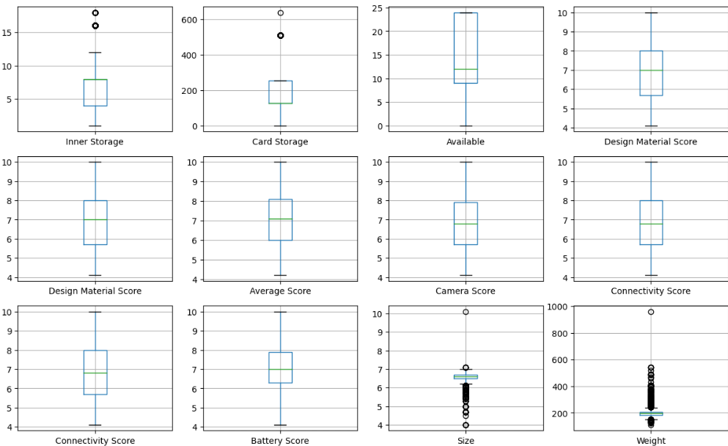
Explanatory Data Analysis
Boxplots shows that there are some outliers. Now we will clean outliers

Slide 9
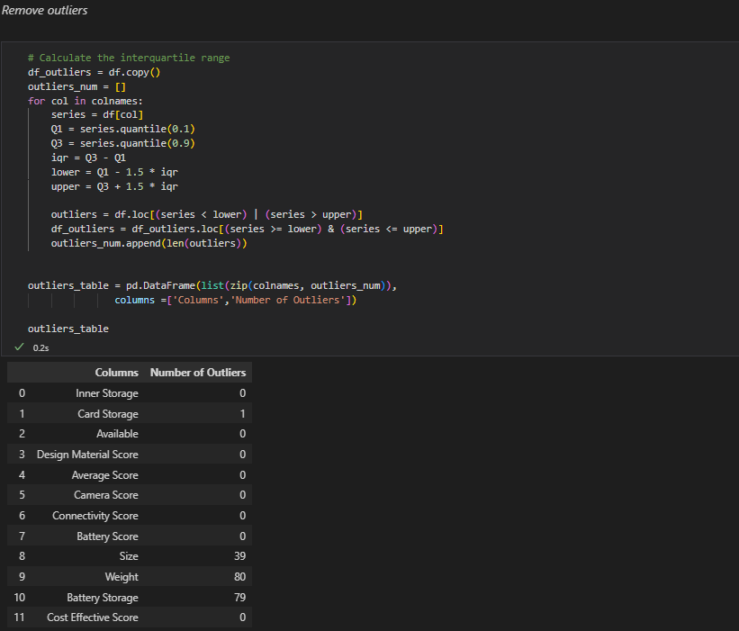
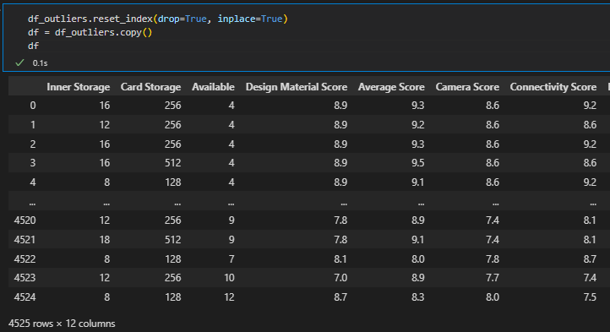
Explanatory Data Analysis

Slide 10
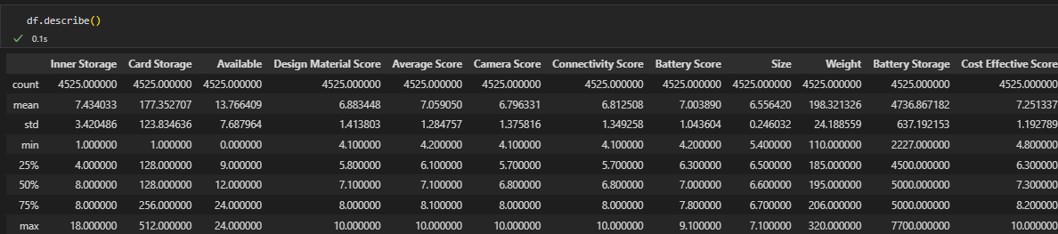
Explanatory Data Analysis
This table shows the basic statistical feature of the data. That is, mean, median, quantile, min and max values.

Slide 11
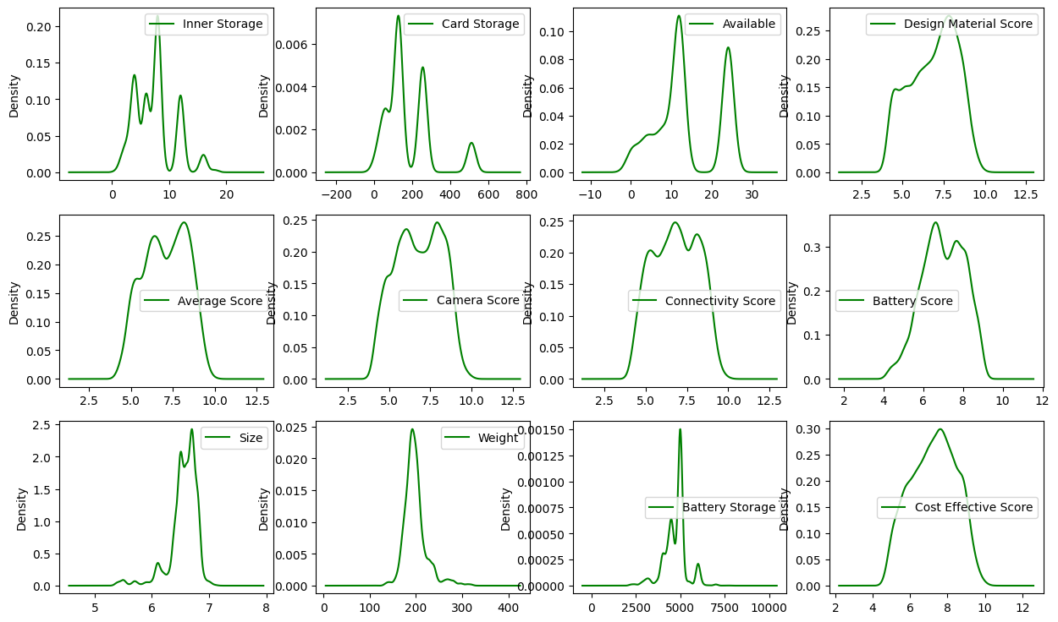
Density Graph

Slide 12
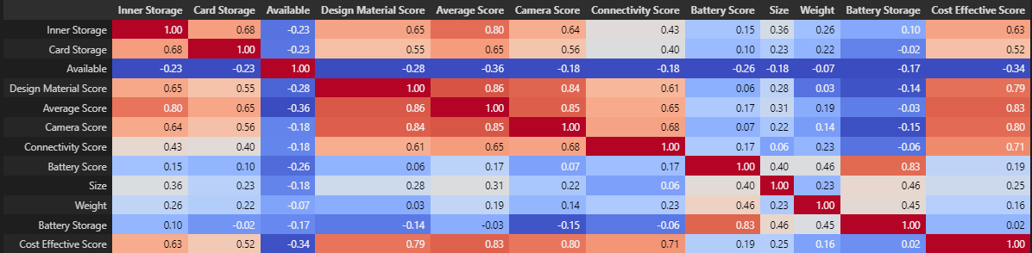
Correlation Analysis
Target variable is cost effective score. This table shows that the Cost Effective Score have linear relations with the Inner Storage, Card Storage, Design Material Score, Average Score, Camera Score and Connectivity Score

Slide 13
Regression Models (Regression Model)
Research questions
* Can we predict the cost effective score of the smartphone?
* Which regressor model is the best?
* Evaluate the model using RMSE and R2-score.

Slide 14
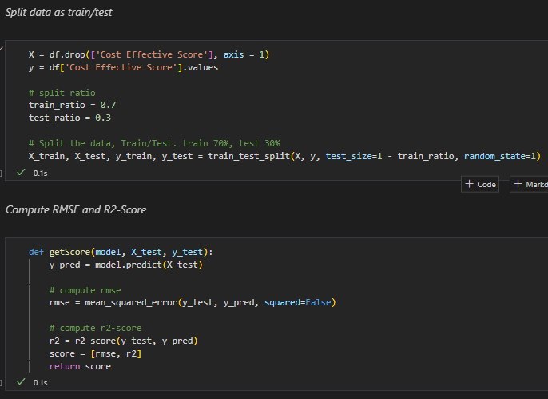
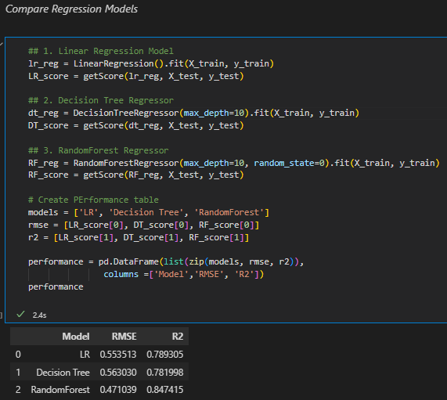
Regression Models

Slide 15
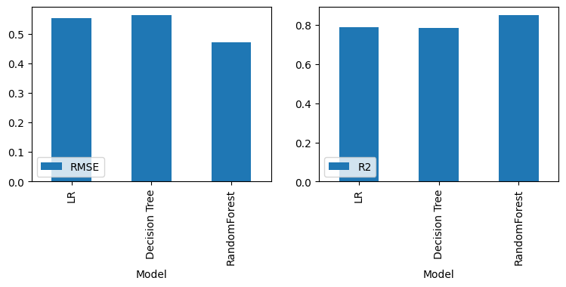
Compare Model Performance

Slide 16
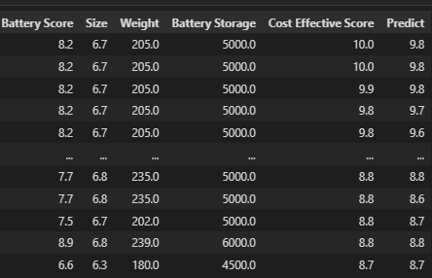
Research Question Answer
From above result, we can see that the RandomForest model have the smallest RMSE and r2-score. Hence, we will use RandomForest model to predict the cost effective score. Below table shows the real and predicted cost effective scores.

Slide 17
Summary
In this project, we scraped the phone features and rating scores to predict the cost effective score. To predict it, we used Linear Regression, Decision Tree Regressor, RandomForest Regressor. The RandomForest Regressor model have the smallest RMSE and highest R2-score. It shows that this model fit the data well. The R2-score is 0.847 and we can use this model to predict the cost effective score.

