Slide 1
Flag Analysis
Sofia Milton
Notes:
Hello and welcome to my presentation on analysing flags. This project is on using data analysis to group flags
First I will explain the reasoning, then give my methodology and then the problems encountered.

Slide 2

Flag Symbolism
Hypothesis:
Countries with shared culture and heritage use similar symbolism on their flags
Equator
Sea
12 indigenous
tribes
Notes:
Every country has a flag to represent it, and as such flags are generally not chosen at random, but have specific symbolism in their struture. I therefore wanted to try clustering flags to find shared symbolism. For example, the flag of the island nation Nauru shown here has blue to represent the sea, and other island nations such as Barbados and Cape Verde also have elements to represent the sea

Slide 3
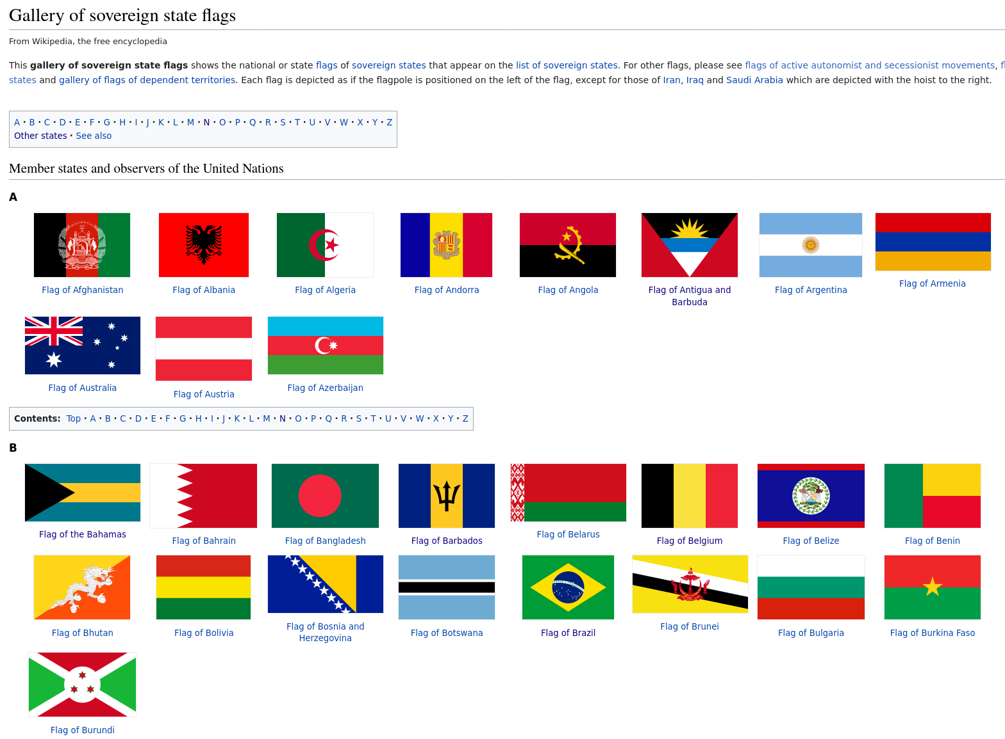
Data Scraping
https://en.wikipedia.org/wiki/Gallery_of_sovereign_state_flags
This page includes Countries with limited international recognition
Notes:
The list of country flags was obtained from wikipedia. Given the list of sovereign states is not universally agreed, this means I included flags from countries with limited recognition, such as Abkhazia and Taiwan. However it does not include micro-states such as Sealand.

Slide 4
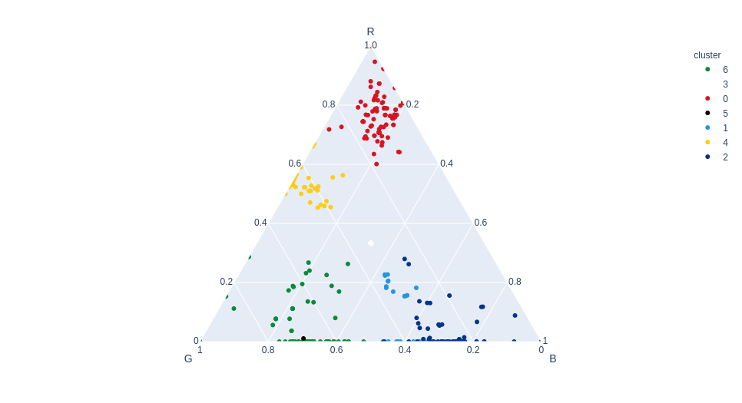
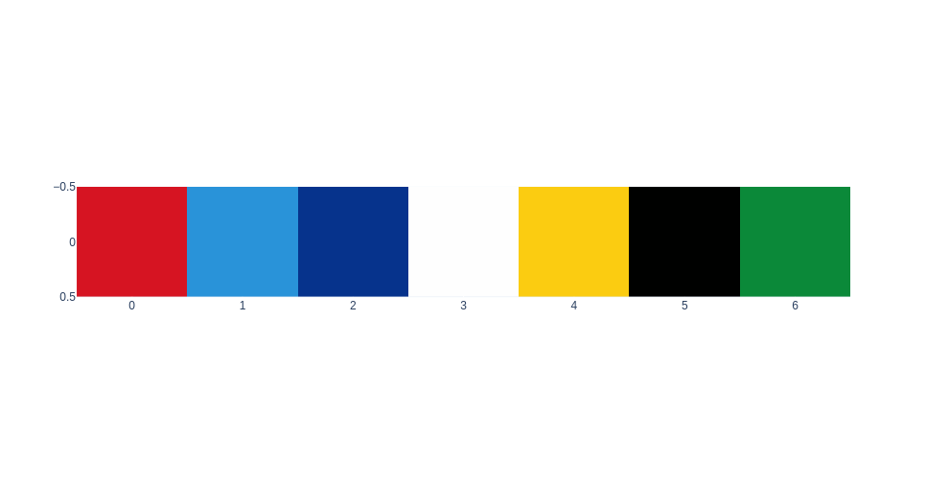
Colour Clustering
Clustering of colour spectrum into 7 shades
This was used to give each flag a percentage of colour used
Notes:
Given that countries use a vast array of different shades on their flags the spectrum was clustered to improve ability to compare colours between them. I then analysed the images to give the percentage of each colour used. But colour is not the only important factor on a flag.

Slide 5
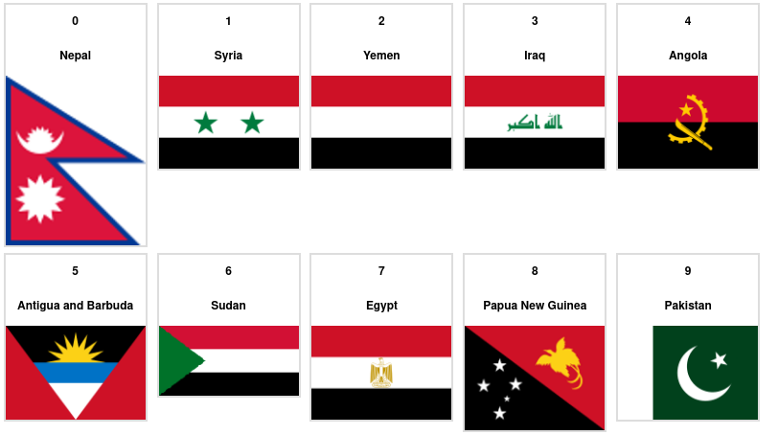
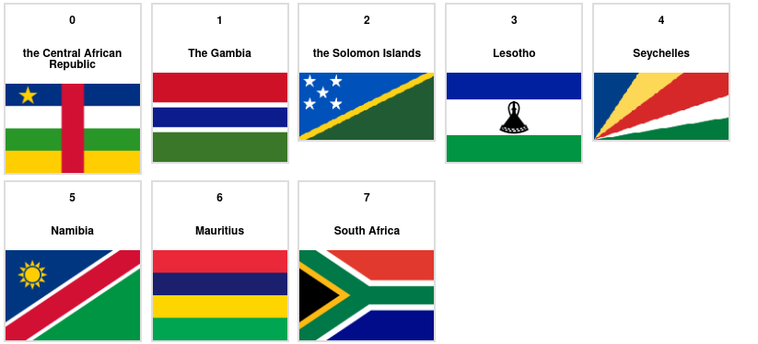
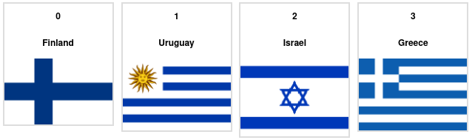
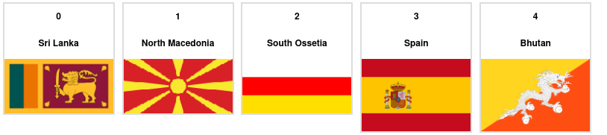
Colour Clustering

Slide 6
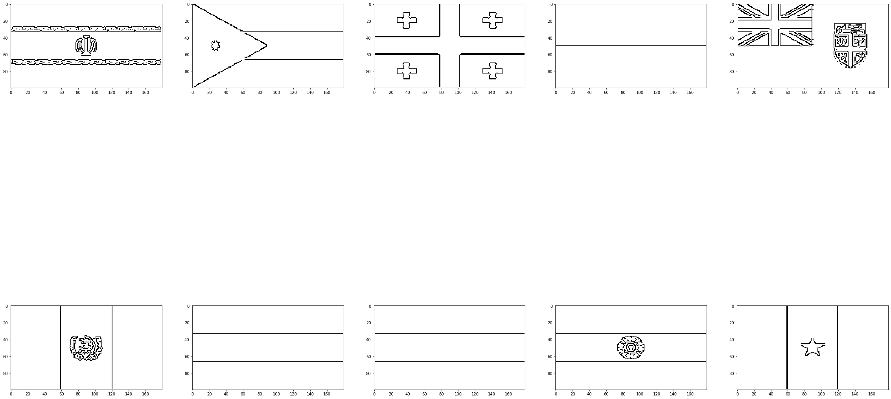
Edge Clustering
Clustered using PCA with VGG16
This does result in loss of control
No distinction between base shape and insignia
Notes:
Shape is also important, and this proved trickier to deal with. First I used edge detection to transform each flag into a basic shape. I then used the pre-trained VGG-16 cognitive neural network to try to find similarities using Principla Component Analysis.
This meant I did not have full control over what feature were being analysed and how they were grouped, but it did provide me with a clustering of edge shapes with important similarities
A key item lost is the difference between the base shape of the flag and shapes defacing them such as insignia and coats of arms.

Slide 7
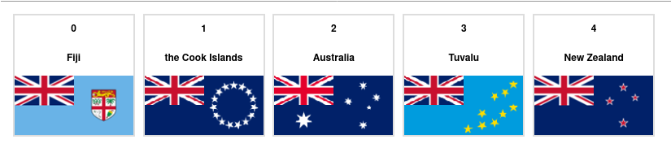
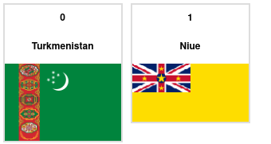
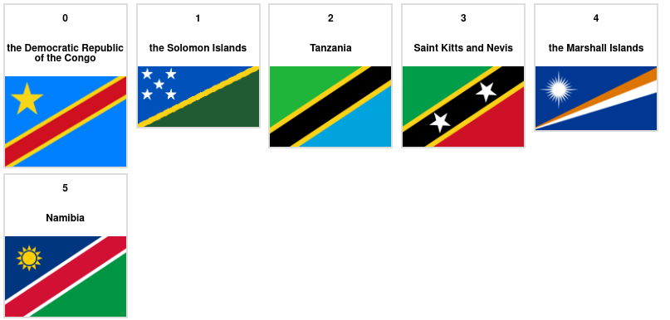
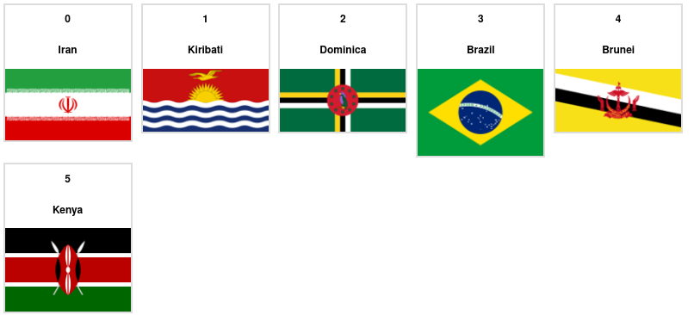
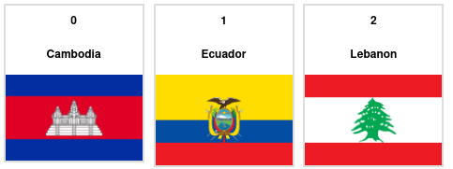
Edge Clustering

Slide 8
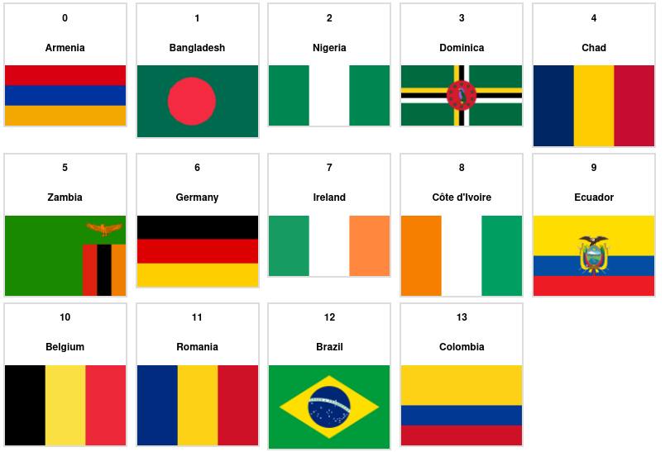
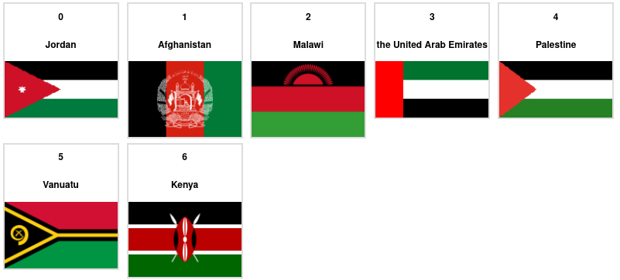
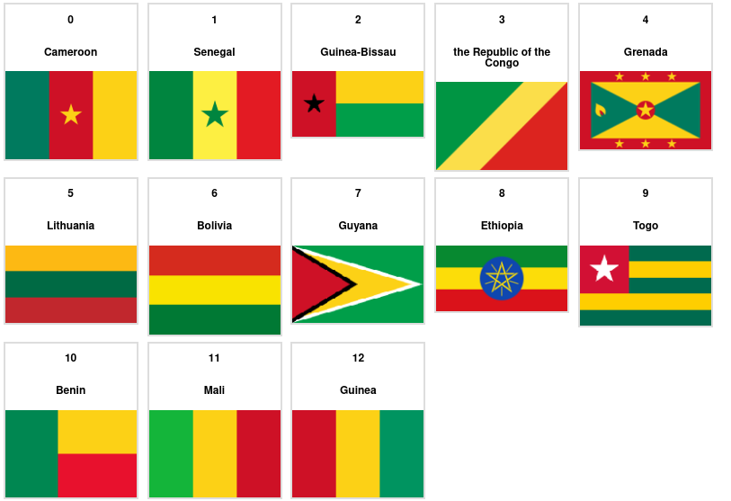
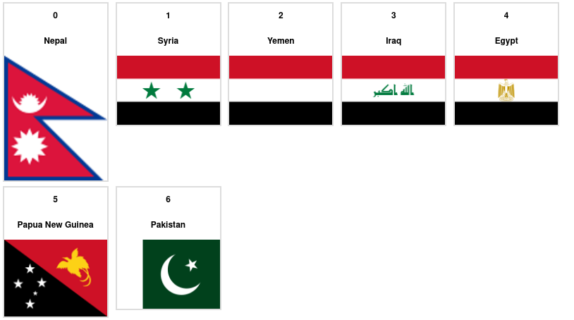
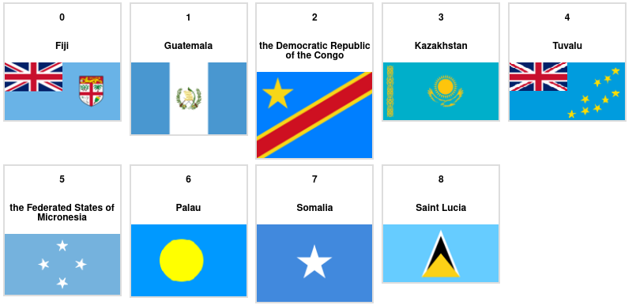
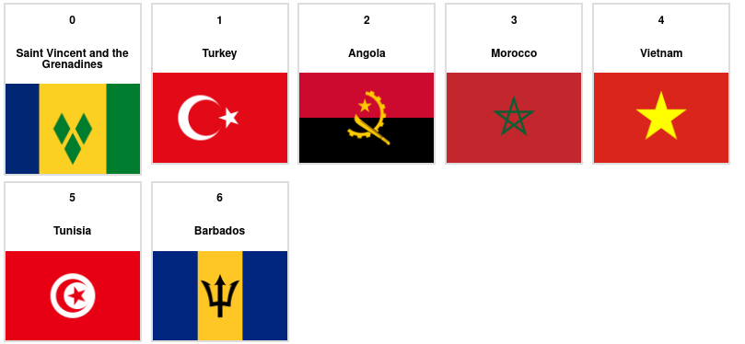
Combination
Notes:
Now I could cluster by both colour and shape of the flag.

Slide 9

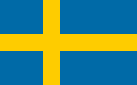





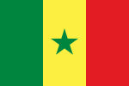
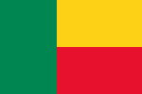

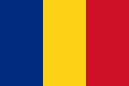

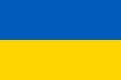
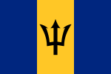
Problems
Determining which properties should be used to goup flags requires prior knowledge of the importance of symbols
Differentiation between shared culture and isolated coincidence is hard
Chad
Romania

Slide 10
Supervised
An attempt was made to add some manual supervision by two methods:
Dropping colour and shape clusters that held no value
Manually adding tags to certain flags e.g. Pan-Arab colours
This made clusters from the tags and gave little benefit
Also image recognition changes clusters on each run

Slide 11
Conclusion
Some isolated good results
Clusters do exist but are hard to choose
Image recognition lacks control
For an improved project:
Image recognition that can differentiate base flag and insignia
Trawl wikipedia pages for meaning behind colours/symbols

