Slide 1

Big-Data Analytics and Sentiment Classification with Twitter Stream Data
Sofia Dutta
Data 603, Fall 2019
Final Project Presentation

Slide 2
Project overview
In this project:
Worked on large real-time streaming data from Twitter.
Performed analytics using PySpark and created visualizations.
Created MyClassifier a sentiment classifier via Word2Vec model using Spark MLlib.
Project Goal: Learn PySpark, a Big Data tool and perform analytics driven by the 6Vs of Big Data.
If in future I face work challenges with petabyte scale data I wanted to be prepared for that.
Wanted to prepare for Big Data career using knowledge gained in this class.
The world is generating data at an extremely fast rate. So, need to learn tools that will help
Collect, process and analyze this data.
Provide meaningful results quickly.

Slide 3
Input data
Input – Twitter Data API
Used via Spark Streaming & as tweets stored in MongoDB – 53k docs
Input data type – Tweepy API provides a wrapper object for a data stream from Twitter. Each line of the stream contains a Tweet which may be:
Accessed using Spark Streaming of PySpark directly to be processed using MapReduce DStream operation to perform real-time streaming data analytics and visualization.
Or processed using PyMongo to be stored in MongoDB for sentiment classification using Spark MLlib.
Additional Data used :
Positive and Negative Words File from work of Liu, 2010.
Labeled tweets (1.6 million) from work done by Go et. al. 2009 to create Word2Vec Model driven Logistic Regression sentiment classifier.
World country Jason file for Tweet Geo Location Plot.

Slide 4
Expected outcome
On streaming Twitter data, expected to generate following visualizations:
Trending topic #hashtag counts
Labeled word sentiment driven Tweet stream sentiment flow analysis
Word cloud generation for Tweet stream
On stored tweets in MongoDB
Expected to perform sentiment classification via Word2Vec model driven LogisticRegression sentiment classifier created from labeled tweets (1.6 million) of work done by Go et. al. 2009
Study my classifier’s agreement with sentiment classifier from Hutto et. al. AAAI, 2014
Additional goals achieved
Geo-visualization and count visualization of country-wise distribution of tweets.

Slide 5








Project Implementation
iPython Notebook used for data processing and visualization
Spark StreamingContext Data entry point
Mapper
Reducer
Visualization
Hashtag count
Input Data Source: Twitter Data API
My Sentiment Classifier
Tweet stream sentiment flow
Stanford Labeled Twitter Dataset (1.6 million tweets)
Mongo Spark
Data Connector
Visualization
MLLib
Word2Vec
model
Country-wise
Tweet
distribution
pymongo
data
connector
Classifier agreement
stats
+ve / -ve
Word-clouds
Vader Sentiment Classifier
Tweet
sentiment classification

Slide 6
Final project diff from proposal
Have implemented everything exactly as stated during initial project proposal
Added more to the plans and carried out additional analytics and visualization on Tweet Geolocation information

Slide 7
Project Implementation
Created Twitter Developer Account
Wrote script to receive tweets: TweetReadSendToSparkStreaming.py
The program handles authentication and connection to Twitter’s streaming API via the Tweepy library.
Then sends tweets “received” to Spark engine via a TCP socket.
Created Jupyter Notebook to perform Big Data Analytics using Spark Streaming: Twitter_Stream_Analysis_Using_Spark_Streaming.ipynb

Slide 8
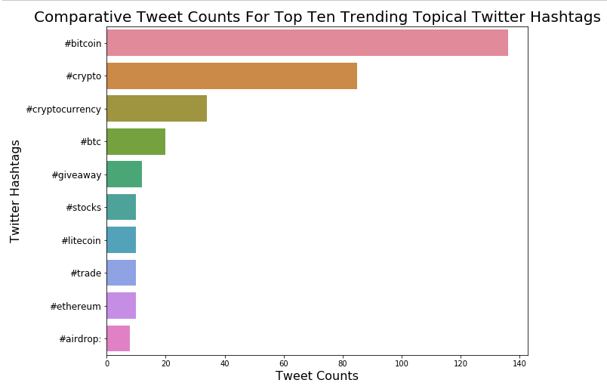
Project results: #hashtag counts

Slide 9
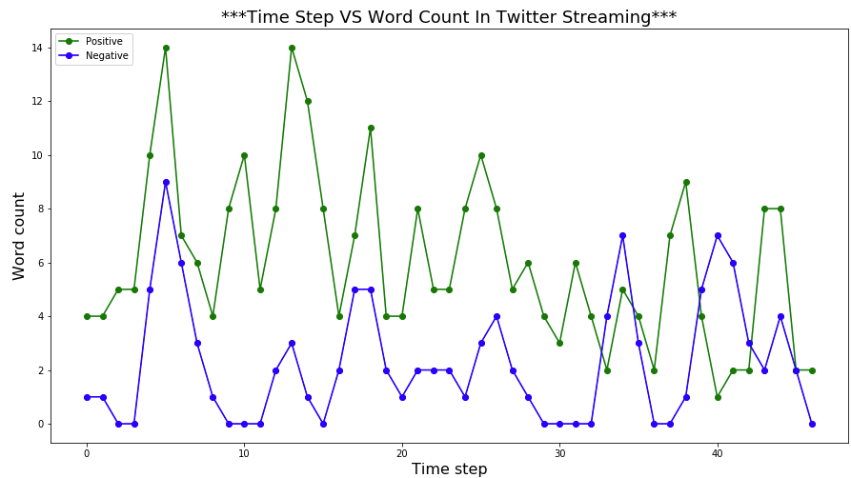
Project results: tweet sentiment flow

Slide 10
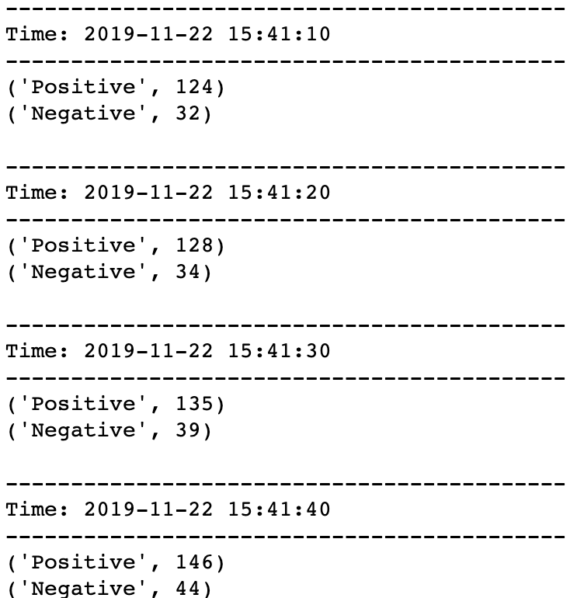
Running total of positive and negative words in Tweet stream
Project results

Slide 11
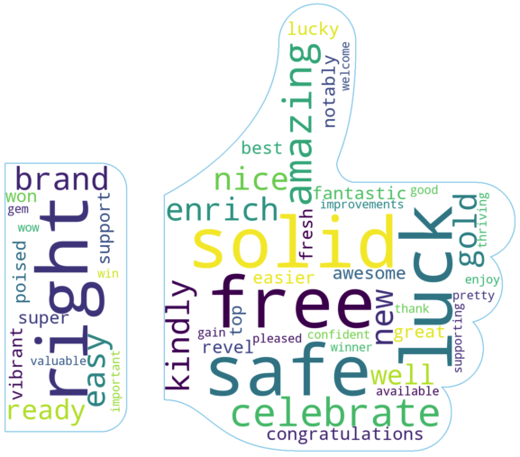
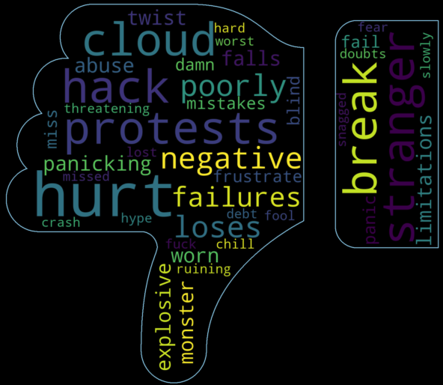
Project results: +ve/-ve word clouds

Slide 12
Project results: MyClassifier creation
Created Jupyter Notebook:
Using_SparkMLLib_Word2Vec_Model_Driven_LogReg_Sentiment_MyClassifier_Creation.ipynb
The code in the notebook creates MyClassifier: a Word2Vec Model Driven LogisticRegression Sentiment Classifier using Spark MLLib.
ROC-Accuracy of model at predicting sentiment is: 0.8276
Accuracy of model at predicting sentiment is: 0.7479

Slide 13
Project results:Big Data Analytics & Sentiment Classification
Wrote script to read data from Twitter Data API and store in MongoDB via PyMongo Connector:
TweetReadSendToMongo.py
Created Jupyter Notebook to carry out Big Data Analytics and study agreement between MyClassifer and publicly available well-known Vader sentiment classifier (Hutto et. al. AAAI 2014):
Using_MyClassifier_Twitter_Data_Sentiment_Classification_and_Big_Data_Analytics_on_Spark_Dataframe.ipynb

Slide 14
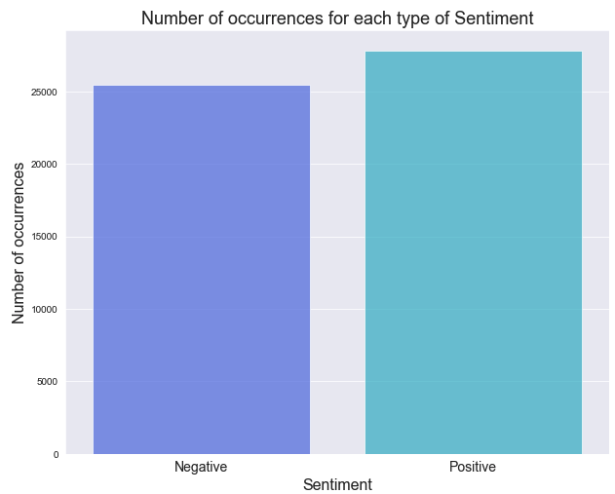
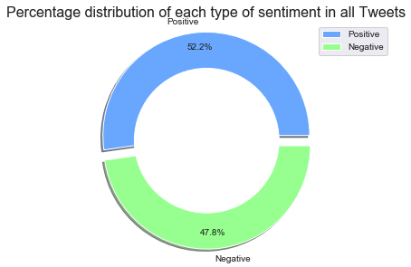
Project results: classification with Vader sentiment

Slide 15
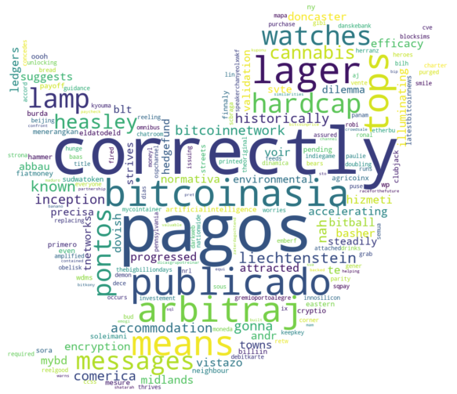
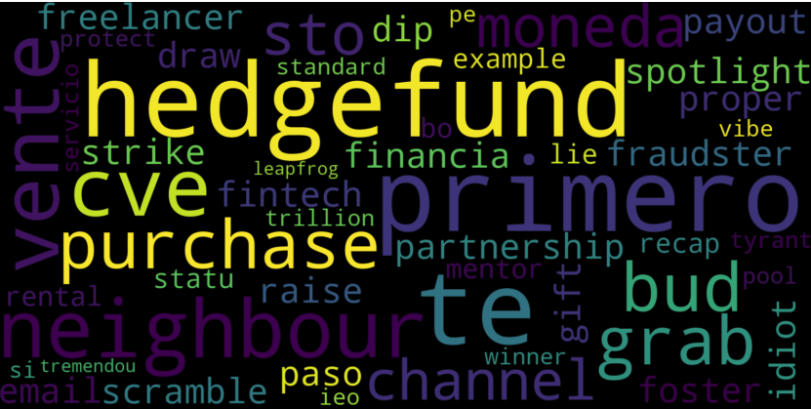
Project results: exploring collected tweets
Word Cloud of frequently found words
Word Cloud of all words

Slide 16
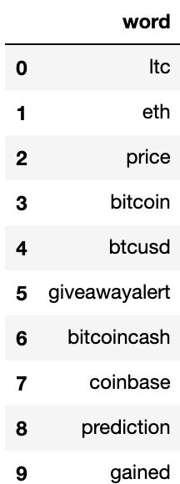
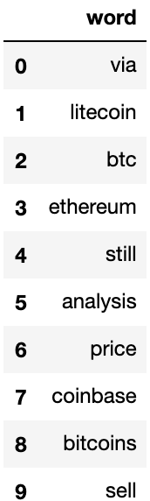
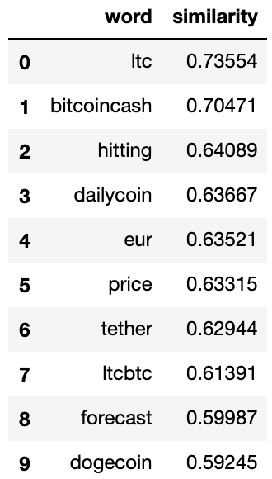
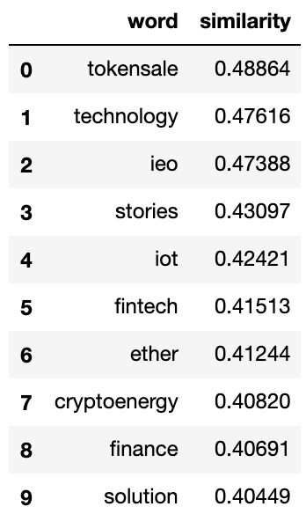
Project results: exploring Word2Vec outcome
Words similar to BTC
Words similar to Bitcoin
Word similarity score to Litecoin
Word similarity score to Blockchain

Slide 17
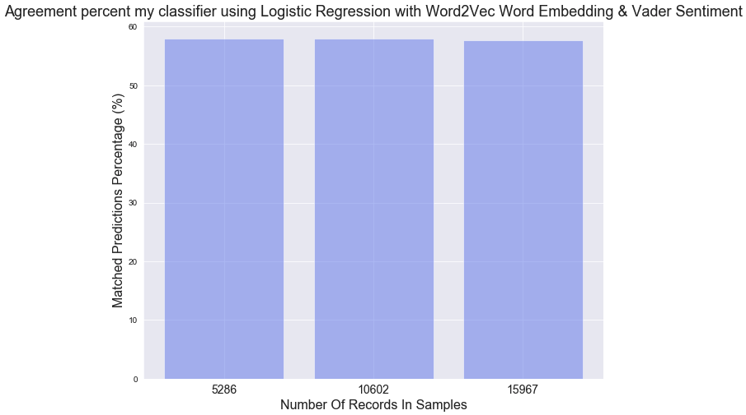
Project results: classifier agreement for 5k, 10k, 15k tweets

Slide 18
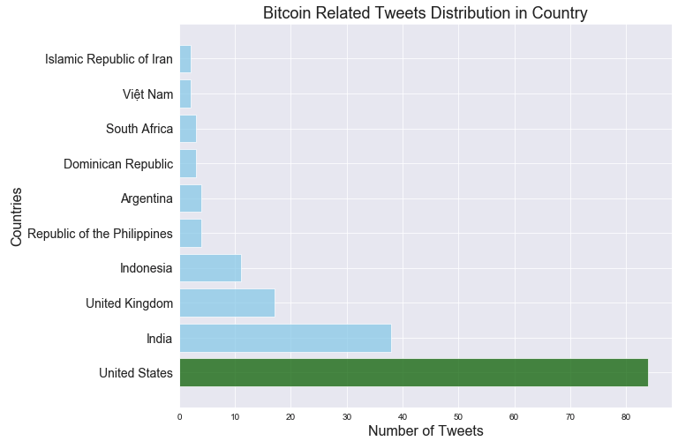
Project results: country-wise tweet distribution

Slide 19
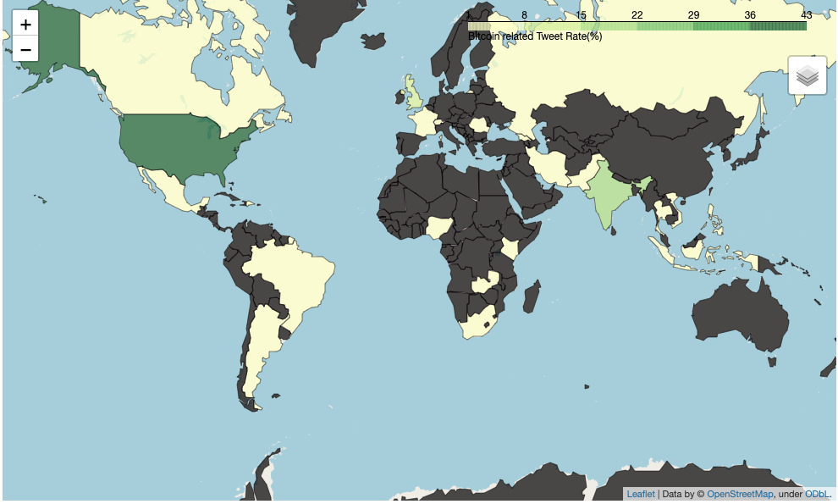
Project results: geo-plot of country-wise tweet distribution

Slide 20
Conclusion
During the project I learned how to perform Big Data Analytics using PySpark
Learned how to collect data from Streaming API
Via PyMongo stored into a Document Database i.e. MongoDB
Sent tweets over TCP socket to perform for Big Data Analytics using Spark Streaming
Learned how to use Spark MLlib library to create Word2Vec model driven LogisticRegression Sentiment classifier, MyClassifier
Compared results with a well-known classifier
Learned Big Data technologies and implemented following Big Data Vs in my project:
Velocity – Accessing Twitter data stream using Big-Data tools like SparkStreaming API
Volume – Analysis of large number of tweets. Creation of Word2Vec ML models and classification on large number of tweets using Spark MLlib
Veracity – Study of agreement between by my ML model and publicly available sentiment classifier.
Value – Analysis performed can be used to track the state of discourse on topics, I used “Bitcoin” as it’s a popular topic.

Slide 21
References
Go, A., Bhayani, R., & Huang, L. (2009). Twitter sentiment classification using distant supervision. CS224N Project Report, Stanford, 1(12), 2009.
Hutto, C. J., & Gilbert, E. (2014, May). Vader: A parsimonious rule-based model for sentiment analysis of social media text. In Eighth international AAAI conference on weblogs and social media.
Liu, B. (2010). Sentiment analysis and subjectivity. Handbook of natural language processing, 2(2010), 627-666.
Agarwal, A., Xie, B., Vovsha, I., Rambow, O., & Passonneau, R. (2011, June). Sentiment analysis of twitter data. In Proceedings of the Workshop on Language in Social Media (LSM 2011) (pp. 30-38).

