Slide 1
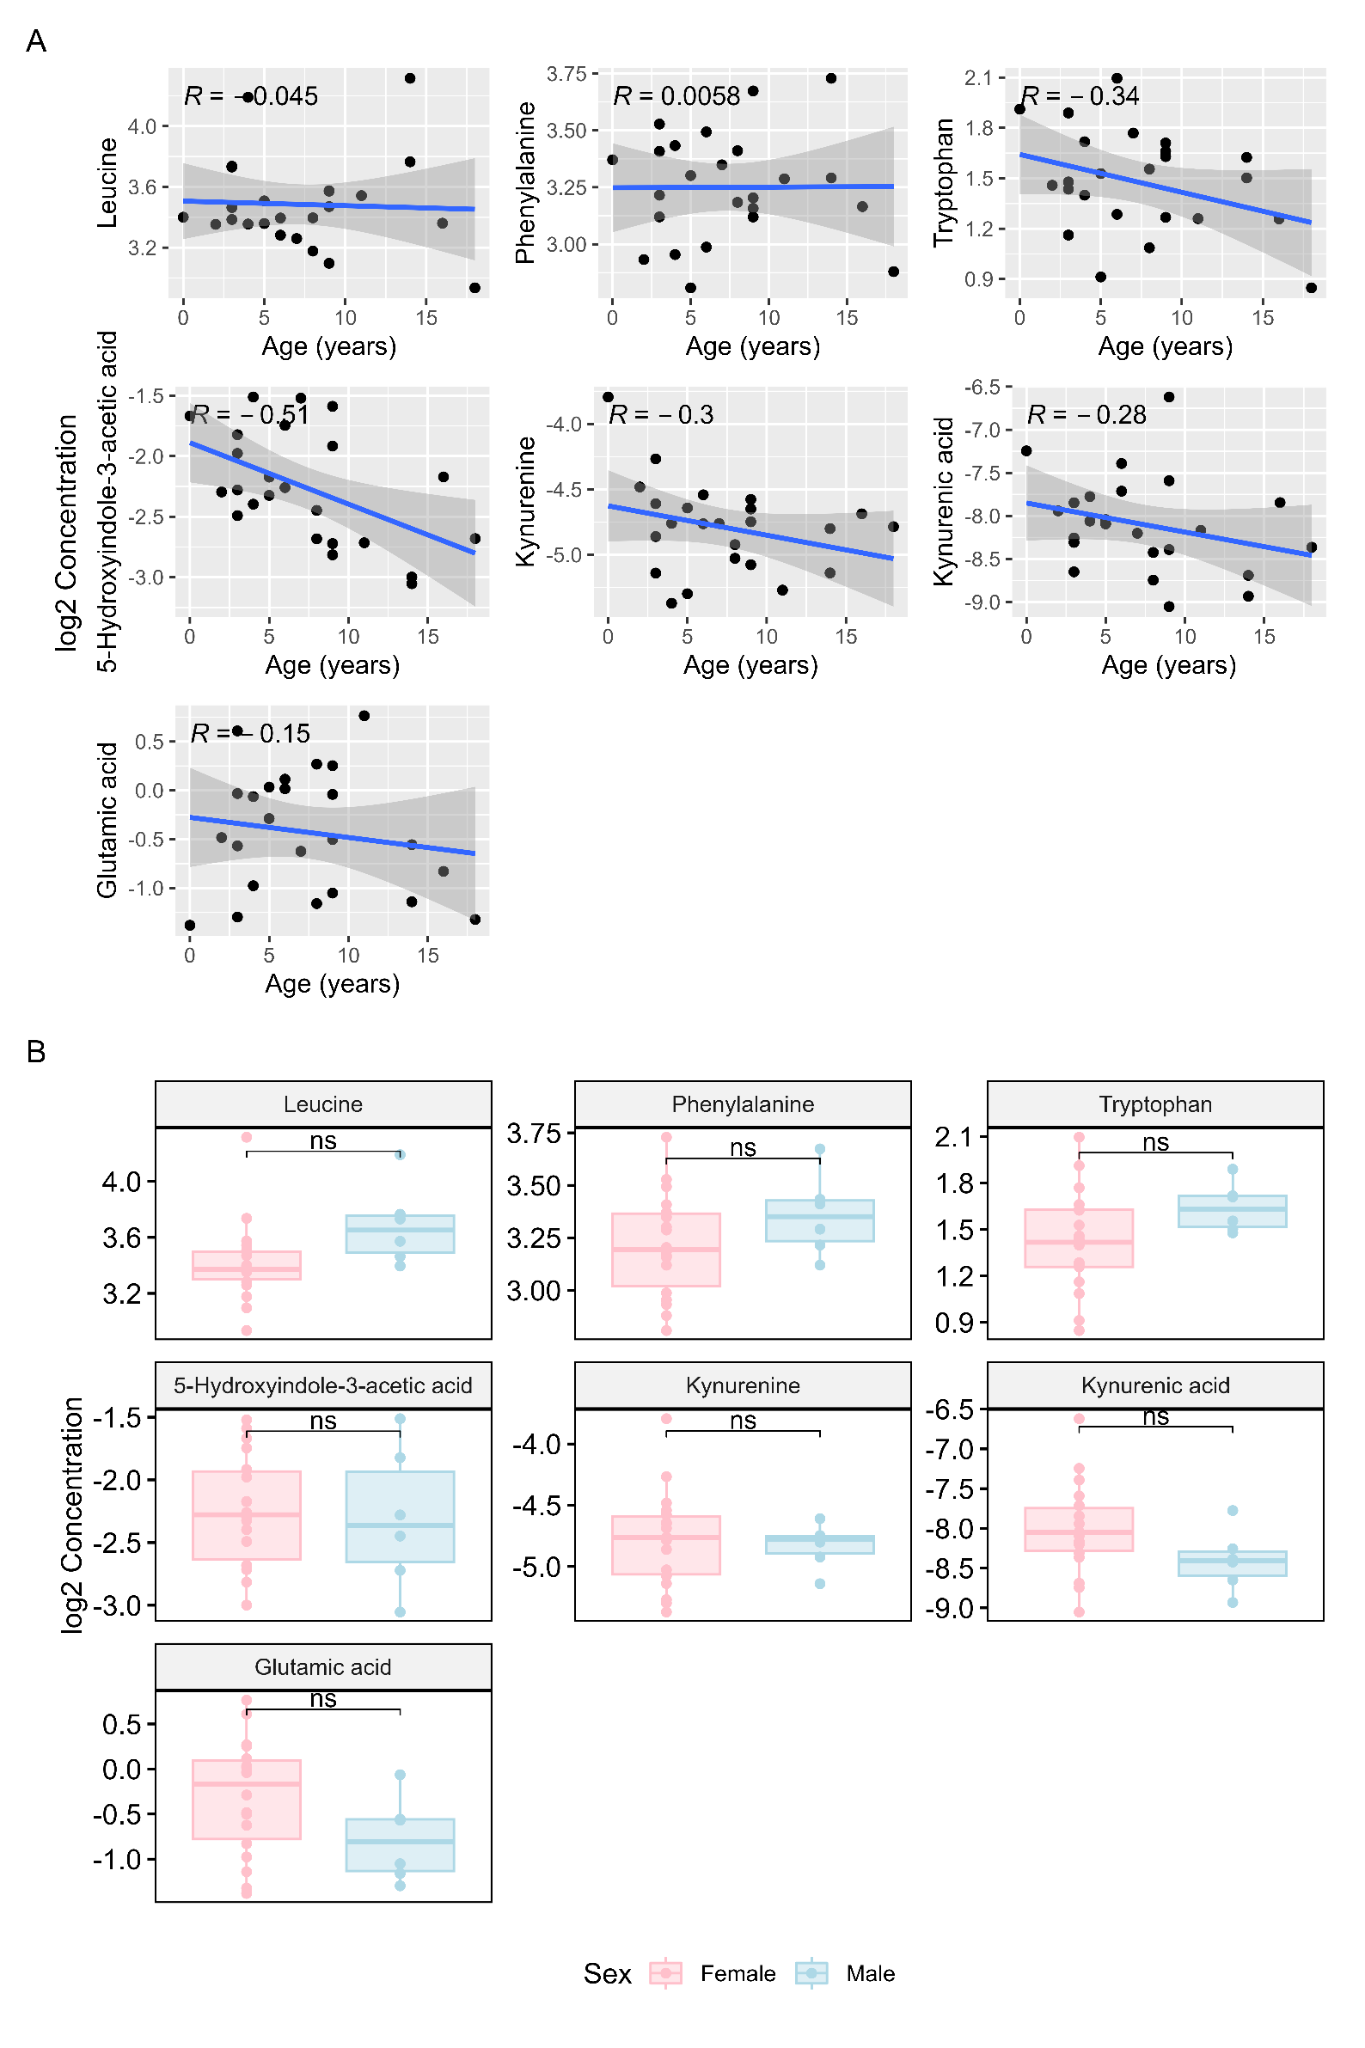
Supplementary Figure 1. A) Correlation between age of patients and concentration of selected metabolites. Pearson’s correlation was computed for the ages of patients from both cohorts and the concentration of the metabolites of interest previously found to be altered between either patient cohort and controls. None of the metabolites showed significant correlation, with the largest coefficient found for 5-Hydroxyindole-3-acetic acid (R=-0.51). B) Alterations in selected metabolite concentrations between sexes. Mann-Whitney U tests were performed on patients grouped by sex, followed by multiple testing correction by FDR. None of the metabolites of interest were significantly altered.

Slide 2
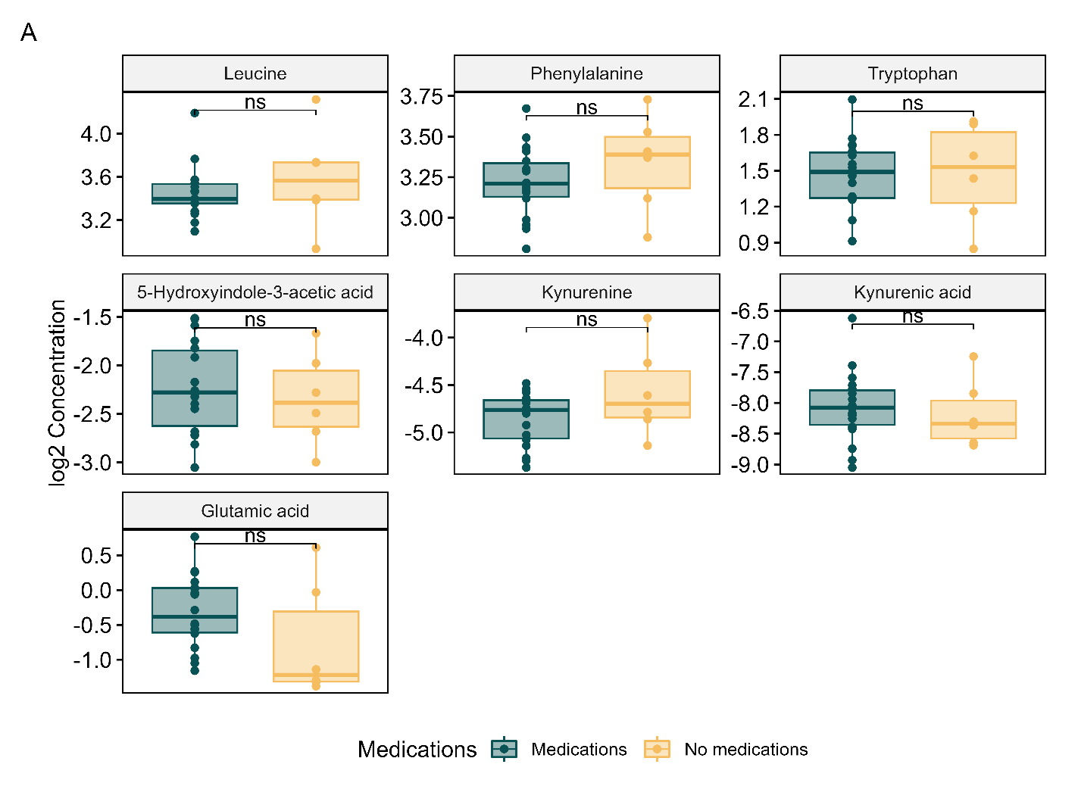
Supplementary Figure 2. Alterations in selected metabolite concentrations based on medication intake. Mann-Whitney U tests were performed to determine if patients known to be taking medications had significantly altered metabolite concentrations. Patients whose medication intake was unknown were excluded from this analysis. None of the metabolites of interest were significantly altered after FDR multiple testing correction.

