Slide 1
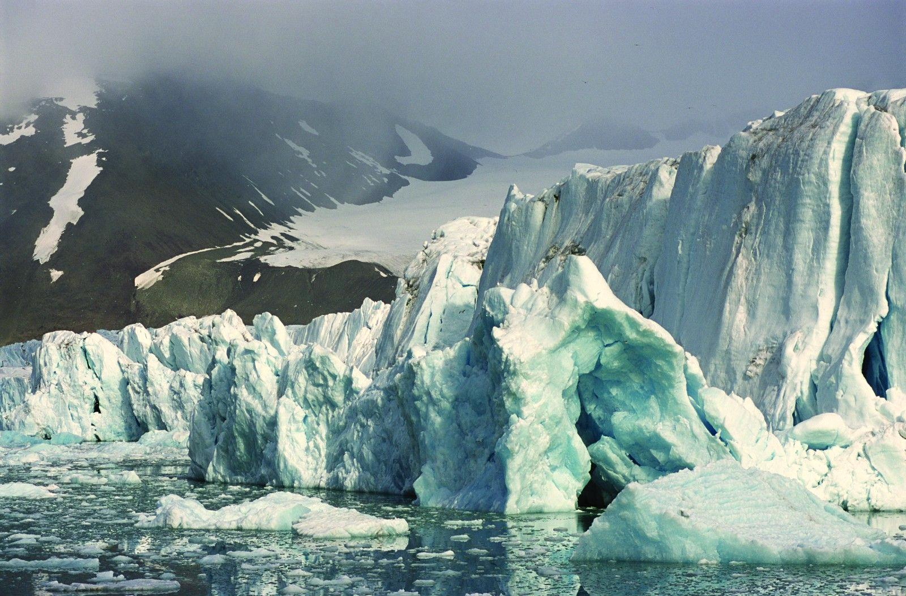

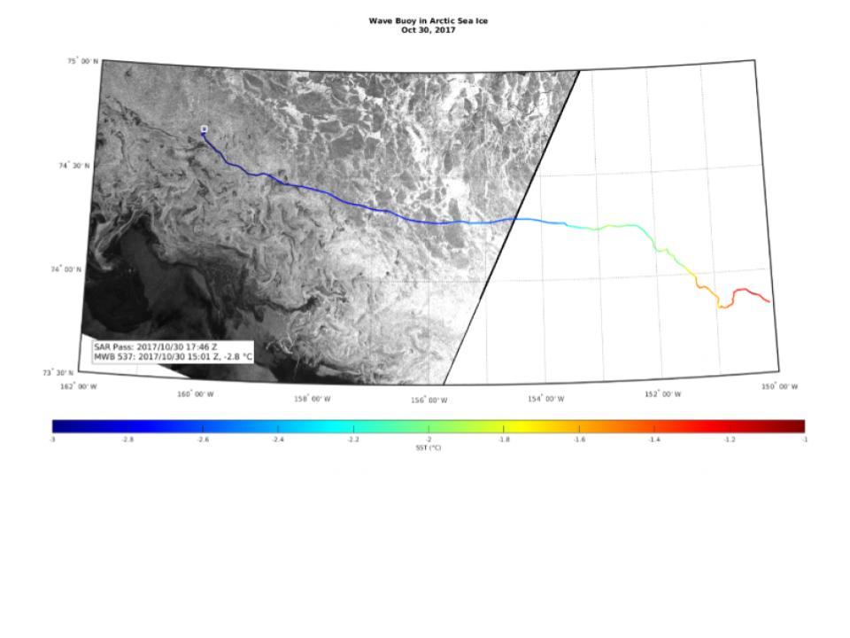

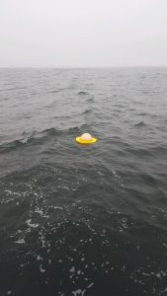
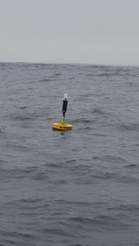
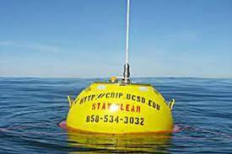
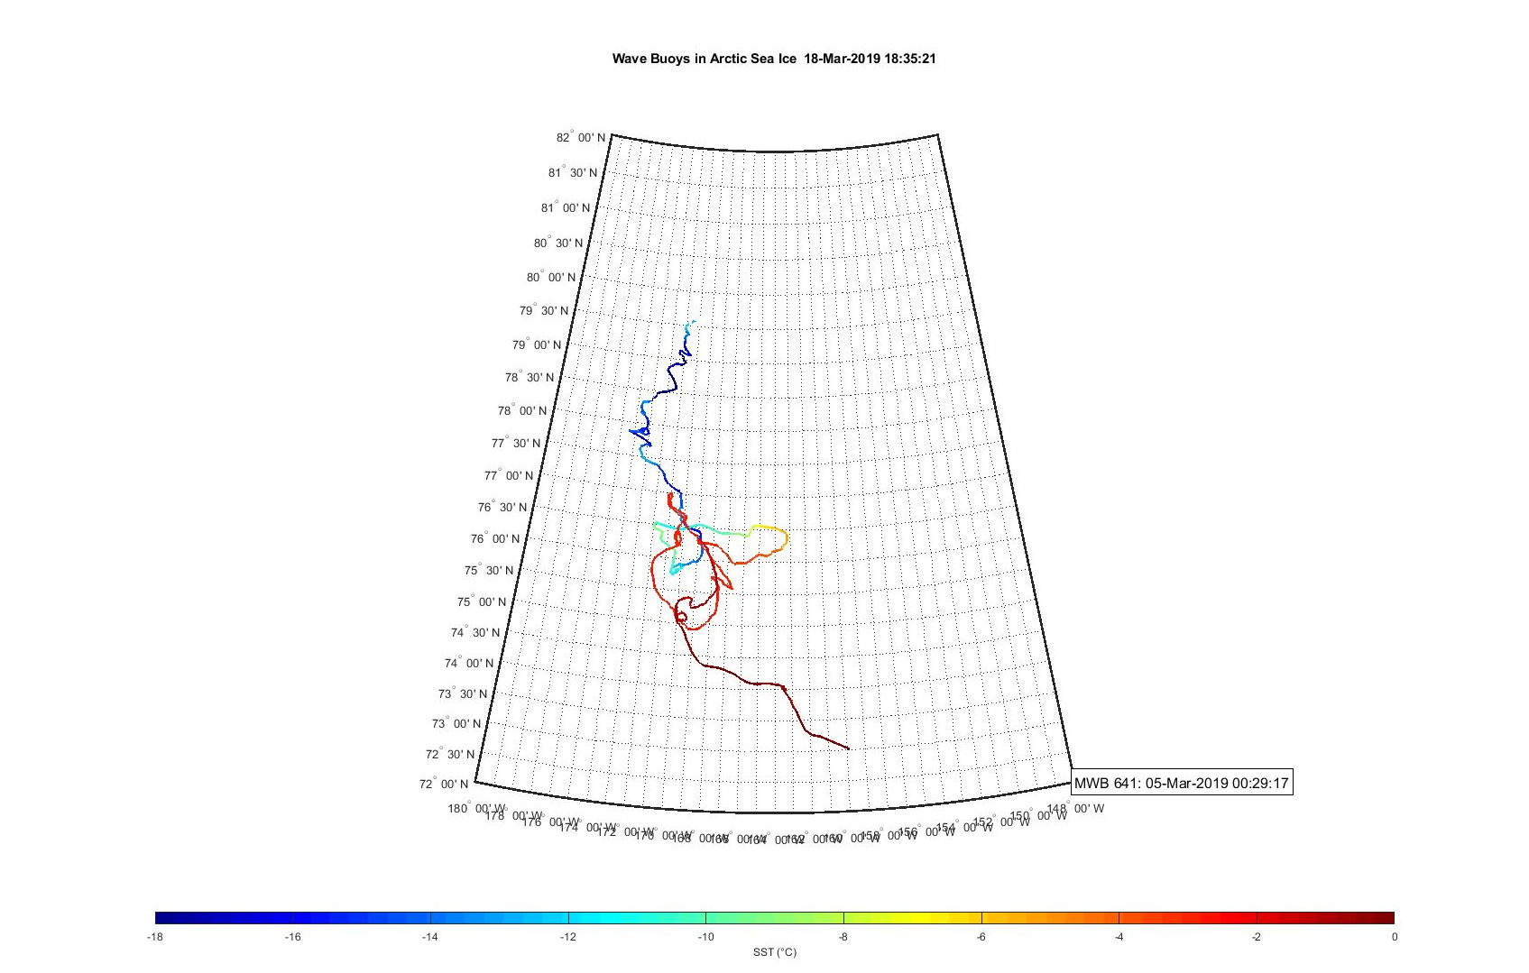
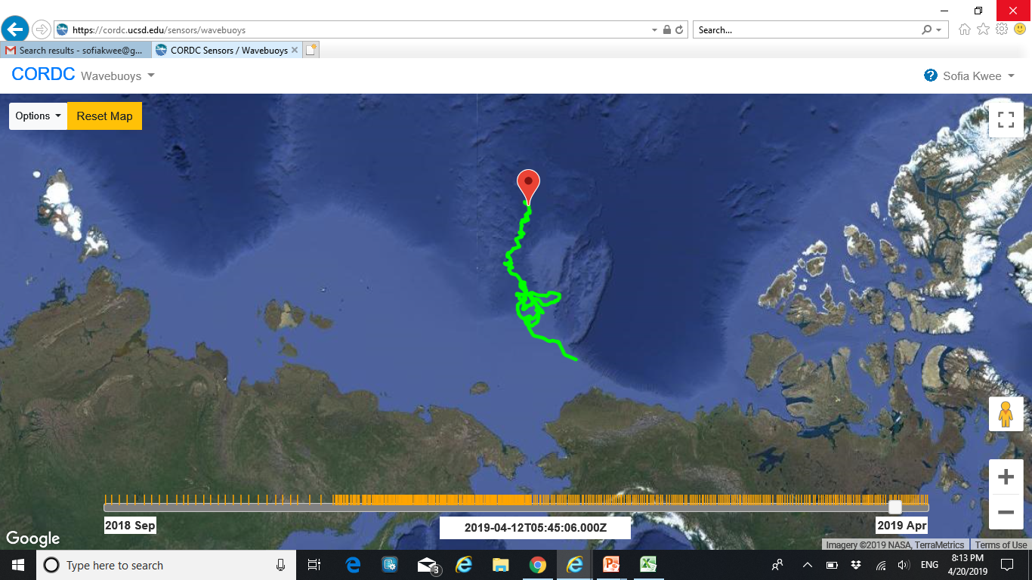
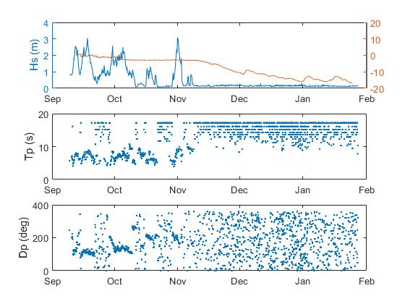
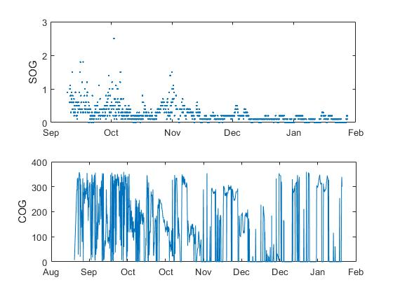
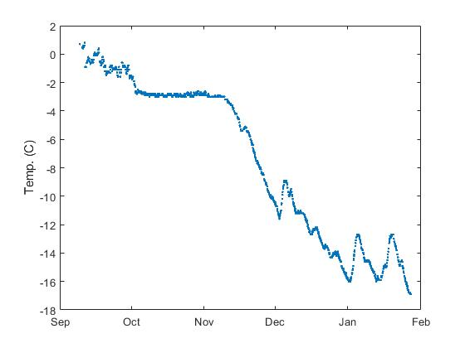
Tracking Arctic GPS Wave Buoys Sofia Kwee – Senior, Canyon Crest Academy High School Mentor: Tony de Paolo Coastal Observing Research and Development Center (CORDC)
Arctic Buoy Research
hghg
Miniature Drifting Wave Buoy
Met Buoys
Scripps Institution of Oceanography has been deploying the GPS based drifting wave buoys for over 10 years. These buoys collect data on sea surface (SST) temperature, speed, course, wave height, period, frequency, and direction. Additionally, since the buoys are drifting, we can look at their path to get information on the current. SIO uses this data to assist the Navy. Data collected on buoys in the north and south poles assist in locating where the ocean has frozen over. These buoys can also help track the movement of the ice. These calculations can assist the navy in navigating the Arctic and Antarctic seas. Additionally, these buoys give us an insight into the details of ice floes. Researchers can observe patterns in the data throughout many years on ice formation, temperature, and movement,
Datawell buoy
The photo on the right is a overlay of the path of a buoy on a satellite image showing the buoy’s location at that time. The color depicts the sea surface temperature over time. The image clearly depicts the buoy frozen in ice on October 30th 2017.
My Project
For my project, I continued the research that the Scripps Institution of Oceanography began about two years ago. I started in the fall, observing which of the many buoys near the Arctic and Antarctic appeared to be frozen in ice. I selected three promising buoys: buoy 639, 641, and 642. Based on the temperature and the speed over ground, the buoys all appeared to be frozen. Over the next few months, both buoy 639 and 642 stopped transmitting data. It is difficult for the batteries to function in that frigid condition. 641 prevailed, so I focused my calculations on that buoy. My mentor assisted me in writing code in MatLab that could take the data transmitted from the buoy (in the form of a CSV file) and generate different line graphs comparing information. We also created the graph on the left that plots the temperature over the path of the buoy. As expected, as the buoy traveled north its temperature decreased. However near the top the temperature increases slightly. However, this could be due to the changing of seasons as this was made at the beginning of spring.
Freezing Point
Significant Have Height: Hs is defined as the top 30% of the wave heights, and it is measured in meters. It is clear to see that the buoy is frozen as the wave height goes to 0.
Period: The number of seconds between wave crests. The inverse is wave frequency. When the buoy is frozen the period goes to maximum allowed (20 seconds).
Direction: The angle in which the waves are coming from. When the buoy freezes the direction of the waves becomes random because they cannot be measured.
Speed Over Ground: meters/second
The speed significantly decreased when the buoy froze. Then it sped up a little bit when the temperature rose in December.
Course Over Ground: degrees relative to true north
Since it is frozen its direction appears to be random. This could be because the ice flows move too slowly to be accurately measured with a GPS receiver.
Sea Surface Temperature:
The buoy began to freeze when the temperature dropped to -2 degrees Celsius, but did not fully freeze until the temperature dropped to -4 and had a steep decline. The temperature rise in December could be due to warm water upwelling or animal interference. Since SOG increased but wave height did not, maybe the buoy was in a puddle that opened and closed again.
Further Research: To further my research, it would be interesting to investigate the temperature change inside the ice. Additionally SIO is adding a gimbal inside the buoys to keep the centers of buoy upright and pointing towards the sky. Buoys can become inverted for a variety of reasons such as ice flow or animal interference. This could increase their lifetime and their ability to survive, thus extending the amount of data the artic buoys can transmit. Right now, the buoys in the artic tend to have a low battery life and are unlikely to survive the winter.

