Slide 1
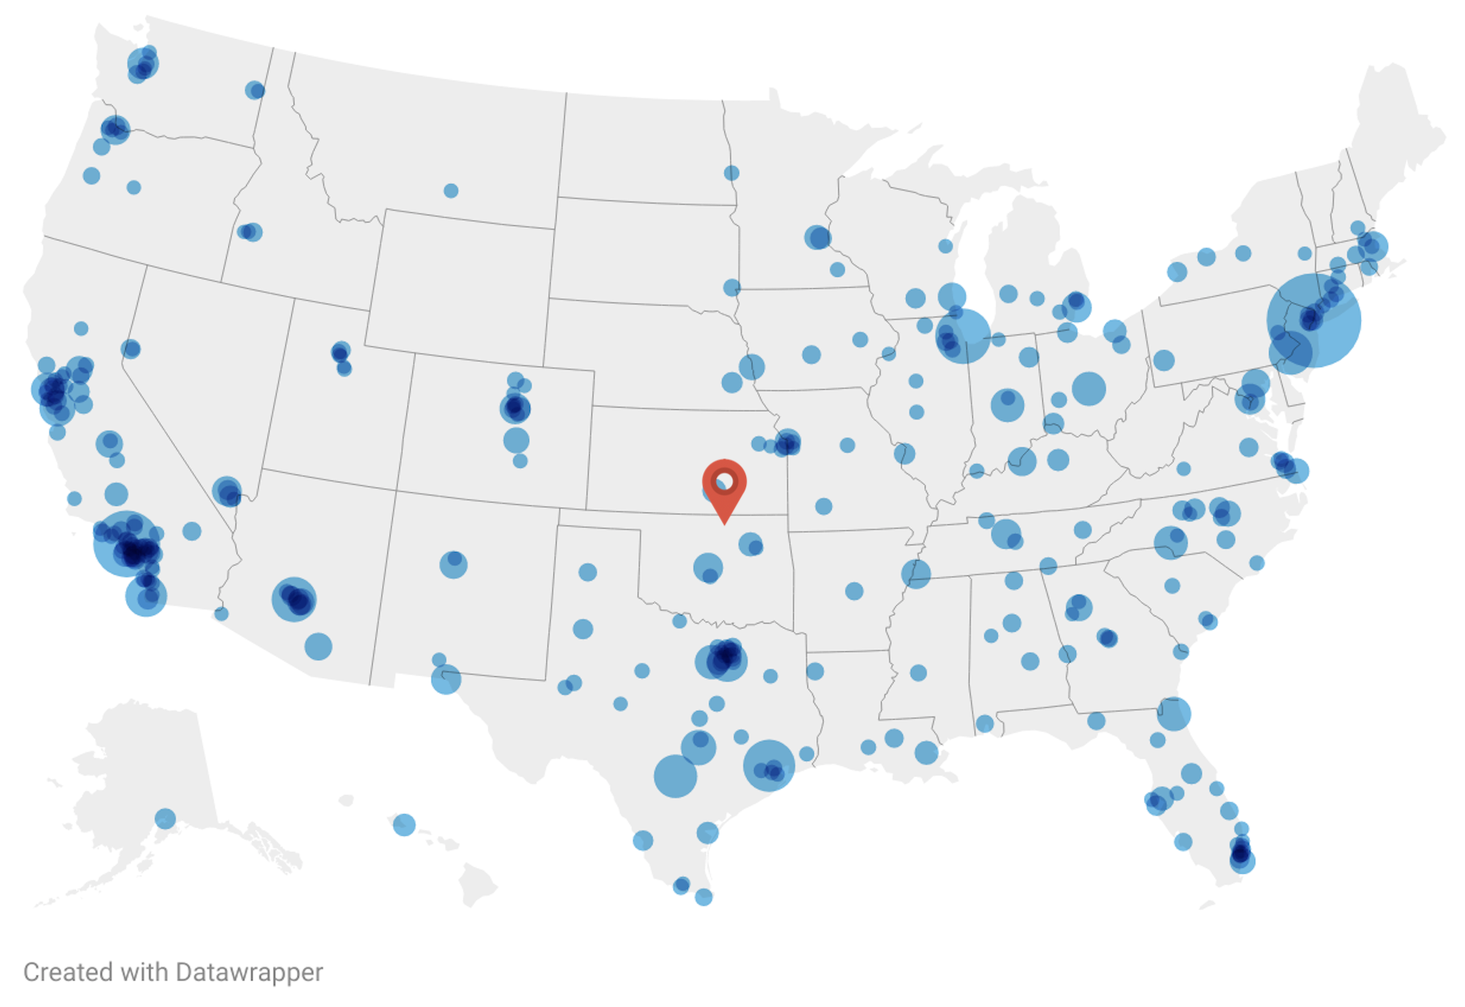
Center by Population Density (36.833,-96.975)
Population density of most populated towns represented by size of blue circles.

Slide 2
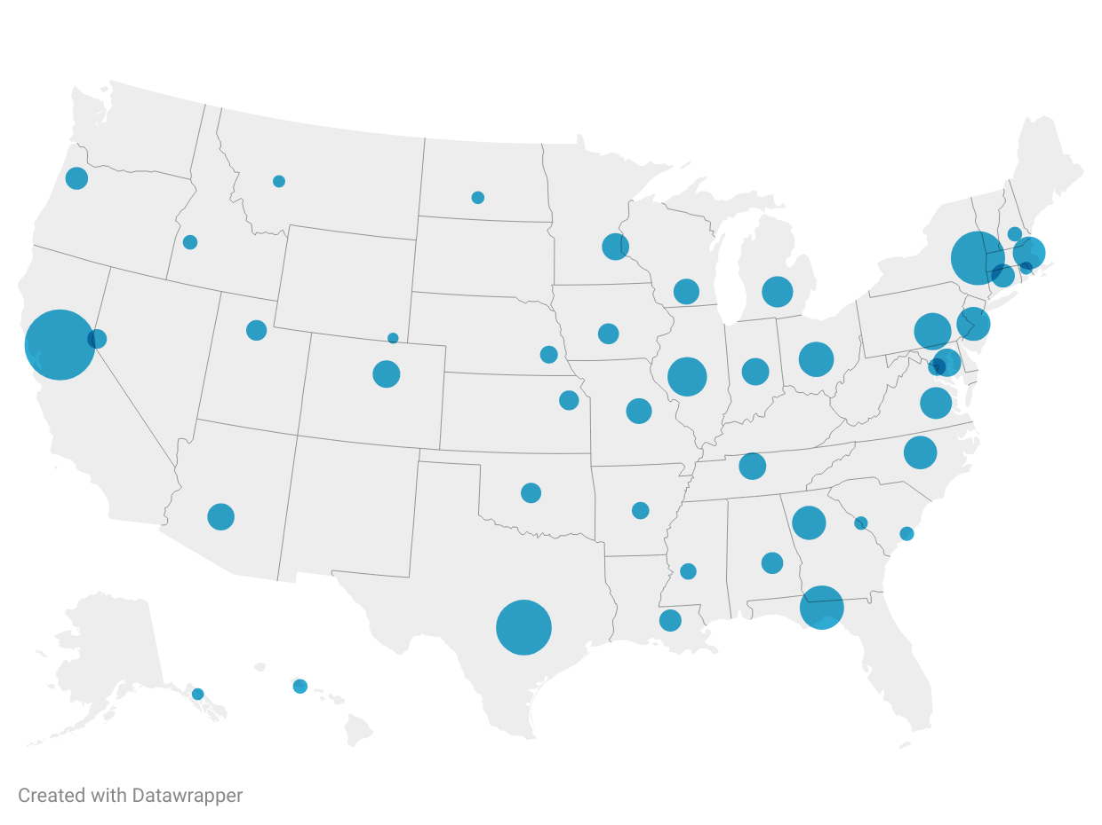

Center by GDP (37.432,-87.09)
GDP of state is estimated with a corresponding size dot at the capitol of the state.

Slide 3
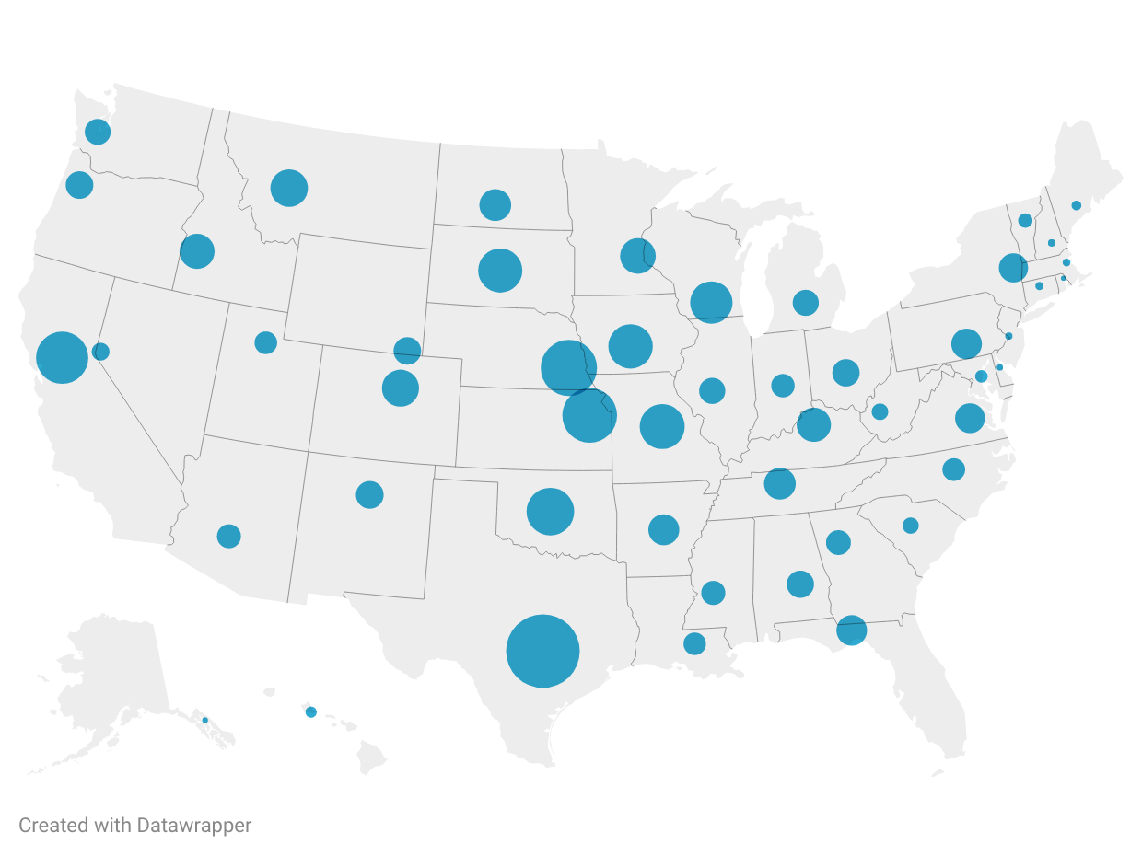
Center by Cattle Population (38.585,-97.16)
Cattle population of state is estimated with a corresponding size dot at the capitol of the state.

Slide 4
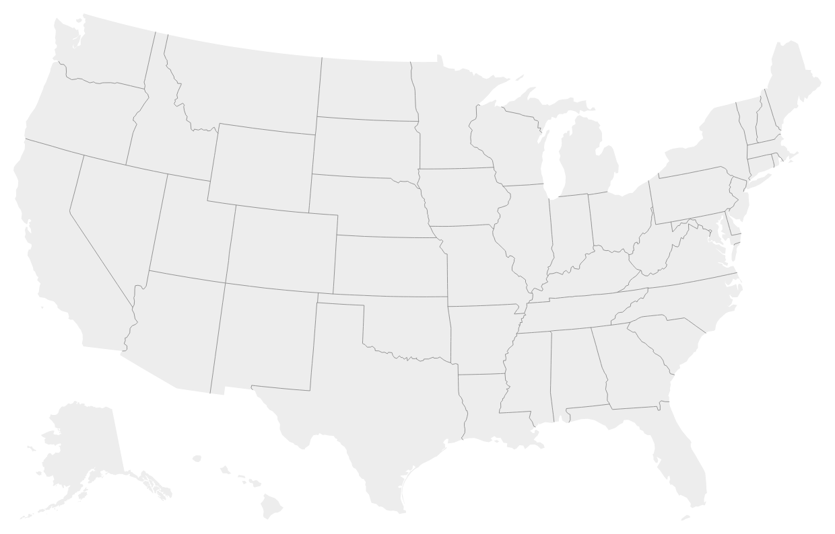
Geographic Center including Alaska/Hawaii (44.967,-103.771)

Slide 5
Data Sources
Population: https://www.census.gov/data/tables/time-series/demo/popest/2010s-total-cities-and-towns.html
Cattle: https://beef2live.com/story-cattle-inventory-vs-human-population-state-0-114255
GDP: https://en.wikipedia.org/wiki/List_of_U.S._states_and_territories_by_GDP
Geographic: https://en.wikipedia.org/wiki/Geographic_center_of_the_United_States

