Slide 1
MOVIEdb
Aplicação para Exploração Visual de Dados - Visualização de Informação
Universidade de Aveiro - Departamento de Eletrónica, Telecomunicações e Informática
Ana Sofia Fernandes, nmec 88739
Pedro Oliveira, nmec 89156

Slide 2
Dataset - Movies on Netflix, Prime Video, Hulu and Disney+
Know in which streaming platform(s) a movie can be found
IMDb and Rotten Tomatoes scores for the movies of each platform
Target age group movies
Year of production of each movie
Who directed the movie
Get to know the genres of movies in each platform
Notes:
Pedro

Slide 3
TARGET USERS
MovieDB should answer to a main question:
Which platform should I choose - which one matches my taste and my personal expenses.
Thus, the target users will be people who are trying to decide which platform to use.
Notes:
Pedro

Slide 4
ANSWER TO ALL USER QUESTIONS
02.
01.
MINIMALIST PLATFORM
TAKE ADVANTAGE OF THE DATASET
04.
CLEAR INFORMATION
03.
Main goals
All the questions regarding to which movie platform to choose should be answered
Easy to use and intuitive
The dataset should be carefully explored so that the user is not overloaded with information
Information visualization should be clear and easily analized
Notes:
Pedro

Slide 5
MOVIEDB WEBSITE
https://tinyurl.com/ycpx3jm7
Notes:
Metade metade

Slide 6
IMPLEMENTATION CHALLENGES
Very large dataset
Difficulties to find the best charts
Javascript challenges
Notes:
Sofia

Slide 7
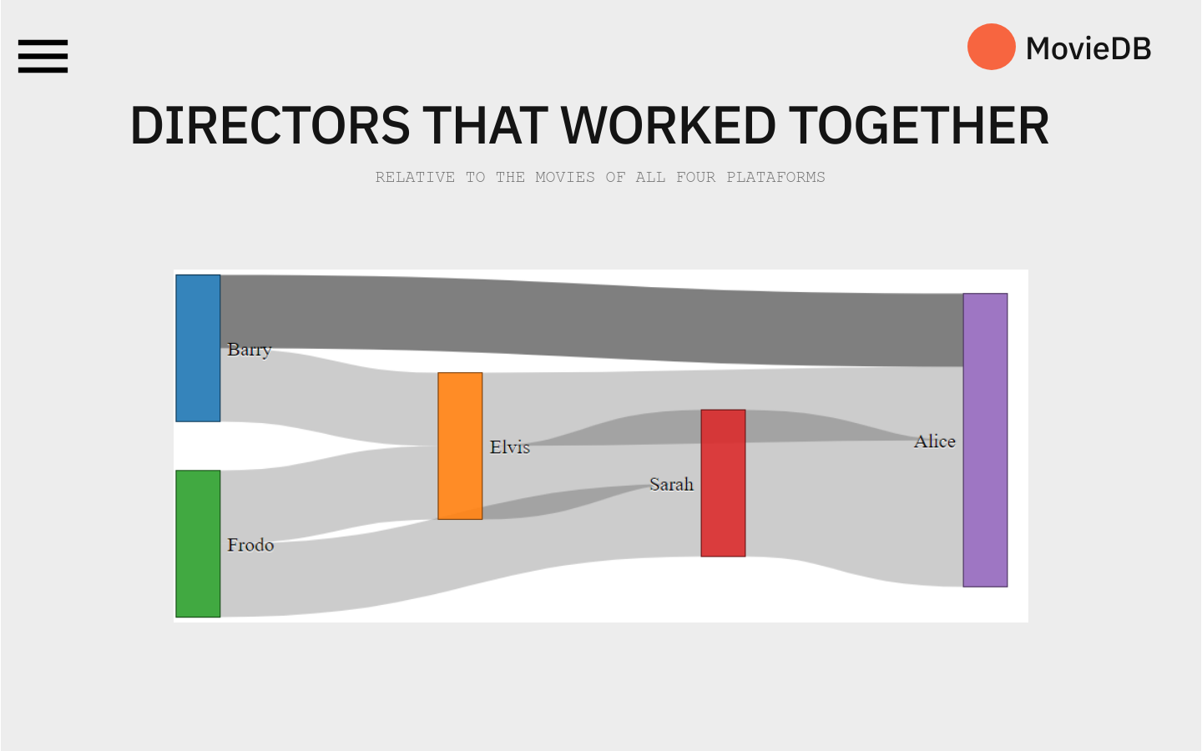
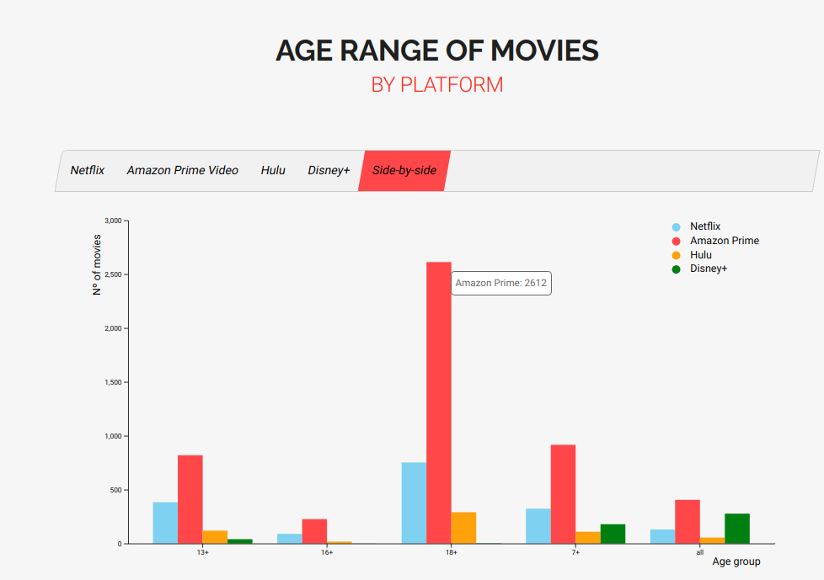
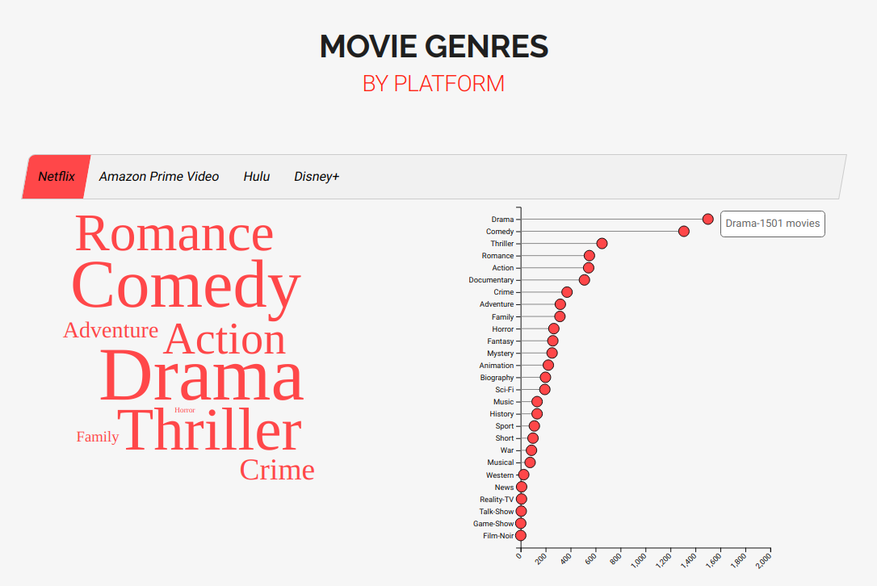
EVALUATION AND CHANGES IN THE PROTOTYPE
Directors page was useless when it comes to take the platform decision
Some charts are better perceptible if colored
The wordcloud alone is not clear
Notes:
Sofia

Slide 8
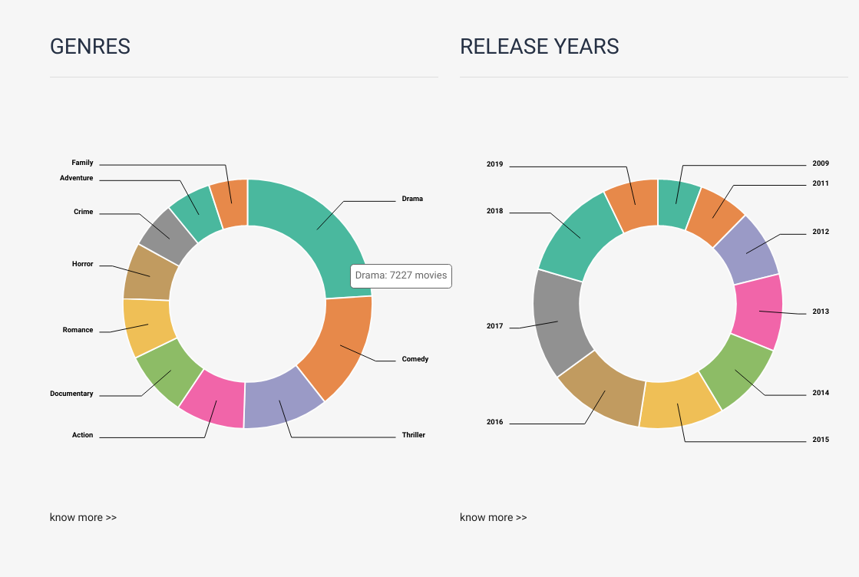
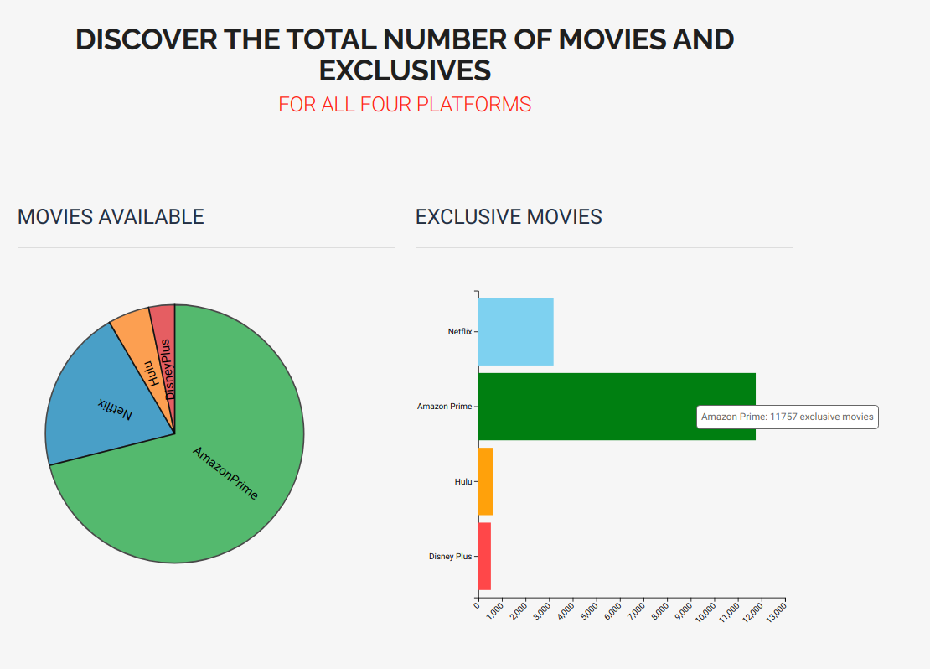
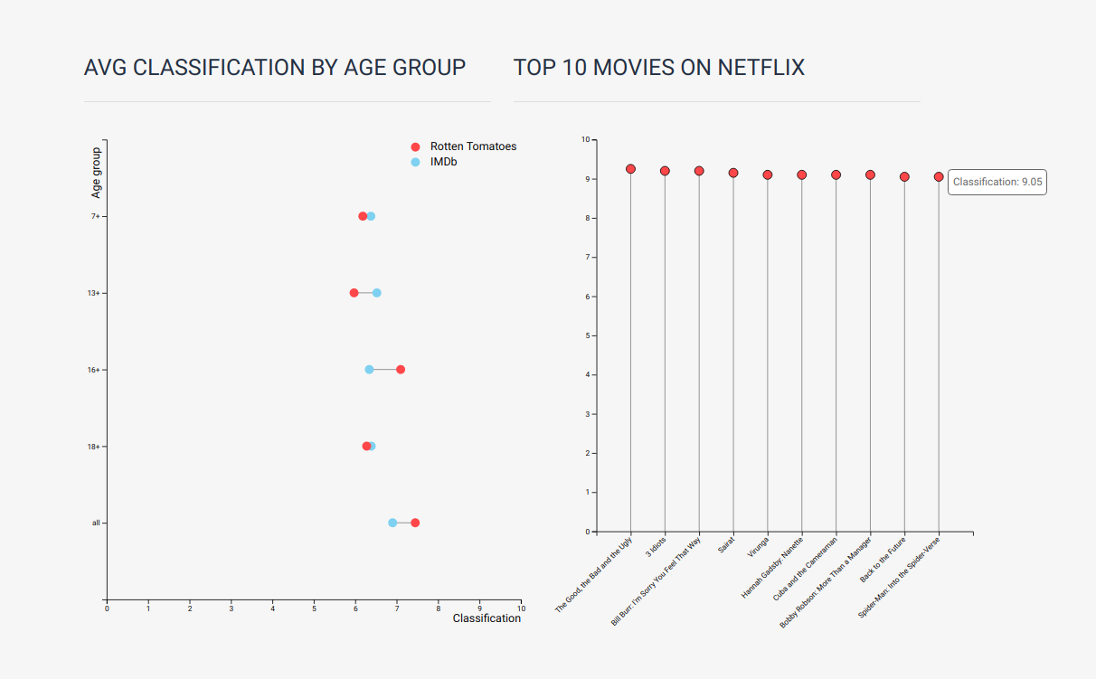
EVALUATION AND CHANGES IN THE PROTOTYPE
Only the top 10 release years and genres could be shown, in the home page
Exclusive movies per platform may count to the user
Top 10 movies were added in the reviews page
Notes:
Sofia

Slide 9
CONCLUSION AND FUTURE WORK
The way data is presented matters
Mobile application for MovieDB
Important decision
Nowadays, the choice of subscribing to a movie platform is more important than we think
Misleading charts may lead to a wrong platform choice
Charts have to be tailored
Notes:
Sofia

Slide 10
tHANK YOU!
QUESTIONS?
Notes:
Susu

