Slide 1
Network Intrusion Detection
Sofiane Alhoz

Slide 2
Overview
Goal :
Implement and evaluate the accuracy of different machine learning models for classification tasks using K-Fold Cross-Validation.
Dataset
For each model:
Perceptron
NN3
NN5
CNN2
CNN5
→ Model view → Hyperparameter Tuning → K-Fold evaluation
Conclusion
‹#›

Slide 3
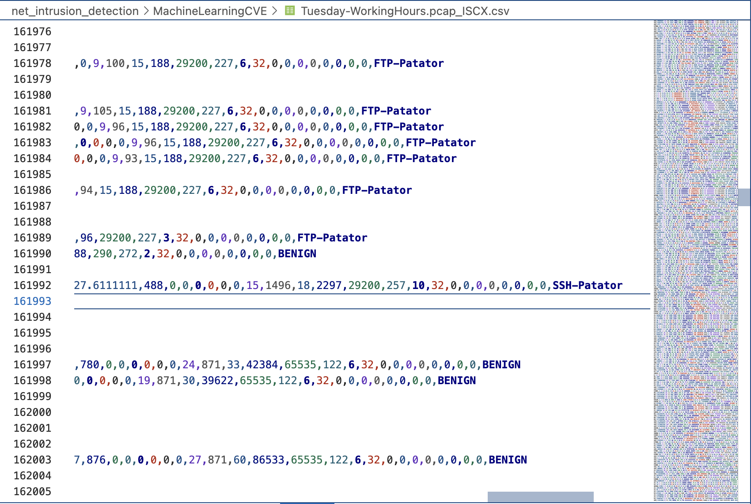
Dataset
Network intrusion detection involves identifying
network flows that carry malicious traffic.
A flow is defined as a sequence of packets
sharing the same attributes, such as:
Source IP, Destination IP, Source Port,
Destination Port, Protocol
Flow features refer to the statistical
characteristics extracted from these flows.
76 features per file, 5 files
Total: 2830749 samples
...
‹#›

Slide 4
Dataset
 | Flow Type | Number of flows
1 | BENIGN | 2,273,097
2 | DoS Hulk | 231,073
3 | PortScan | 158,930
4 | DDoS | 128,027
5 | DoS GoldenEye | 10,293
6 | FTP-Patator | 7,938
7 | SSH-Patator | 5,897
8 | DoS slowloris | 5,796
9 | DoS Slowhttptest | 5,499
10 | Bot | 1,966
11 | Web Attack Brute Force | 1,507
12 | Web Attack XSS | 652
13 | Infiltration | 36
14 | Web Attack Sql Injection | 21
15 | Heartbleed | 11
 | Total | 2,830,743
Emulated Data
Imbalanced data
76 features (flow statistics)
‹#›

Slide 5
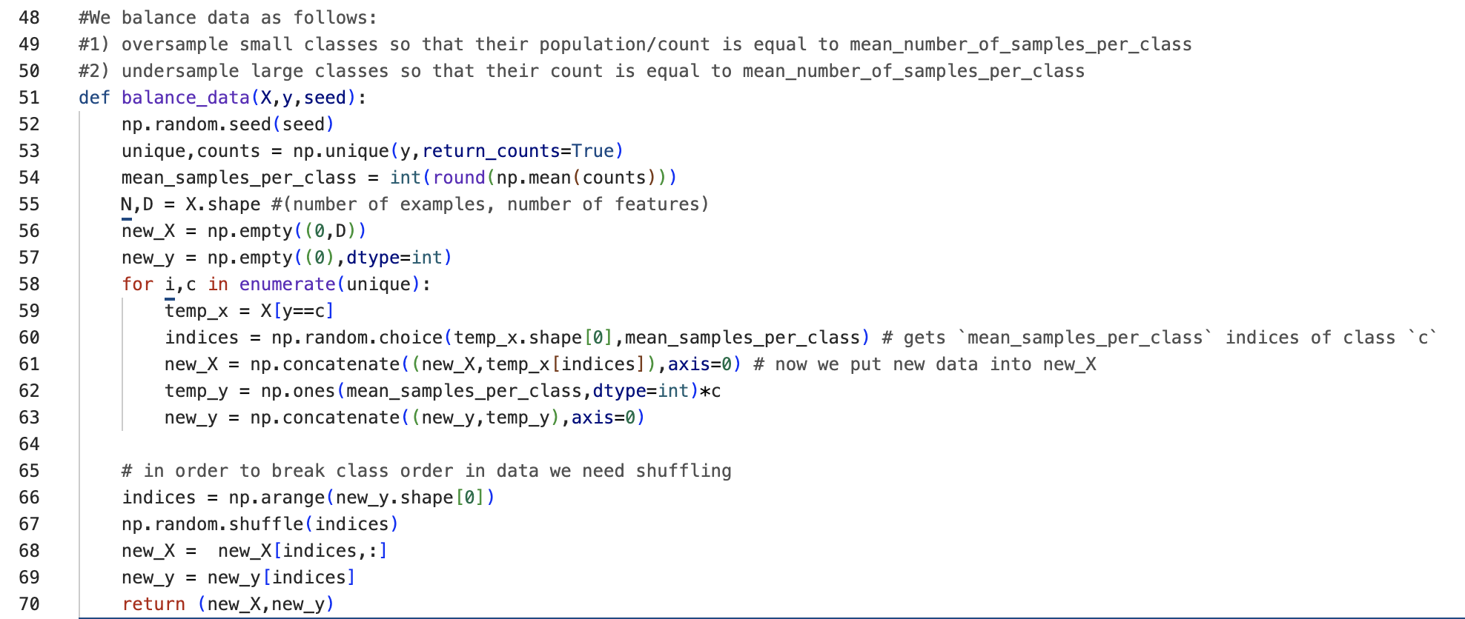
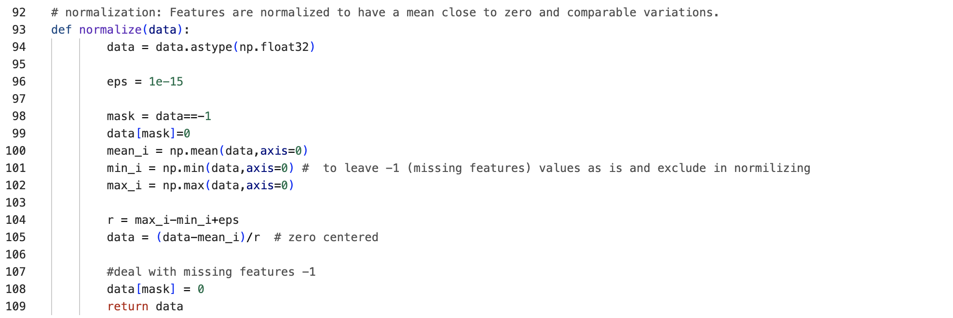
Balance data:
Normalize data:

Slide 6
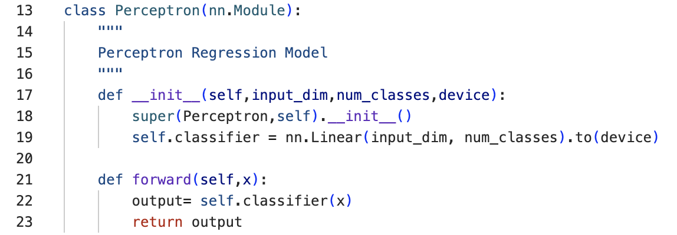
Perceptron Classifier

Slide 7
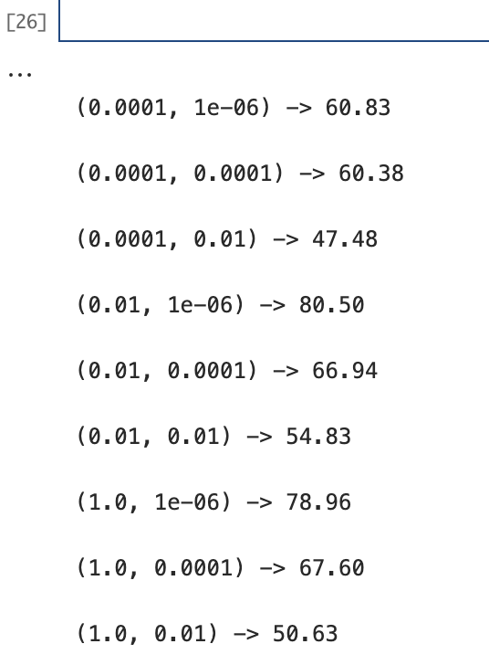
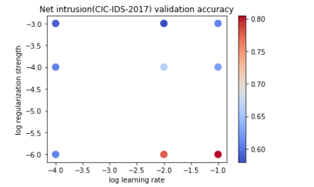
Perceptron Classifier
Results:
Best Learning rate is: [1e-1]
Best Regularization rate is : [1e-6]
Configurations:
Batch_size = 1024
learning_rates = [,1e-4,1e-2,1e-1]
regularizations = [1e-6,1e-4,1e-3]
Epoch = 25
Training Accuracy on above hyperparameters:
‹#›

Slide 8
KFold Evaluation
Split train 80% / test 20% might be problematic because attacks happens at different and precise moments => We need to use KFold Evaluation: The model is trained K times, each time using K-1 folds for training and the remaining fold for testing.
5Fold Evaluation:
Itération 1: [Train | Train | Train | Train | Test ]
Itération 2: [Train | Train | Train | Test | Train]
Itération 3: [Train | Train | Test | Train | Train]
Itération 4: [Train | Test | Train | Train | Train]
Itération 5: [Test | Train | Train | Train | Train]
This ensures that every data point is used for both training and testing, leading to better generalization and reducing the risk of overfitting.

Slide 9
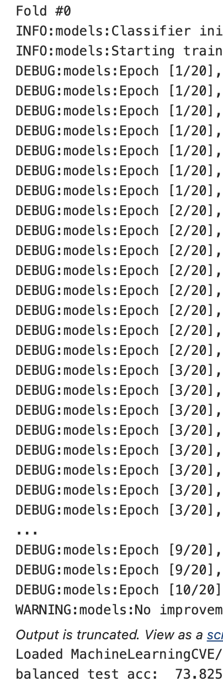
Perceptron Classifier
‹#›

Slide 10
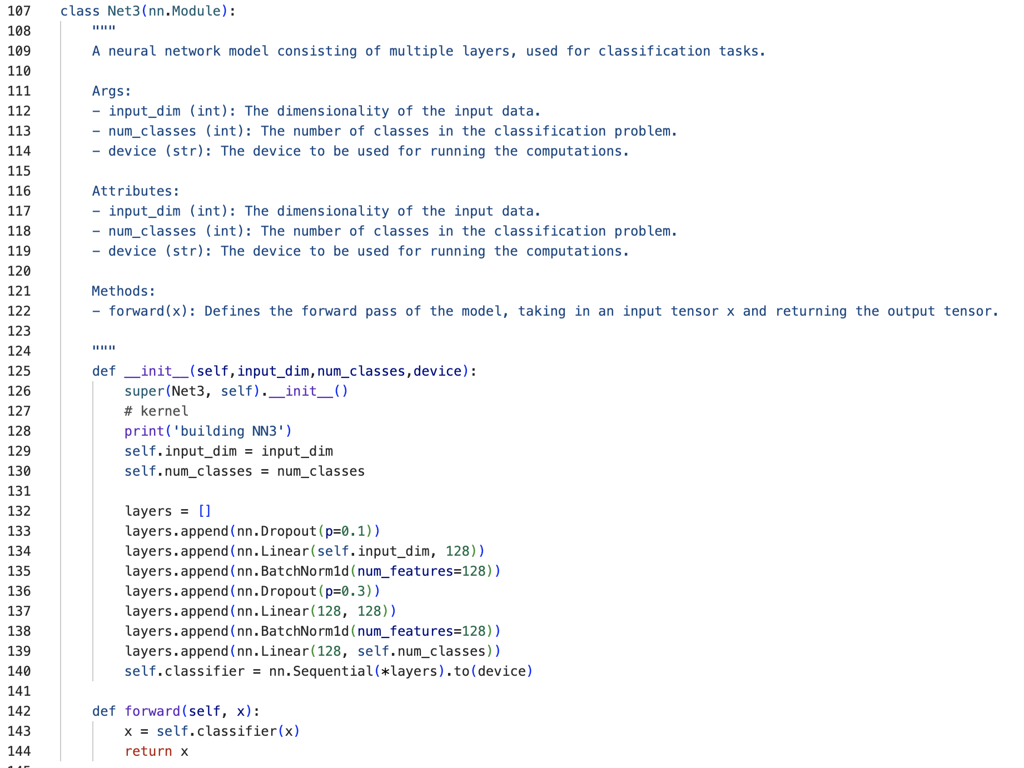
NN3 architecture
‹#›

Slide 11
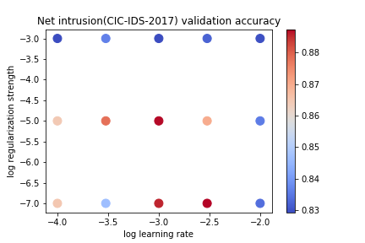
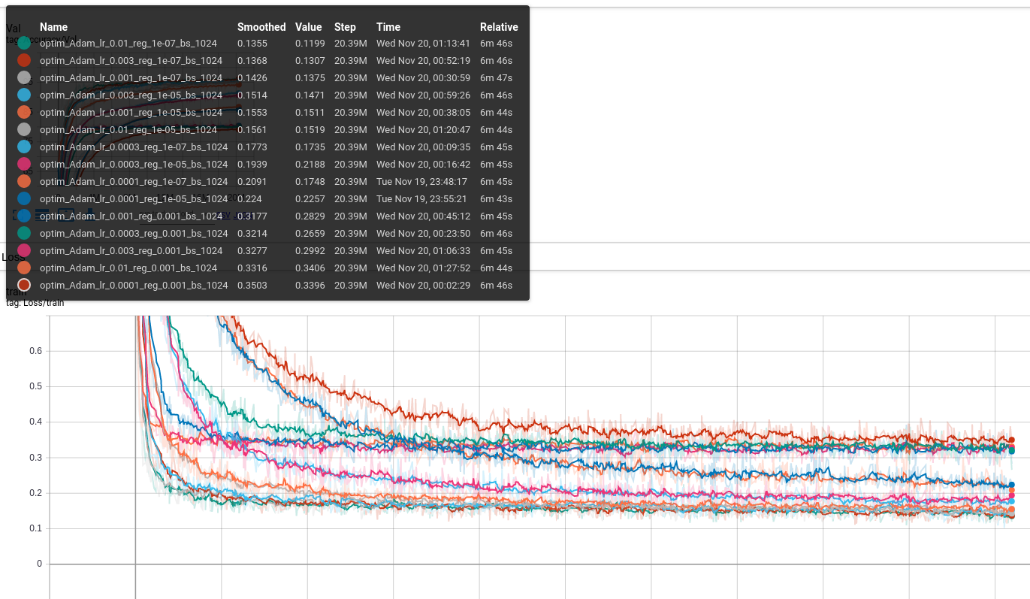
NN3: Hyperparameter Tuning 1st run
Settings:
learning_rates = [1e-4,3e-4,1e-3,3e-3,1e-2]
regularizations = [1e-7,1e-5,1e-3]
Results:
Need more epochs:Because, as we can see for example in the loss curves, the model has not yet completed its learning process.
plot: Best val accuracy: 88.74
plot : Best parameters:(1e-3,1e-5)
‹#›

Slide 12
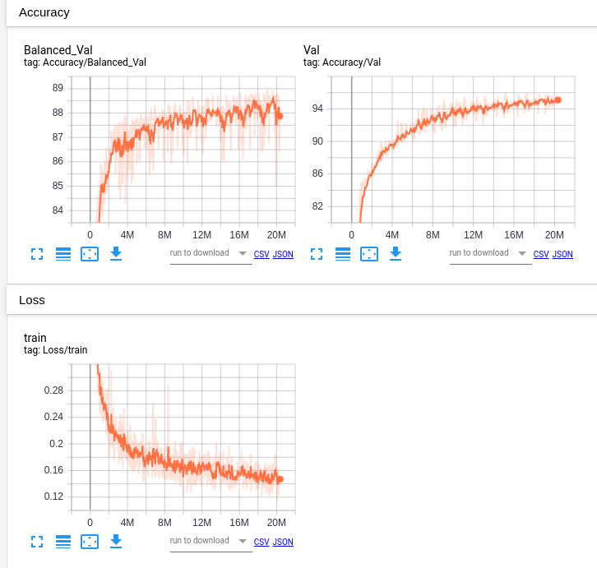
NN3: 2nd run with batchnorm
Settings:
learning_rates = [1e-3]
regularizations = [1e-5]
Num_epochs = 10
Use of batchnorm
Results:
Best val accuracy:88.98, small improvement
Graph feedback: It is still learning. Need more epochs
‹#›

Slide 13
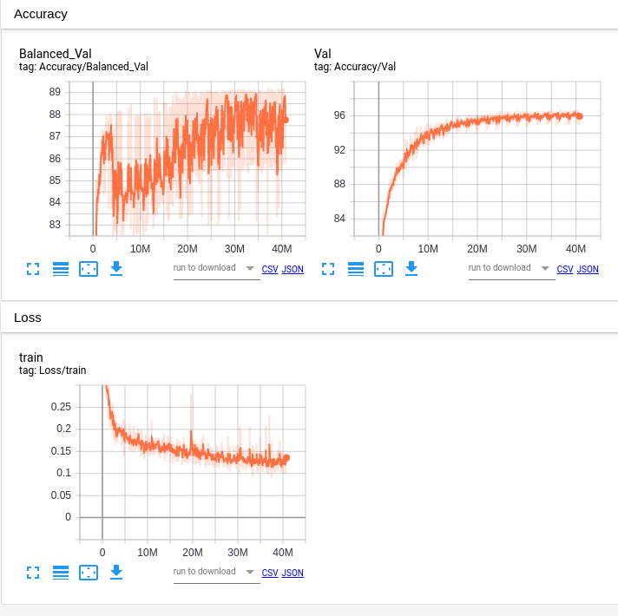
NN3: 3rd run with batchnorm + dropout
Settings:
learning_rates = [1e-3]
regularizations = [1e-5]
Use of batchnorm
Use of dropout (0.1,0.3)
num_epochs=20
Results:
Best val accuracy:89.22, small improvement
‹#›

Slide 14
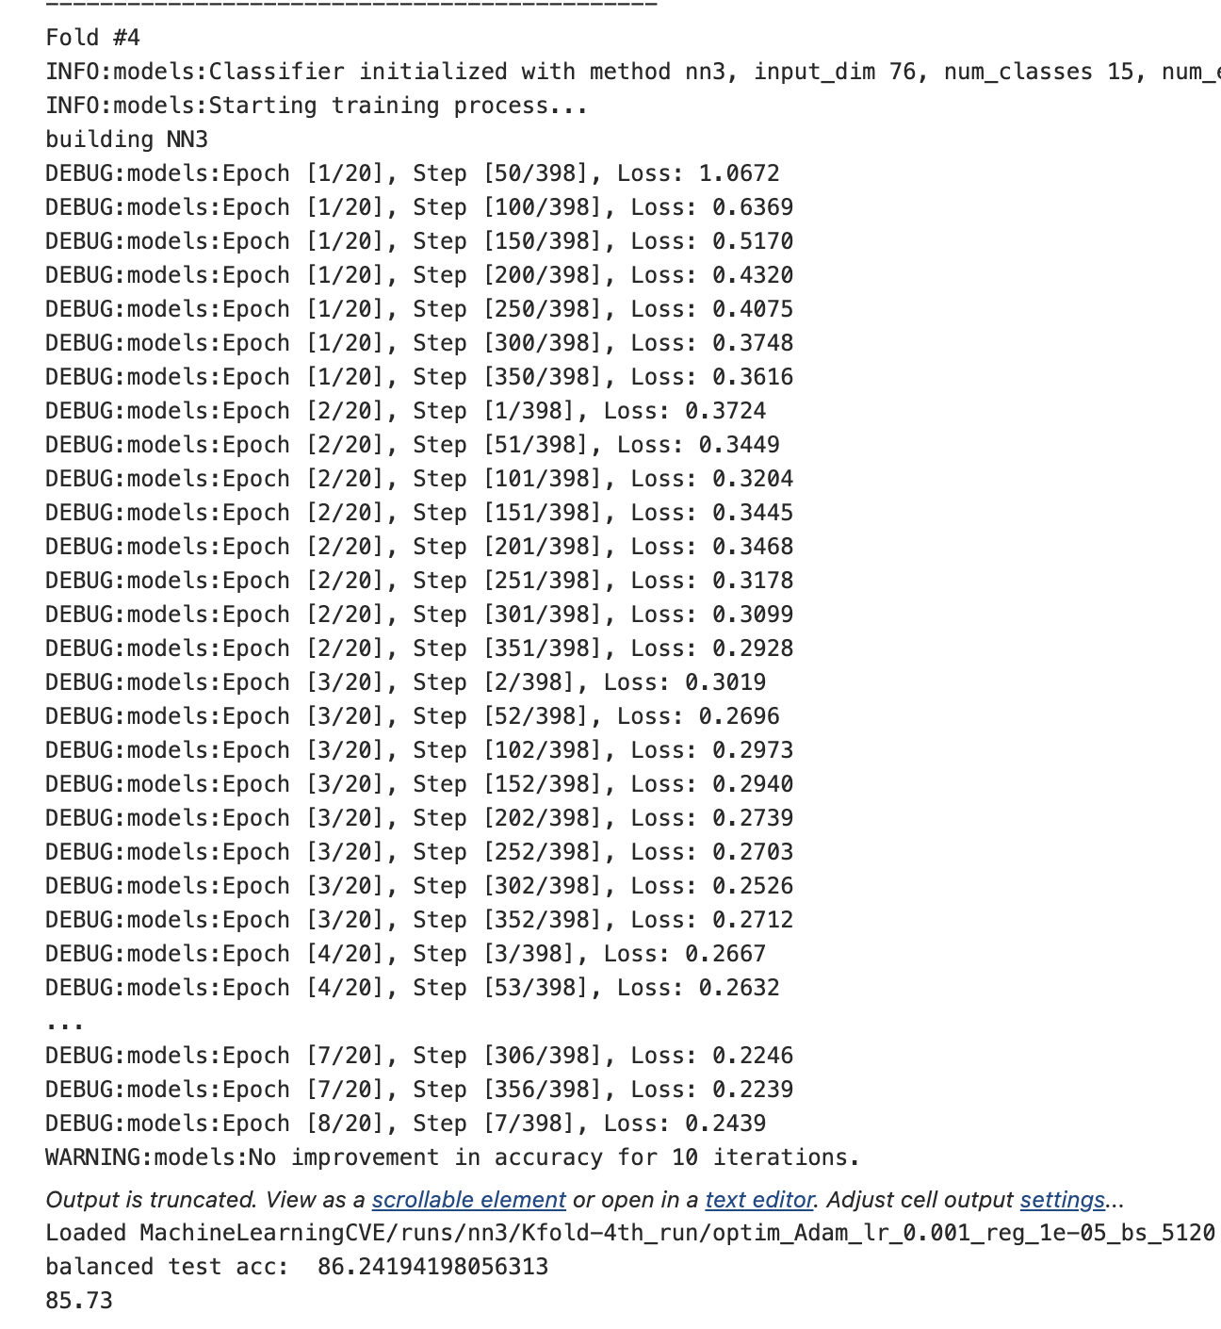
NN3: 5-Fold evaluation
Settings:
learning_rates = [1e-3]
regularizations = [1e-5]
Use batchnorm
Use dropout (0.1,0.3)
num_epochs=20
Results of the 5 fold::
Balanced Test acc: 85.61
‹#›

Slide 15
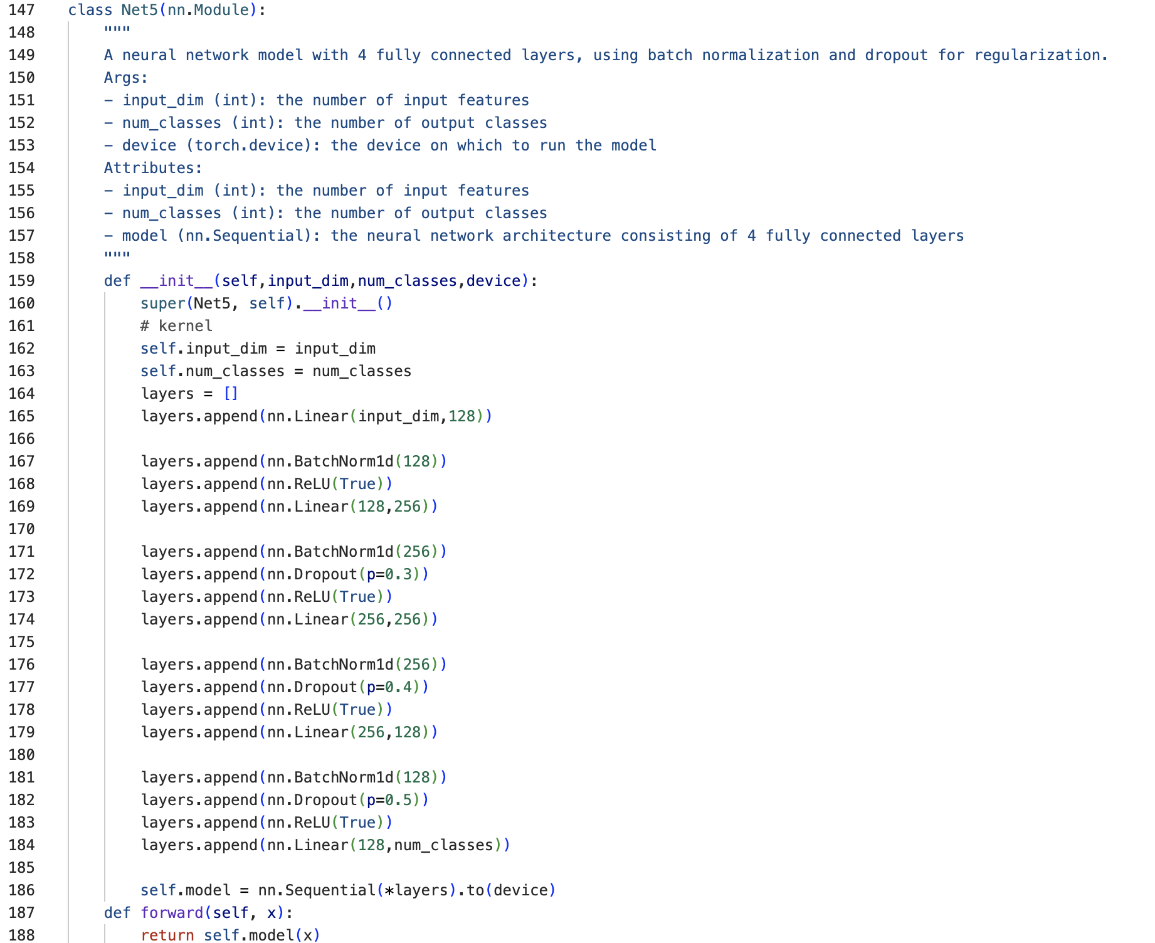
5 layer NN architecture
‹#›

Slide 16
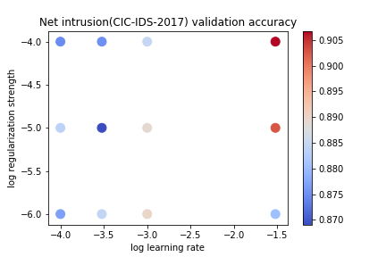
NN5: Hyperparameter Tuning: 1st run: Dropout higher layers
Configurations:
learning_rates = [3e-2,1e-3,3e-4,1e-4]
regularizations = [1e-6,1e-5,1e-4]
Batchnorm
Dropout prob: (0, 0, .3, .4, .5)
Epoch = 20
Results:
Val acc: 90.67
Feedback:
Bigger reg
Bigger lr
Larger epoch
‹#›

Slide 17
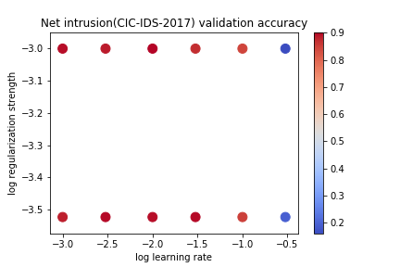
NN5: Run 2: Dropout higher layers
Configurations:
learning_rates = [1e-3,3e-3,1e-2,3e-2,1e-1,3e-1]
regularizations = [3e-4,1e-3]
Batchnorm
Dropout prob: (0, 0, .3, .4, .5)
Epoch = 60
Results:
Val acc: 90.27
Feedback:
Search does not have to be dense
Bigger reg range
smaller lr
Conflicting to previous run, it could be because of small epoch number previously
‹#›

Slide 18
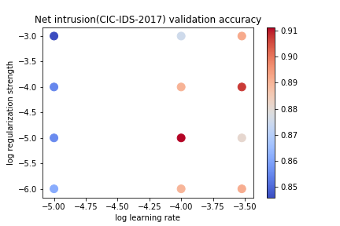
NN5: Run 3: Dropout higher layers
Configurations:
learning_rates = [1e-5,1e-4,3e-4]
regularizations = [1e-6,1e-5,1e-4,1e-3]
Batchnorm
Dropout prob: (0, 0, .3, .4, .5)
Epoch = 60
Results:
Val acc: 91.14,
Feedback:
Best param lr,reg = (1e-4,1e-5)
‹#›

Slide 19
5-fold Evaluation: NN5
Settings
Best param lr,reg = (1e-4,1e-5)
Epochs = 60
Results:
5-Fold Balanced Test acc: 85.63
‹#›

Slide 20
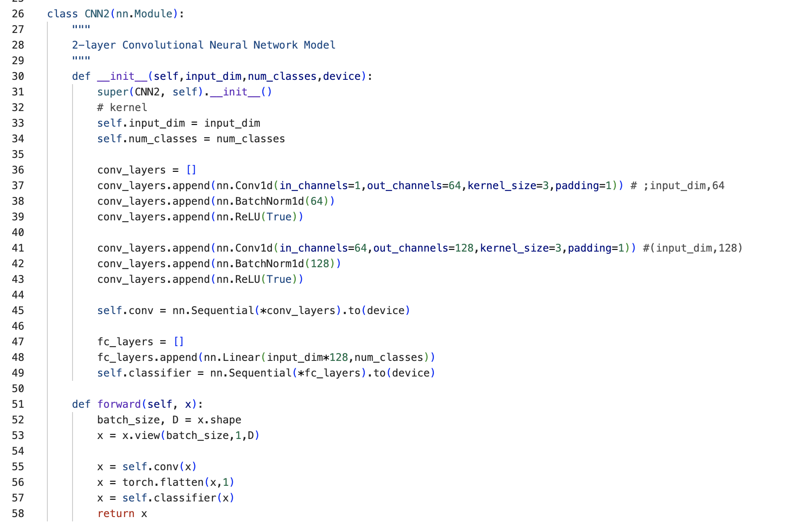
CNN2 architecture
‹#›

Slide 21
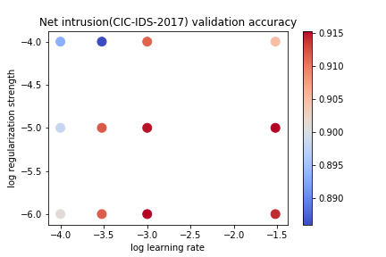
CNN2: run 1
Config::
num_epochs = 60
learning_rates = [3e-2,1e-3,3e-4,1e-4]
regularizations = [1e-6,1e-5,1e-4]
acc:
Val:91.53
Feedback:
Lr 1e-3 is best, maybe need smaller reg
‹#›

Slide 22
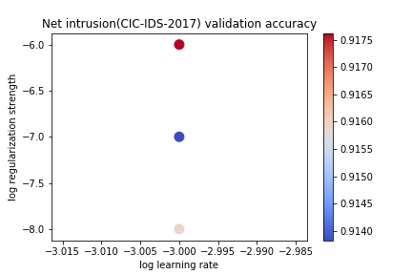
CNN2: run 2
Configs:
num_epochs = 60
learning_rates = [1e-3]
regularizations = [1e-8,1e-7,1e-6]
acc:
Val:91.76
Feedback:
Best reg is 1e-6
‹#›

Slide 23
5-fold Evaluation: CNN2
Settings:
num_epochs = 60
learning_rates = [1e-3]
regularizations = [1e-6]
Results:
5-Fold acc: 88.14%
‹#›

Slide 24
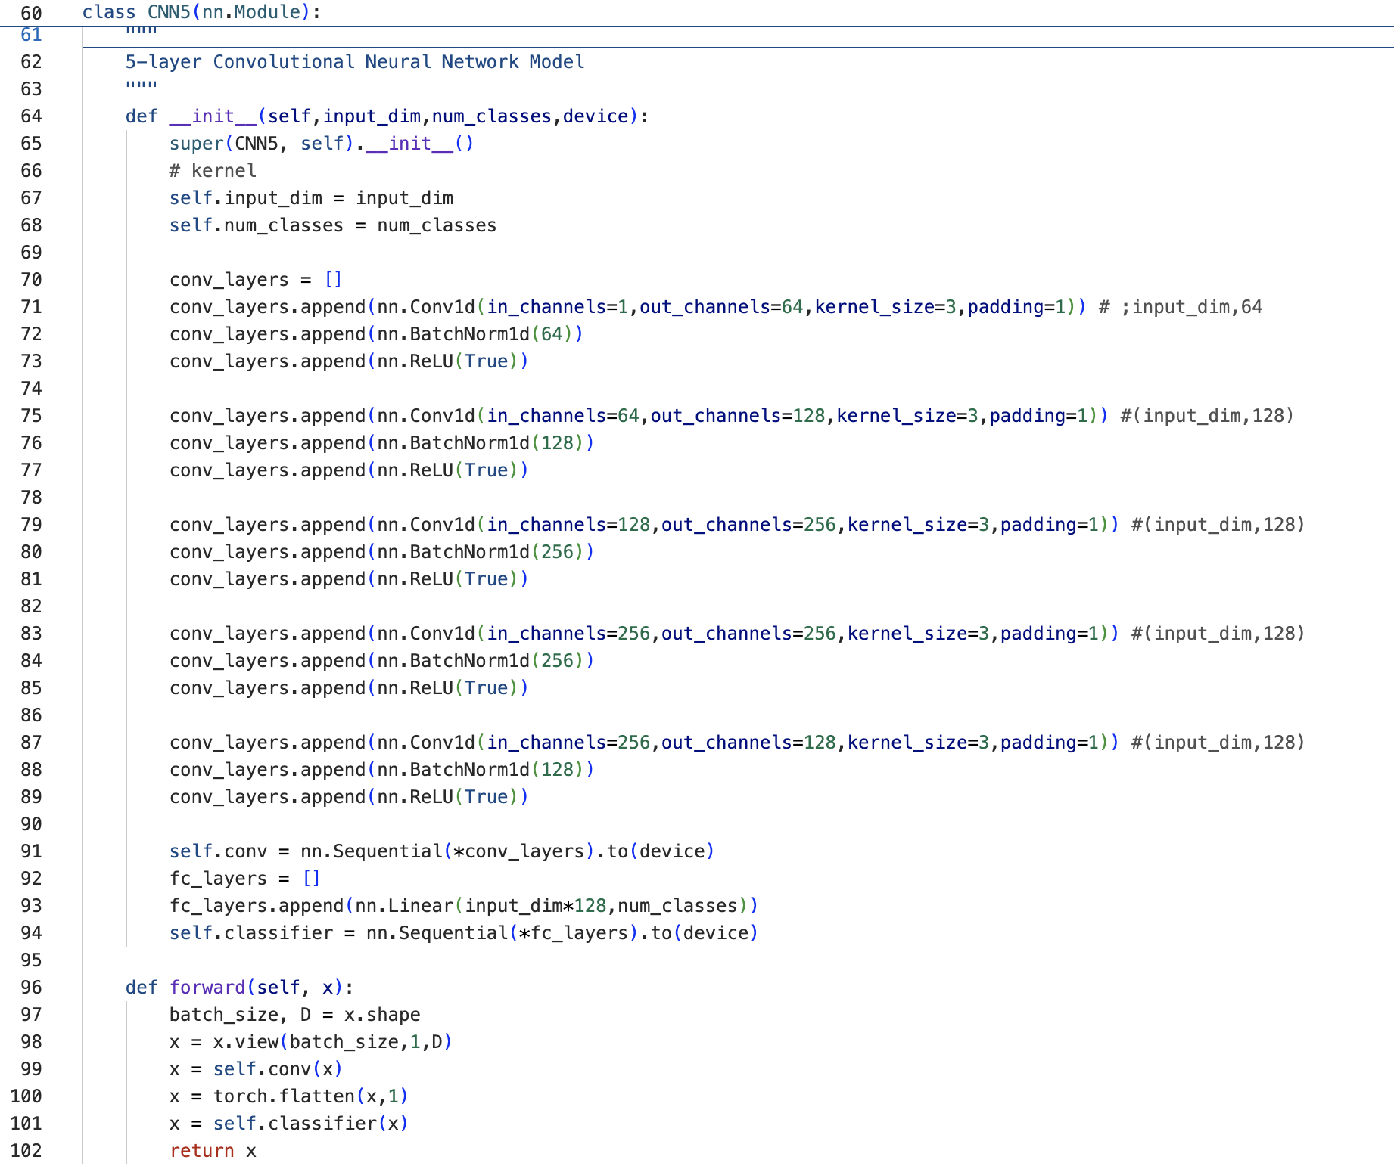
CNN5 architecture
‹#›

Slide 25
5-fold Evaluation: CNN5
Settings:
num_epochs = 60
learning_rates = [1e-3]
regularizations = [1e-6]
Results:
5-Fold acc: 88.18%
‹#›

Slide 26
Conclusion
Classifier | 5-fold Accuracy
Perceptron | 76.27
NN3 | 85.73
NN5 | 85.61
CNN2 | 88.14
CNN5 | 88.18
‹#›

