Slide 1
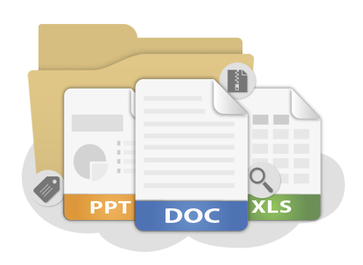
Software Requirements Specification
Reading and Reviewing SRS
QA
Fundamentals
SoftUni Team
Technical Trainers
Software University
http://softuni.bg

Slide 2

Table of Contents
What is SRS?
Requirements
Use Cases
Readability
Review

Slide 3
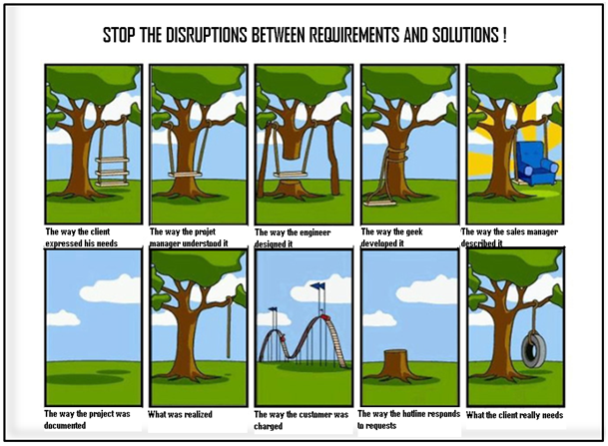
First Look at SRS

Slide 4
First Look at SRS
A software requirements specification (SRS) is a description of a software system to be developed, laying out functional and non-functional requirements, and may include a set of use cases that describe interactions the users will have with the software.
Establishes the basic agreement between costumer and contractor
What software product to do
What is NOT expected to do

Slide 5

First Look at SRS (2)
Should enlist enough and necessary requirements for the project development
Should have clear understanding of the product
Often changed after each meeting with customer

Slide 6
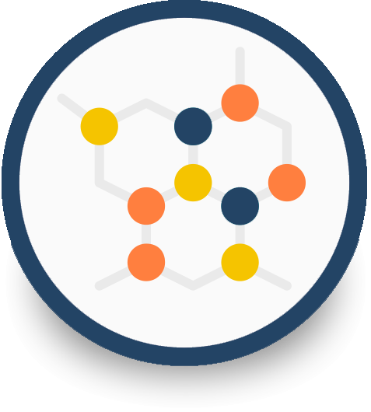
Use Cases

Slide 7
Use Cases
List of interaction steps
Defines relation between an actor and a system
Usually satisfying a goal
Actors are able to take decisions
Decisions lead to subcases

Slide 8

Use Cases (2)
Models
Can be modeled via UML
Can be flat text documents
Template
Name
Actors
Preconditions
Flow
Post conditions

Slide 9
Use Cases – Live Demo

Slide 10
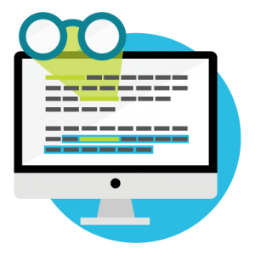
Readability

Slide 11
Readability
In order to be easy to read, an SRS should answer
Contains a high-level description of the scope?
Is it easy to navigate?
Is it easy to distinct primary from secondary cases?
Contains links to related features?
Calls out questions which still need to be addressed?

Slide 12

Review

Slide 13
Review
SRS review is going to through the document and trying to understand what the target application is going to be like.
The review results in
Test scenarios list
Found errors by statically going through the document
Questions for better understanding
Preliminary idea of the test environment
Test scope identification
How many test cases will end-up having

Slide 14
Useful Links
Example SRS: http://www.cse.chalmers.se/~feldt/courses/reqeng/examples/srs_example_2010_group2.pdf

Slide 15
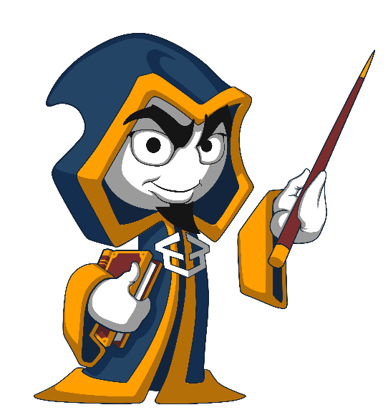
Summary
What is an SRS?
What does it contain?
How use cases are described?
High level and low level cases
Requirements for readable SRS
Reviewing SRS
How to do it?
Pre-steps
Results
…
…
…

Slide 17
Diamond Partners

Slide 18
Diamond Partners

Slide 19
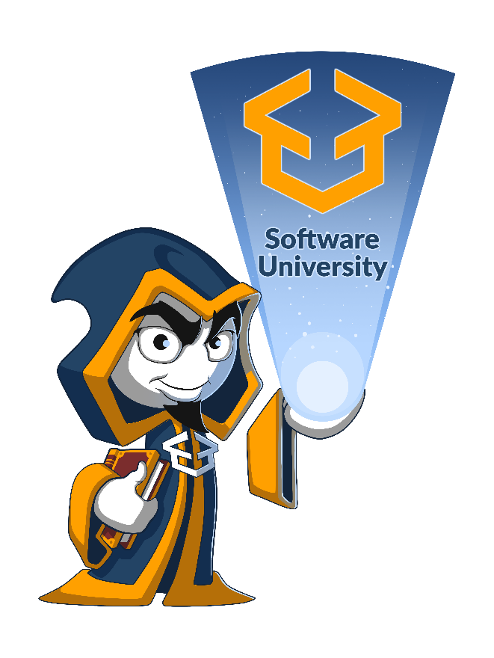




Trainings @ Software University (SoftUni)
Software University – High-Quality Education, Profession and Job for Software Developers
softuni.bg
Software University Foundation
http://softuni.foundation/
Software University @ Facebook
facebook.com/SoftwareUniversity
Software University Forums
forum.softuni.bg

Slide 20

License
This course (slides, examples, demos, videos, homework, etc.) is licensed under the "Creative Commons Attribution-NonCommercial-ShareAlike 4.0 International" license

