Slide 1

Test Automation Foundations
Selenium WebDriver
QA
Fundamentals
SoftUni Team
Technical Trainers
Software University
http://softuni.bg

Slide 2
Table of Contents
Test Automation Introduction
Selenium Introduction
Selenium IDE
Selenium Webdriver
Select Elements
Send Keys
Assertions

Slide 3

Automation

Slide 4
What is Test Automation?
Executing repetitive but necessary tasks
Login, registration, etc…
Comparing the actual and expected outcomes
Checking visual result
Checking API responses
Adding a test to difficult to perform manual actions
Big scenario e.g. login the user, then add some products to cart, then check database, then checkout the cart,
etc…

Slide 5
What Is Selenium Automation Good For ?
Selenium can be used for automating:
Acceptance / Functional testing
Reproducing bugs
Regression testing
Smoke-testing
Etc.

Slide 6

Selenium

Slide 7
Introduction to Selenium?
Framework and a tool for web automation
Consists of two components
Selenium IDE – record/playback tool for Firefox
Selenese – A domain-specific language
Selenium WebDriver – API For most of the popular languages

Slide 8
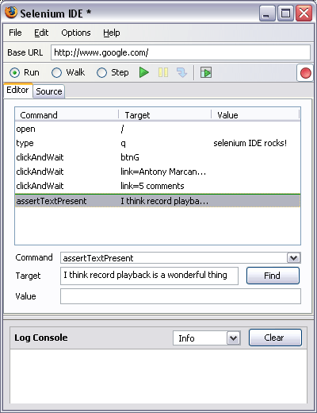
Selenium IDE

Slide 9
Selenium IDE (2)
Recording actions
Using selectors/x-path for interaction
Has basic own API for various actions (click, wait, select, etc..)

Slide 10
Selenium IDE - Live Demo

Slide 11

Selenium WebDriver
Setup and Overview

Slide 12
Selenium WebDriver
Library for automating scripts in various languages (Java, C#, Ruby, Python, PHP…)
Uses unit testing engine for a lot of the core actions
Has API for all web-browser actions a user can do

Slide 13
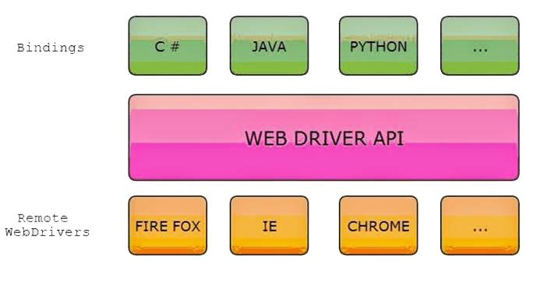
Flexibility Of Selenium WebDriver

Slide 14
IDE vs RC vs WebDriver
Selenium IDE
Firefox add-on that you can create relatively simple test cases.
Selenium Remote Control
Use programming languages in creating complex tests.
Also known as Selenium 1
WebDriver
Communicate directly to the browser, thereby controlling it from the OS level.

Slide 15
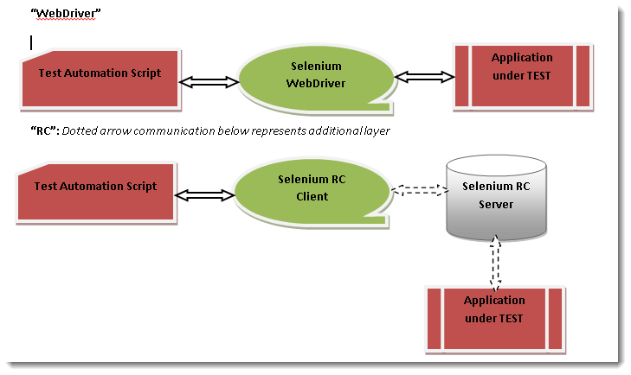
Selenium WebDriver and RC Model

Slide 16
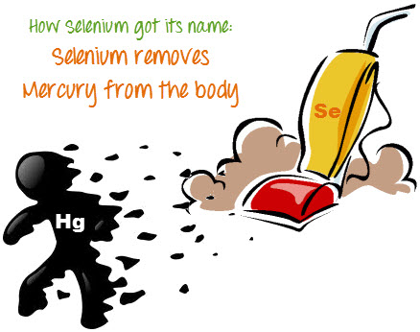
Why Selenium WebDriver?
To use a certain programming language in designing your test case.
To test applications that are rich in AJAX-based functionalities
To execute tests on the HtmlUnit browser
To create customized test results
Since Selenium is a well-known antidote for Mercury poisoning

Slide 17
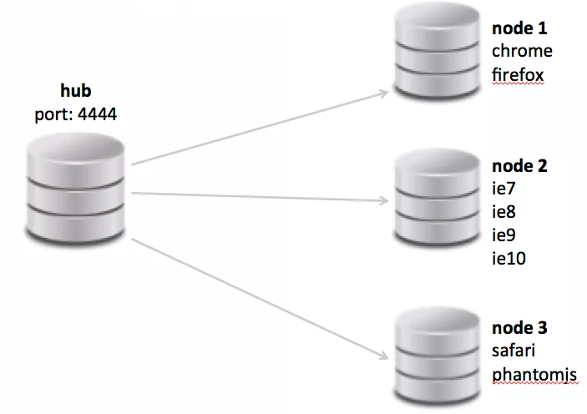
Selenium Grid
Many browsers per node

Slide 18

Why Selenium WebDriver?
Install Selenium Web Driver
Add using OpenQA
IWebDriver driver = new ChromeDriver();
driver.Url = "http://softuni.bg";
driver.Quit();
using OpenQA.Selenium;
using OpenQA.Selenium.Chrome;

Slide 19
Why Selenium WebDriver?
Install Selenium Web Driver
Add using OpenQA
IWebDriver driver = new ChromeDriver();
driver.Url = "http://softuni.bg";
driver.Quit();
using OpenQA.Selenium;
using OpenQA.Selenium.Chrome;

Slide 20
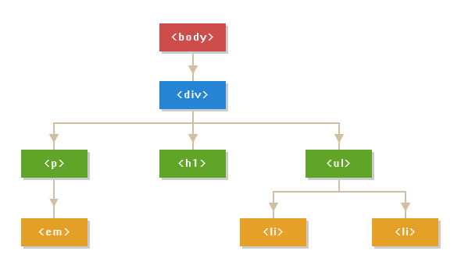
Element Present in DOM
An element not being present at all in the DOM.
An element being present in the DOM but not visible.
An element being present in the DOM but not enabled. (i.e. clickable)

Slide 21
IWebElement
Each browser need defferent driver
IWebElement interface represent HTML elements
IWebDriver driver = new ChromeDriver();
IWebElement element = driver.FindElement(By.Id("coolestWidgetEvah"));
List<IWebElement> list = driver.FindElements(By.TagName("input")).ToList();

Slide 22
Locating Elements
Elements can be located by the same properties as in the IDE
By ID
By class name
By tag name
IWebElement element = driver.FindElement(By.Id("coolestWidgetEvah"));
IList<IWebElement> cheeses = driver.FindElements(By.ClassName("cheese"));
IWebElement frame = driver.FindElement(By.TagName("iframe"));

Slide 23
Locating Elements (2)
By Name
By Link Text
By CSS Selector
IWebElement cheese = driver.FindElement(By.Name("cheese"));
IWebElement cheese = driver.FindElement(By.LinkText("cheese"));
IWebElement cheese =
driver.FindElement(By.CssSelector("#food"));

Slide 24
Locating Elements (3)
By Xpath
Internet Explorer have special rules for XPath
Chain of locators
IList<IWebElement> inputs = driver.FindElements(By.XPath("//input"));
IWebElement cheese = this.driver.
FindElement(By.ClassName(“firstElementTable")).
FindElement(By.Id(“secondElement"));

Slide 25
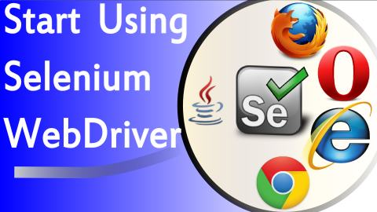
Selenium WebDriver API

Slide 26
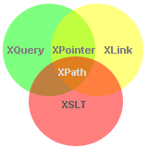
Xpath
What is XPath?
XPath is a syntax for defining parts of an XML document
XPath uses path expressions to navigate in XML documents
XPath contains a library of standard functions
XPath is a major element in XSLT
XPath is a W3C recommendation

Slide 27
Xpath Syntax
Driver | Tag and Attribute
bookstore | /bookstore/book[last()]
/bookstore | /bookstore/book[last()-1]
bookstore/book | /bookstore/book[position()<3]
//book | //title[@lang]
bookstore//book | //title[@lang='en']
//@lang | /bookstore/book[price>35.00]
/bookstore/book[1] | /bookstore/book[price>35.00]/title
//book/title | //book/price | /bookstore/*
//* | //title | //price
https://www.w3schools.com/xml/xpath_intro.asp

Slide 28
Xpath Axes
Location path can be absolute or relative
AxisName | Expression
ancestor | Selects all ancestors (parent, grandparent, etc.)
descendant | Selects all descendants (children, grandchildren, etc.)
following-sibling | Selects all siblings after the current node
preceding-sibling | Selects all siblings before the current node
child | Selects all children of the current node
parent | Selects the parent of the current node
attribute | Selects all attributes of the current node
https://www.w3schools.com/xml/xpath_axes.asp

Slide 29
Selenium WebDriver - Live Demo

Slide 30

Sikuli Script

Slide 31

What is Capture/Replay tool
The test developer interacts with an application under test, typically through the graphical user interface (GUI), while some capture tool simultaneously generates an automated test script
Tests are difficult to maintenance as the application changes

Slide 32
Issues to solve
GUIs are difficult to test directly in code
Need of a reliable consistent regression test execution approach
Need of easy-to-read test execution results
Too many repeatable test steps
No suitable tools for specific applications

Slide 33

Introducing Sikuli
Images driven – it is a visual technology to search and automate GUI using images
Intuitive open-source visual scripting tool
Scripts are written in Jython
Jython is an implementation of the high-level, object-oriented language Python seamlessly integrated with the Java platform

Slide 34
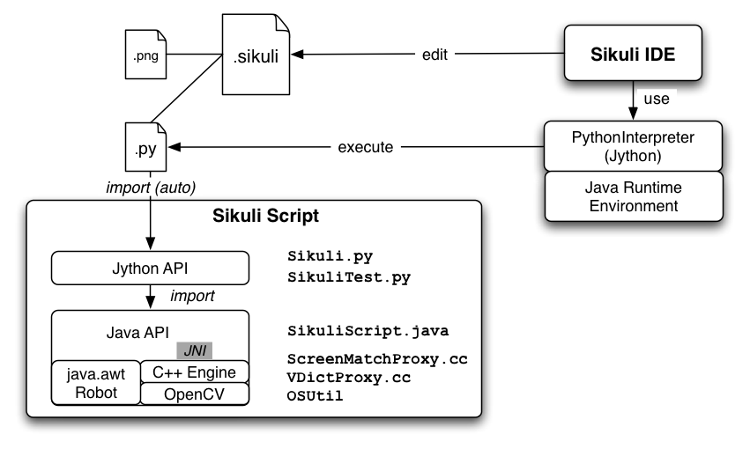
System Design

Slide 35



Platform Independence
Works on any GUI can be displayed on Windows/Linux/Mac
Virtual machines
Remote desktop
Mobile simulators: Android, iPhone
Web: Flash, HTML + JavaScript

Slide 36
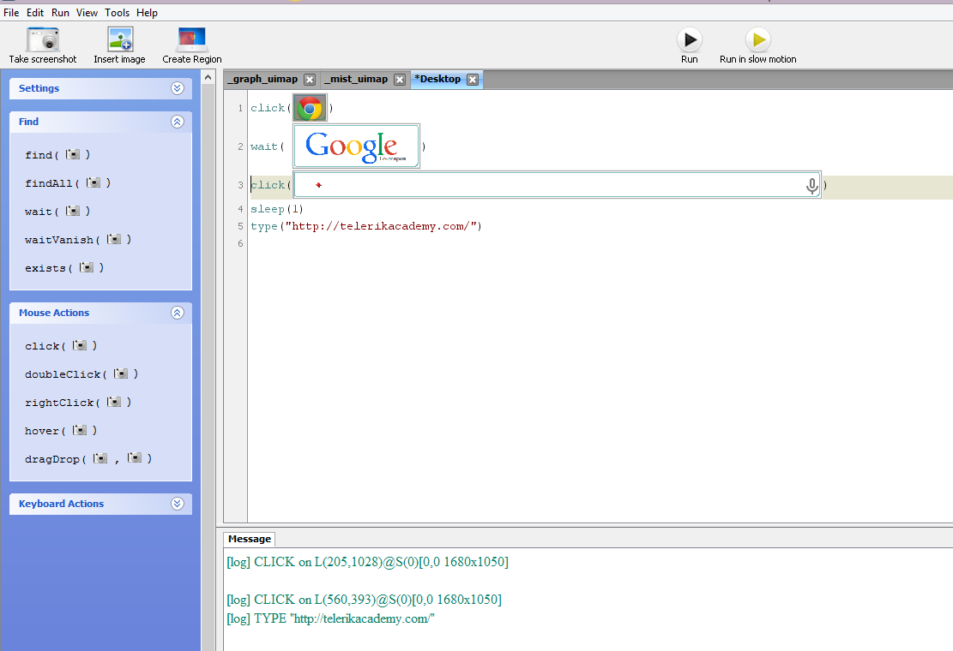
How Sikuli Works
Combination of GUI & Traditional coding
Jython coding that can use images as parameters and variables
Screen Capture utilized for image selection instead of object IDs
Can upload image files

Slide 37
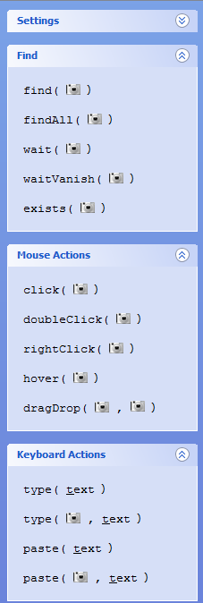
Using Sikuli IDE
Basic Sikuli functions
exists
find
findAll
waitClick
doubleClick
dragDrop
type

Slide 38

Summary
Test automation theory
Selenium IDE – record, play, export case
Selenium WebDriver
Sikuli Script
…
…
…

Slide 40
Diamond Partners

Slide 41
Diamond Partners

Slide 42





Trainings @ Software University (SoftUni)
Software University – High-Quality Education, Profession and Job for Software Developers
softuni.bg
Software University Foundation
http://softuni.foundation/
Software University @ Facebook
facebook.com/SoftwareUniversity
Software University Forums
forum.softuni.bg

Slide 43

License
This course (slides, examples, demos, videos, homework, etc.) is licensed under the "Creative Commons Attribution-NonCommercial-ShareAlike 4.0 International" license

