Slide 1

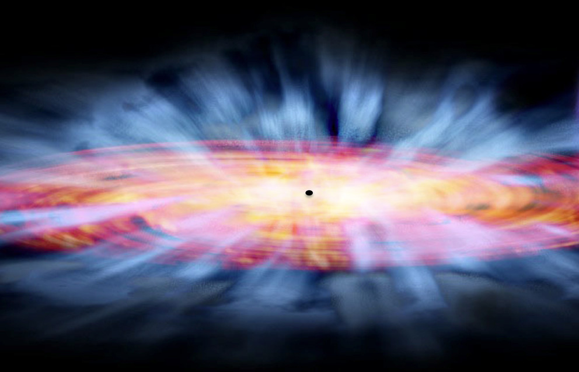
The Cause of Variability in Windy Quasars
Sofia Pasquini
SupervisorS: Dr. Sarah Gallagher, Kaylie Green
NASA/CXC, & Tr’ehnl, N. (2016, March 21). [Artist’s impression of winds from supermassive black hole.]. Record-Breaking Ultraviolet Winds Discovered near Black Hole. https://news.psu.edu/story/398531/2016/03/21/research/record-breaking-ultraviolet-winds-discovered-near-black-hole
Notes:
Good morning everyone! My name is Sofia Pasquini and I have been working with Dr.Gallagher and Ph.D. candidate Kaylie Green here at Western to determine the cause of variability in windy quasars. Without going into too much detail, I will briefly highlight the motivation behind this project and then go into more detail about some of the background theory so that you can have a better understanding about what my work on this project means.

Slide 2
Motivations for My Project
Quasar winds/outflows influence the interstellar medium and star formation rates in host galaxies (Farrah et al. 2012).
Structure and kinematics of central quasar regions remain poorly understood.
NASA/CXC, & Tr’ehnl, N. (2016, March 21). [Artist’s impression of winds from supermassive black hole.]. Record-Breaking Ultraviolet Winds Discovered near Black Hole. https://news.psu.edu/story/398531/2016/03/21/research/record-breaking-ultraviolet-winds-discovered-near-black-hole
Fitting 2 epochs of spectroscopic data from a confirmed variable quasar.
Constrain physical parameters of the gaseous region close to black hole.
Relationship between black hole and evolution of host galaxy.
Notes:
On the right here I have an artists renditions of the winds that are launched from quasars. These winds or outflows are extremely powerful, and are believed to be one of the mechanisms by which quasars interact with and effect their host galaxies, specifically impacting star formation rates.
I will go further into this in a moment, but quasars are extremely difficult to study, so in the context of relevant literature, the structures and kinematics of these outflows are severely understudied and generally poorly understood.
For this project, I have fit 2 epochs of spectroscopic observations of a quasar which is confirmed varying in the time domain. I have done this in order to constrain physical parameters which model the gases in the regions close to the central black hole. By constraining these physical parameters, we can come to better understand this mysterious and exciting relationship between the evolution of the host galaxy and its central black hole.

Slide 3

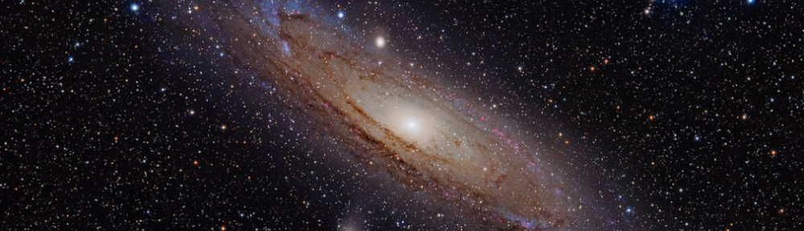
Central supermassive black hole
Star-like light from accretion around black hole
The host galaxy
Bell, E. F. (2017, July 19). The M31 Galaxy [Illustration]. Mapping the Efficiency of AGN Feedback in Galaxies. https://sites.lsa.umich.edu/ericbell/2017/07/19/mapping-the-efficiency-of-agn-feedback-in-galaxies/
Black holes of 10⁶-10^{9.5} Solar Masses at the center of every massive galaxy (Kormendy & Richstone 1995).
Strong relationship between the mass of the central black hole and the size of the host galaxy(Gueltekin et al. 2009)
Notes:
So now let’s take a step back.
At the center of virtually every massive galaxy exists a supermassive black hole which has a mass of around 10^6-10^9.5 Solar Masses! One would expect that given the huge masses of these objects that they would likely have an effect on the galaxy in which they live, and that turns out to be the case; there is a strong positive correlation between the mass of the central black hole and the size of the host galaxy (larger the central black hole, the larger the galaxy). Right away we are seeing that the physical parameters describing the central black hole are coupled with those that describe the host galaxy.

Slide 4

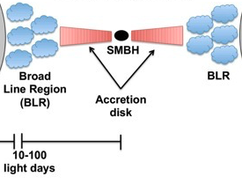
Quasar: extremely luminous object powered by a central supermassive black hole and located at the center of its host galaxy
NASA/CXC, & Tr’ehnl, N. (2016, March 21). [Artist’s impression of winds from supermassive black hole.]. Record-Breaking Ultraviolet Winds Discovered near Black Hole. https://news.psu.edu/story/398531/2016/03/21/research/record-breaking-ultraviolet-winds-discovered-near-black-hole
Central regions cannot be spatially resolved
Spectroscopy!
Adapted from : Ricci. (n.d.). [Typical structure (not to scale) of an AGN]. Active Galactic Nuclei. http://www.isdc.unige.ch/~ricci/Website/Active_Galactic_Nuclei.html
Notes:
A quasar is a very luminous object that is powered by a central black hole. There is an artists rendition of a quasar in the top left, and on the right we see a cartoon cross-section of the structural components of a quasar. The central black hole is surrounded by a disk of swirling gas infalling towards the black hole, as well as what are believed to be systems of clouds known as the Broad Line Regions. I am particularly interested in the BLR.
Quasars in general exist in the early Universe, so very far away from us, which makes it very difficult to study them in detail. We cannot spatially resolve these objects, so we turn to spectroscopy ( analyzing the light from these objects) in order to study them.

Slide 5
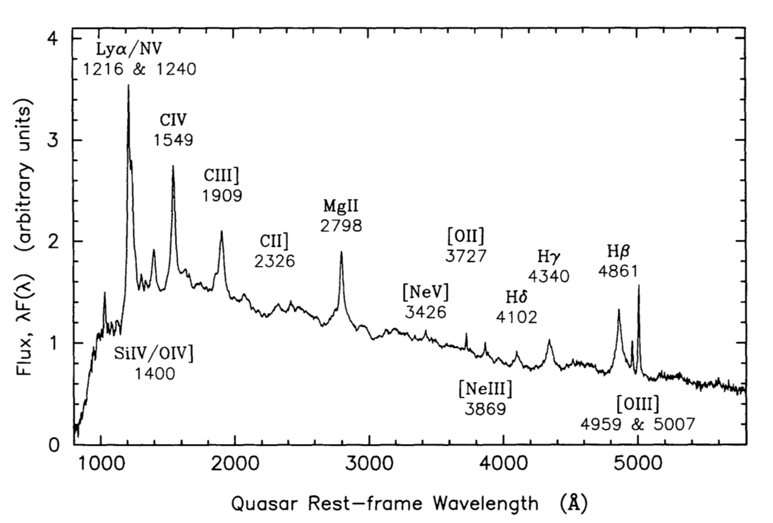
Typical Quasar Spectrum
Broad emission lines
Light from the accretion disk passes through gas/other material which changes it.
Gives us clues about the physical conditions of the material the light travelled through.
“A snapshot in time.”
Light from accretion disk
Francis et al. 1991. A composite quasar spectrum.
Notes:
For those of you who are unfamiliar with spectroscopy, it is based on the premise that light passing through a given medium will change in some characteristic way based on the physical conditions of the medium. Here I have an example of what a typical spectrum from a quasar might look like. It is a plot of the energy of the light received as a function of wavelength. We see the light from the accretion disk as this kind of power law pattern, which is referred to as the continuum, and then based on the physical conditions of the gases/other material through which the light travels, we might see emission or absorption features such as the ones I have highlighted above. This is a snapshot in time of some of the physical conditions observed for that quasar in the instant where the light we received began its journey to us.

Slide 6
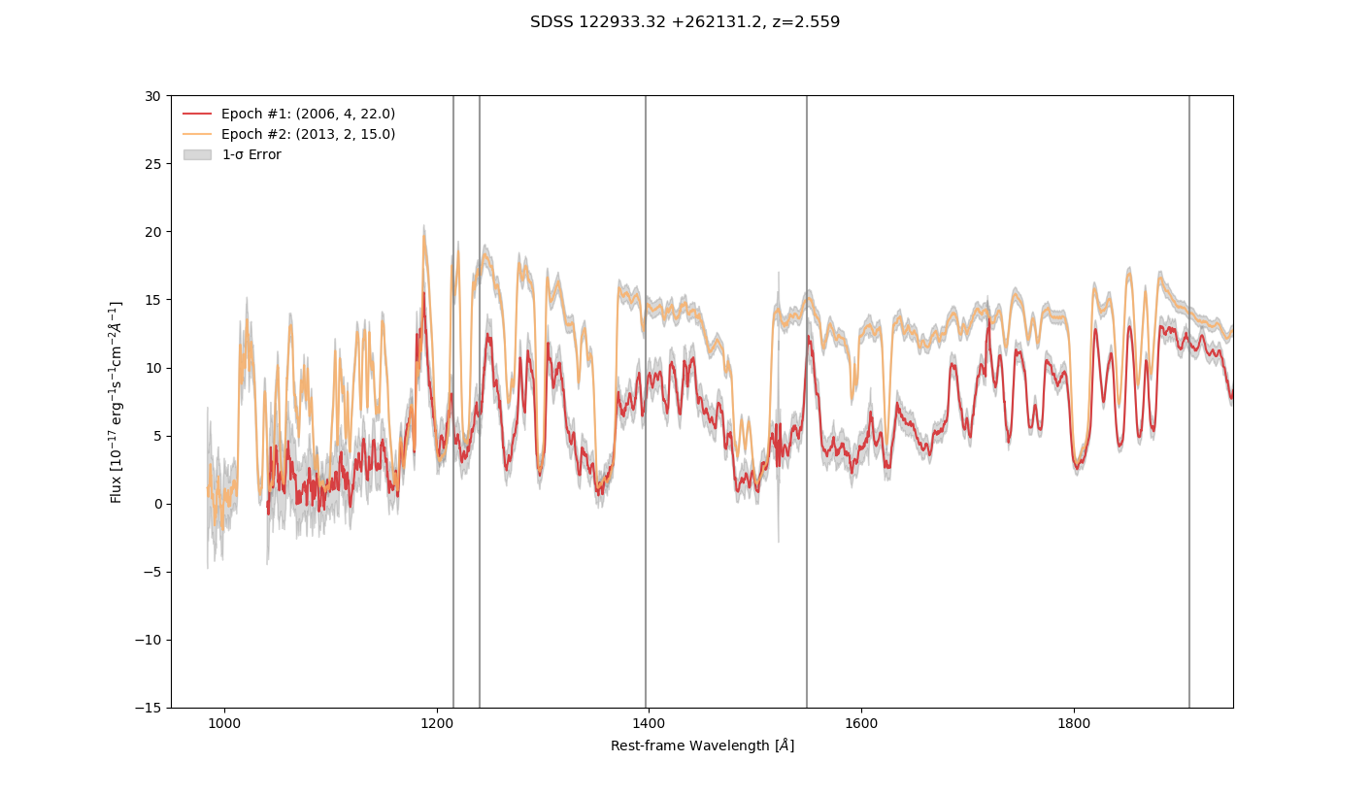

Quasar Variability
February 2013
N V
Ly⍺
C IV
C III
Si IV
April 2006
Notes:
Lets consider going on vacation, and coming home and showing our friends all the photos we took. We likely want to show them the entire album, not just one photo, because we want them to see the entire experience we had! In the same way that individual snapshots from our vacations make up entire, longer-term experiences we want to remember, multiple spectra from quasars or other objects that are changing in time are like snapshots which altogether tell a bigger story about the processes at large in the quasars/objects we observe. Here I have included the two spectra for the quasar I am studying. The first night this object was observed was on April 22, 2006 and the spectrum looked like the one in red, and then when it was observed again about 7 years later on February 15, 2013, it looked like the one in orange. Clearly something interesting is going on here, we can see that the light from this object has significantly changed in time.

Slide 7
Broad Absorption Lines…Winds!
N V
Ly⍺
C IV
C III
Si IV
Broad Absorption Lines
Notes:
In purple here I have highlighted some prominent featues in the spectrum that are very broad and deep absorption lines. These lines are due to the winds launched from the inner regions of quasras that I mentioned earlier, as gas in the accretion disk around the central black hole is spiraling inwards, it is actually so hot and emitting such intense radiation that it actually pushes surrounding matter away, launching it at CRAZY FAST speeds of tens of thousands of kilometers per second away from the host galaxy’s center. It is by this mechanism that these quasrs are believed to effect their host galaxies. So by analysing these broad absorption lines, we can directly probe these powerful outflows.

Slide 8
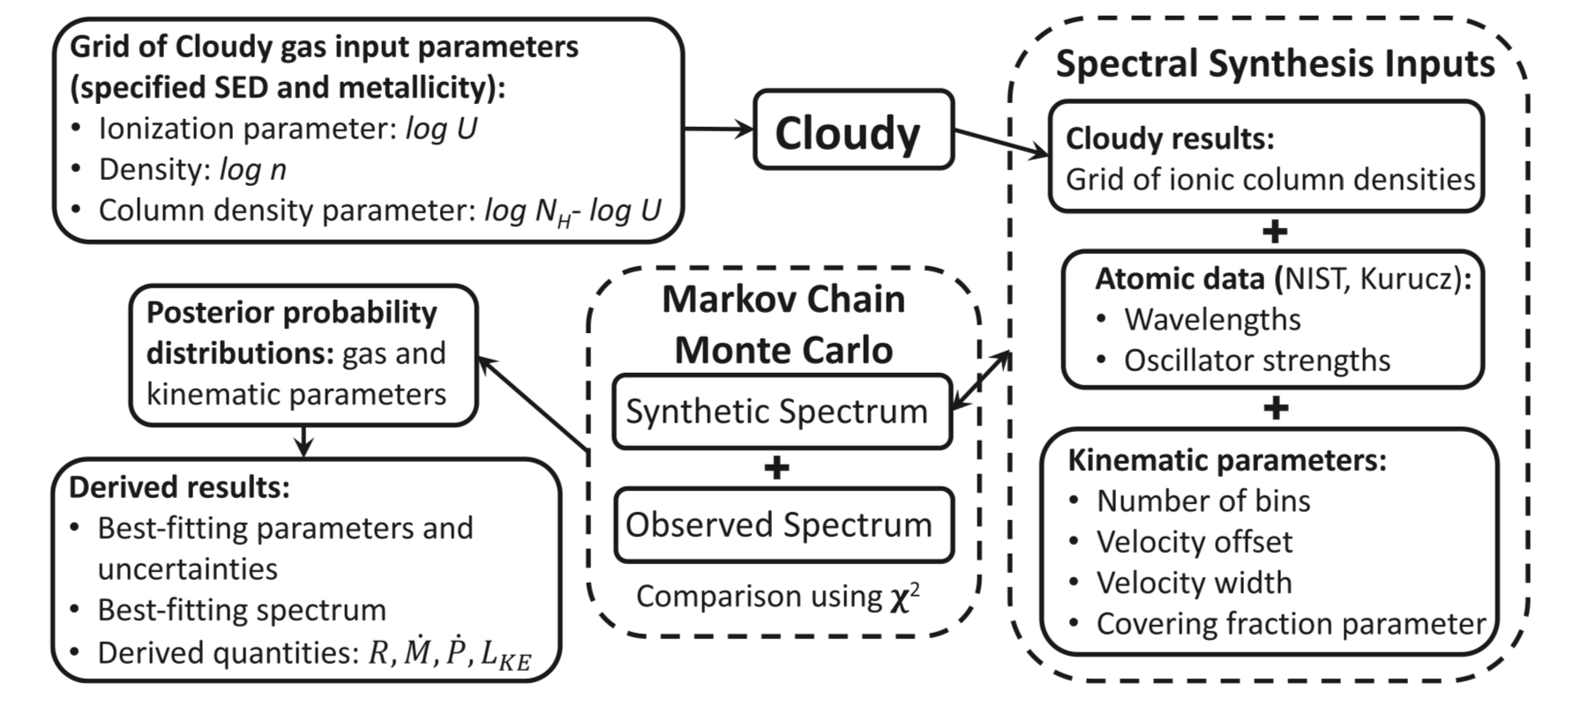
simBAL- Analyzing Broad Absorption Lines
Leighly et al. 2018. SimBAL analysis flow-chart.
Notes:
I now want to introduce to you simBAL, which is a new spectral analysis software that I am using to fit my spectra. Here I have included a flow-chart of the way simBAL works. Essentially, you begin with you best guess at what you believe the model to look like, and simBAL then generates a synthetic spectrum, and compares it with the real spectrum using a Markov Chain Monte Carlo algorithm. It goes back and forth like this until it agrees on the best model for your data, from which you can derive physical quantities describing your outflow. All of this computing certainly could not be done on my Macbook, and so I have been using SHARCNET, which is essentially a large – the largest in Canada in fact, array of high performance computing systems.

Slide 9
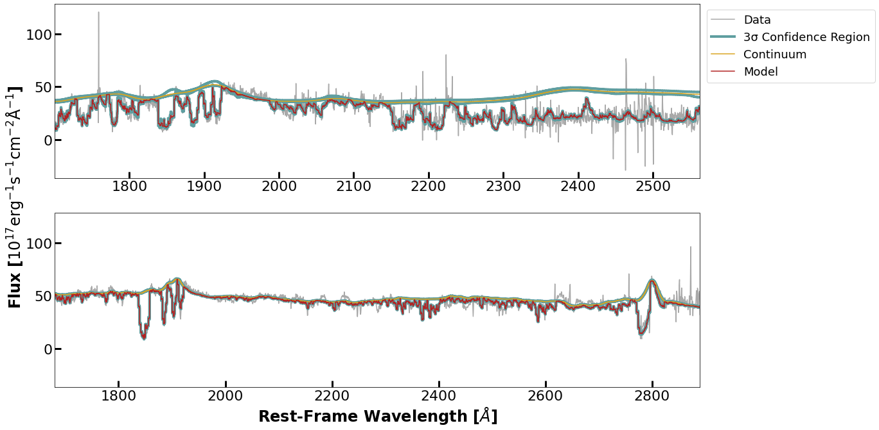
Best-Fitting Spectral Models
Epoch A – 04/22/2006
Epoch B – 02/15/2013

Slide 10
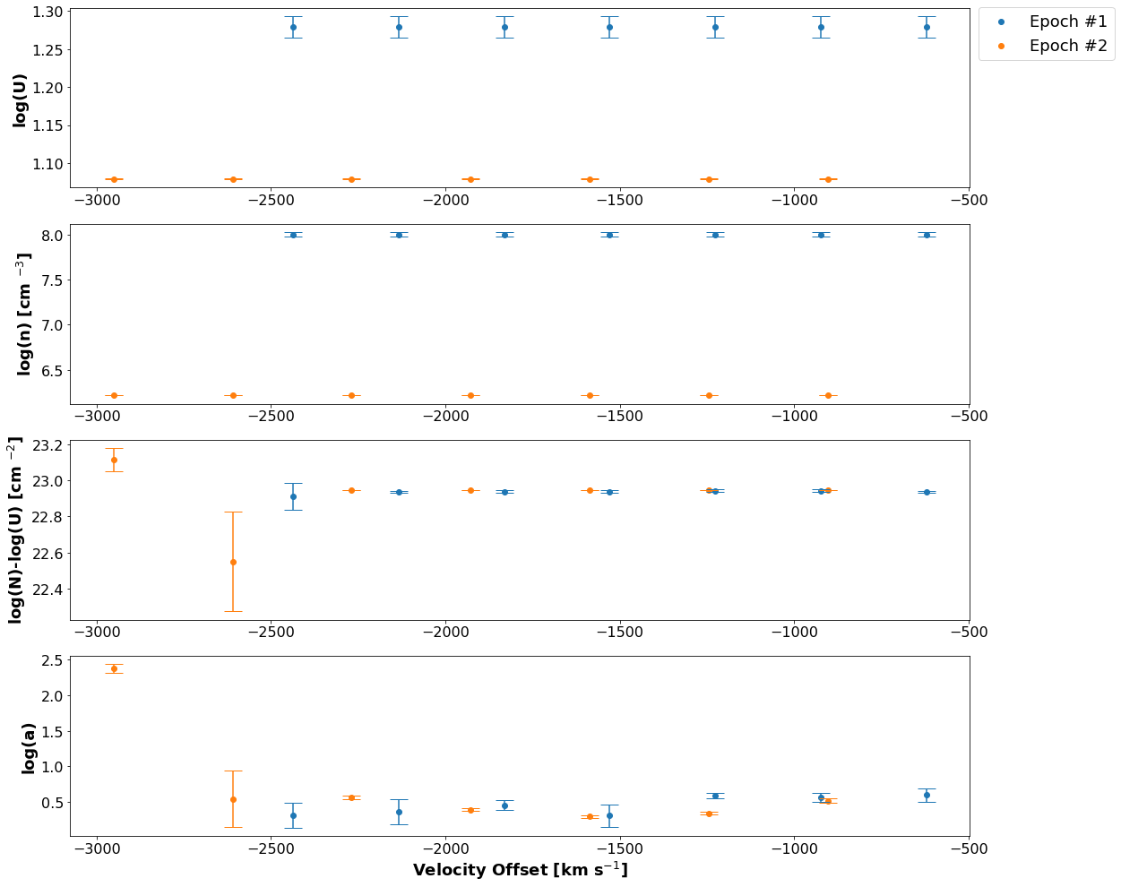
Ionization Parameter
Density
Column Density
Covering Fraction

Slide 11

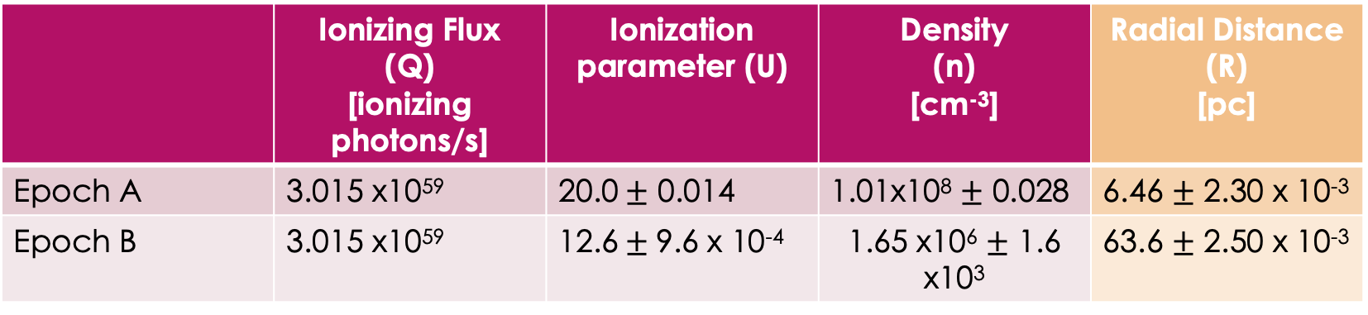
Radius Calculation $U=\frac{Q}{4πR^{2}nc}$
 | Ionizing Flux (Q) [ionizing photons/s] | Ionization parameter (U) | Density (n) [cm⁻³] | Radial Distance (R) [pc]
Epoch A | 3.015 x10⁵⁹ | 20.0$±$ 0.014 | 1.01x10⁸ $±$ 0.028 | 6.46 $±$ 2.30 x 10⁻³
Epoch B | 3.015 x10⁵⁹ | 12.6$±$9.6 x 10⁻⁴ | 1.65 x10⁶ $±$ 1.6 x10³ | 63.6 $±$ 2.50 x 10⁻³
A change of about 57 parsecs in just under 2 years (1.86 years in quasar rest-frame)!
Quick Conversion: 57 parsecs $≅$ 1.8 x 10¹⁵ km!

Slide 12
Summary of Findings
Successfully fit spectra for two epochs of observations of variable quasar SDSS J122933.32+262131.2 .
Extracted best-fit parameters from SimBAL output; ionization parameter, density, column density, covering fraction index, velocity offset, etc.
Used extracted best-fit parameters to constrain the physical location of the outflow with respect to the central SMBH; a dynamical model.

Slide 13
Future Work
Verify the ”best-fit” model
Further qualitative outflow property calculations
Mass-loss rate
Momentum
Energy
Complete the large-scale dynamical model
Thank you for your attention!

