Slide 1
PCB 24wells
Sofia Peressotti
DSM collaboration

Slide 2
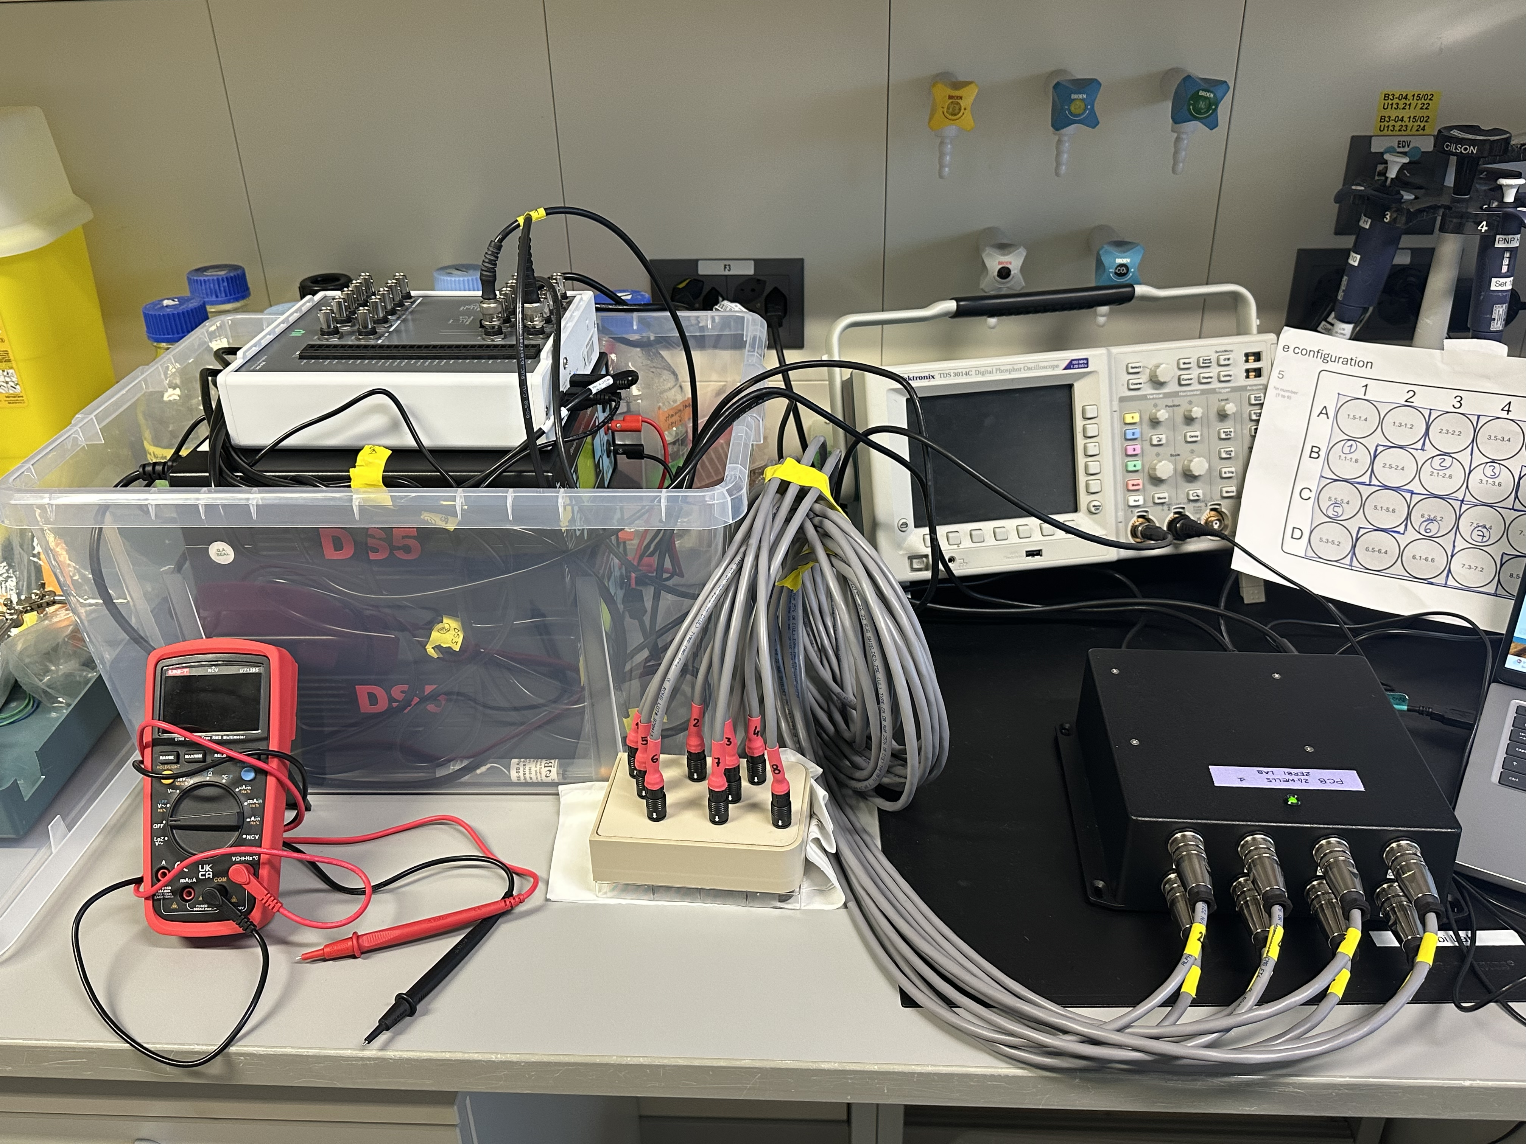
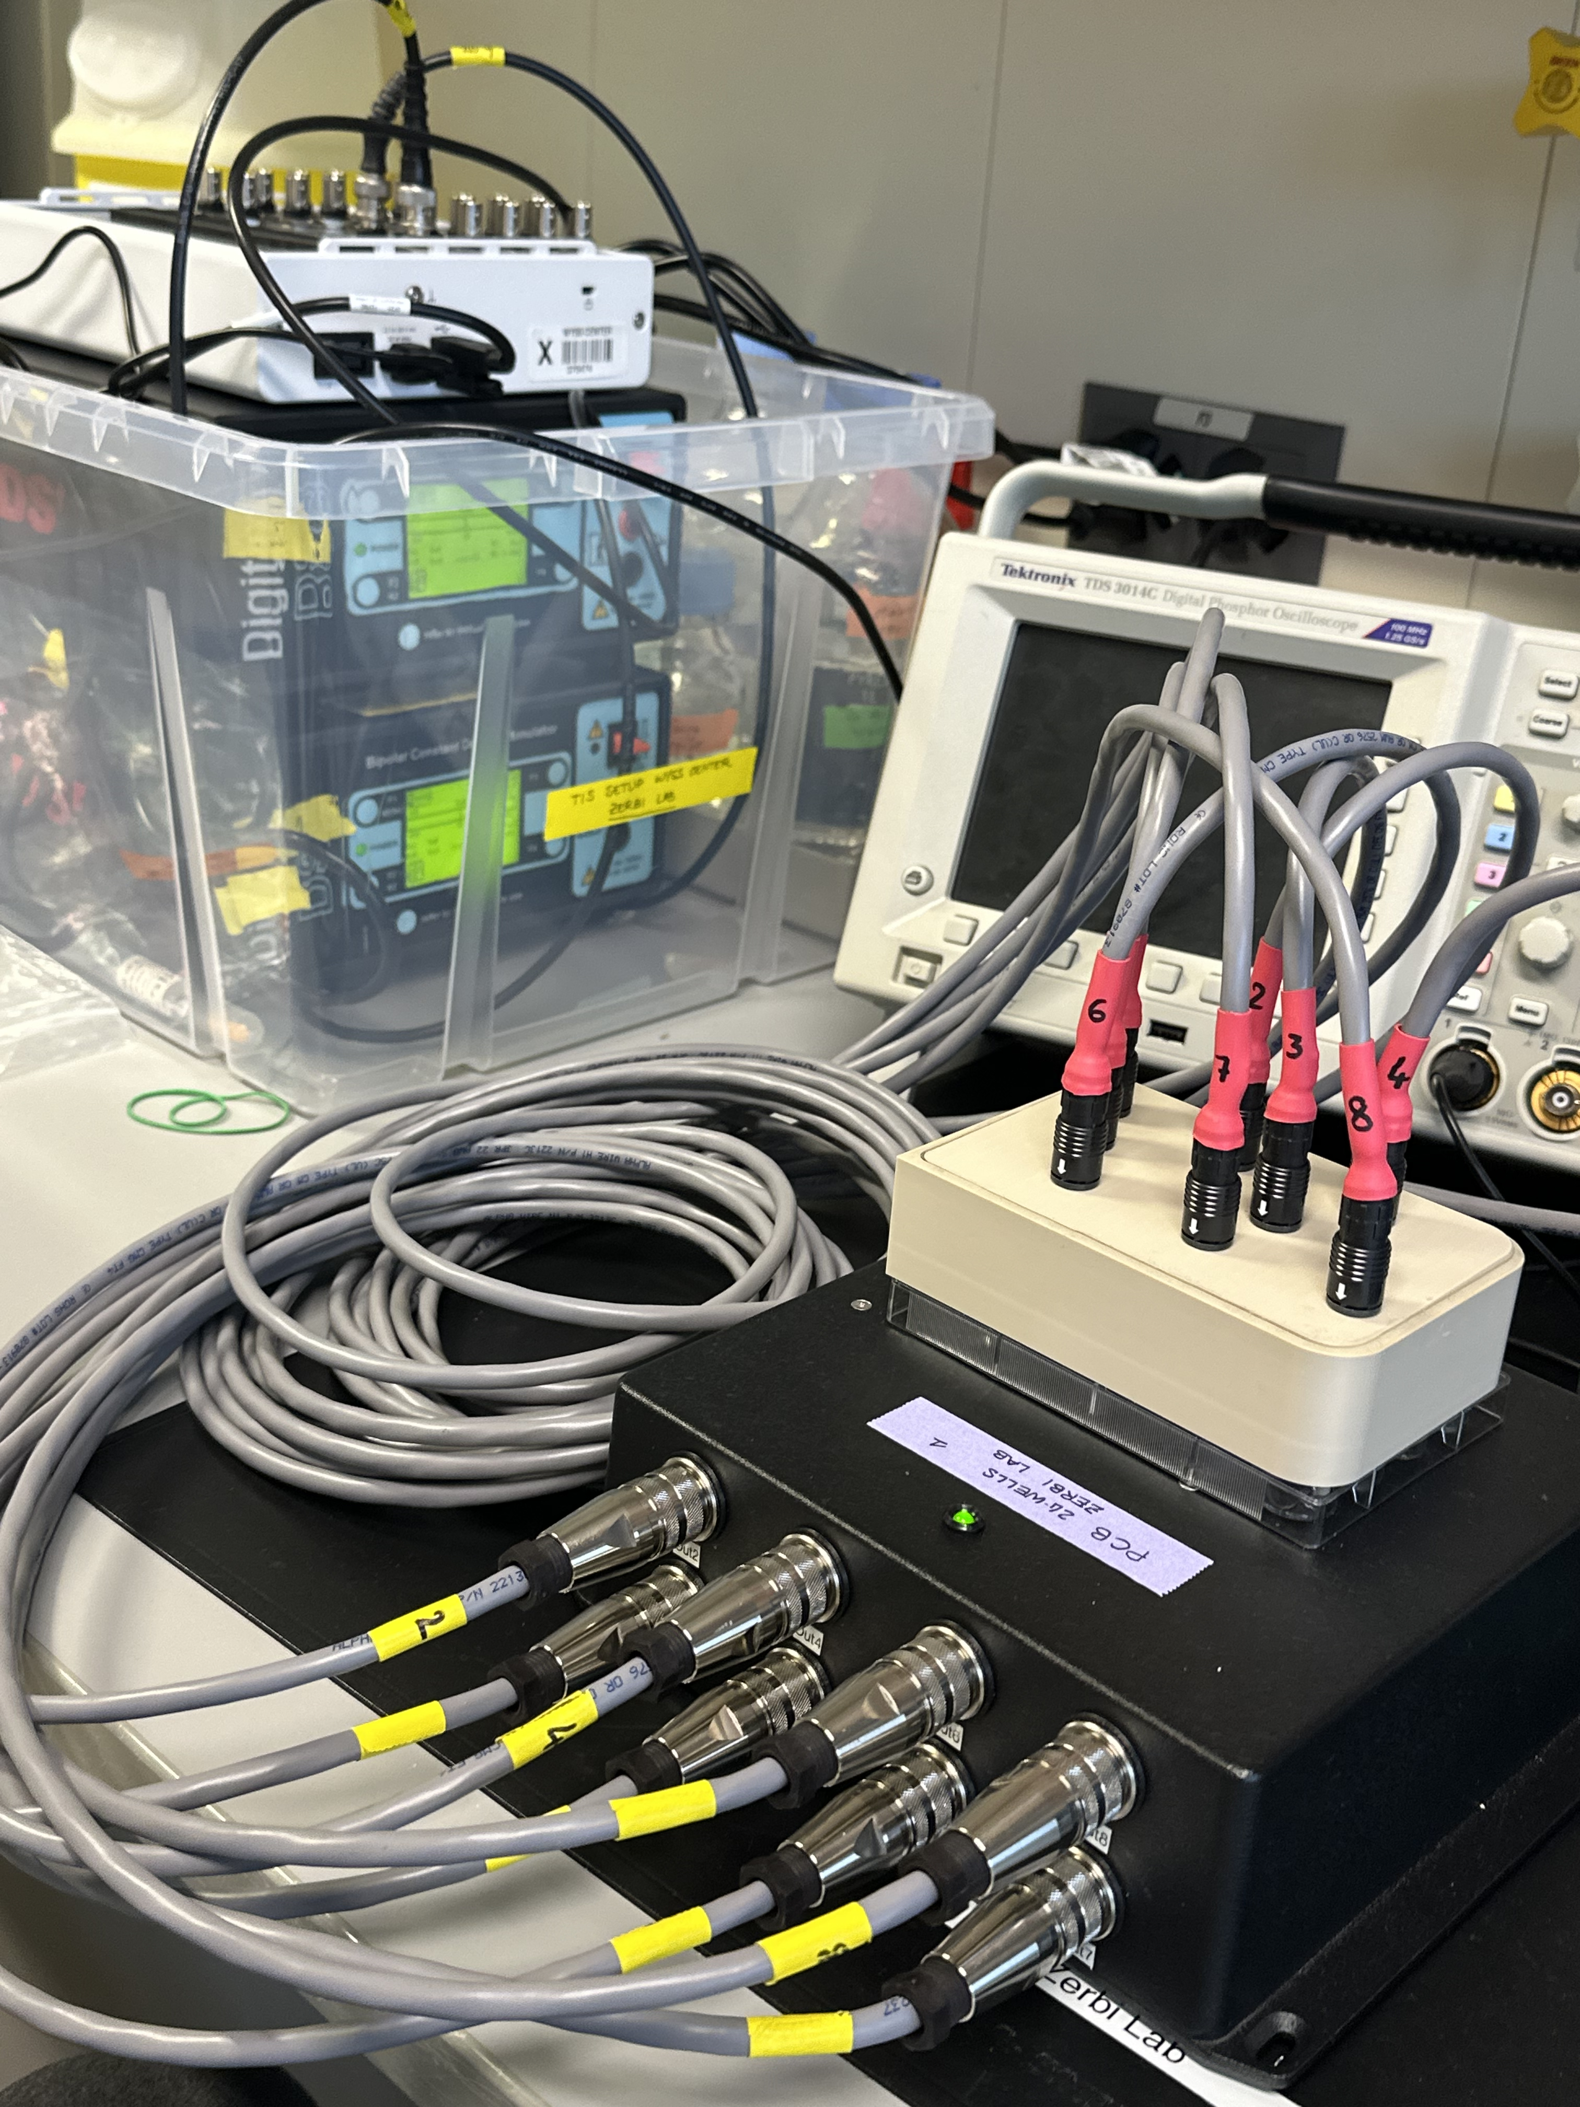
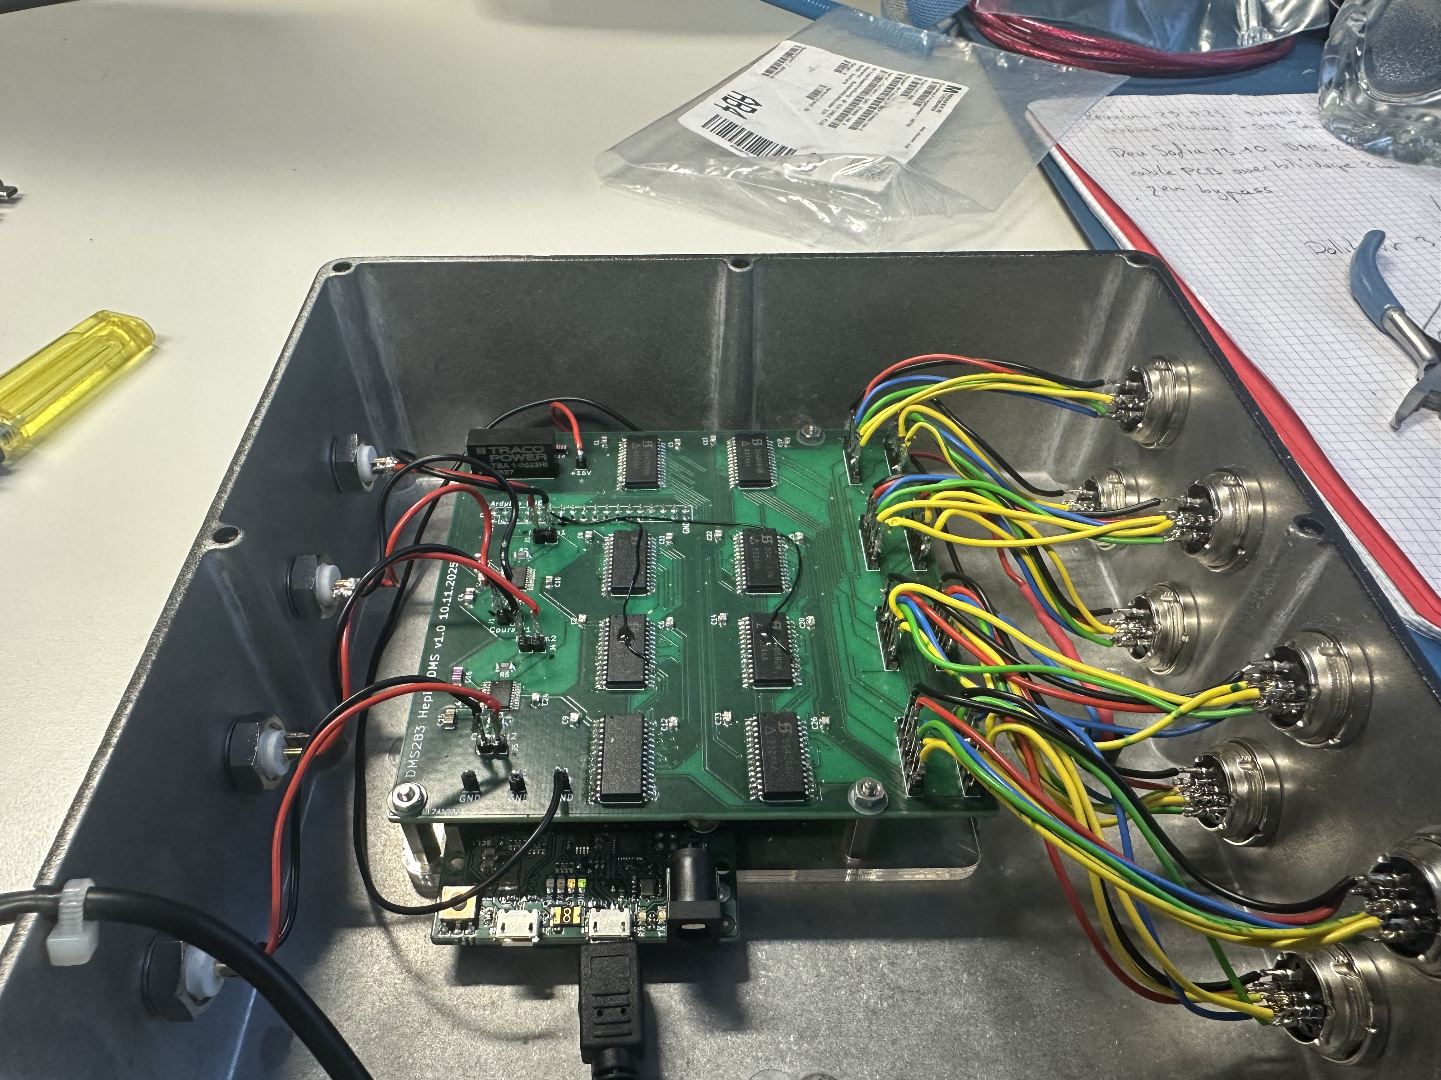

Slide 3
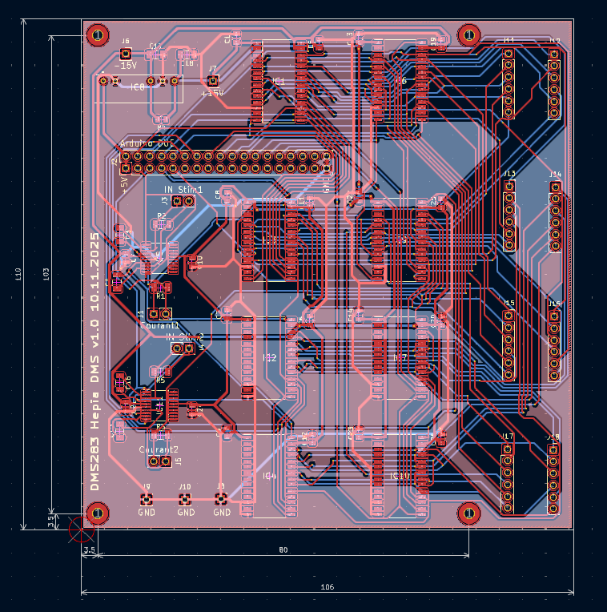
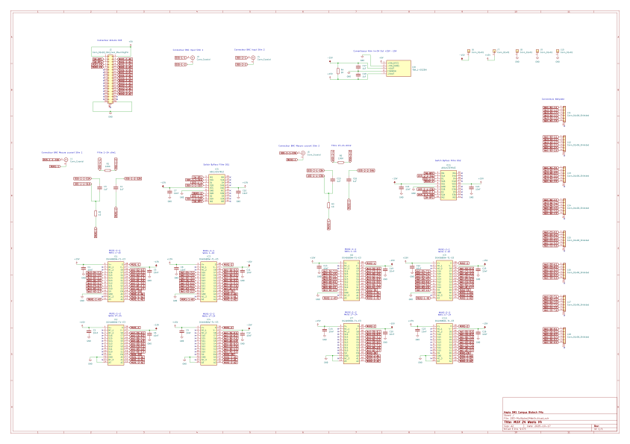
PCB desgin
PHASE 1.2
Setup and Characterization
Specs:
24 channels
Can be connected to 1 or 2 stimulators (DS5s in this case but it’s flexible)
0-16 mA, 1-
Current and voltage can be measured for each well using an external differential oscilloscope
A filter is applied to remove DC offset (but can be switched on and off) with the capacitors and a 100kohm leakage resistors is there for discharges of the capacitors and potential current leakages

Slide 4
PHASE 1.2
Setup and Characterization

Slide 5
EIS results
AUTOLAB LSBI
14.01.26

Slide 6
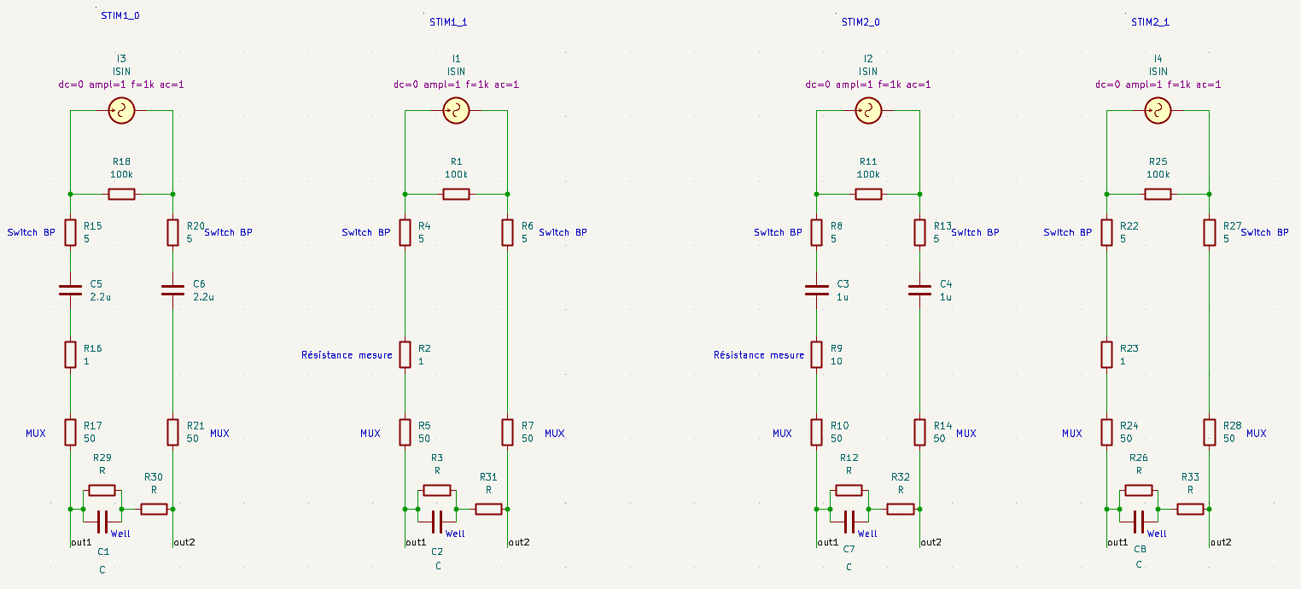
The circuit

Slide 7
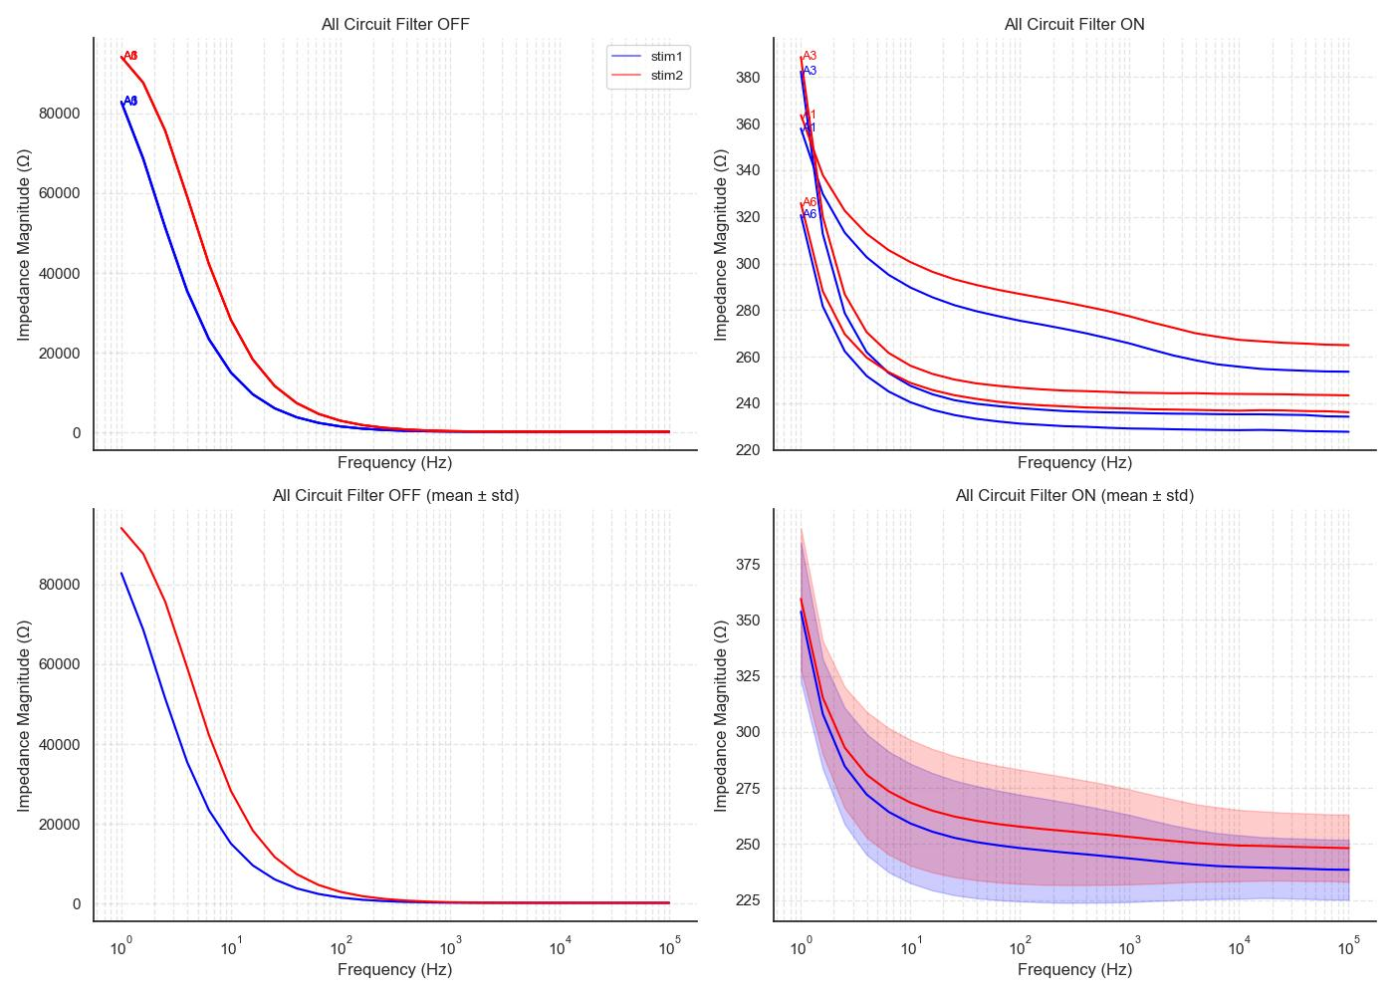
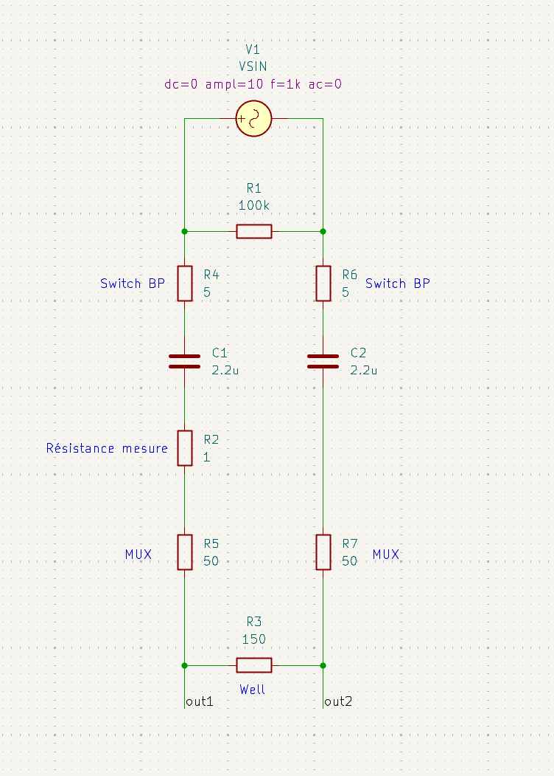
All circuit - impedance

Slide 8
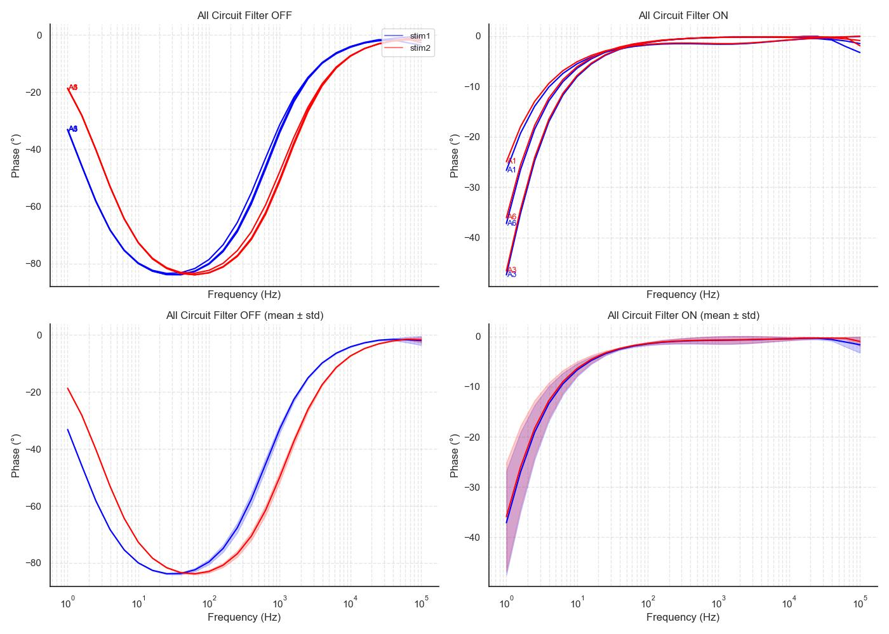
All circuit - phase

Slide 9
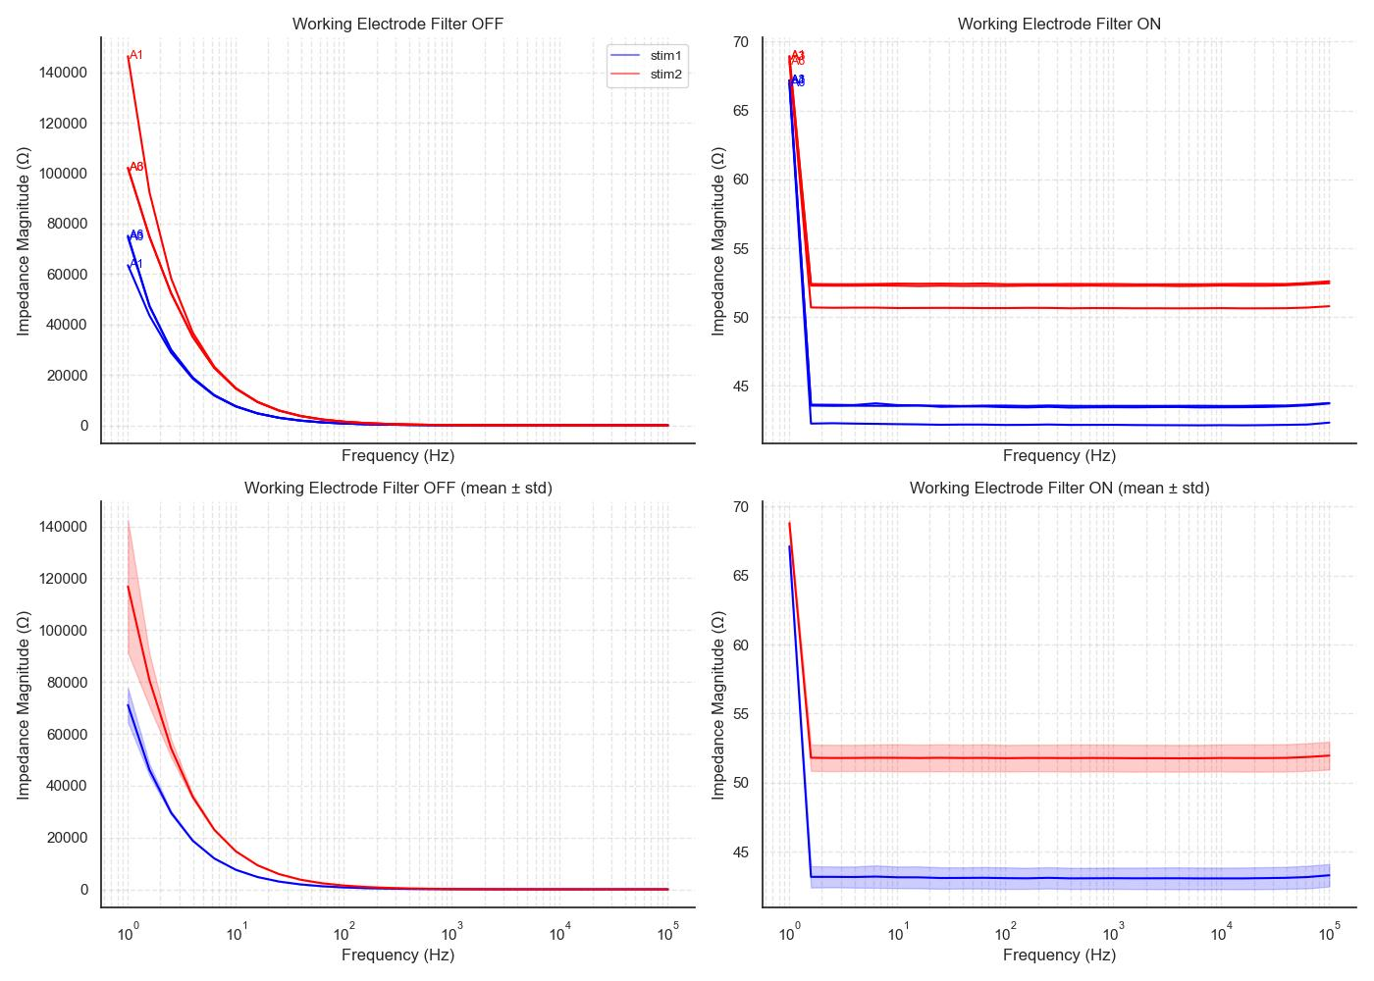
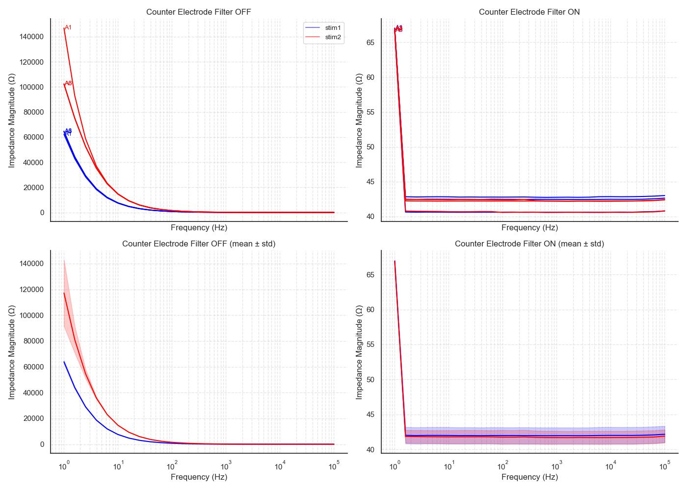
Single arm - Impedance
Stim1
C=2.2 uF, R2 = 1 ohm
Stim2
C=1 uF, R2 = 10 ohm
Working electrode (+)
Counter electrode (-)

Slide 10
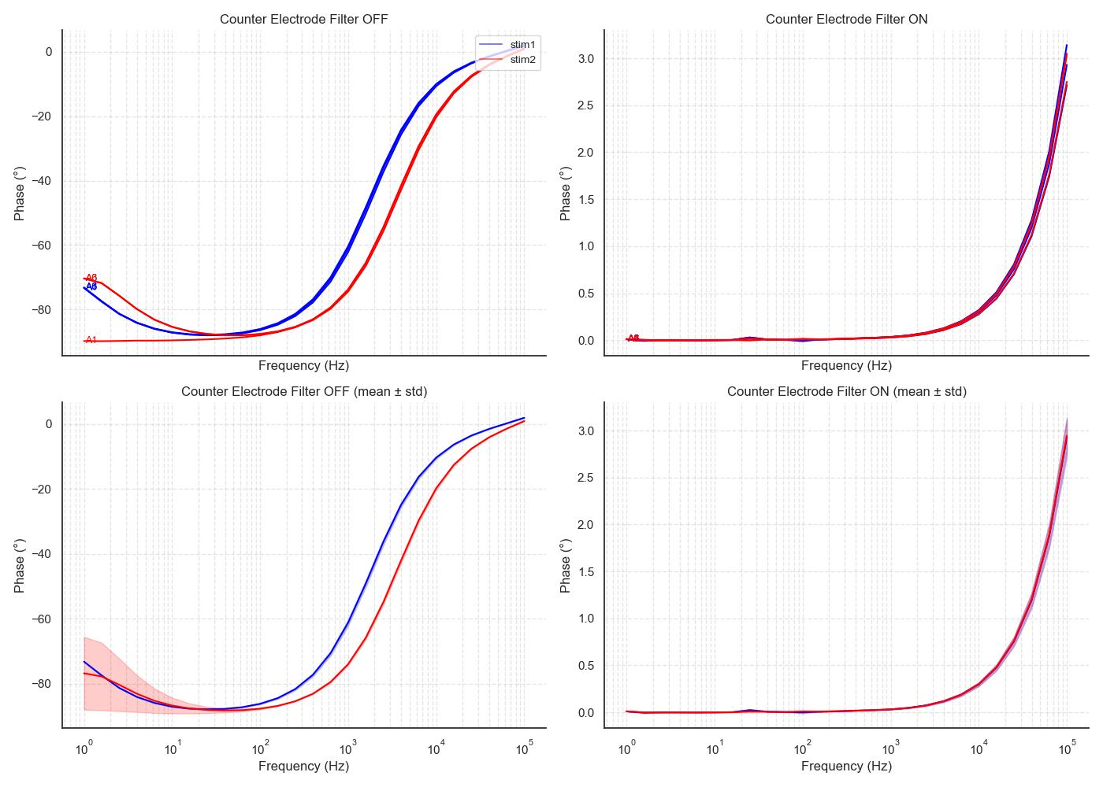
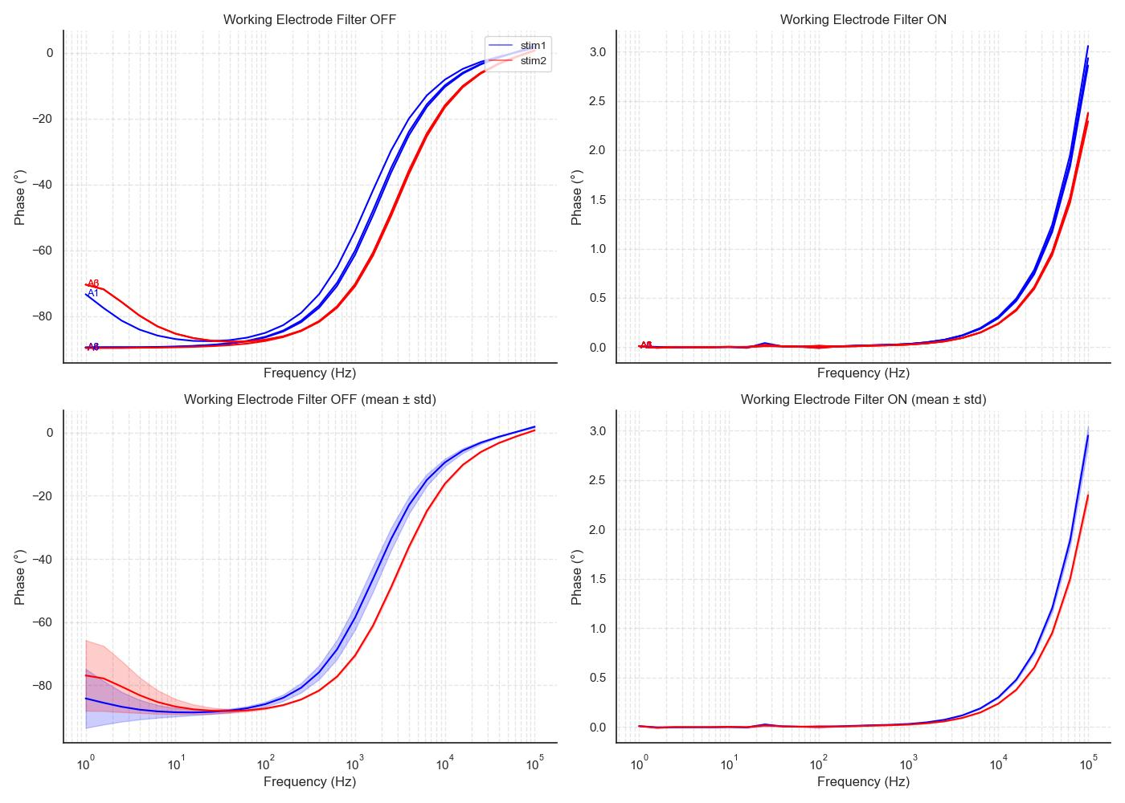
Single arm - Phase
Stim1
C=2.2 uF, R2 = 1 ohm
Stim2
C=1 uF, R2 = 10 ohm
Working electrode (+)
Counter electrode (-)

Slide 11
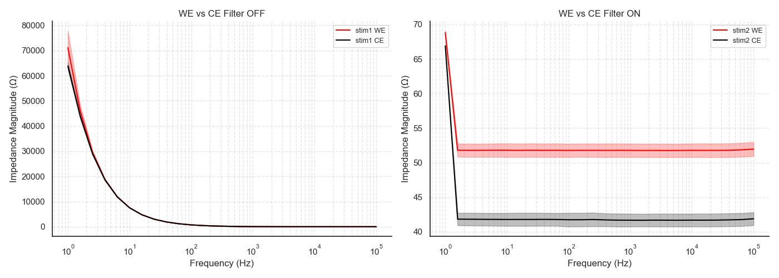
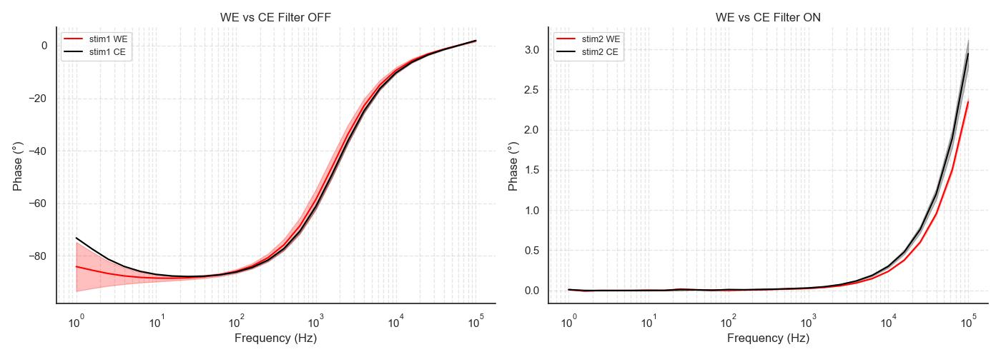
WE vs CE
Stim1
C=2.2 uF, R2 = 1 ohm
Stim2
C=1 uF, R2 = 10 ohm
Stim1
Stim2

Slide 12
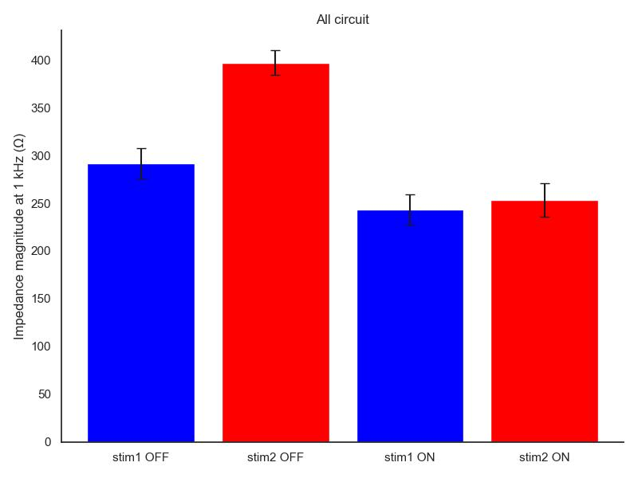
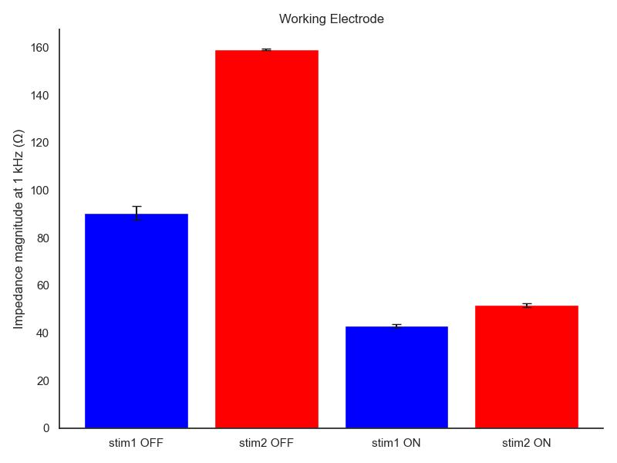
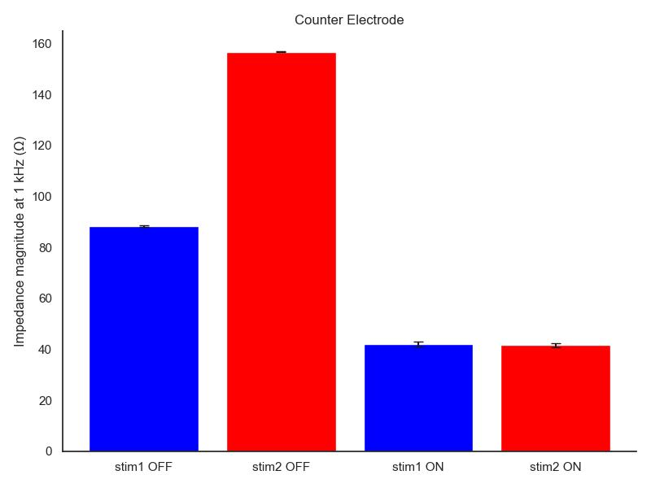
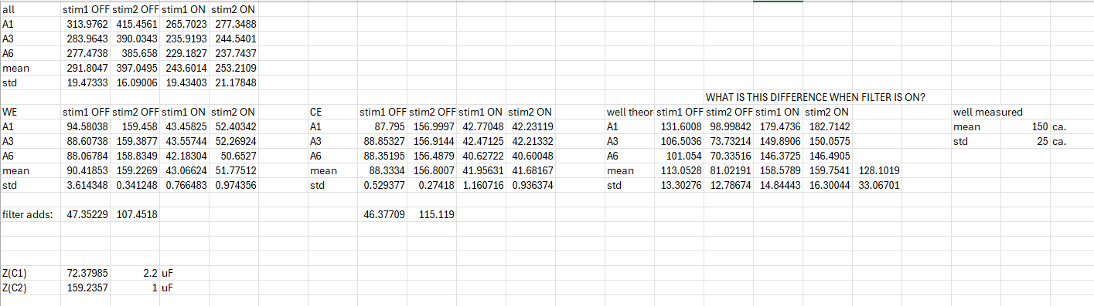
Values @ 1 kHz
Stim1
R2 = 1 ohm
Stim2
R2 = 10 ohm
All circuit
Working electrode (+)
Counter electrode (-)
With (actual)
filter ON
Well impedance:
Stim1: 113.1 ohm
Stim2: 81.0 ohm
With (actual)
filter OFF
Well impedance:
Stim1: 158.6 ohm
Stim2: 159.8 ohm

Slide 13
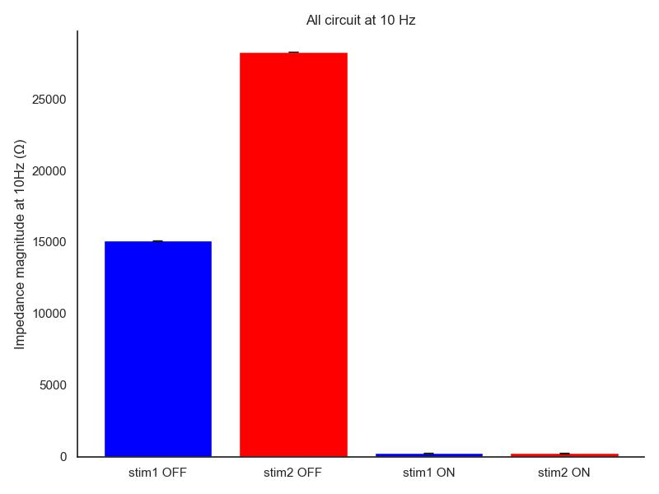
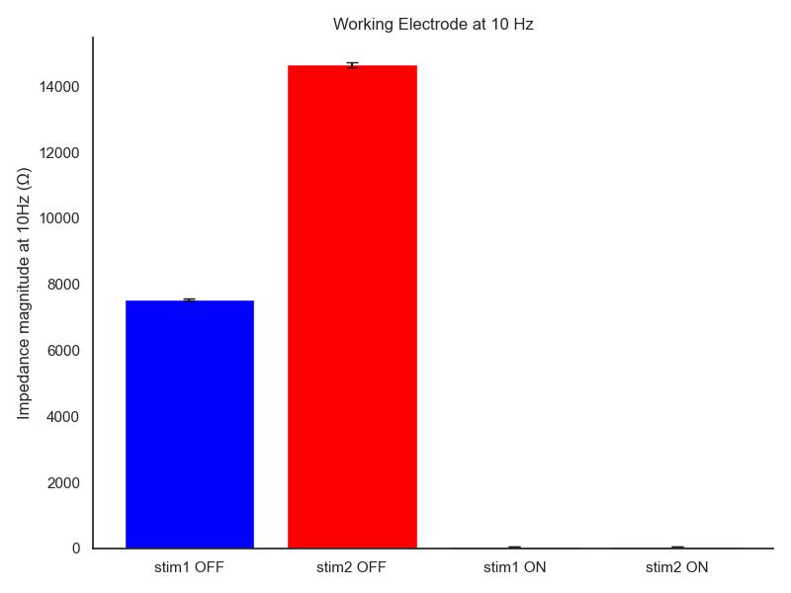

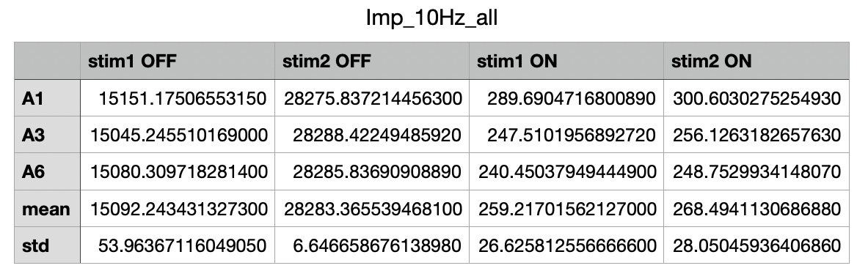
Values @ 10 Hz
Stim1
R2 = 1 ohm
Stim2
R2 = 10 ohm
All circuit
Working electrode (+)
Counter electrode (-)
With (actual)
filter ON
Well impedance:
Stim1: 113.1 ohm
Stim2: 81.0 ohm
With (actual)
filter OFF
Well impedance:
Stim1: 158.6 ohm
Stim2: 159.8 ohm

Slide 14
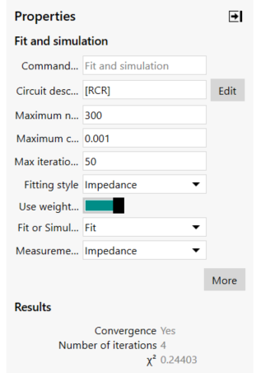
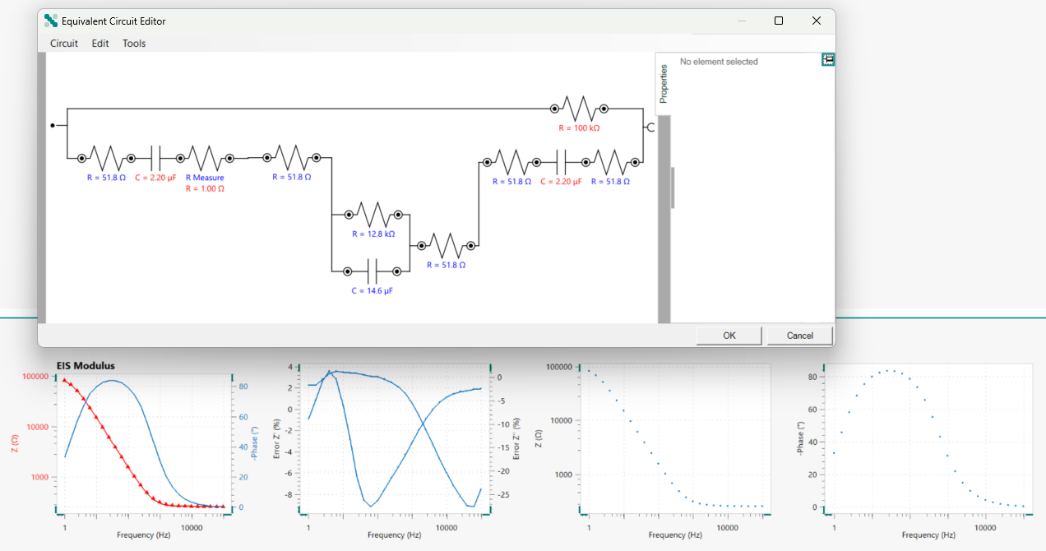
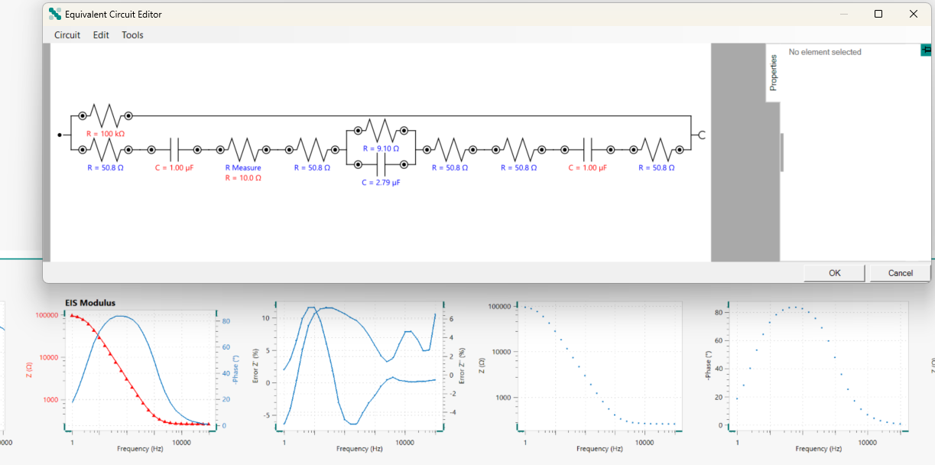
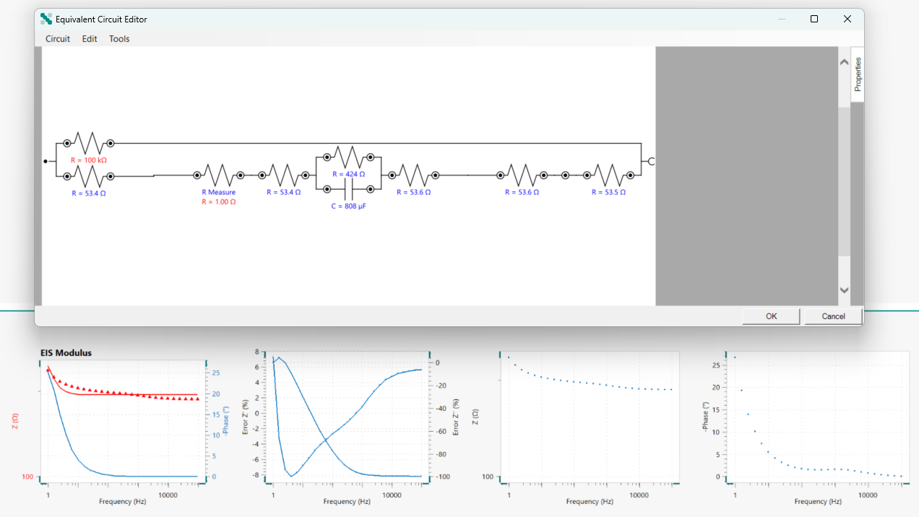
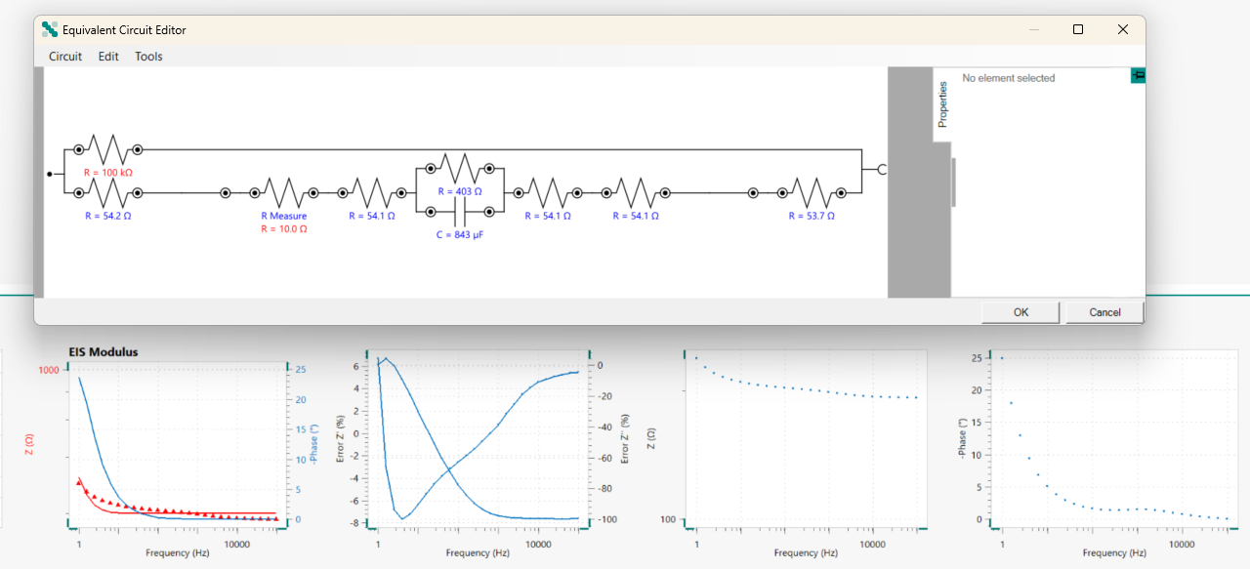
Fit and simulation(Autolab) – all circuit, well: A1
Stim1_0 – A1
Stim2_0 – A1
Stim1_1 – A1
Stim2_1 – A1

Slide 15
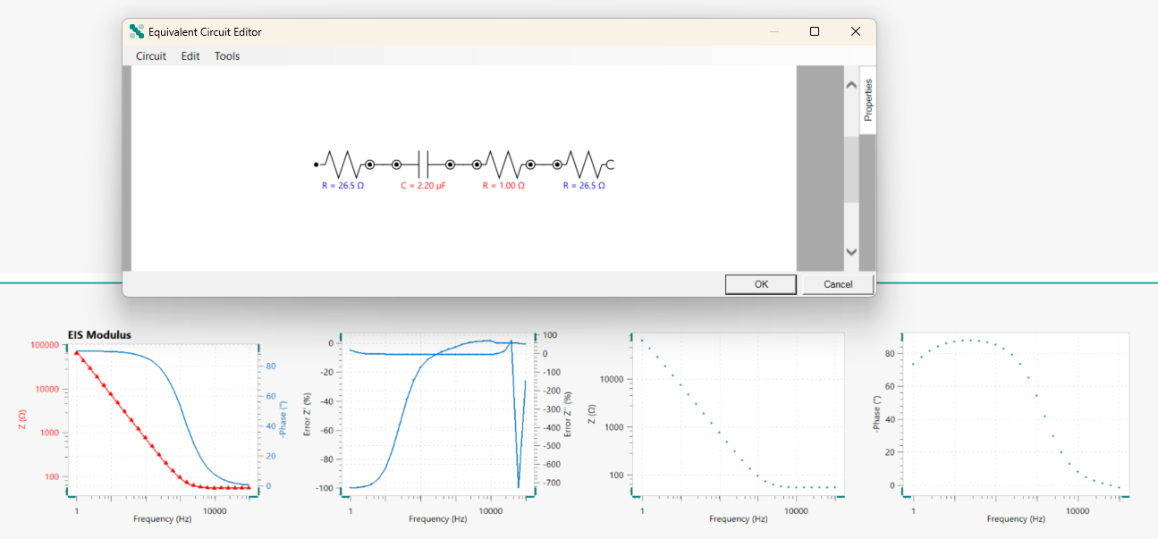
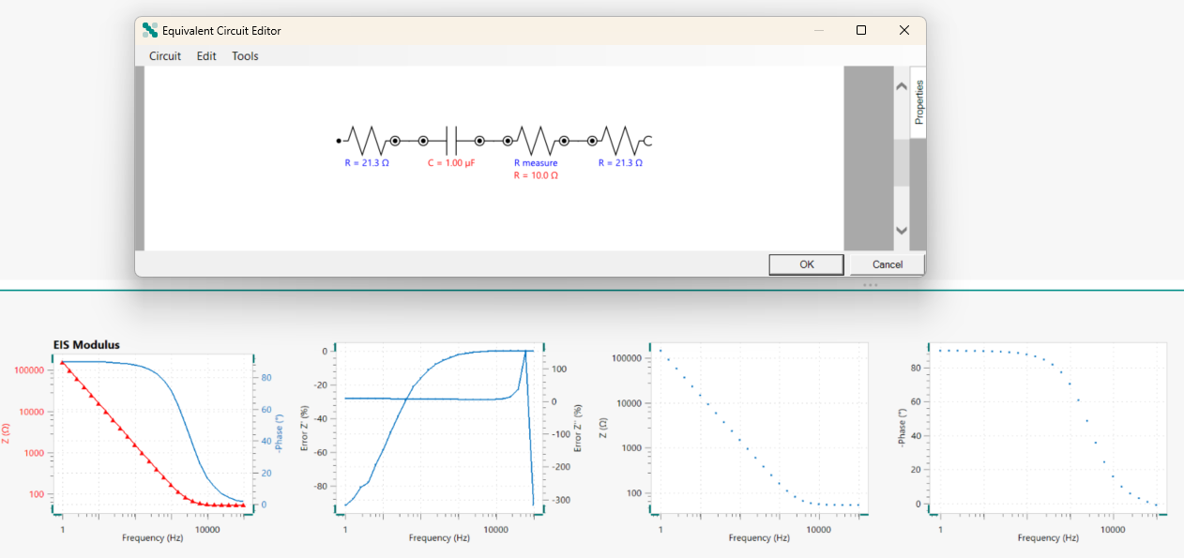
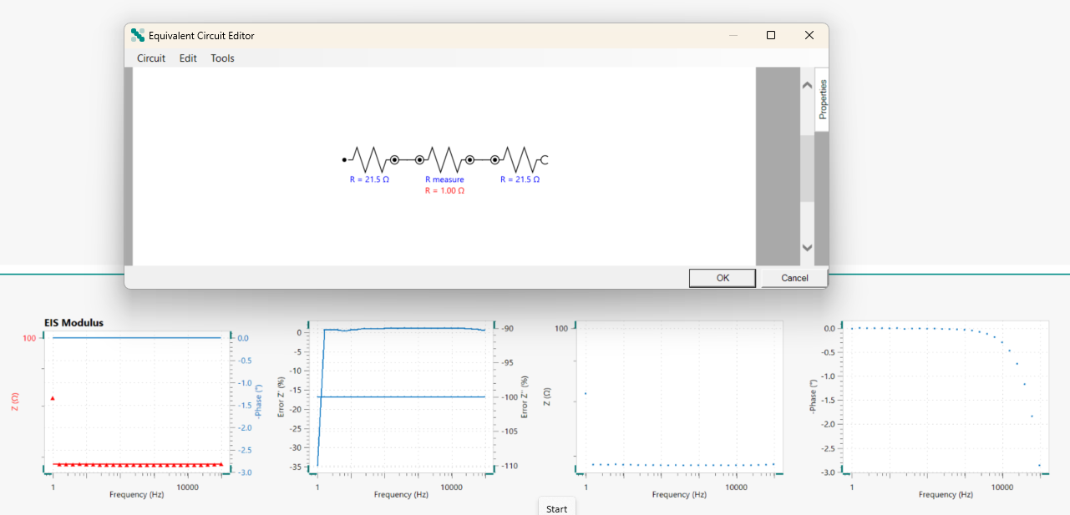
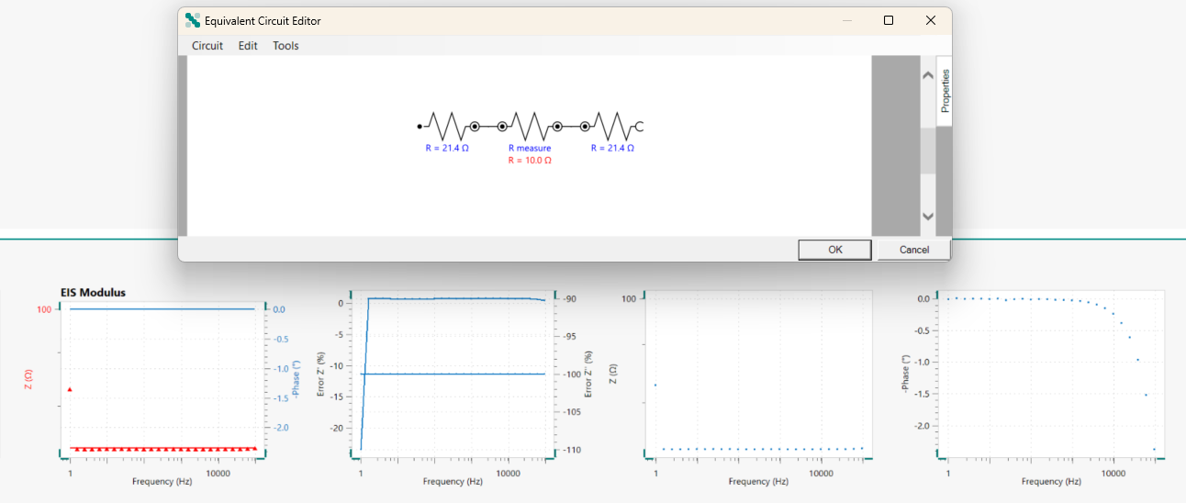
Fit and simulation(Autolab) – WE arm, well: A1
Stim2_0 – A1
Stim1_0 – A1
Stim1_1 – A1
Stim2_1 – A1

Slide 16
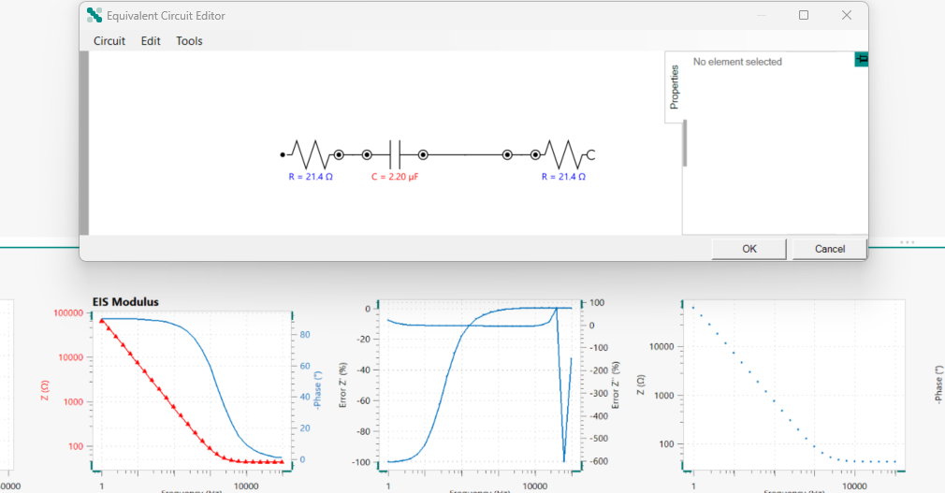
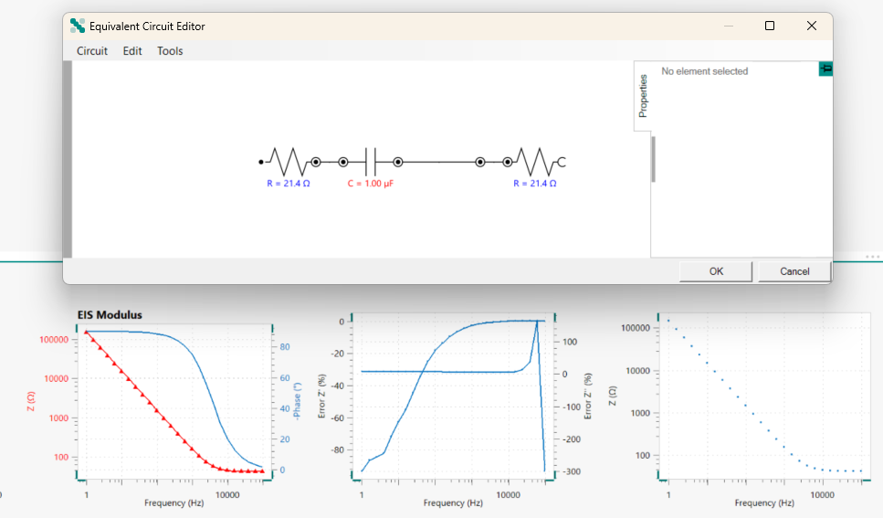
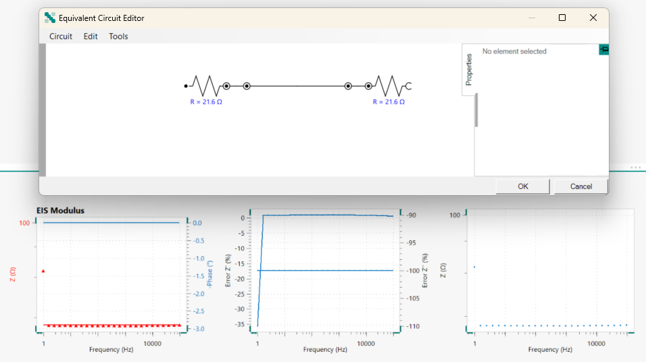
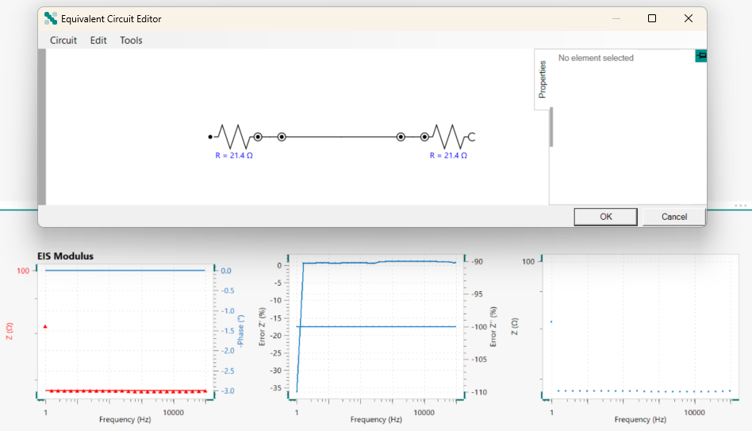
Fit and simulation(Autolab) – CE arm, well: A1
Stim1_0 – A1
Stim2_0 – A1
Stim1_1 – A1
Stim2_1 – A1

Slide 17
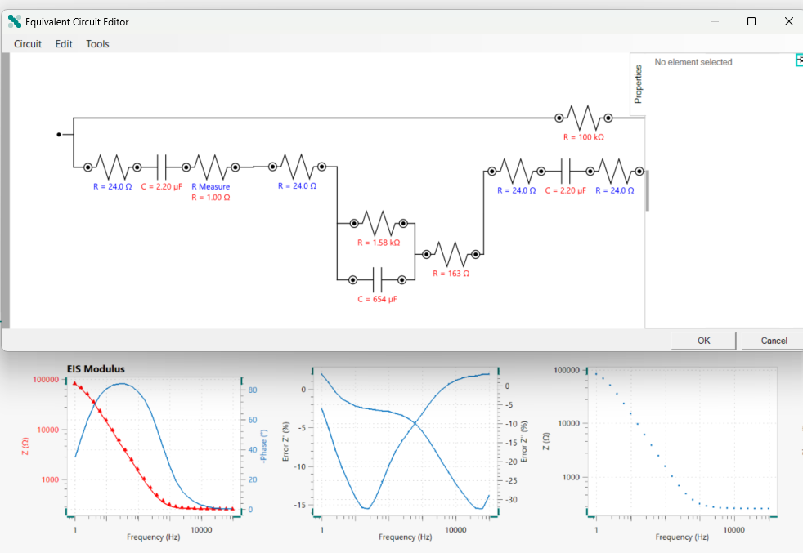
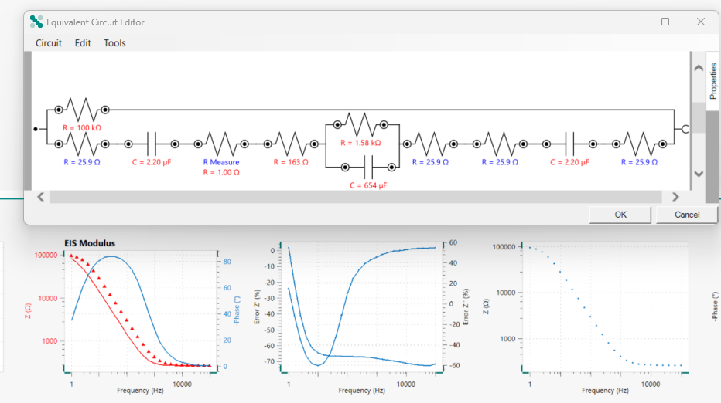
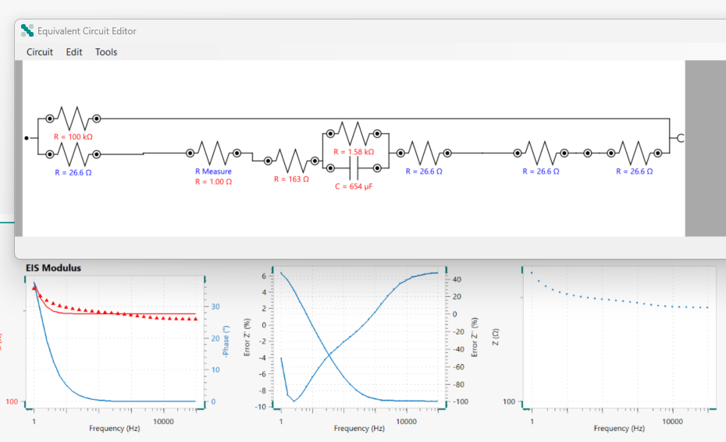
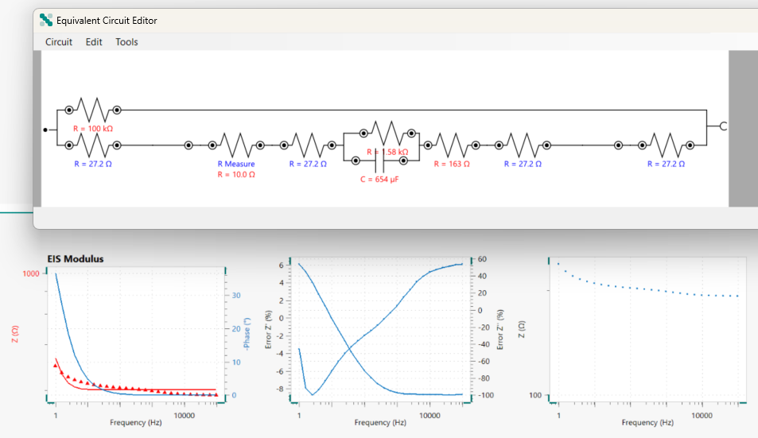
Circle fit (Autolab) – all circuit, well: A1 FIXED
Rcomponent:
24.0x4=96
25.9x4=103.6
26.6x4=106.4
27.2x4=108.8
Avg=103.7 ohm
From single arm: 21.4x4=85.6 ohm
MUX: 50ca.x2
IC6: 5 ca. x2
Expected: 110 ohm
Stim1_0 – A1
Stim2_0 – A1
Stim1_1 – A1
Stim2_1 – A1

Slide 18
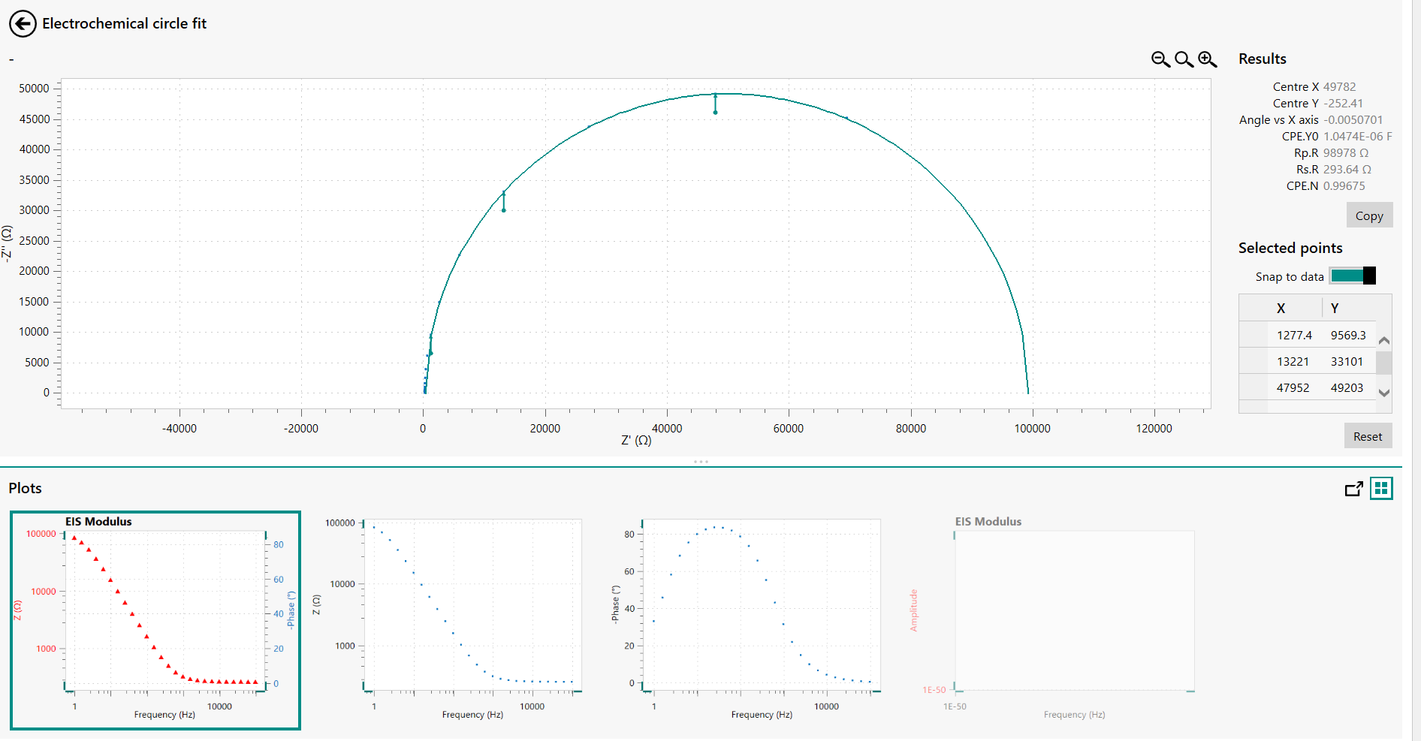
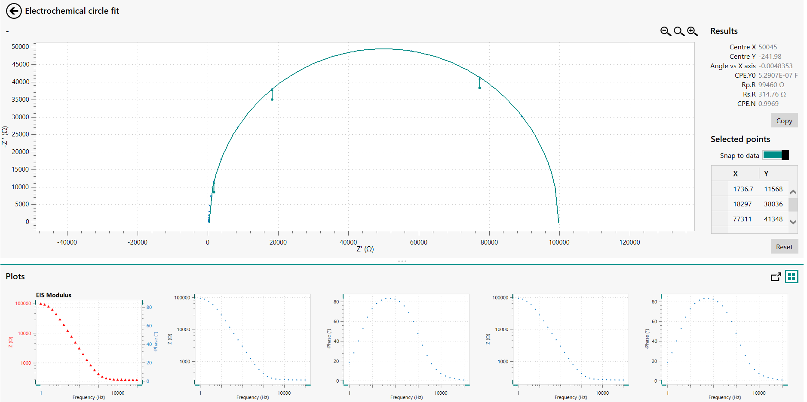
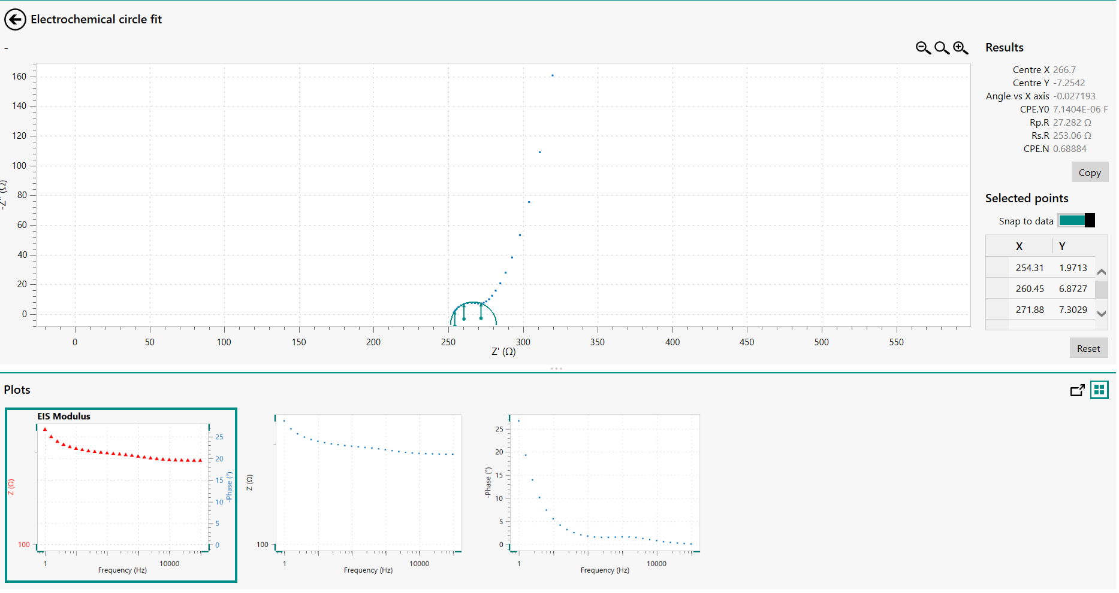
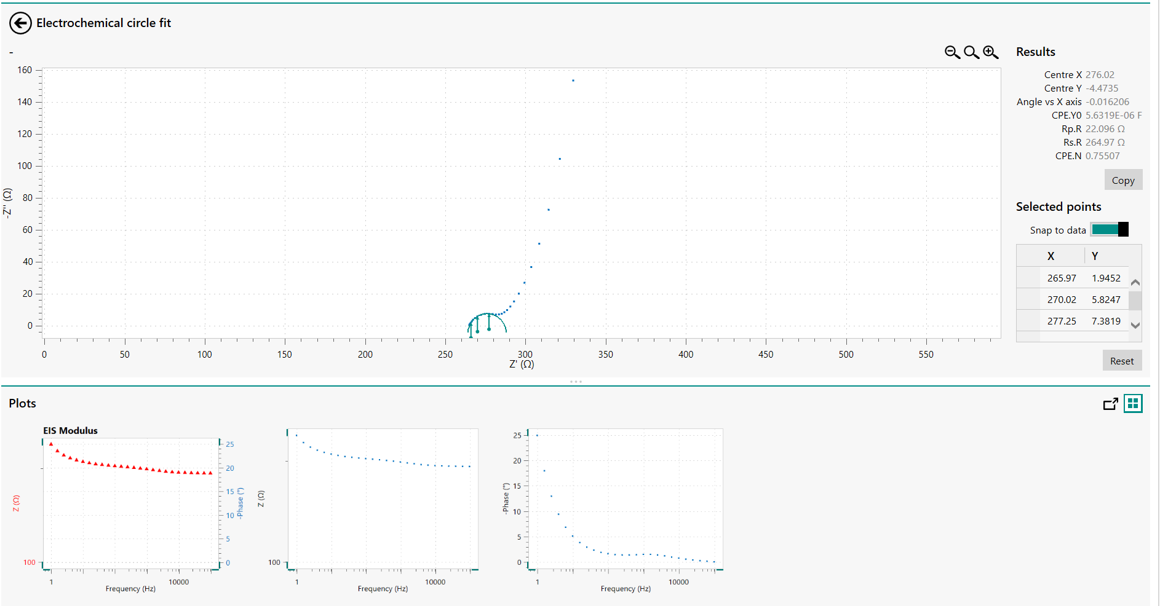
Circle fit (Autolab) – all circuit, well: A1
Stim1_0 – A1
Stim2_0 – A1
Stim1_1 – A1
Stim2_1 – A1

Slide 19
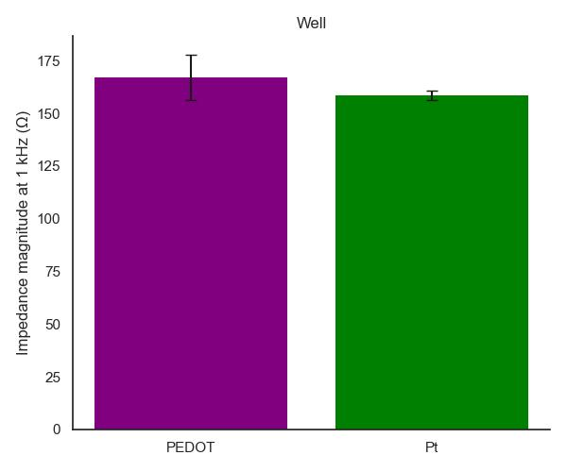
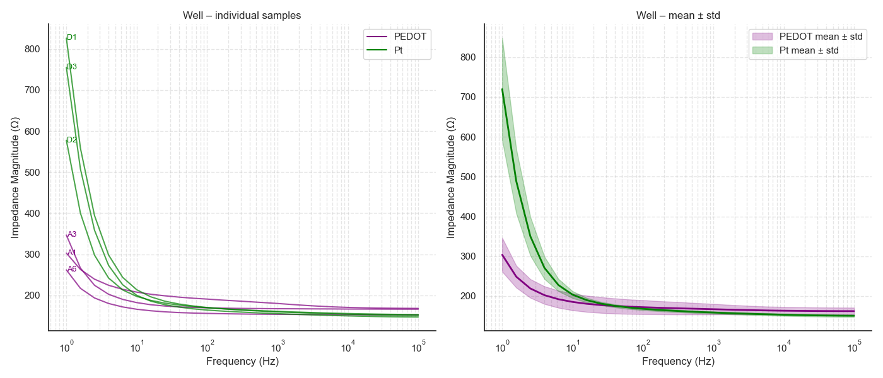
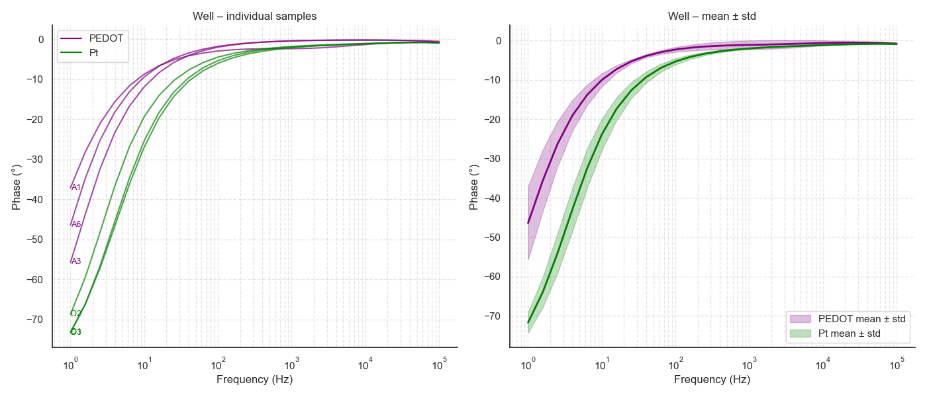
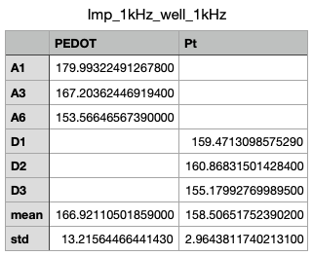
Values @ 1 kHz circuit - well

Slide 20
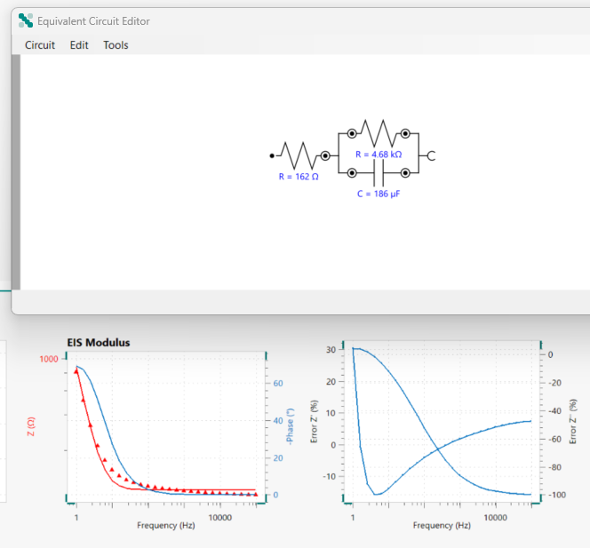
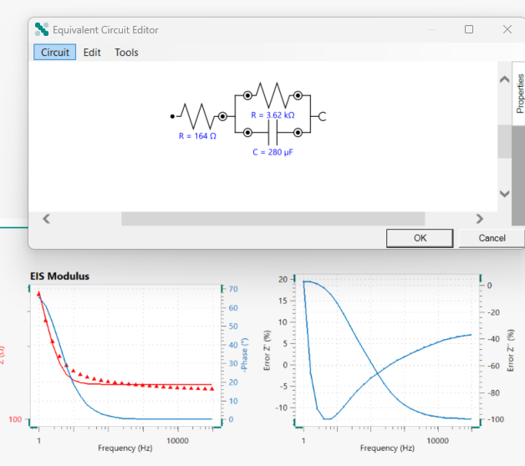
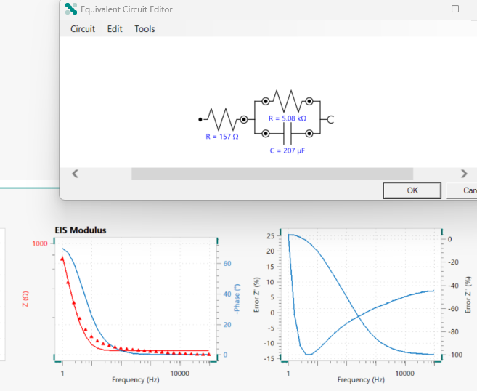



Circle fit (Autolab) – well PEDOT vs Pt
D1_Pt
D2_Pt
D3_Pt
Pt Average
Rs = 161 ohm
Cdl = 224.3 uF
Rct = 4.45 kohm
PEDOT Average
Rs = 163 ohm
Cdl = 653.5 uF
Rct = 1.58 kohm
NB: A1 was excluded because the fitting was not accurate
A1_PEDOT
A3_PEDOT
A6_PEDOT

Slide 21




24device - well only

Slide 22


Simulation – Stim1_0

Slide 23

Simulation – Stim1_1

Slide 24
Conclusions
Electrode-electrolyte interface values are:
PEDOT Average
Rs = 163 ohm
Cdl = 653.5 uF
Rct = 1.58 kohm
Pt Average
Rs = 161 ohm
Cdl = 224.3 uF
Rct = 4.45 kohm
The impedance of the well only at 1 kHz is 160 ohm ca. (at 1mA, expected EF is )
impedance of the circuit is around 300 ohm at >1000 Hz and without capacitors
Capacitors make the impedance at low frequency too high to be used, so the filter will only be activated at >1000 Hz
The capacitors shift the phase quite a lot
Stim 2 had a lower impedance of the circuit
R_{measure} resistor is ok at 1 ohm to minimize difference between WE and CE
PEDOT and Pt have comparable impedance and behaviour. Impedance only changes a lot at 1-5 Hz. I will probably keep it Pt to minimize variability
I can calculate the actual impedance of the well for each frequency and estimate the well Voltage, assuming circuit impedance is 270 ohm and the well impedance is 160 ca.
The impedance and phase values at 1kHz are reflected in the simulations
To calculate the impedance of the well, I will remove the average impedance of the circuit at the given frequency based on average ON and OFF values. The phase will also be recorded
Next:
change both MUX to stim 2 conditions
Remove PEDOT and measure all circuit values again
Validate the well voltage values with oscilloscope
Build GUI to operate PCB and to visualize the voltage in the well real time and record expected impedance and phase shift

