Slide 1
Assignment 4: Slides
Link to YT video where I present
https://youtu.be/il0ww3Jl6FI

Slide 2
Are air fryer recipes simpler?
We spend less time in the kitchen nowadays (Scanlon, 2004; Wolfson et al., 2016)
This affect is amplified by new kitchen technology (Palmer, 2018)
We use more cocise language nowadays (Joshi, 2014)

Slide 3
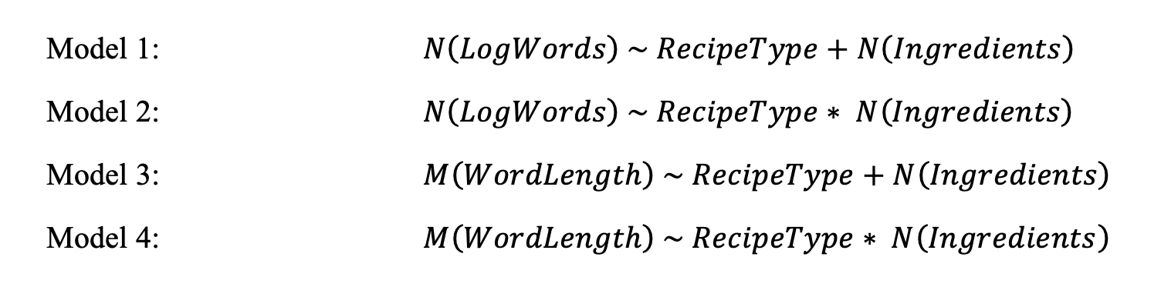
My models

Slide 4
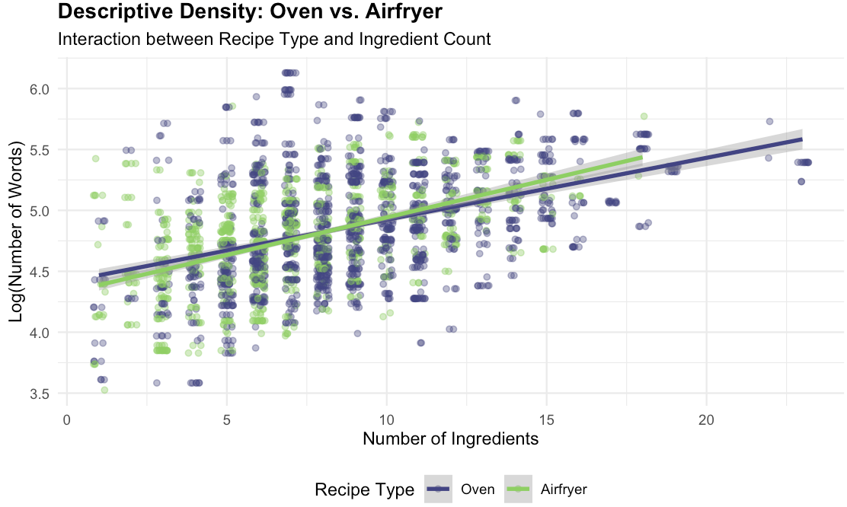
My plots

Slide 5
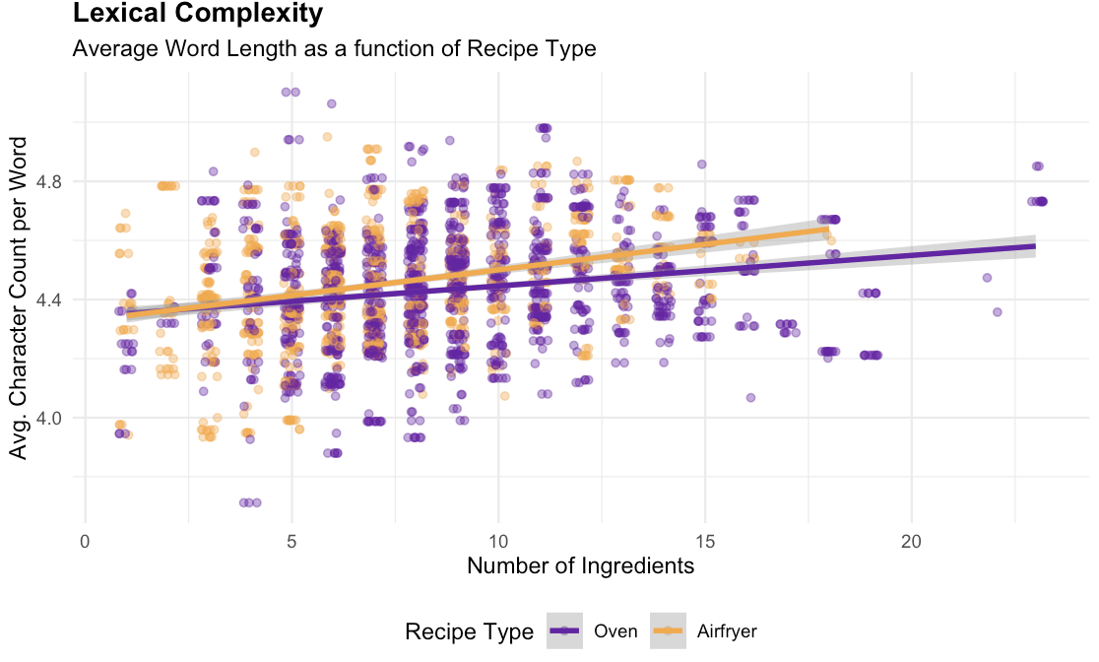
My plots

