Slide 1
PROJECT TOPIC
FIT-N-FINE
NIIT

Slide 2
DEVELOPED BY
Gbojuwo Daniel
Ehimhen Fidelis Orasotie
Osimi Philips
Adeyemi Sofiat
Name of the Coordinator
Mr. Akinwale

Slide 3
ENTITIES
Number of Entities: 8
Names of Entities:
1. Members
2. Facility
3. Feed Backs
4. Staffs
5. Plan
6. Plan Details
7. Bookings
8. Payments

Slide 4
ATTRIBUTES
Entity | Attributes
Members | Member ID
 | First Name
 | Last Name
 | Booking ID
 | Facility ID
 | Plan ID
 | Phone Number
 | Email Address
 | House Address
 | Staff ID
 | Payment ID
 | Feedback Type
Facility | Facility ID
 | Facility Name
 | Facility Capacity
 | Facility Type
 | Staff ID
 | Member ID
 | Feedback Type
 | Booking ID
Feedbacks | Feedback Type
 | Feedback Details
 | Reference No
 | Member ID
 | Facility ID
 | Plan ID
 | Staff ID

Slide 5
ATTRIBUTES
Staff | Staff ID
 | First Name
 | Last Name
 | Title
 | Member ID
 | Feedback Type
 | Phone Number
 | Email Address
 | Address
Booking | Booking ID
 | Date
 | Time
 | Booking Status
 | Plan ID
 | Facility ID
 | Member ID
 | Payment ID No
Plan | Plan ID
 | Plan Type
 | Plan Fee
 | Member ID
 | Payment ID
 | Feedback Type
Plan Details | Plan ID
 | Member ID
 | Date
 | Time
Payments | Payment ID
 | Payment Amount
 | Payment Mode ID
 | Payment Mode
 | Payment Date
 | Plan ID
 | Member ID
 | Booking ID
 | Credit Card No
 | Cardholder’s Name
 | Credit Card Expiry Date

Slide 6
Members (Entity) Facility (Entity) Staff (Entity)
Members |  | Facility |  | Staff
Member ID |  | Facility ID |  | Staff ID
First Name |  | Facility Name |  | First Name
Last Name |  | Facility Capacity |  | Last Name
Booking ID |  | Facility Type |  | Member ID
Facility ID |  | Staff ID |  | Phone Number
Plan ID |  | Member ID |  | Title
Phone Number |  | Feedback Type |  | Email Address
Email Address |  | Booking ID |  | Address
Address |  |  |  | Feedback Type
Staff ID
Payment ID

Slide 7
Payments (Entity) Bookings (Entity) Feedbacks (Entity)
Payments |  | Bookings |  | Feedbacks
Payment ID |  | Booking ID |  | Feedback Type
Payment Amount |  | Booking Status |  | Feedback Details
Payment Mode |  | Name |  | Reference Number
Payment Mode ID |  | Date |  | Member ID
Payment Date |  | Plan ID |  | Facility ID
Plan ID |  | Facility ID |  | Staff ID
Member ID |  | Member ID |  | Plan ID
Booking ID |  | Payment ID
Credit Card Number
Card Holder’s Name
Credit Card Expiry Date

Slide 8
Plans (Entity) Plan Details (Entity)
Plans |  | Plans Details
Plan ID |  | Plan Detail ID
Plan Type |  | Plan ID
Plan Fee |  | Date
Payment ID |  | Time
Member ID
Feedback Type
Plan Detail ID

Slide 9
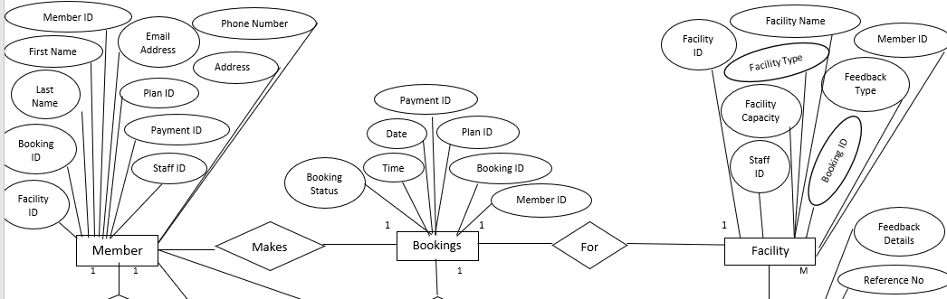
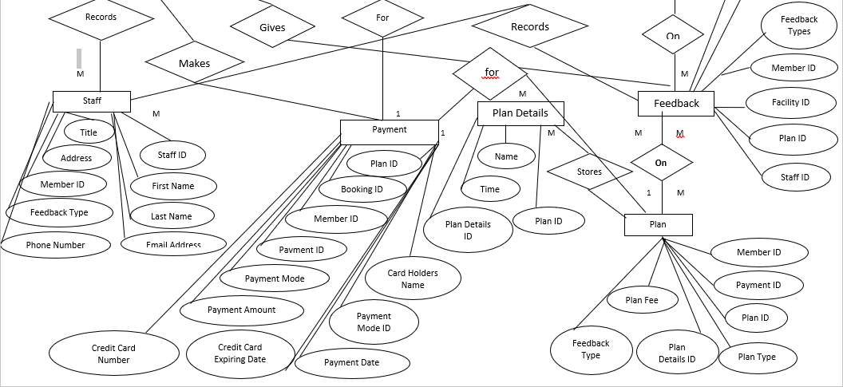
ER DIAGRAM

Slide 10
TABLES AFTER 1NF
The tables are already in 1 NF. The tables structures are shown here.
Members (Entity) Facility (Entity) Staff (Entity)
Members |  | Facility |  | Staff
Member ID |  | Facility ID |  | Staff ID
First Name |  | Facility Name |  | First Name
Last Name |  | Facility Capacity |  | Last Name
Booking ID |  | Facility Type |  | Member ID
Facility ID |  | Staff ID |  | Phone Number
Plan ID |  | Member ID |  | Title
Phone Number |  | Feedback Type |  | Email Address
Email Address |  | Booking ID |  | Address
Address |  |  |  | Feedback Type
Staff ID
Payment ID

Slide 11
TABLES AFTER 1NF
The tables are already in 1 NF. The tables structures are shown here.
Payments (Entity) Bookings (Entity) Feedbacks (Entity)
Payments |  | Bookings |  | Feedbacks
Payment ID |  | Booking ID |  | Feedback Type
Payment Amount |  | Booking Status |  | Feedback Details
Payment Mode |  | Name |  | Reference Number
Payment Mode ID |  | Date |  | Member ID
Payment Date |  | Plan ID |  | Facility ID
Plan ID |  | Facility ID |  | Staff ID
Member ID |  | Member ID |  | Plan ID
Booking ID |  | Payment ID
Credit Card Number
Card Holder’s Name
Credit Card Expiry Date

Slide 12
TABLES AFTER 1NF
The tables are already in 1 NF. The tables structures are shown here.
Plans (Entity) Plan Details (Entity)
Plans |  | Plans Details
Plan ID |  | Plan Detail ID
Plan Type |  | Plan ID
Plan Fee |  | Date
Payment ID |  | Time
Member ID
Feedback Type
Plan Detail ID

Slide 13
TABLES AFTER 2NF
Members (Entity) Facility( Entity) Staff (Entity)
The tables are already in 2NF . The table structures are shown here.
Members |  | Facility |  | Staff
Member ID |  | Facility ID |  | Staff ID
First Name |  | Facility Name |  | First Name
Last Name |  | Facility Capacity |  | Last Name
Booking ID |  | Facility Type |  | Member ID
Facility ID |  | Staff ID |  | Phone Number
Plan ID |  | Member ID |  | Title
Phone Number |  | Feedback Type |  | Email Address
Email Address |  | Booking ID |  | Address
Address |  |  |  | Feedback Type
Staff ID
Payment ID

Slide 14
TABLES AFTER 2NF
Payments (Entity) Bookings (Entity) Feedbacks (Entity)
The tables are already in 2NF. The table structures are shown here.
Payments |  | Bookings |  | Feedbacks
Payment ID |  | Booking ID |  | Feedback Type
Payment Amount |  | Booking Status |  | Feedback Details
Payment Mode |  | Name |  | Reference Number
Payment Mode ID |  | Date |  | Member ID
Payment Date |  | Plan ID |  | Facility ID
Plan ID |  | Facility ID |  | Staff ID
Member ID |  | Member ID |  | Plan ID
Booking ID |  | Payment ID
Credit Card Number
Card Holder’s Name
Credit Card Expiry Date

Slide 15
TABLES AFTER 2NF
Plans (Entity) Plan Details (Entity)
The tables are already in 2NF. The table structures are shown here.
Plans |  | Plans Details
Plan ID |  | Plan Detail ID
Plan Type |  | Plan ID
Plan Fee |  | Date
Payment ID |  | Time
Member ID
Feedback Type
Plan Detail ID

Slide 16
TABLES AFTER 3NF
In the Payment table, the attribute payment mode depends on Payment Mode ID and not on payment ID. Therefore, for the tables to be in 3NF, we need to create another table, Payment Methods. Also, in the Feedback Table, the attribute Feedback Details depends on Feedback Type and not Reference Number. We need to create a separate table, Feedback Information. In addition, the attributes Cardholder’s Name and Credit Card Expiry Date depend on Credit Card Number and not on payment Mode. Therefore, we need to create another table, Credit Cards. The updated table structures are shown here.
Members |  | Facility |  | Staff
Member ID |  | Facility ID |  | Staff ID
First Name |  | Facility Name |  | First Name
Last Name |  | Facility Capacity |  | Last Name
Booking ID |  | Facility Type |  | Member ID
Facility ID |  | Staff ID |  | Phone Number
Plan ID |  | Member ID |  | Title
Phone Number |  | Feedback Type |  | Email Address
Email Address |  | Booking ID |  | Address
Address |  |  |  | Feedback Type
Staff ID
Payment ID

Slide 17
TABLES AFTER 3NF
Plans ( Entity) Bookings(Entity) Plan Details (Entity)
Plans |  | Bookings |  | Plans Details
Plan ID |  | Booking ID |  | Plan Detail ID
Plan Type |  | Booking Status |  | Plan ID
Plan Fee |  | Name |  | Date
Payment ID |  | Date |  | Time
Member ID |  | Plan ID
Feedback Type |  | Facility ID
Plan Detail ID |  | Member ID
 |  | Payment ID

Slide 18
TABLES AFTER 3NF
Plans (Entity) Payment Methods (Entity) Credit Cards (Entity)
Payments |  | Payment Methods |  | Credit Cards
Payment ID |  | Payment Mode |  | Credit Card Number
Payment Amount |  | Payment Mode ID |  | Card Holder’s Name
Payment Mode ID |  |  |  | Credit Card Expiry Date
Payment Date
Plan ID
Member ID
Booking ID
Credit Card Number

Slide 19
TABLES AFTER 3NF
Feedbacks (Entity) Feedback Info(Entity)
Feedbacks |  | Feedback Info
Feedback Type |  | Feedback Type
Feedback Details |  | Feedback Details
Reference Number
Member ID
Facility ID
Staff ID
Plan ID

Slide 20
TABLE AFTER DENOMALIZATION
Members |  | Facility |  | Staff
Member ID |  | Facility ID |  | Staff ID
First Name |  | Facility Name |  | First Name
Last Name |  | Facility Capacity |  | Last Name
Booking ID |  | Facility Type |  | Member ID
Facility ID |  | Staff ID |  | Phone Number
Plan ID |  | Member ID |  | Title
Phone Number |  | Feedback Type |  | Email Address
Email Address |  | Booking ID |  | Address
Address |  |  |  | Feedback Type
Staff ID
Payment ID
Payments |  | Payment Methods
Payment ID |  | Payment Mode
Payment Amount |  | Payment Mode ID
Payment Mode ID
Payment Date
Plan ID
Member ID
Booking ID
Credit Card Number
Feedbacks |  | Feedback Info
Feedback Type |  | Feedback Type
Feedback Details |  | Feedback Details
Reference Number
Member ID
Facility ID
Staff ID
Plan ID
Plans |  | Bookings |  | Plans Details
Plan ID |  | Booking ID |  | Plan Detail ID
Plan Type |  | Booking Status |  | Plan ID
Plan Fee |  | Name |  | Date
Payment ID |  | Date |  | Time
Member ID |  | Plan ID
Feedback Type |  | Facility ID
Plan Detail ID |  | Member ID
 |  | Payment ID

Slide 21
PRIMARY AND FOREIGN KEYS
The Primary and Foreign keys (wherever applicable) for each table are listed with their respective table names
Members
Primary key: Member ID
Foreign key: Booking ID, Facility ID, Plan ID, Staff ID, Payment ID
Facility
Primary key: Facility ID
Foreign key: Member ID, Booking ID, Staff ID
Feedback
Primary key: Feedback Type
Foreign key: Member ID, Facility ID, Plan ID, Staff ID
Staff
Primary key: Staff ID
Foreign key: Member ID, Feedback Type
Bookings
Primary key: Booking ID
Foreign key: Plan ID, Facility ID, Member ID, Payment ID
Plan
Primary key: Plan ID
Foreign key: Payment ID, Member ID, Feedback Type, Plan Details ID
Payments
Primary key: Payment ID,
Foreign key: Member ID, Plan ID, Booking ID

Slide 22
FINAL RELATION BETWEEN TABLES
Staff |  | Members |  |  |  | Bookings |  | Facility
Staff ID |  | Member ID |  |  |  | Booking ID |  | Facility ID
First Name |  | First Name |  |  |  | Booking Status |  | Facility Name
Last Name |  | Last Name |  | Payments |  | Name |  | Facility Capacity |  | Feedbacks
Member ID |  | Booking ID |  | Payment ID |  | Date |  | Facility Type |  | Feedback Type
Phone Number |  | Facility ID |  | Payment Amount |  | Plan ID |  | Staff ID |  | Feedback Details
Title |  | Plan ID |  | Payment Mode |  | Facility ID |  | Member ID |  | Reference Number
Email Address |  | Phone Number |  | Payment Mode ID |  | Member ID |  | Feedback Type |  | Member ID
Address |  | Email Address |  | Payment Date |  | Payment ID |  | Booking ID |  | Facility ID
Feedback Type |  | Address |  | Plan ID |  |  |  |  |  | Staff ID
 |  | Staff ID |  | Member ID |  | Payment Methods |  | Plans |  | Plan ID
 |  | Payment ID |  | Booking ID |  | Payment Mode |  | Plan ID
 |  |  |  | Credit Card Number |  | Payment Mode ID |  | Plan Type |  | Plans Details
 |  |  |  | Card Holder’s Name |  |  |  | Plan Fee |  | Plan Detail ID
 |  |  |  | Credit Card Expiry Date |  |  |  | Payment ID |  | Plan ID
 |  |  |  |  |  |  |  | Member ID |  | Date
 |  |  |  |  |  |  |  | Feedback Type |  | Time
 |  |  |  |  |  |  |  | Plan Detail ID

Slide 23
THANK YOU

