Slide 1

Aeronix Hackathon – AI Test Procedure
Notes:
Tyler

Slide 2





Aeronix Team
Tyler Jandreau
Director of Technology and Innovation
Drew Kaisner
Software Engineer
Tony Lleonart
Hardware Engineer
Emmalee Brown
Hardware Engineer
Michael Schoonmaker
Software Engineering Intern
Notes:
Tyler

Slide 3

Agenda
Description of the problem and desired solution
3 recommended approaches to the solution
Description of Aeronix given inputs
LoRa Radio
Arduino Uno
Hackathon Logistics
Necessary resources and technology
Aeronix judging criteria
Submission requirements
Helpful Links
Hackathon Schedule
Prize Information
Notes:
Tyler

Slide 4
1
Problem and Desired Solution Description
Notes:
Drew

Slide 5
Bring-up Procedure Background
Testing PCBs is time-consuming, manual, and highly specialized.
Current Challenges:
Manual Test Plan Creation
Test engineers must handcraft procedures from design documents, netlists, and schematics.
Every new board or revision requires starting over or heavy rework.
Process is time-consuming depending on complexity of design.
Requires Deep Domain Knowledge
Testers must understand hardware design and basic firmware functionality.
Customer requirement documents can be time consuming to parse through.
Often involves back-and-forth with design teams.
Slow Feedback Loop
Delays in developing test procedures slow down product validation and time-to-market.
Depending on the customer, review of all test plans are required which adds additional time to the process.
Notes:
Drew
Goal here is to explain that Aeronix develops a lot of custom PCBs and each one has to be “checked” out using a test plan. This slide shows some of the issues that we have with making these test plans.

Slide 6
Overall Solution Goals for AI Test Plan Generator
Netlists/ Gerber files
Schematics/Board files
Requirement Documents
Bring-Up Test Plan
Bring-Up Test Plan
Understand PCB Design Inputs
Parse through schematics, netlists, component data, requirement documents.
Identify key testable elements: power rails, ICs, communication buses, etc.
Generate Structure Test Plans
Output clear, executable test cases in human-readable format.
Include setup, expected behavior measurement points, pass/fail criteria.
Adapt to different board types
Handle variations in complexity, board size, and components.
Support analog, digital, and mixed-signal systems.
Ensure Test Coverage
Prioritize critical paths and high-risk components.
Include edge cases, boundary conditions, and fail-safes.
Explainable and Reviewable
Allow for engineer review and modification.
Include explanations for process used in design solution.
Notes:
Drew

Slide 7
2
Suggested Solution Approaches
Notes:
Michael

Slide 8
Core Approach
Goal: Develop a model workflow able to accurately analyze a netlist and BOM to produce a test plan.
Tooling:
Cloud source GPT/Gemini, or Copilot via UF modeling architecture
Alternative, student-driven model approaches (local hosting, etc. - feel free to explore)
Python libraries like LangChain/NeMo, Pydantic, and PCB Tools
Baseline:
Cloud source LLM
Robust system prompt
Automated workflow using your tool's API, driven through the command line
Notes:
Michael

Slide 9
End Application Ideas
Goal: Develop an end application that engineers can interface with, expanding on your core CLI tool.
Idea: The CLI tool is a strong first cut. How can you develop and iterate upon it further to improve your end user's experience?
General Improvement Ideas:
RAG/Libraries – Users only need to upload files once, chunked files are stored in a vector database
Agentic Modeling – Multi-model architecture, or add the ability to web search for data sheets
Image Generation - Can your model generate images corresponding to steps within the test plan?
Frontend – Node.js integration with something like flask or fast to make your user experience brighter
Baseline:
Leverage strong UI/UX design to improve user experience
Get creative!!
Notes:
Michael

Slide 10
3
Aeronix Given Input/Output Descriptions

Slide 11
Provided Inputs and Outputs
LoRa Radio Inputs:
LoRa Radio Software design Requirements
Lora Radio Hardware design requirements
PCB-Car-Radio zip file (schematics)
Car-PCB Netlist & BOM
Arduino Uno Input (Test Case)
1. Arduino Uno Netlist & BOM
Lora Radio Output:
1. LoRa Bring Up Procedure (Test plan)
Given this information we expect you to recreate the LoRa Bring Up Procedure using your AI test generator, and to create a procedure for the Arduino Uno as an additional test case.
Notes:
Drew

Slide 12
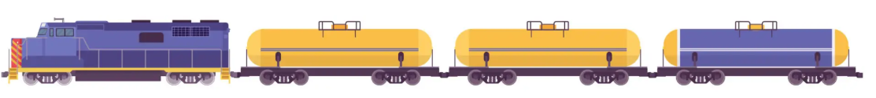

LoRa Radio Explanation
Trains are a complex dynamic system
Each train is comprised of multiple locomotives and cars
Trains are constantly reshuffled as they enter/exit shunting yards to pick up and drop off new cargo
Trains compress/expand depending on terrain - up to 400 meters in some cases
Conductors must independently control HoT/EoT Locomotives to manage the slack
Failure to Communicate between HoT/EoT Can be a Safety Hazard (Foreshadowing…)
Head of Train (HoT)
End of Train (EoT)
Notes:
Drew:Bit of background on the Lora Radio

Slide 13

LoRa Radio Explanation
“… reaction and commentary focused on industry working conditions and safety concerns, including: the lack of modern brake safety regulations…”
-David Sirota, The Lever
Norfolk Southern Train Derailment (Feb 3rd, 2023)
Derailed due to speed management issue
Released toxic chemicals into neighboring area
Because of this, The Rail Industry is Keenly Focused on Modernizing Braking Safety Regulations
Notes:
Drew

Slide 14
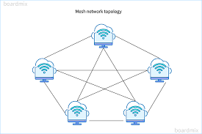

LoRa Radio Explanation
Our Idea
Use Long Range (LoRa)/Internet of Things (IoT) Meshing and Self-Healing Chipsets to Serve as Car-to-Car Radio
Low-Power, Wide-Area networking Protocol
Used for Bi-Directional Communication, End-to-End Security
Low Bit Rate (0.3 kbit/s to 50 kbit/s)
900MHz ISM Band is License-Exempt
IP Backhaul
IoT Relays on Each Car, One IP Backhaul to Communicate with Scheduling and Servicing Depots
Braking-Force Propagation From Each Locomotive/Car
Notes:
Drew

Slide 15
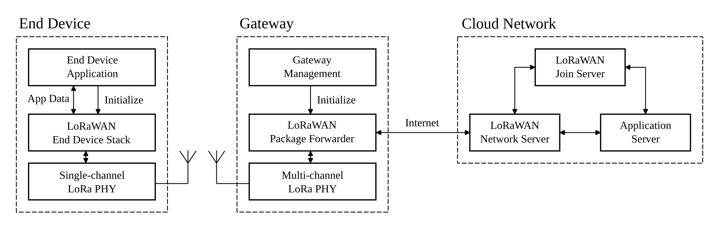
LoRa Radio Explanation
*...1
Client Depot at Dispatch
Rail Car
1...1
HoT IP Gateway
End Goal – Develop a Ruggedized, Low Power Meshing Radio to:
Actuate a Pneumatic Valve for Braking
Sort Mesh Network to Communicate HoT/EoT
Implement Low-Power Consumption/Standby Mode
Log Connected Neighbors, GPS Location, Time
Implement IP Backhaul for Log Offload, Health and Status (CBIT Status, Power Level)

Slide 16
4
Hackathon Logistics

Slide 17
Hackathon Necessary Resources and Technology
1. Submission Requirements
Computer with Internet access and basic software engineering tools
Git
Text Editor
Compiler tools (if compiled)
Ability to record a video demonstration
Recommendation: record a zoom meeting.
Access to a YouTube account where you can upload your video submission and provide a link.
Video demonstration must be in this format.
Notes:
Emmalee

Slide 18
Judging Criteria
Category | 5-Excellent | 3-Satisfactory | 1-Needs Improvement
1. AI Architecture Explanation | Clear, detailed explanation of model design, components, and rationale. Shows deep understanding. | General explanation of components; some reasoning provided but lacks clarity or depth. | Vague or incorrect explanation; lacks understanding of the architecture.
2. Technical Innovation | Demonstrates novel approach or unique adaptation of AI techniques. Clearly goes beyond basic design. Plusses are image scanning, graphic output capability, design for manufacturing and creating breakout/debug boards, adding test points, making sure test points and jumpers are easily accessible when in housing, test plan document output is a Word document. | Uses standard architecture with minor modifications or originality. | Basic or common architecture used without significant innovation.
3. Functionality / Output | The AI system works as intended; video clearly shows strong, relevant, and accurate output. | The system runs with some success; output is shown but may be incomplete or partially working. | Little to no output shown; system may be broken, unclear, or non-functional.
4. Communication & Clarity | Video is engaging, well-organized, and easy to follow. Explanations are coherent and well-paced. | Some organizational or clarity issues; generally understandable but occasionally confusing. | Poor video structure or confusing explanation; difficult to follow.
5. Reflection on Process | Honest, thoughtful reflection on what went well, what was challenging, and lessons learned. | Some reflection on process; may be surface-level or lacking in depth. | Little or no reflection; unclear what the team learned or how they felt about the process.
6. Accuracy | Accurate output test plan where all signals, parts, and reference designators are accurate to the design. There are no added signals/parts that are not part of the input design. | Some inaccuracy with the test plan; there may be some added signals/parts that do not exist, or missing parts/signals. | Little to no accuracy; majority of the test plan has inaccurate names, numerous added parts/signals and/or numerous missing parts/signals.

Slide 19
Submission Requirements
Video Demonstration
Maximum 5 minute in length
Video must be uploaded as an unlisted video to YouTube and link for video submitted with form
Zip File
Must include all code
Google Reflection Form
Must fill out all sections on the Google form provided
Demo must include brief explanation of process
Demo must show the output for the Lora Radio and the output for the Arduino Uno
Include picture of diagram for AI architecture model (this can be hand-drawn, looking for functionality not presentation)
Must include both Lora radio test plan and Arduino Nano test plan that were produced during the video demonstration
Must include YouTube link for video demonstration
Must include zip file with all components required
Must fill out all reflection questions for project.
Include local git repository in zip file
ALL SUBMISSIONS DUE BY 5PM SEPTEMBER 27th

Slide 20
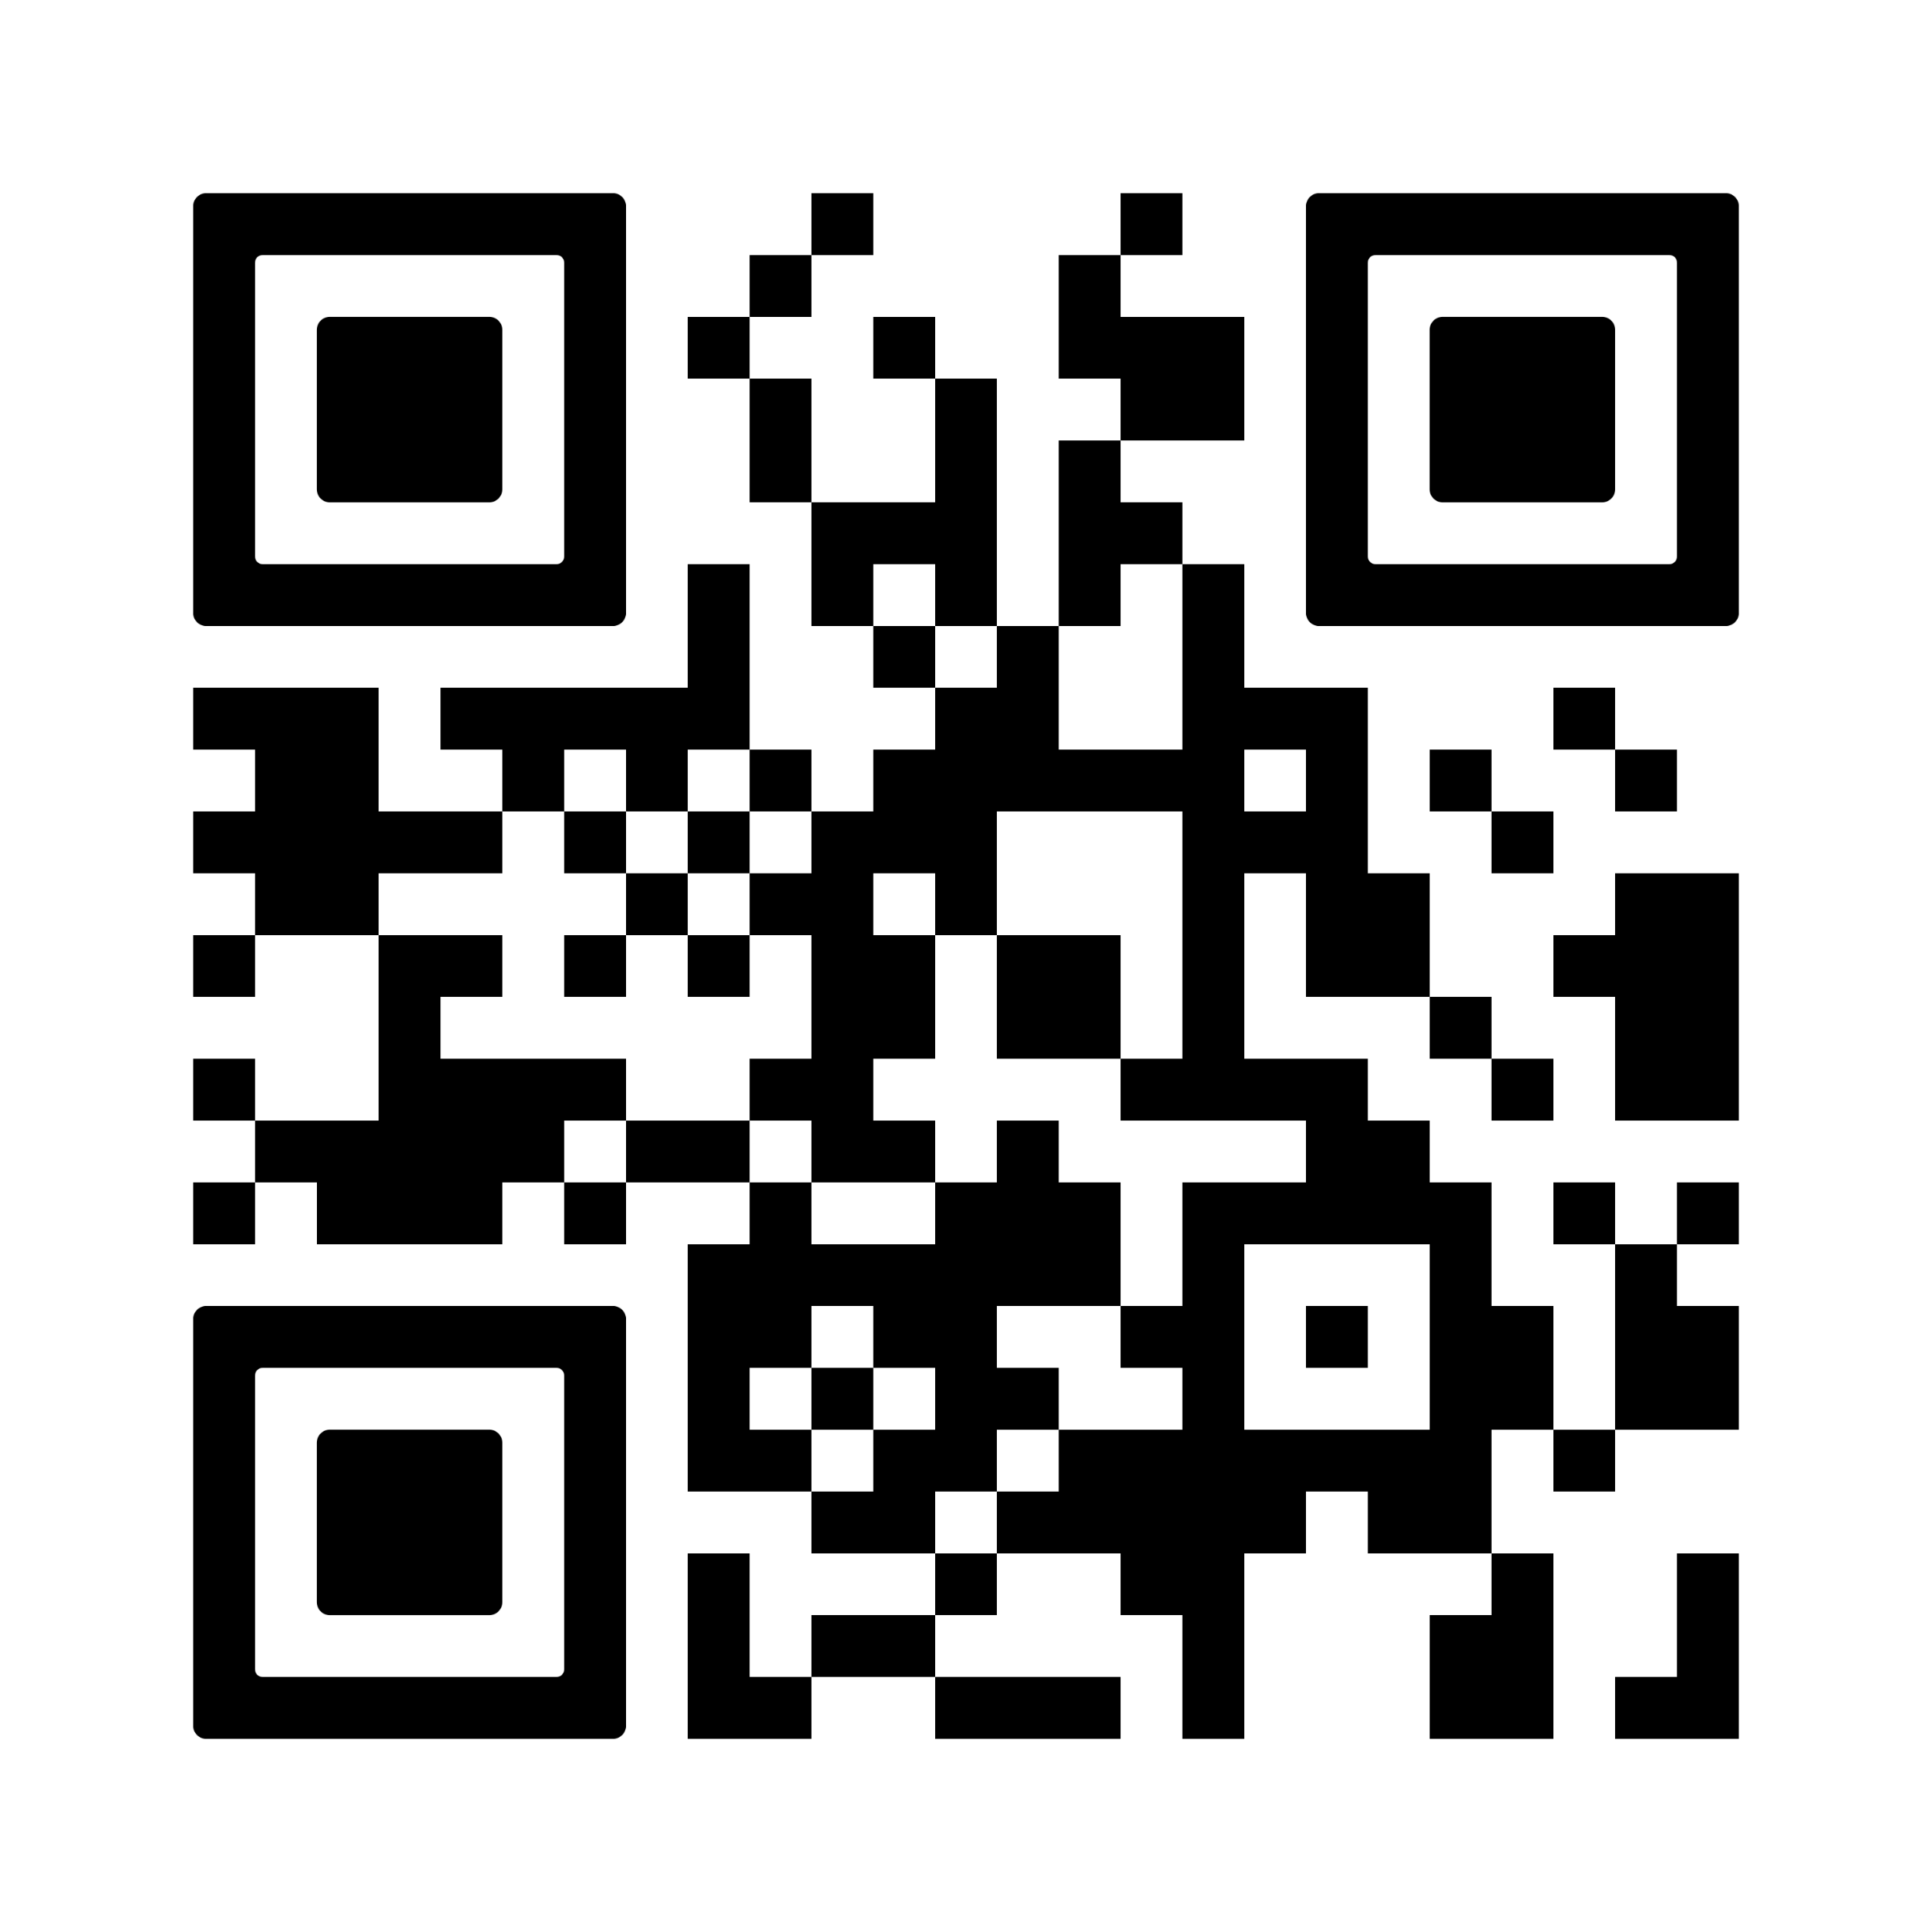
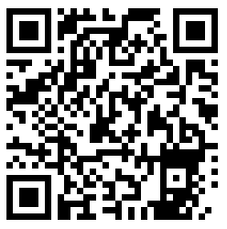
Helpful Links
Youtube Demo:
https://www.guidingtech.com/upload-private-and-unlisted-videos-on-youtube/
Submission Form:
https://docs.google.com/forms/d/e/1FAIpQLSdqcoidbd9PjGTdoQ56EIdqbEswi48Fn0zVZ28VHHUMrzcoZw/viewform?usp=header
File Vault:
https://vault.aeronix.com/vault/index.php/s/aPZTsckPZcdrMXo
Password: AeronixUFHackathon
Submission Form
File Vault

Slide 21
Prize Information
Winning team gets automatic interviews for internships/co-ops/full-time starting summer of 2026*. Goal of the internship is to further this solution, although internship focus may change due to company needs at the time.
Preferential treatment will be given to hackathon winners over students from career fairs, online applications, etc.
Team winners will be contacted via email with interview invitations sent within 2 weeks.
*Full-time/Internship/Co-Op opportunities can only be offered to US Citizens.

Slide 22

Hackathon Schedule → Wertheim Laboratory for Engineering Excellence
8:00 - Doors open/Breakfast → Wertheim Lobby
8:15 – Project Overview and Submission Review
8:40 - Group Formation
9:00 - Competition Begins
12:30 - Lunch (Optional Break) → Wertheim Lobby
5:00 – Code/Video Submissions Due

Slide 23

Product Timeline
9:00 – 10:30 – Literature review and AI workflow plan
1:00 – 4:00 (Recommendation) Backend improvements and iteration
10:30 – 12:30 – First iteration of backend AI pipeline and CLI tool running
5:00 – Code/Video Submissions Due
12:30 - Lunch (Optional Break) → Wertheim Lobby
4:00-5:00 – (Recommendation) Complete video demo, work through submission form
Notes:
Michael

