Slide 1
Exploring the Relationship between Design Metrics and Software Diagnosability using Machine Learning
Thomas Dornberger, Sofie Kemper
2018-07-13

Slide 2
Research Question
Is there a connection between software metrics and the applicability of spectrum-based fault localization techniques?
Focus on the viewpoint of the developer
Notes:
As the tile suggests, we tried to find a link between …
Viewpoint of dev. This means, druing model building we raised the question: How can we build a model that yields to useful information for the dev or concerning our results we wondered how can we use these to support the dev during testing activities, e.g. to give him a hint whether he should apply spectrum based fault loc or not.

Slide 3
Structure
Data collection
Data exploration
Machine learning techniques
Results & discussion
Data Collection
Notes:
The presentation is structured into the 4 parts of …
I‘ll now present the data collection part

Slide 4
Static and dynamic metrics
LOC, SLOC, cyclomatic complexity, nesting depth assessment, …
Measure project size and complexity
Code Smells like unused parameters, star imports, …
Hypothesis: Link between quality and software diagnosability
Graph centrality, vertex/edge connectivity
Deeper analysis of code complexity
Hypothesis: Link between complexity and software diagnosability
Data Collection
Notes:
First of all we collected some general static metrics …
Code Smells
Indicator that their might be some quality defect in the code and shows potential for Refactoring
Assumption: Link between code quality and the occurrence of smells
Graph
complexity of the analyzed test cases

Slide 5
Test suite and bug metrics
Nr of relevant tests, DDU as density diversity uniqueness
Empirical evidence: Optimization of a test suite in terms of DDU improves software diagnosability
Size of the bug, repair patterns and actions
Hypothesis: Close link between a specific bug and its diagnosability
Data Collection
Notes:
Regarding test suite we‘re talking of metrics that we computed based on the gzoltar matrix
standard metrics like #tests #passed #failed
DDU as a metric that measures density, diversity and uniqueness of a test suite
Bug Metrics: also computed static metrics on the buggy Files
Idea: Code directly around the bug is much more important than the whole Code of the project

Slide 6
Target Values
Focus on the viewpoint of the developer
#Methods to examine
Lang_5 | Components | D-Star 2 | Rank
 | Method A | 0.8 | 1
 | Method B | 0.67 | 2
 | Method C | 0.67 | 2
 | Method D | 0.67 | 2
 | Method Z | 0.2 | 5
Data Collection
Notes:
So much for the metrics and now the question arises against which target values we analyze them

Slide 7
Target Values
Focus on the viewpoint of the developer
#Methods to examine
#Methods to examine = 1
Lang_5 | Components | D-Star 2 | Rank
 | Method A | 0.8 | 1
 | Method B | 0.67 | 2
 | Method C | 0.67 | 2
 | Method D | 0.67 | 2
 | Method Z | 0.2 | 5
Data Collection

Slide 8
Target Values
Focus on the viewpoint of the developer
#Methods to examine
#Methods to examine = 3
Lang_5 | Components | D-Star 2 | Rank
 | Method A | 0.8 | 1
 | Method B | 0.67 | 2
 | Method C | 0.67 | 2
 | Method D | 0.67 | 2
 | Method Z | 0.2 | 5
Data Collection

Slide 9
Target Values
Focus on the viewpoint of the developer
#Methods to examine
Class labels
perfect – good – medium – useless
Data Collection
Notes:
Noise that doesn’t lead to additional information for the developer
Check 20 methods or 100 doesn‘t matter, in both casesethe applicability of spectrum based fault loc is not given

Slide 10
Structure
Data collection
Data exploration
Machine learning techniques
Results & discussion
Data Exploration
Notes:
[MINUTE 4]

Slide 11
Data Overview
166 metrics collected in total
Some missing data due to problems
(e.g.,unreliable callgraph generation)
Data Exploration
Notes:
1st look at what we‘re working with:
Main problem: choosing features for our models!

Slide 12
Feature-Feature Correlations
Data Exploration
Notes:
Can‘t see specifics, but impression: a lot of correlations; not actually as many dimensions
We did try dimensionality-reduction: PCA didn‘t work too well

Slide 13
Feature-Target-Correlations
Data Exploration
Notes:
Here: y axis targets, x axis features;
Blue = positive cor, red = negative cor, grey = insignificant cor
-> let‘s look only at the significant features

Slide 14
Feature-Target-Correlations
Data Exploration
Notes:
We‘re looking at this target as an example
First: no really high correlations! (abs <0.3)
Doesn‘t mean no correlation, just nothing significant!
Interesting: correlations similar for all targets! Seem to capture very similar aspects

Slide 15
Correlated Features - Types
Data Exploration
Notes:
We‘re looking at this target as an example
First: no really high correlations! (abs <0.3)
But some correlations -> looking into it: a lot of dynamic metrics, some static, a few test, no bug metrics
Doesn‘t mean no correlation, just nothing significant!
Interesting: correlations similar for all targets! Seem to capture very similar aspects

Slide 16
Structure
Data collection
Data exploration
Machine learning techniques
Results & discussion
Machine Learning
Notes:
[MINUTE 8]

Slide 17
Machine learning – Linear Regression I
Why choose least squares linear regression?
Performant and easy to interpret
Direct link to found correlations
We use a train-test split to ensure generalizable results and evaluate with mean squared error (MSE) and adjusted R-Squared (R²)
First approach: random combinations of two features -> very bad results
Refine by using only “important” features -> slight improvement
Machine Learning
Notes:
efficient: no high performance computing environment; especially important: try lots of combinations

Slide 18
Machine learning – Linear Regression II
Outliers and strongly scattered, high target values seem problematic
Apply a log-transformation
Significantly improved results: MSE ~ 0.9, R² ~ 0.3
Still not a great result, but a starting point for other methods
Linear regression might not be powerful enough
Best models use only dynamic metrics!
Maximum vertex outdegree in callgraph
Eigenvector centrality distribution in the data dependency graph
Callgraph size: mean geodesic distance, edge count, or vertex count
Machine Learning

Slide 19
Machine learning – Decision trees
Decision tree regression
Bad results, negative r2-scores
Problem: High target values are very strongly scattered
Decision tree classification
Class labels:
1-11 useful > 11 useless
perfect good medium useless
Machine Learning
Notes:
negative r2-scores: a constant model would be better
Classification: The class label ‘useless’ combines high target values

Slide 20
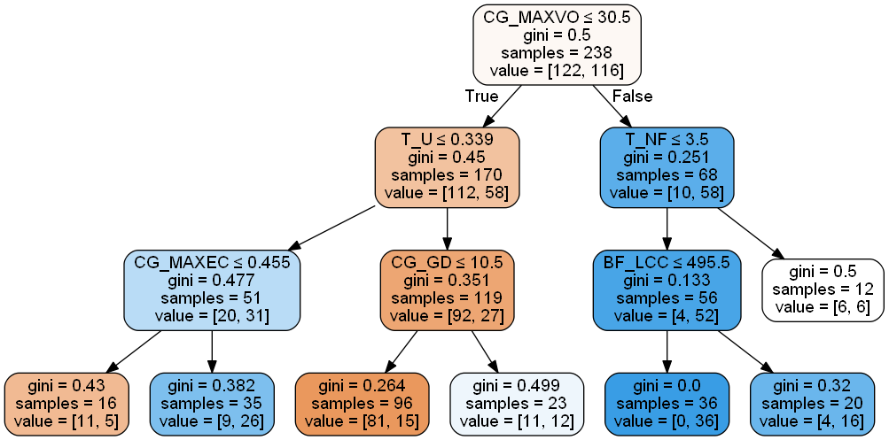
Decision Tree – coarse-grained class labels
Machine Learning
Notes:
CallGraph MaxVertex Out Degree <= 30.5

Slide 21
Decision Tree – coarse-grained class labels
F1-score ≈ 0.64 accuracy-score ≈ 0.69
Machine Learning
Notes:
CallGraph MaxVertex Out Degree <= 30.5

Slide 22
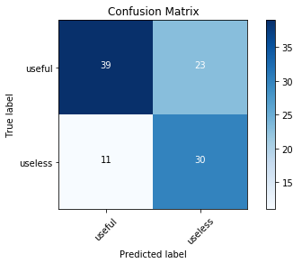
Decision Tree – coarse-grained class labels (II)
Machine Learning
Notes:
When Model predicts spectrum based fault loc works bad → can‘t be sure if it‘s actually bad
However when model predicts a good sw diagnosability → Dev should apply it because it‘s likely to be actually good

Slide 23
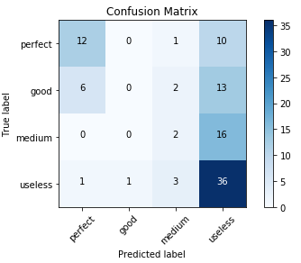
Decision Tree – fine-grained class labels
→ Inputs predicted as perfect tend to be actually useful
accuracy-score (equal to F1 ‘mean’ score) ≈ 0.50
Machine Learning

Slide 24
Structure
Data collection
Data exploration
Machine learning techniques
Results & discussion
Results & Discussion
Notes:
[MINUTE 17]

Slide 25
Discussion: Insights from Models
All three analysis methods share some important features:
Callgraph complexity and centrality, especially high quartiles of eigenvector centrality
In linear regression:
Only dynamic metrics are important
The size of the data dependency graph is also used
In decision trees:
Higher diversity of metrics: also some test metrics
Decision trees tend to perform better (but only for classification)
Results & Discussion
Notes:
CG_EC90Q, GC_MAXVO, CG_MD
T_U, T_DDU, T_NF
B_NL, B_NCH not that important

Slide 26
Threats to Validity & Future work
External validity is given: diverse and reliable data
Internal validity is problematic: too little data; DDU and some other test metrics only computed on relevant tests
Outlier elimination could significantly improve robustness and results
Focus on dynamic complexity metrics to train more complex models
Use auto-encoders or other dimensionality reduction techniques
Clustering to find native classes in the data
Results & Discussion

Slide 27
Conclusion
Most important: dynamic metrics, especially graph centrality and complexity
Decision tree classifier: identification of software versions for which spectrum-based fault localization works well
→ Help developer decide whether to use fault localization suggestions
Results & Discussion

Slide 28
Thank you for your attention! Questions?

Slide 29
Backup (I)
CG_MAXVO: maximum vertex outdegree in callgraph
DD_EC90Q: 90th quartile of eigenvector centrality values in data dependency graph
DD_MAXEC: maximum eigenvector centrality value in data dependency graph
CG_MD: mean geodesic distance in callgraph
CG_EC: number of edges in callgraph
CG_VC: number of vertices in callgraph
T_U: uniqueness of test suite (relevant tests)
T_DDU: density-diversity-uniqueness of test suite (relevant tests)
T_NF: absolute number of failing tests (relevant tests)

Slide 30
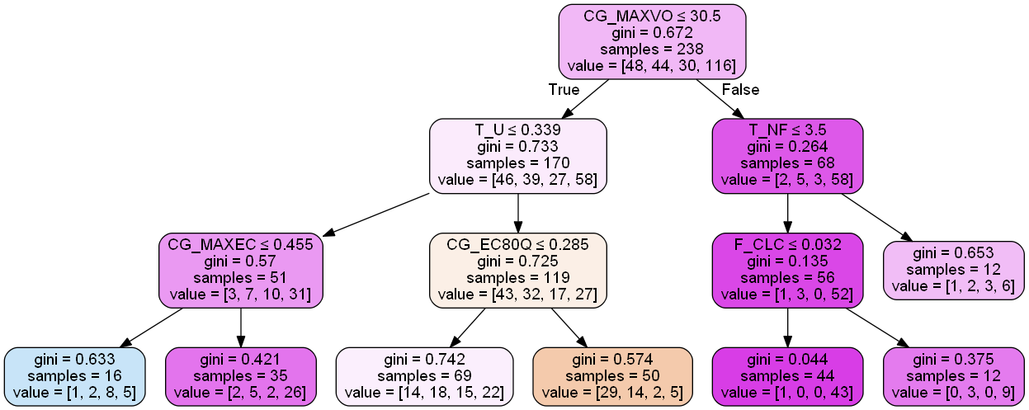
Backup (II) Decision Tree – fine-grained

Slide 31
Backup (III) - PCA
Difficult due to missing values; only ~100 samples could actually be used
Interpolation of missing values distorts PCA!

