Slide 1
Physically-Based Simulation Final Project: Paper Simulation
Group 8
Sofie Kamber, Jasmin Koller, Jonathan Manz

Slide 2
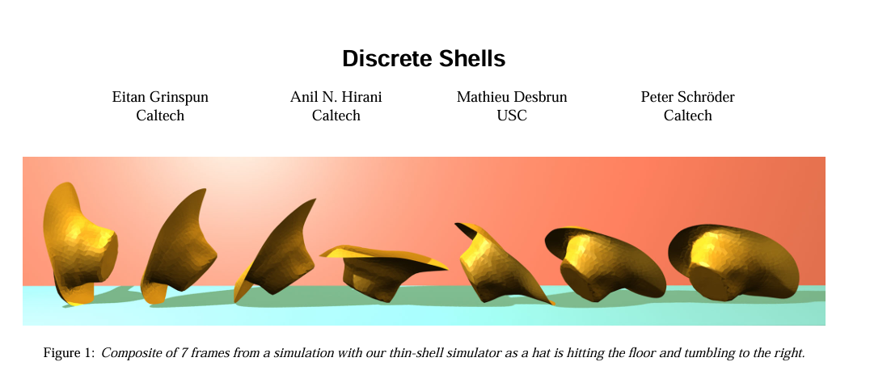
Overview
Notes:
Bonus Targets: Viscosity, Friction effects
Taichi: GPU Acceleration

Slide 3
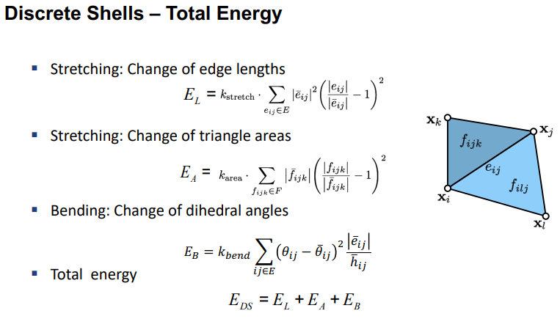
Automatic Differentiation
Newmark Time Stepping

Slide 4
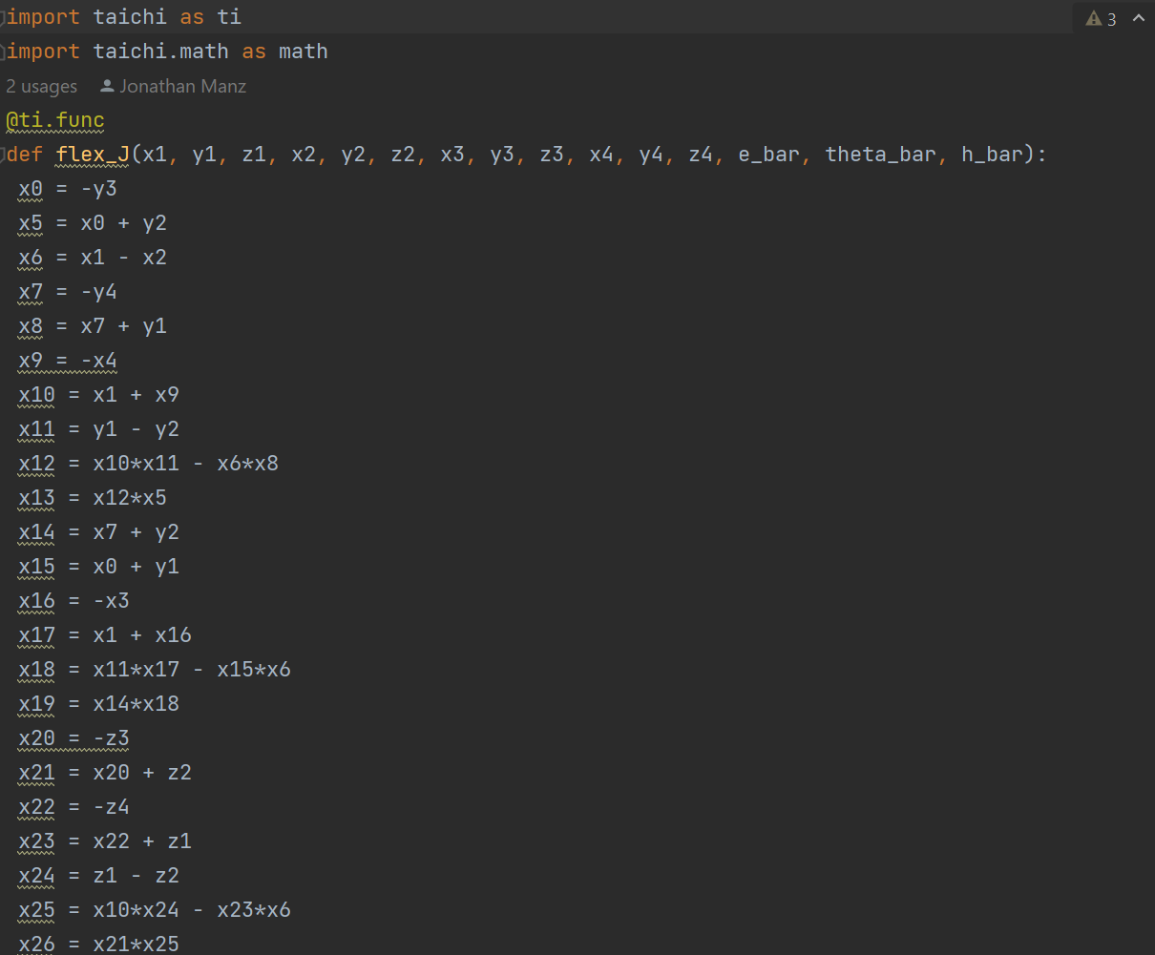
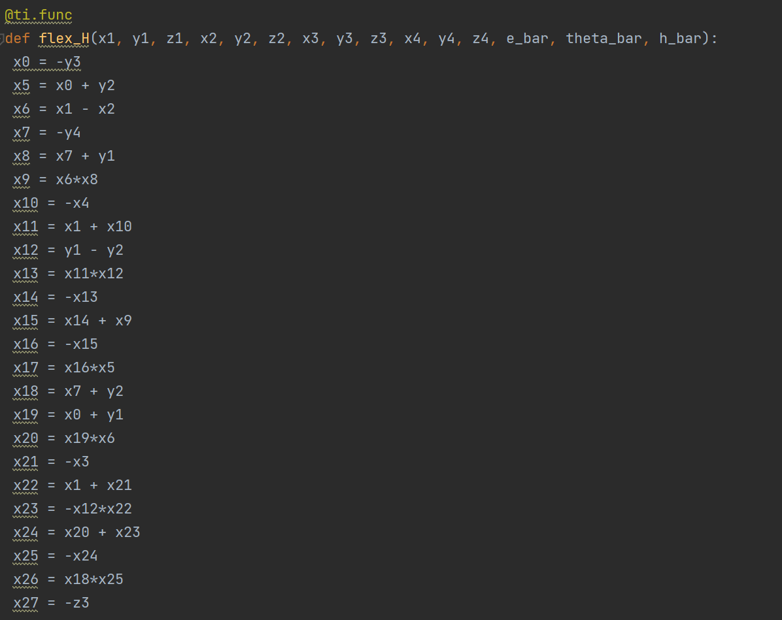
Progress since Milestone Presentation
Implemented Membrane and Flexure Energies
Lecture slide 12 (Thin Shells)
Notes:
Talk about energies
Talk about automatic differentiation problems

Slide 5
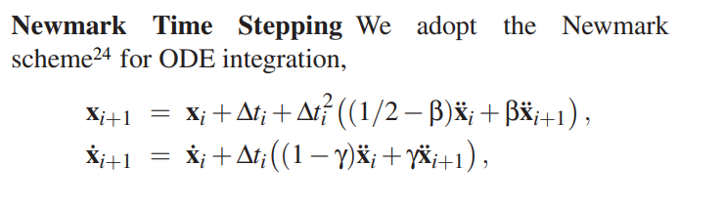
Progress since Milestone Presentation
Implemented Newmark Integration Scheme
[24] N. M. Newmark. A method of computation for structural dynamics. ASCE J. of the Engineering Mechanics Division, 85(EM 3):67–94, 1959.
Notes:
Found a mistake in the paper

Slide 6
Targets
Minimal Target: Membrane and flexure energies
Desired Target: A scrunched paper including self collision, basic rendering
Bonus Target: Friction effects, viscosity
Notes:
Somewhere between the first two targets

Slide 7

Demo
https://www.youtube.com/watch?v=bn6mS2_9tE4&ab_channel=10thElementGraphics
Expectation
Reality
Notes:
Desired Target including self collision

Slide 8

Difficulties / Take-aways
Don’t use
Debugging
Notes:
Seg faults instead of meaningful error descriptions

Slide 9
Thanks for your attention!
Notes:
Set up: time to get to know it

