Slide 1
Physically-Based Simulation Project Milestone: Paper Simulation
Group 8
Sofie Kamber, Jasmin Koller, Jonathan Manz

Slide 2
Milestones
Setting up framework (week 1-2)
Implementing membrane and flexure energies (week 2-4)
Collision handling (week 5-6)
Parameter tuning / optimization, rendering and bonus targets (week 6-7）
Notes:
Bonus Targets: Viscosity, Friction effects

Slide 3
Milestones
Setting up framework (week 1-2)
Implementing membrane and flexure energies (week 2-4)
Collision handling (week 5-6)
Parameter tuning / optimization, rendering and bonus targets (week 6-7）

Slide 4

Framework
Notes:
Set up: time to get to know it

Slide 5
Milestones
Setting up framework (week 1-2)
Implementing membrane and flexure energies (week 2-4)
Collision handling (week 5-6)
Parameter tuning / optimization, rendering and bonus targets (week 6-7）

Slide 6
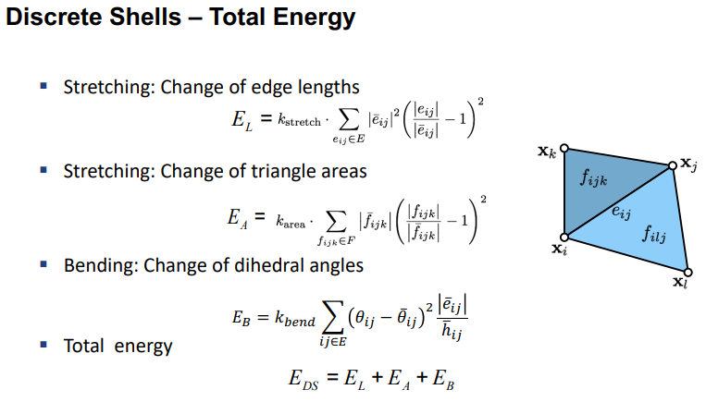
Membrane and flexure energies
Lecture slide 12 (Thin Shells)
Notes:
Minimal Target

Slide 7
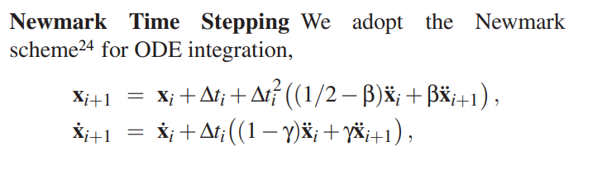
Newmark Integration Scheme
[24] N. M. Newmark. A method of computation for structural dynamics. ASCE J. of the Engineering Mechanics Division, 85(EM 3):67–94, 1959.

Slide 8
Milestones
Setting up framework (week 1-2)
Implementing membrane and flexure energies (week 2-4)
Collision handling (week 5-6)
Parameter tuning / optimization, rendering and bonus targets (week 6-7）

Slide 9

Inspirational Video
https://www.youtube.com/watch?v=bn6mS2_9tE4&ab_channel=10thElementGraphics
Notes:
Desired Target including self collision

Slide 10
Milestones
Setting up framework (week 1-2)
Implementing membrane and flexure energies (week 2-4)
Collision handling (week 5-6)
Parameter tuning / optimization, rendering and bonus targets (week 6-7）
Notes:
Bonus Targets: Viscosity, Friction effects
Taichi: GPU Acceleration

Slide 11
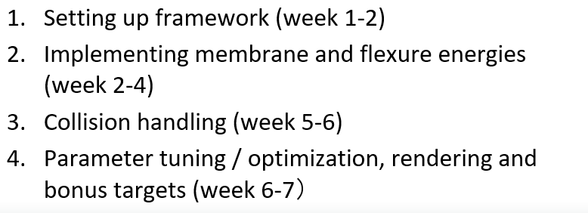
Timeline
2
14/11
6
12/12
0
31/10
4
28/11
7
19/12

