Slide 1
Physically-Based Simulation Project Plan: Paper Simulation
Group 8
Sofie Kamber, Jasmin Koller, Jonathan Manz

Slide 2
Simulation Scenario
Scrunching paper simulation
Motivation: Scrunching paper seems interesting
Inspired by the papers “Discrete Shells”[1] and “Discrete Viscous Sheets”[2]
[1] Grinspun, Eitan, et al. "Discrete shells." Proceedings of the 2003 ACM SIGGRAPH/Eurographics symposium on Computer animation. 2003.
[2] Batty, Christopher, et al. "Discrete viscous sheets." ACM Transactions on Graphics (TOG) 31.4 (2012): 1-7.

Slide 3
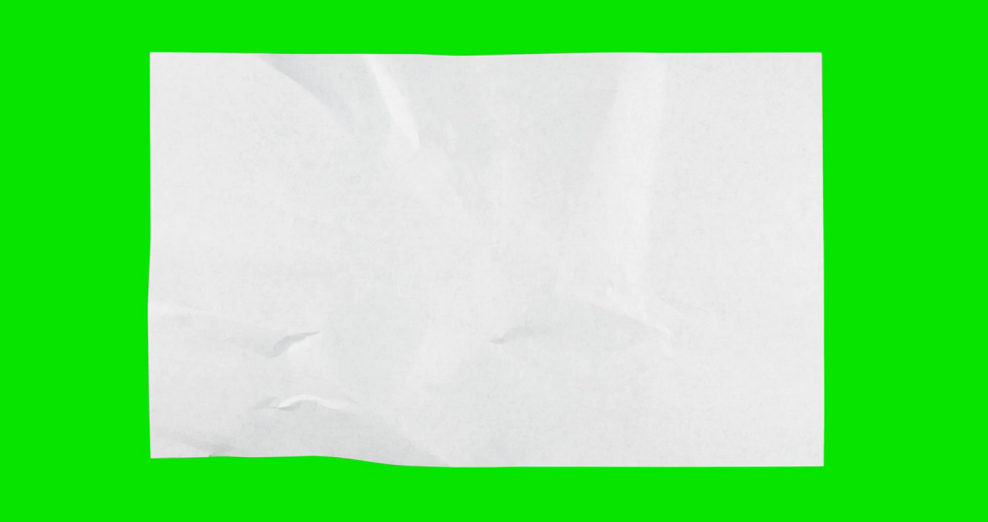
Inspirational Video
https://www.youtube.com/watch?v=bn6mS2_9tE4&ab_channel=10thElementGraphics

Slide 4
Simulation Methods
Discrete shells
(Self) collision
Friction effects

Slide 5
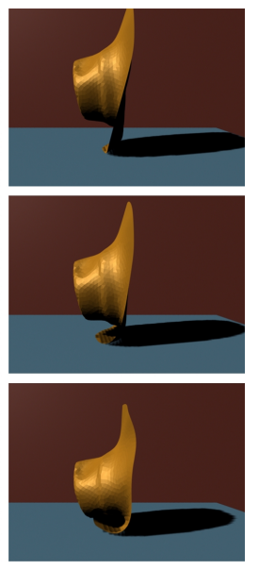
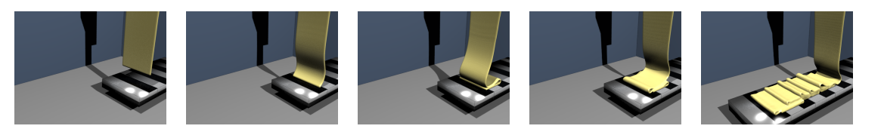
Related Work
[1] Grinspun, Eitan, et al. "Discrete shells." Proceedings of the 2003 ACM SIGGRAPH/Eurographics symposium on Computer animation. 2003. Figure 1
[2] Batty, Christopher, et al. "Discrete viscous sheets."
ACM Transactions on Graphics (TOG) 31.4 (2012): 1-7. Figure 10

Slide 6
Minimal Target
Membrane and flexure energies [1] or [2]
[1] Grinspun, Eitan, et al. "Discrete shells." Proceedings of the 2003 ACM SIGGRAPH/Eurographics symposium on Computer animation. 2003.
[2] Batty, Christopher, et al. "Discrete viscous sheets." ACM Transactions on Graphics (TOG) 31.4 (2012): 1-7.

Slide 7
Desired Target
A scrunched paper including self collision
Basic rendering

Slide 8
Bonus Target
Friction effects
Viscosity [2]
[2] Batty, Christopher, et al. "Discrete viscous sheets." ACM Transactions on Graphics (TOG) 31.4 (2012): 1-7.

Slide 9
Milestones
Setting up framework (week 1-2)
Implementing membrane and flexure energies (week 2-4)
Collision handling (week 5-6)
Parameter tuning / optimization, rendering and bonus targets (week 6-7）

Slide 10
Timeline
2
14/11
6
12/12
0
31/10
4
28/11
7
19/12

