Slide 1
TypeScript
by Sofiia Matsyhin

Slide 2
What is TypeScript?
TypeScript is an open-source programming language developed and maintained by Microsoft. It is a strict syntactical superset of JavaScript and adds optional static typing to the language. TypeScript is designed for development of large applications and transcompiles to JavaScript. As TypeScript is a superset of JavaScript, existing JavaScript programs are also valid TypeScript programs.

Slide 3
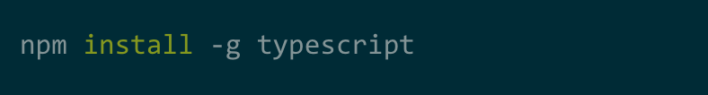
How to install TypeScript?
You will need a copy of Node.js as an environment to run the package. Then you use a dependency manager like npm, yarn or pnpm to download TypeScript into your project.

Slide 4
TypeScript features

Slide 5
Static Types
For programs to be useful, we need to be able to work with some of the simplest units of data: numbers, strings, structures, boolean values, and the like. In TypeScript, we support the same types as you would expect in JavaScript, with an extra enumeration type thrown in to help things along.

Slide 6


Boolean
The most basic datatype is the simple true/false value, which JavaScript and TypeScript call a boolean value.
Number
As in JavaScript, all numbers in TypeScript are either floating point values or BigIntegers. These floating point numbers get the type number, while BigIntegers get the type bigint. In addition to hexadecimal and decimal literals, TypeScript also supports binary and octal literals introduced in ECMAScript 2015.

Slide 7
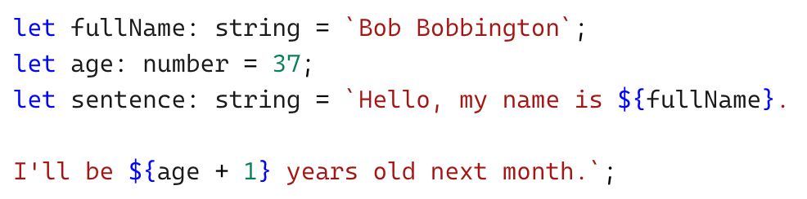
String
TypeScript also uses double quotes (") or single quotes (') to surround string data.
You can also use template strings, which can span multiple lines and have embedded expressions. These strings are surrounded by the backtick/backquote (`) character, and embedded expressions are of the form ${ expr }.

Slide 8
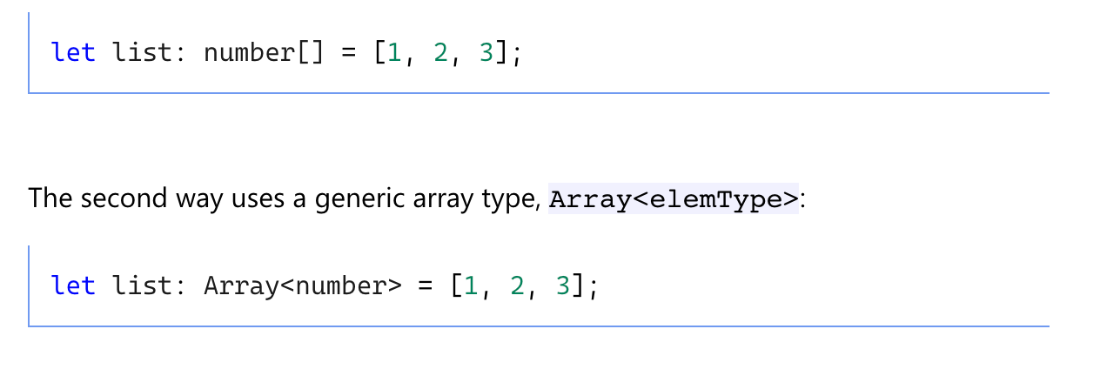
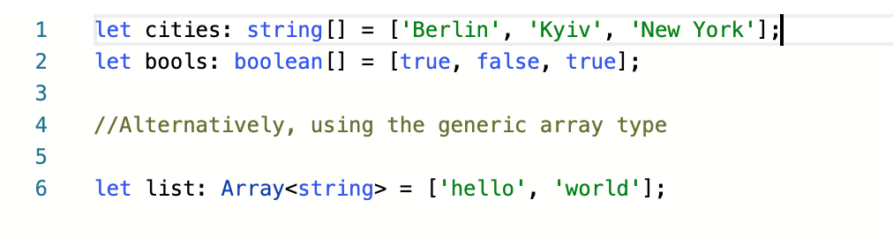
Array
Array types can be written in one of two ways. In the first, you use the type of the elements followed by [] to denote an array of that element type.

Slide 9

Any
In some situations, not all type information is available or its declaration would take an inappropriate amount of effort. These may occur for values from code that has been written without TypeScript or a 3rd party library. In these cases, we might want to opt-out of type checking. To do so, we label these values with the any type:

Slide 10
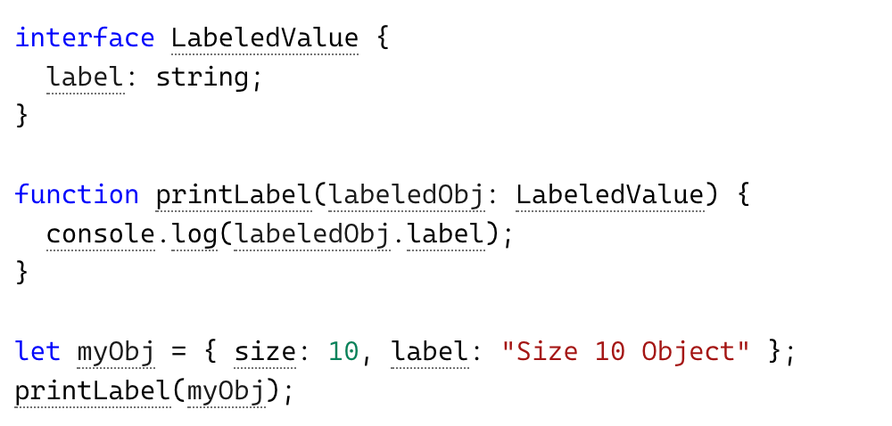
Interface
One of TypeScript’s core principles is that type checking focuses on the shape that values have. This is sometimes called “duck typing” or “structural subtyping”. In TypeScript, interfaces fill the role of naming these types, and are a powerful way of defining contracts within your code as well as contracts with code outside of your project.

Slide 11
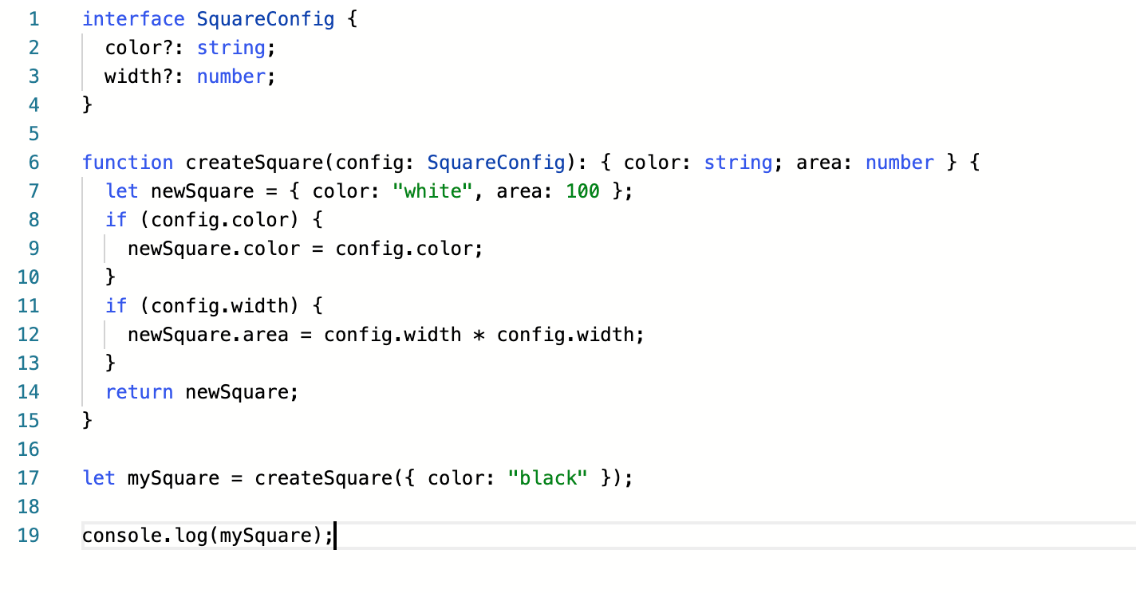
Not all properties of an interface may be required. Some exist under certain conditions or may not be there at all. These optional properties are popular when creating patterns like “option bags” where you pass an object to a function that only has a couple of properties filled in.

Slide 12
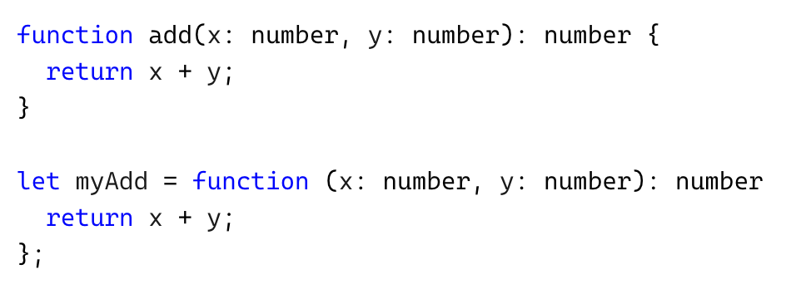
Functions
We can add types to each of the parameters and then to the function itself to add a return type. TypeScript can figure the return type out by looking at the return statements, so we can also optionally leave this off in many cases.

Slide 13
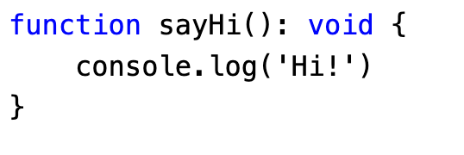
Void
Similar to languages like Java, void is used where there is no data. For example, if a function does not return any value then you can specify void as return type.

Slide 14
Classes
Like others programming languages, TypeScript supports access modifiers at the class level. TypeScript supports three access modifiers - public, private, and protected.
Public - By default, members (properties and methods) of TypeScript class are public - so you don’t need to prefix members with the public keyword. Public members are accessible everywhere without restrictions
Private - A private member cannot be accessed outside of its containing class. Private members can be accessed only within the class.
Protected - A protected member cannot be accessed outside of its containing class. Protected members can be accessed only within the class and by the instance of its sub/child class.

Slide 15
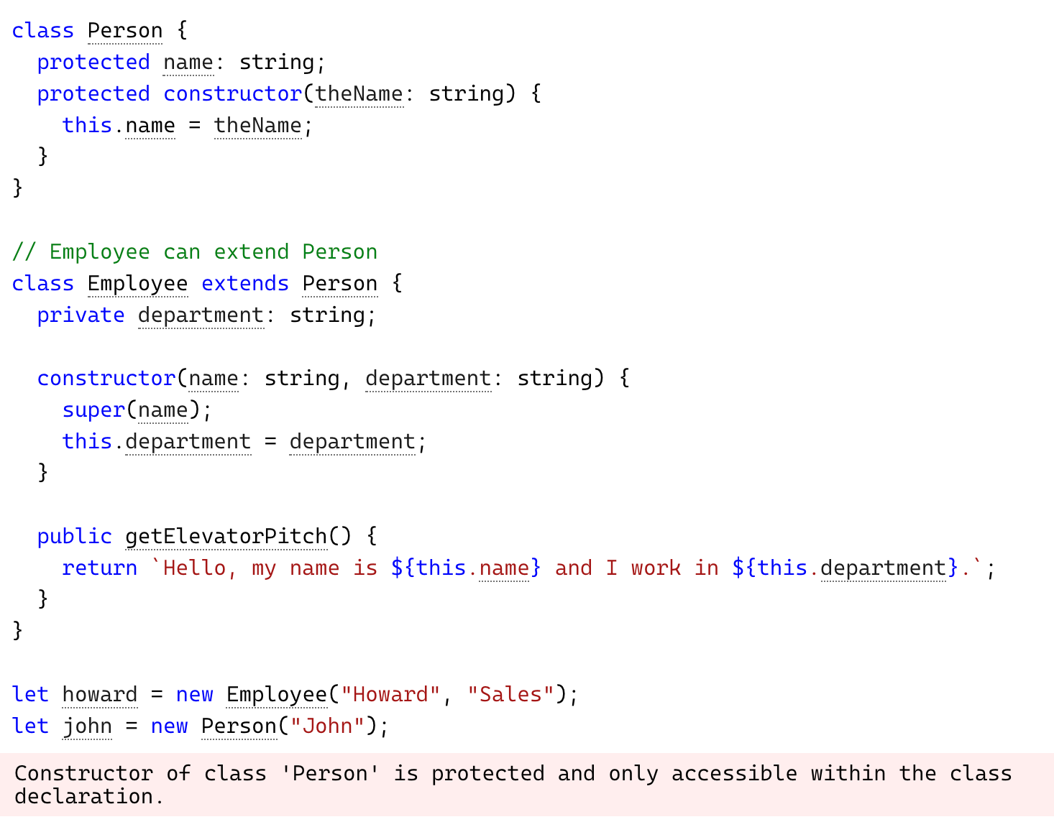
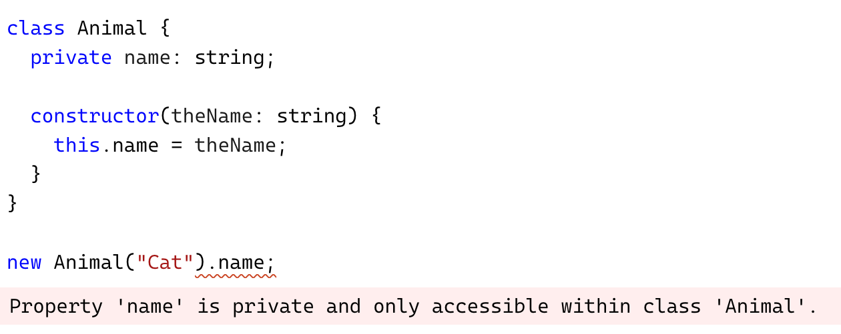
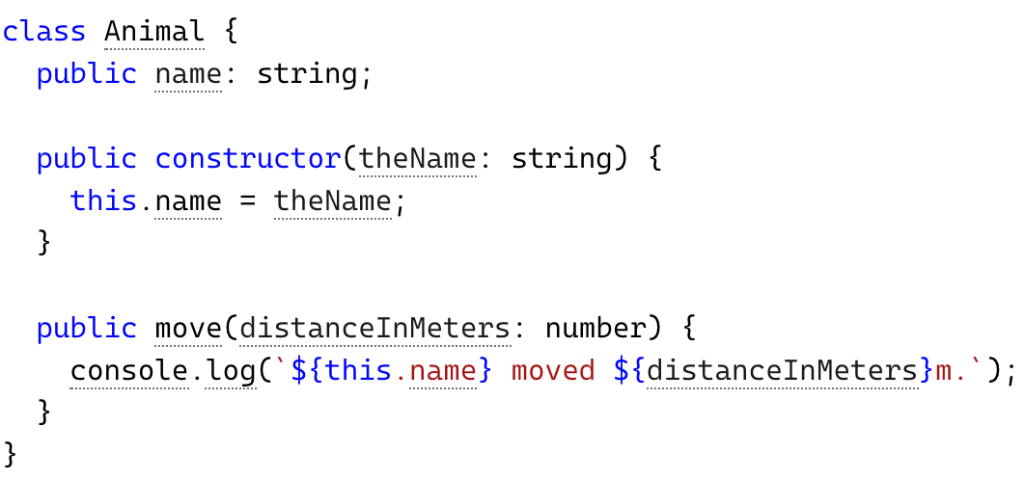

Slide 16


