Slide 1
CST 336 Internet programming
Monday Practice: Sessions/ SQL Inserts

Slide 2
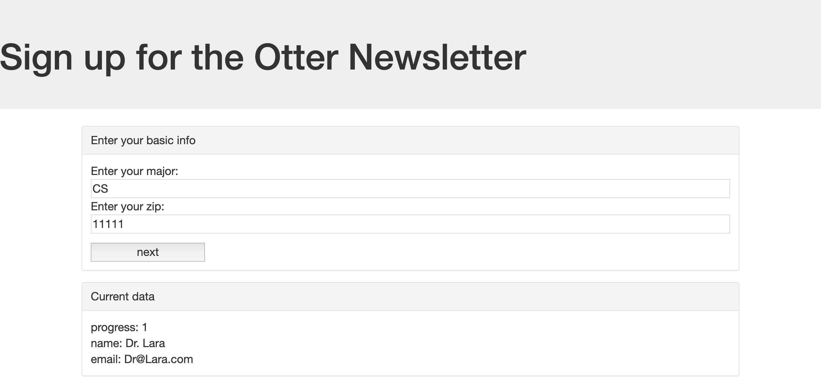
Task: Create a single page sign-up website

Slide 3
Directions:
Download the project files and unzip them to c9
2) Set up the database with the included SQL file
3) “Index.php” contains the HTML template as well as some functions. There is also some PHP files in the “API” folder.
4) Start by looking at how you can save data through the session in the “saveData.php” file
5) Implement the ability to save the user’s data when they click the “next” button

Slide 4
Rubric:
3 Points
1) Send user data through Ajax Call
2) Save user data in a Session – will persist through refresh
3) Insert new row into database table with the session data
+2 Points
4) The appropriate page is displayed if user refreshes halfway through
5) Error handling prevents an empty submission

