Slide 1
Development of a Drug Store Management System of a Simple Drug Store/Pharmacy
by
Md. Sofiqul Islam
J2EE(Round-37)

Slide 2
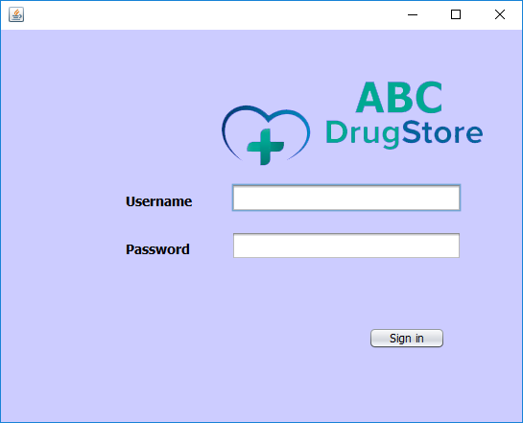
Admin Sign in Page

Slide 3
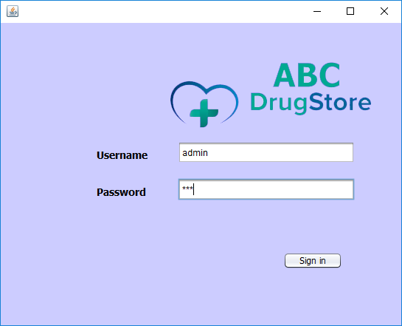
Sign in With Username & Password

Slide 4
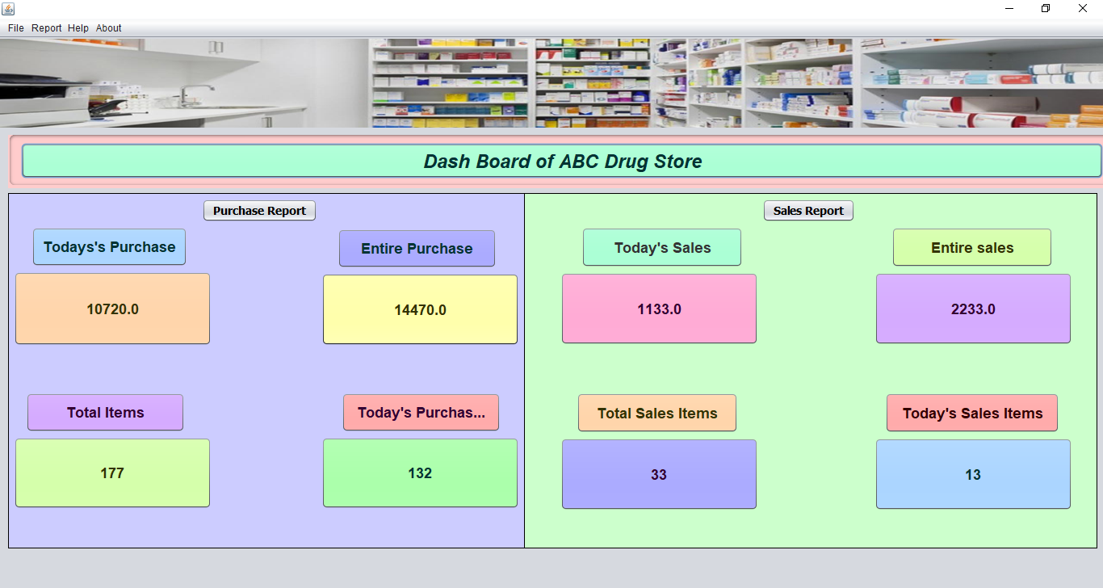
Dashboard

Slide 5
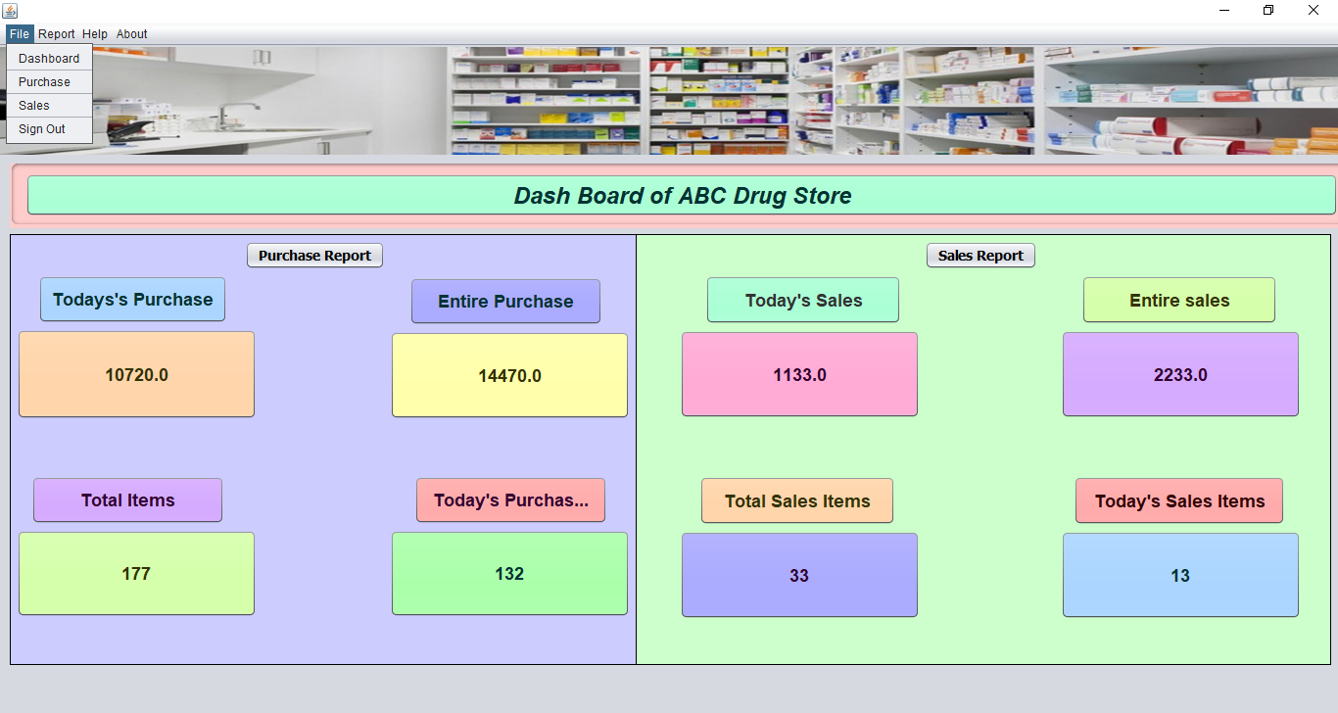
File Menu

Slide 6
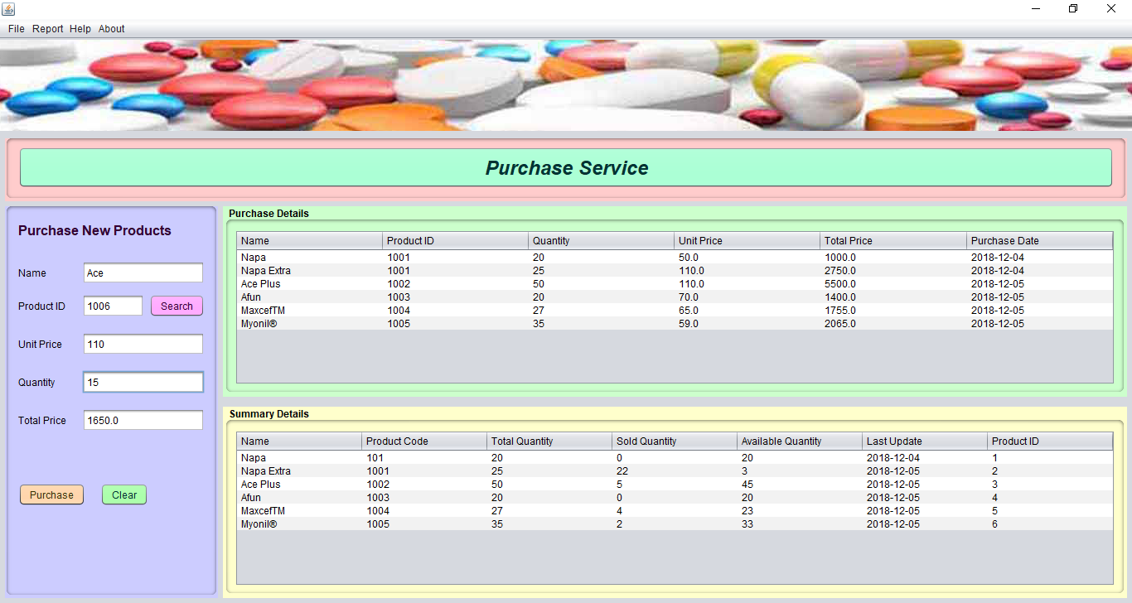
Purchase Service

Slide 7
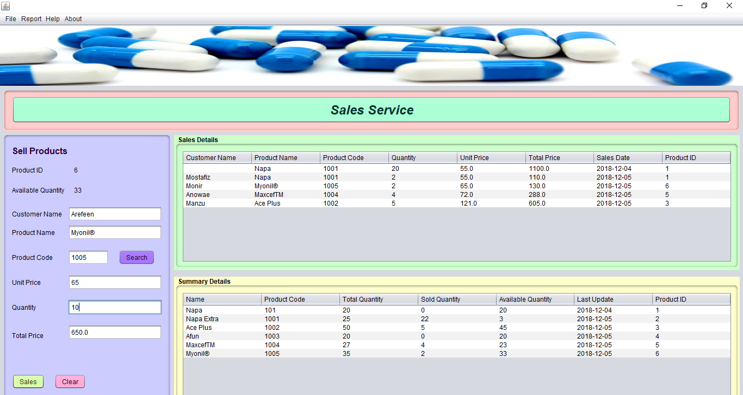
Sales Service

Slide 8
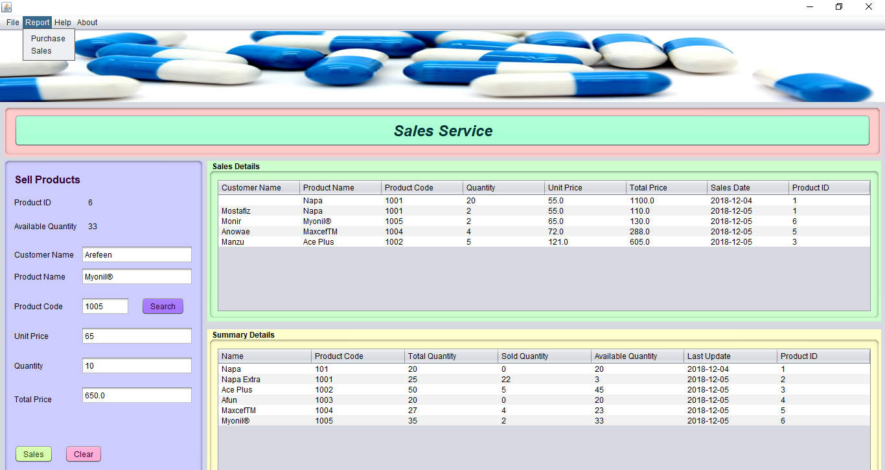
Report Menu

Slide 9
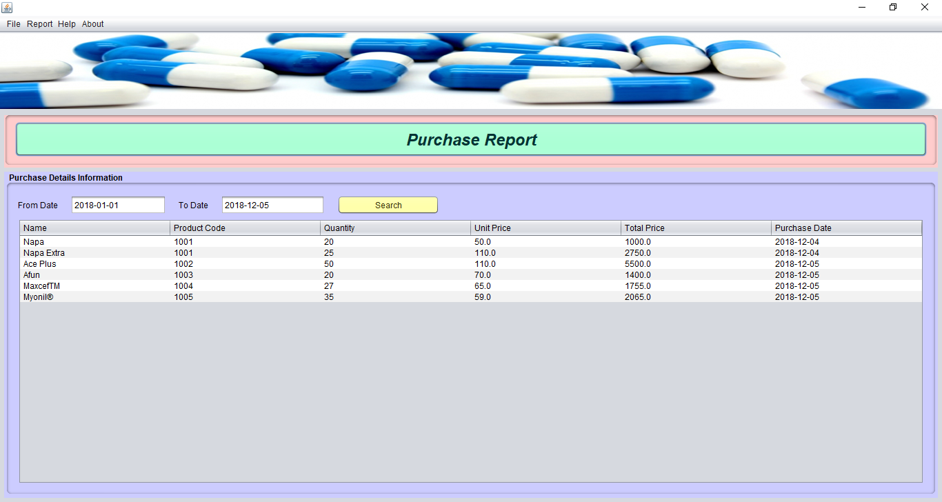
Purchase Report

Slide 10
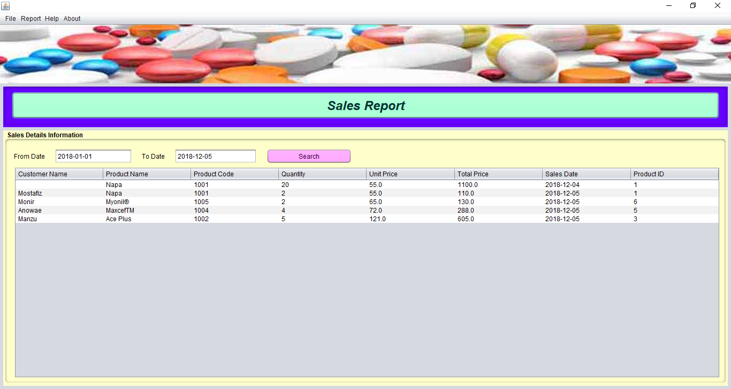
Sales Report

Slide 11
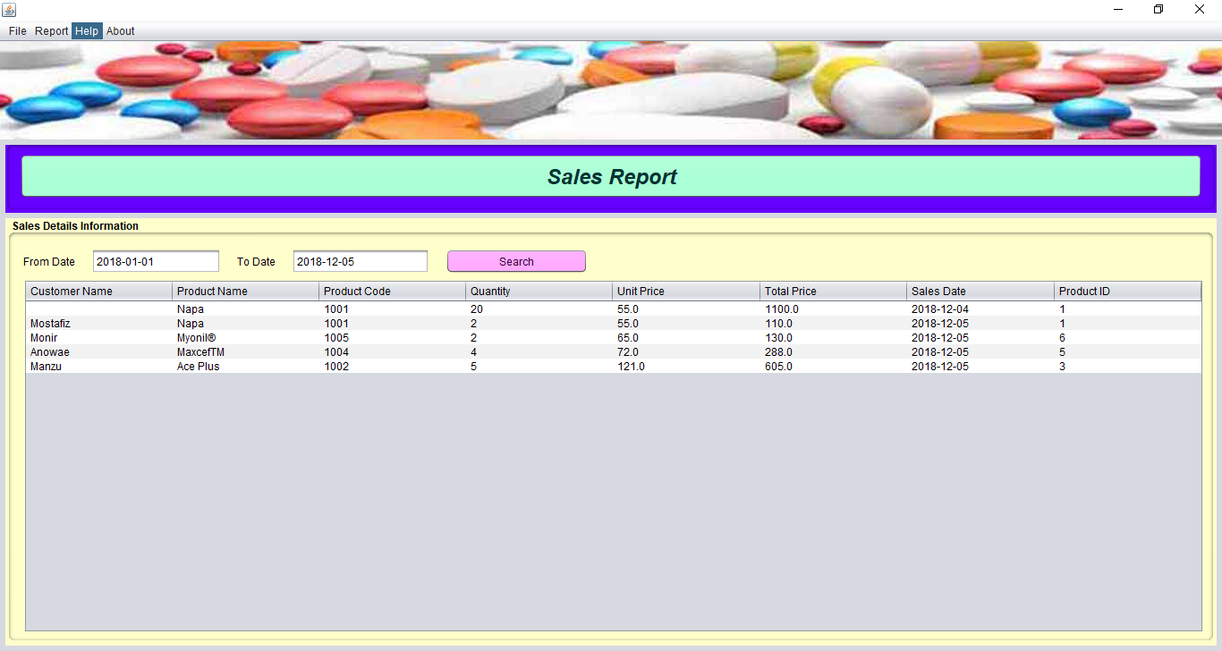
Help Menu

Slide 12
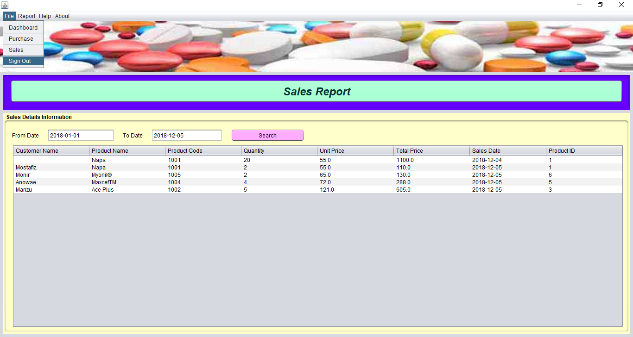
Sign Out Option

Slide 13
Thank You

