Slide 1
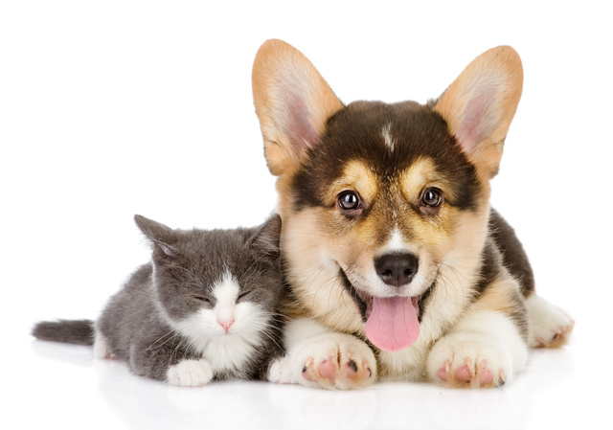
Happy pet

Slide 2

Team “Happy Pet”

Slide 3

Problem Statement
Problem
How does it effect customers
Solution
Who is affected
Many questions appear when you buy a pet
Pets, owners
You have answers for your questions
You are afraid to hurt pet
People found a pet, but they can't leave it at their home. However, they want to give it in good hands.
The animal doesn’t have a home
The ability to find a host on the site
Pets, owners

Slide 4
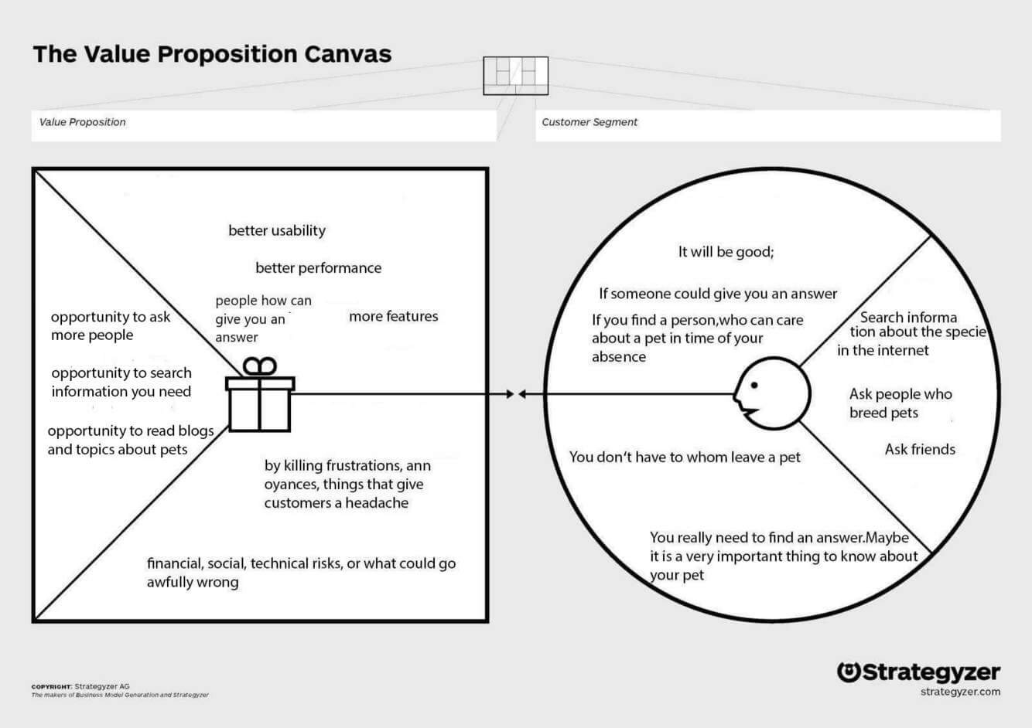

Slide 5
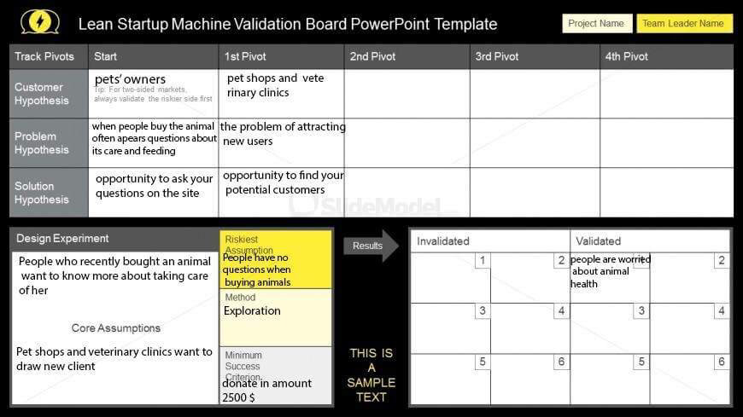
Validation Board

Slide 6

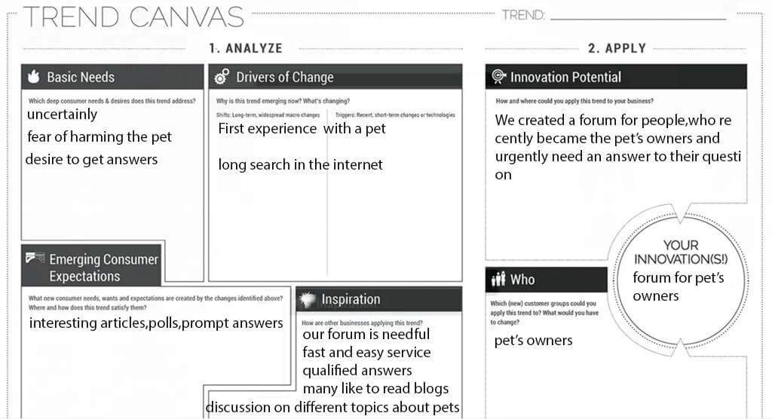

Slide 7
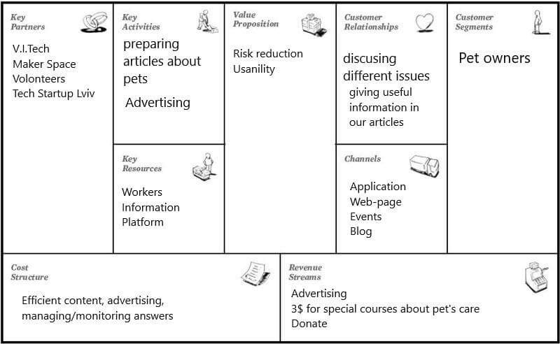
Business Model Canvas

Slide 8
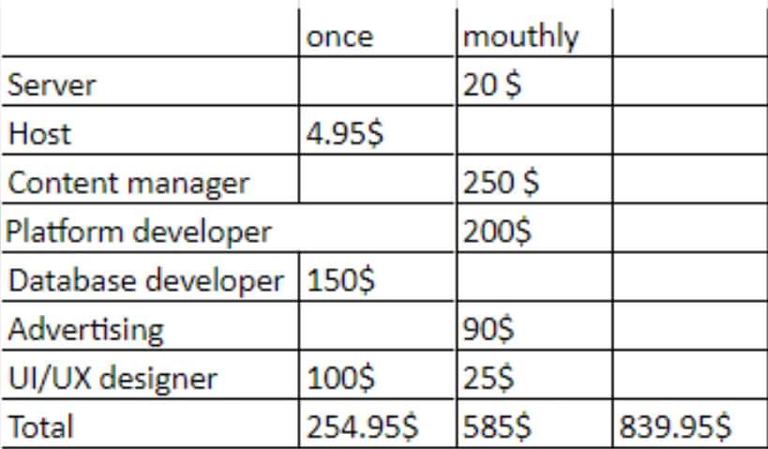
Finances
We ask for 1000$​

Slide 9

Thanks for your attention
Any questions?

