Slide 1
Java programming
Prepared by: Biravi

Slide 2
Introduction
Java is a popular, high-level, object-oriented programming language
first released by Sun Microsystems (now owned by Oracle)
in 1995.
It was designed with the core principle of "Write Once, Run Anywhere" (WORA), meaning code compiled for one platform can run on any other device with a Java Virtual Machine (JVM).

Slide 3
Core Components
The Java ecosystem is built on three main pillars that allow for development and execution:
JVM (Java Virtual Machine): The engine that executes Java bytecode, translating it into machine-specific code for the host operating system.
JRE (Java Runtime Environment): A package that includes the JVM, core libraries, and other components necessary to run Java applications.
JDK (Java Development Kit): The full developer suite that includes the JRE plus development tools like the Java Compiler (javac) and debugger

Slide 4
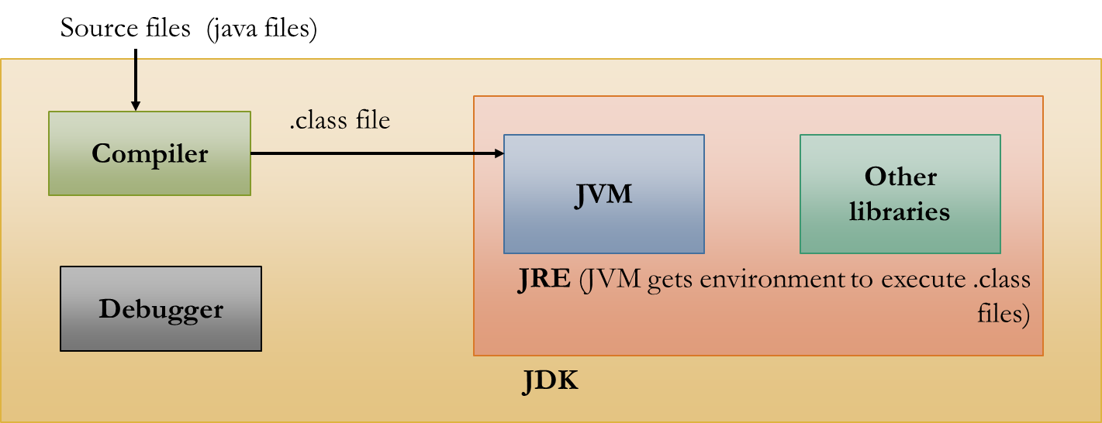
Java ecosystem

Slide 5
Main Editions of Java
Different editions cater to specific development needs:
Java SE (Standard Edition): The core platform for desktop and server applications.
Java EE (Enterprise Edition): Built on SE, it is used for large-scale, distributed enterprise applications.
Java ME (Micro Edition): Specialized for mobile devices and embedded systems with limited resources.
JavaFX: Focused on creating modern, multimedia-rich graphical user interfaces

Slide 6
Features of Java
Object-Oriented: Organises software as a combination of data and methods using objects and classes.
Platform Independent: Compiles code into bytecode that runs on any system with a JVM (Write Once, Run Anywhere).
Secure: Provides a virus-free, tempered-resistant environment by running code in a secure sandbox.
Robust: Ensures reliability through strong memory management, automatic garbage collection, and exception handling.
Architecture Neutral: Maintains fixed sizes for primitive data types regardless of the underlying hardware or OS.

Slide 7
Features of Java
Portable: Enables easy execution on any platform without needing to recompile the source code.
Multithreaded: Allows a single program to execute multiple tasks simultaneously for better CPU efficiency.
High Performance: Enhances execution speed using a Just-In-Time (JIT) compiler to convert bytecode to machine code.
Distributed: Built-in capabilities allow applications to access files and resources across a network seamlessly.
Dynamic: Supports dynamic loading of classes and can adapt to evolving environments at runtime.

Slide 8
Installation
Download the jdk from oracle official website.
Run the installer file.
Set the path variables in environmental variables.
Now its set

Slide 9
How to Run
Write java programs using text editor like notepad and save with file extension .java.
Now open IDE or code editor or command promt
Use javac filename.java to compile.
Use java filename for running the program.
The output will be displayed.

Slide 10
Java Program Structure
Package & import statement
public class Main { //class
public static void main(String[] args) { //main function
System.out.println("Hello World");
}
}

Slide 11
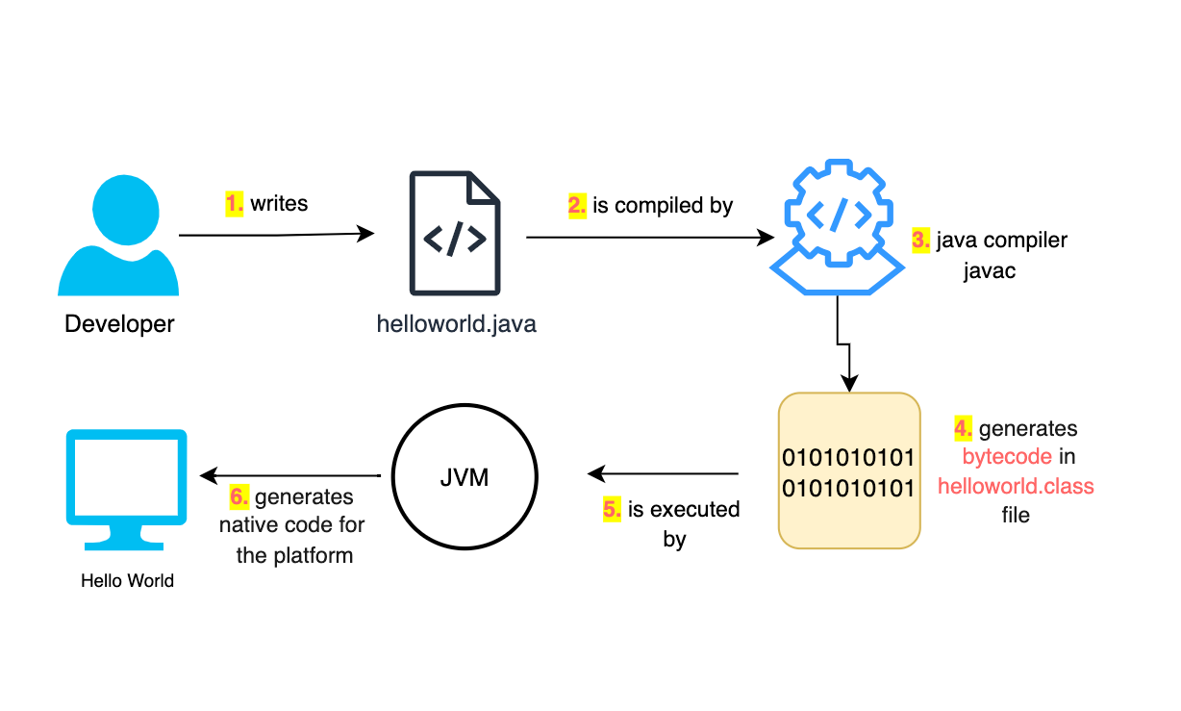
Execution of java code

Slide 12
Java basics
Tokens in java

Slide 13
Keywords
In Java, keywords (also known as reserved words) are predefined identifiers with specific meanings to the Java compiler. These words cannot be used as names for variables, methods, or classes.
As of recent versions like Java 21, there are approximately 53 to 68 keywords,

Slide 14
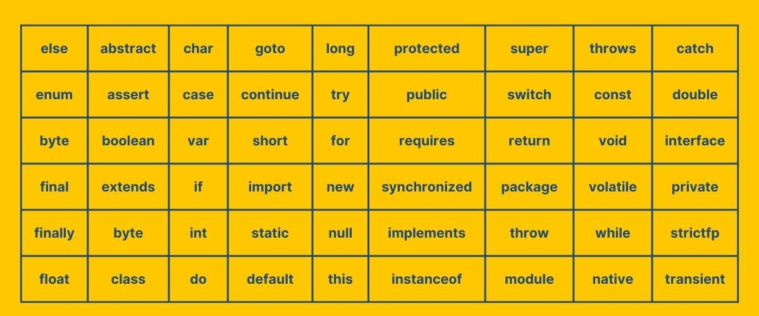

Slide 15
Identifiers
In Java, identifiers are symbolic names that developers give to program elements like variables, methods, classes, and packages to uniquely identify them.

Slide 16
Literals
In Java, literals are the fixed values you write directly into your source code—like 10, 'A', or "Hello World".
Unlike variables, their values are constant and do not change while the program is running
Integer literals
Floating point literals
Character and string literals

Slide 17
Datatypes

Slide 18
Primitive data types
Interger
Floating-point
Character
Boolean

Slide 19
Non-primitive datatype
Non-primitive types refer to objects and are created by the programmer (except for String). They store memory addresses (references) rather than the actual values.
String: A sequence of characters (e.g., "Hello").
Arrays: Collections of multiple elements of the same type.
Classes: Blueprints for creating objects.
Interfaces: Abstract types that specify behavior for classes to implement.

Slide 20
Key Differences
Aspect | Primitive Data Types | Non-Primitive Data Types
Memory Storage | Stores actual values (e.g., numbers, characters). | Stores references to objects or data structures.
Size | Fixed size (e.g., int is 4 bytes). | Variable size (depends on the object or data structure).
Data Representation | Simple, holds a single value. | Can represent complex data (objects, collections, etc.).
Mutability | Mutable (except final variables). | Can be mutable or immutable (e.g., String is immutable).
Examples | int, char, boolean, float, long. | String, Arrays, Classes, Interfaces.

Slide 21
Variables
Local
Instance
static

Slide 22
Local Variables
Declaration:
Local variables are declared inside a method, constructor, or block.
Scope:
Their scope is limited to the method, constructor, or block in which they are declared.
Lifetime:
The lifetime of local variables starts when the method, constructor, or block is entered and destroyed when it is exited.
Initialization:
A local variable must be initialized before you can use them.

Slide 23
Instance Variables
Declaration:
Instance variables are declared inside a class but outside any method, constructor, or block.
Scope:
They are accessible from any method, constructor, or block within the class (non-static context).
Lifetime:
The lifetime of an instance variable starts when an object is created and ends when the object is destroyed.
Initialization:
If these variables are not initialized, they are by default initialized to their default values (e.g., 0 for integers, null for objects).

Slide 24
Static Variables
Declaration:
Declared inside a class with the static keyword.
Scope:
They are accessible inside the class. They can be accessed using class name.
Lifetime:
The lifetime of a static variable starts when a class is loaded into the memory by JVM and ends when the class is unloaded.

Slide 25
Type casting

Slide 26
1. Widening Casting (Implicit)
This happens automatically when you convert a smaller primitive type to a larger one. Since the target type is larger, there is no risk of data loss.
Order: byte → short → char → int → long → float → double
  int myInt = 9;
  double myDouble = myInt; // Automatic casting: int to double

Slide 27
2. Narrowing Casting (Explicit)
This must be done manually by placing the target type in parentheses. It is used when converting a larger type to a smaller one, which can lead to data loss (like losing decimal places).
Order: double → float → long → int → char → short → byte
double myDouble = 9.78d;
int myInt = (int) myDouble; // Manual casting: double to int (outputs 9)

Slide 28
Operators
Arithmetic Operators
Relational Operators
Logical Operators
Assignment Operators
Unary Operators
Ternary Operator

Slide 29
Arithmetic Operators
Addition
Subraction
Multiplication
Division
modulus

Slide 30
Relational operators
==
!=
<
>
<=
>=

Slide 31
Logical operators
&&
||
!

Slide 32
Assignment operator
=
+=
-=
*=
/=
%=

Slide 33
Unary operator
++
--

Slide 34
Ternary operator
variable = (condition) ? expressionTrue : expressionFalse;

Slide 35
If condition
if (condition) {
// block of code to be executed if the condition is true
}

Slide 36
If-else condition
if (condition)
{
// block of code to be executed if the condition is true
} else
{
// block of code to be executed if the condition is false
}

Slide 37
Else if
if (condition1) {
// block of code to be executed if condition1 is true
} else if (condition2) {
// block of code to be executed if condition1 is false and condition2 is true
} else {
// block of code to be executed if both conditions are false
}

Slide 38
Nested if
if (condition1) {
// code to run if condition1 is true
if (condition2) {
// code to run if both condition1 and condition2 are true
}
}

Slide 39
switch statements
switch(expression) {
case x:
// code block
break;
case y:
// code block
break;
default:
// code block
}

Slide 40
Looping statements-for
for (statement 1; statement 2; statement 3) {
// code block to be executed
}
Exactly how many times the loop need to be executed

Slide 41
while
The while loop repeats a block of code as long as the specified condition is true
Int Loopvar=0;
while (condition) {
// code block to be executed
}

Slide 42
For-each loop
loop through elements in an array
for (type variableName : arrayName) {
// code block to be executed
}
String[] cars = {"Volvo", "BMW", "Ford", "Mazda"};
Eg:
for (String car : cars) {
System.out.println(car);
}

Slide 43
Do while loop
do {
// code block to be executed
}
while (condition);

Slide 44
Nested loops
for (int i = 1; i <= 2; i++) {
System.out.println("Outer: " + i); // Executes 2 times
// Inner loop
for (int j = 1; j <= 3; j++) {
System.out.println(" Inner: " + j); // Executes 6 times (2 * 3)
}
}

Slide 45
Break statement
The break statement can also be used to jump out of a loop.
for (int i = 0; i < 10; i++) {
if (i == 4) {
break;
}
System.out.println(i);
}

Slide 46
Continue statement
The continue statement breaks one iteration (in the loop), if a specified condition occurs, and continues with the next iteration in the loop.
This example skips the value of 4:
for (int i = 0; i < 10; i++) {
if (i == 4) {
continue;
}
System.out.println(i);
}

Slide 47
Arrays
Storing same type of data in a collection

Slide 48
Arrays
define the variable type with square brackets [ ].
String[] cars;
Insert values for arrays , list the values in the comma separated list inside the{}.
String[] cars={“audi”,”bmw”,”benz”};
Int[] mynumbers={1,2,3,4,5,6,7,8};

Slide 49
Accessing of array elements
String[] cars = {"Volvo", "BMW", "Ford", "Mazda"};
System.out.println(cars[0]);
// Outputs Volvo
To change array element
Cars[4]=“audi”;

Slide 50
1-D arrays
String[] cars={“cars”,”audi”,”bmw”};
System.out.println(cars[0]);

Slide 51
2-D arrays
Contains rows and columns
Int[] num={{1,2,3,4},{5,6,7,8}};
Int I,j;
for(i=0;i<2;i++) {
For(j=0;j<4;j++){
System.out.println(num[i][j]);
}
}

Slide 52
Array Traversal
Int[] num={1,2,3,4};
Int i;
for(i=0;i<4;i++) {
System.out.println(num[i]);
}

Slide 53
For each loop
which is used exclusively to loop through elements in an array.
Int[] num={1,2,3,4};
for(int x:num)
{
System.out.println(num[x]);
}

Slide 54
Strings
The String class has a set of built-in methods that you can use on strings.
Difference between string literal and new keyword
String class
String method

Slide 55
Method | What it returns | What it does
length() | int | Counts all characters.
charAt(i) | char | Fetches the character at position i.
trim() | String | Erases empty spaces from both ends.
substring(start, end) | String | Extracts text from start index up to (but excluding) end index.
contains("xyz") | boolean | Checks if "xyz" exists anywhere inside the string.
equals("abc") | boolean | Safely checks if two strings have identical content.

