Slide 1
Md Sofiya Naaz
Final Project
3/21/2024 Annual Review

Slide 2
Keylogger and Security
3/21/2024 Annual Review

Slide 3


AGENDA
Introduction to Keyloggers and Security
Problem Statement
Overview of the project
Identifying the End Users
Value Proposition
Solutions
Modelling Techniques
Presenting Result
3/21/2024 Annual Review

Slide 4

PROBLEM STATEMENT
Develop a secure keylogger software that effectively logs keystrokes on a target system while implementing on strong encryption and access controls to prevent unauthorize access to logged data to ensure the privacy and integrity.
3/21/2024 Annual Review

Slide 5

PROJECT OVERVIEW
OBJECTIVE :
To develop a brief understanding of keyloggers, its types and how they work , security measures to prevent keylogger attacks .
SCOPE :
Analysing the hardware and software keyloggers, its ethical implications ,security measures and practices.
3/21/2024 Annual Review

Slide 6




WHO ARE THE END USERS?
End users in the context of keylogging and processing can vary depending on the intent and legality of the activity. Here are some scenarios:
Hackers and Cybercriminals : These individuals use keyloggers to steal sensitive information, such as passwords, credit card numbers, and personal data, for financial gain, identity theft, or other illegal activities.
Corporate Spies: They might use keyloggers to obtain confidential information from competitors.
IT Administrators and Security Professionals: In some organizations, keyloggers might be used for monitoring and securing the network, ensuring employees are not engaging in unauthorized activities that could compromise security.
Parental Control Software: Parents may use keyloggers to monitor their children's online activities to protect them from potential dangers like cyberbullying or inappropriate content.
Employers: Some companies use keyloggers to monitor employee productivity and ensure compliance with company policies.
3/21/2024 Annual Review

Slide 7

YOUR SOLUTION AND ITS VALUE PROPOSITION
Solutions:
Keylogging and processing solutions encompass a range of software and hardware tools designed for different purposes, from cybersecurity to monitoring and data analysis. Here’s an overview of common solutions and their typical applications
Hardware Keyloggers:
USB Keyloggers: These devices are plugged into a computer’s USB port to capture keystrokes. They are often used for physical security testing.
PS/2 Keyloggers: These are similar to USB keyloggers but are used with older keyboards that connect via a PS/2 port.
Wireless Keyloggers: These can capture keystrokes from wireless keyboards by intercepting the signals between the keyboard and the computer.
Software Keyloggers:
Commercial Keylogging Software: Products like Refog , Kidlogger, and Spyrix offer features for monitoring employees, children, or personal use. These solutions usually come with features like screenshot capturing, email reports, and remote monitoring.
Open-Source Keyloggers: There are various open-source keyloggers available for educational and security research purposes, such as PyKeylogger and Logkeys.
3/21/2024 Annual Review

Slide 8
VALUE PROPOSITION
A keylogger, short for keystroke logger, is a type of software or hardware device designed to record keystrokes made by a user. Keyloggers are often associated with malicious activities such as stealing personal information, but they can also have legitimate uses, such as in employee monitoring, IT troubleshooting, or studying user behavior.
Value Proposition of a Keylogger
Threat Detection: Helps in identifying potential security breaches by monitoring and analyzing keystrokes for suspicious activity.
Data Recovery: Assists in recovering lost data due to system crashes or accidental deletion.
Employee Monitoring : Allows employers to monitor employee activities to ensure efficient use of work hours.
Processing Value Proposition
Processing, in the context of keylogging, involves analyzing the collected keystroke data to extract meaningful insights and actionable information. The value proposition of processing this data includes:
Pattern Recognition : Identifies patterns and trends in user behavior that can be used to improve security protocols and user experience.
Real-time Alerts : Triggers immediate alerts to administrators when suspicious activities are detected, allowing for quick response to potential threats.
Automated Actions: Implements automated actions such as locking accounts or initiating additional security measures when specific criteria are met.

Slide 9
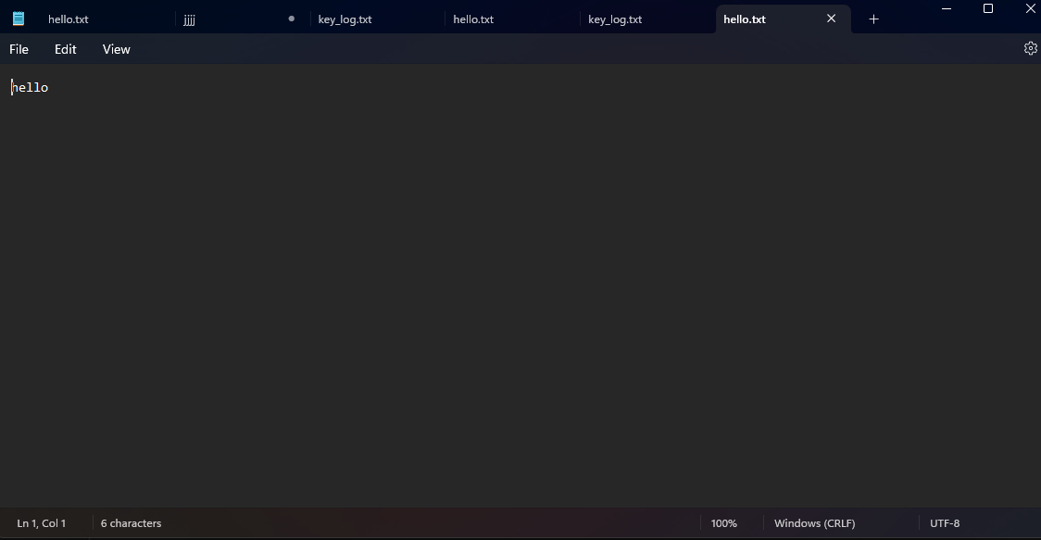

THE WOW IN YOUR SOLUTION
3/21/2024 Annual Review
9

Slide 10
MODELLING
Keyloggers are software or hardware tools that capture and record keystrokes on a computer. When modeling keyloggers, several techniques can be employed to simulate their behavior, understand their mechanisms, or develop defenses against them. Here are some common modeling techniques for keyloggers:
1. Behavioral Modeling :Behavioral modeling involves understanding and simulating the behavior of keyloggers to detect their presence or predict their actions.
Signature-based Detection: Identifying keyloggers based on known signatures or patterns in code.
Anomaly Detection: Using machine learning algorithms to identify deviations from normal system behavior that may indicate the presence of a keylogger.
2. Machine Learning Models :Machine learning techniques can be used to detect and classify keylogger activities.
Supervised Learning: Training models on labeled datasets containing benign and keylogger activities to classify new inputs. -
Algorithms: Support Vector Machines (SVM), Decision Trees, Random Forest, Neural Networks.
Unsupervised Learning: Detecting keyloggers by identifying patterns and anomalies in data without prior labeling. - Algorithms: Clustering (e.g., K-means), Principal Component Analysis (PCA), Autoencoders.
3. Network Traffic Analysis :Keyloggers may transmit captured data over a network. Analyzing network traffic can help identify these transmissions.
Packet Inspection: Inspecting packets for suspicious payloads that may contain captured keystrokes.
Traffic Patterns: Identifying unusual network traffic patterns indicative of data exfiltration
3/21/2024 Annual Review
10

Slide 11
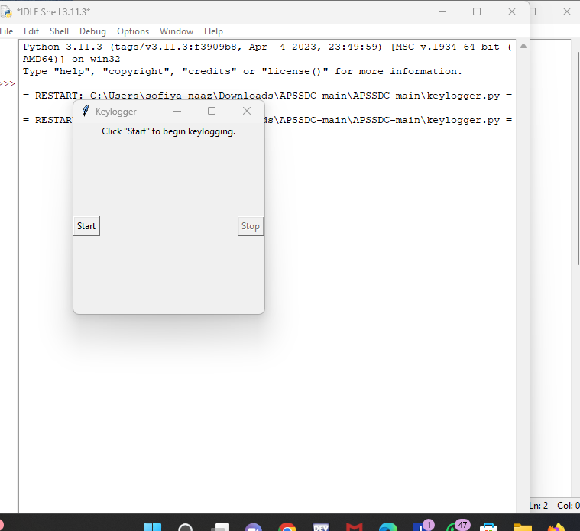
RESULTS
3/21/2024 Annual Review
11

Slide 12
THANK YOU

