Slide 1
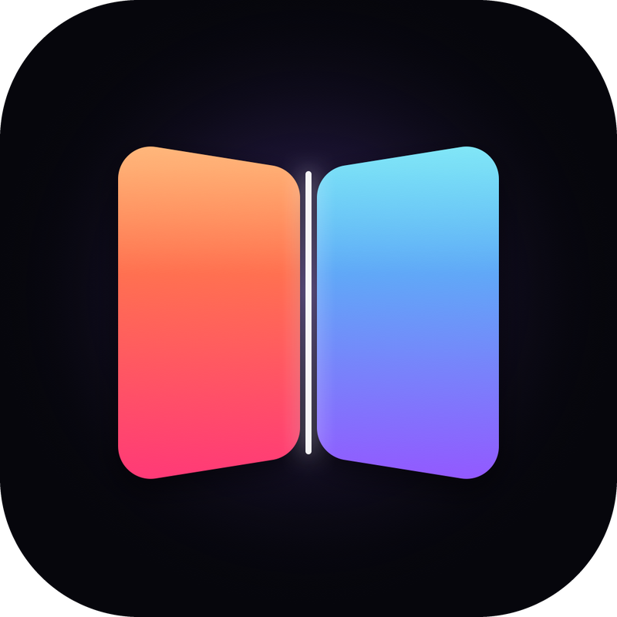
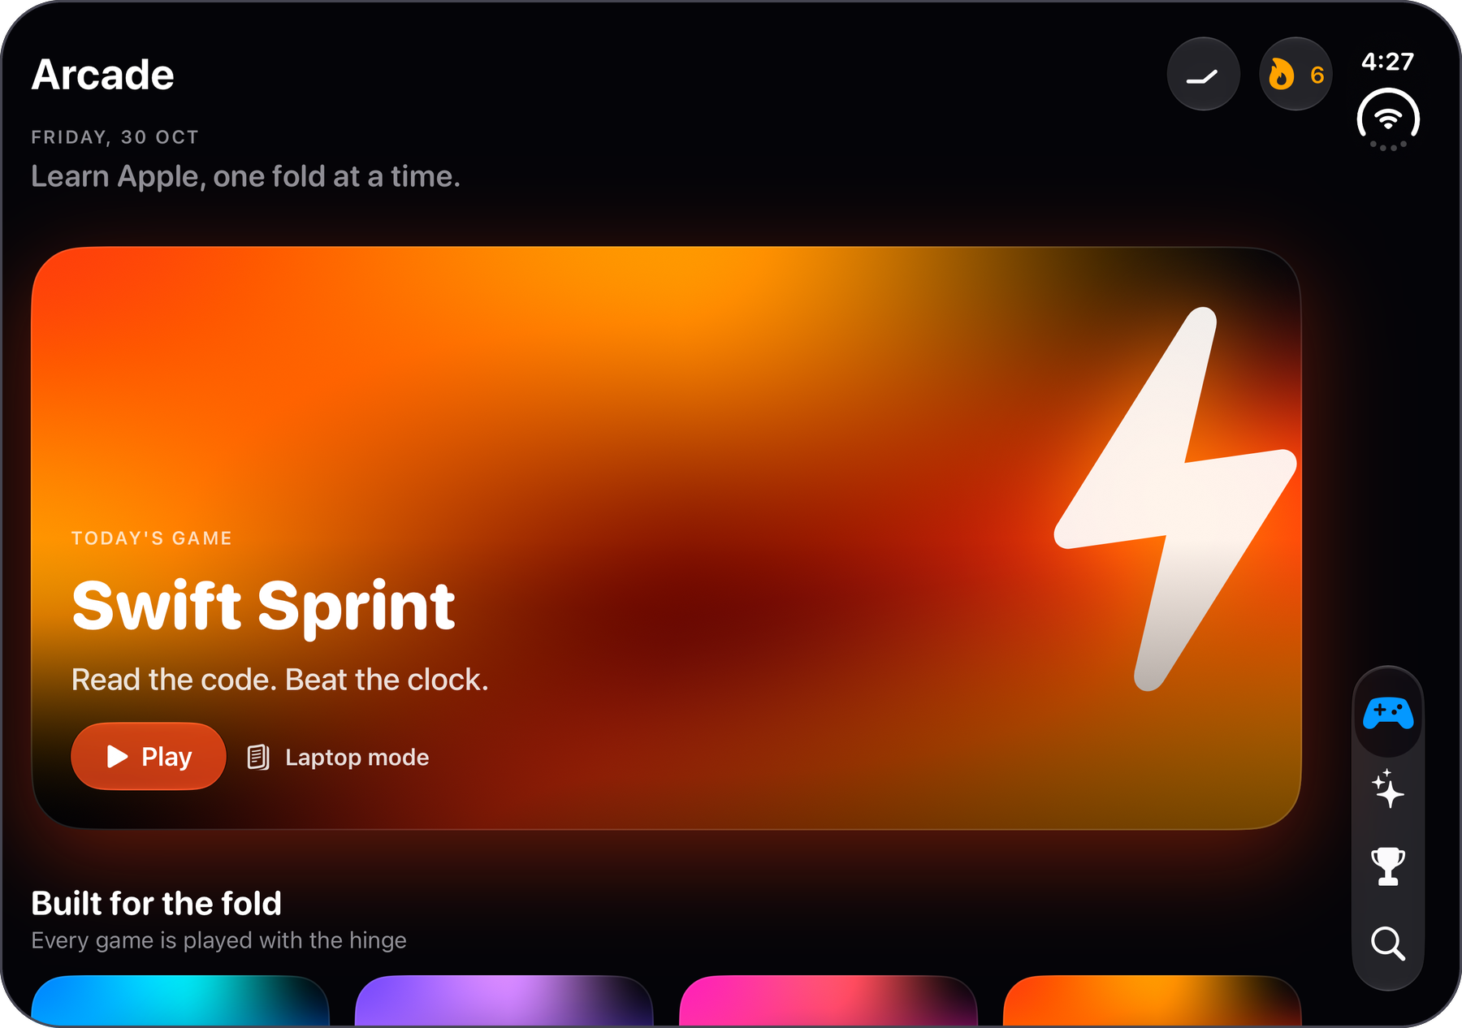
Unfold
Learn Apple, one fold at a time.
An AI-powered learning arcade built for iPhone Duo and iPhone 18 Pro Max.
4 fold-native games
On-device Apple Intelligence
Running on iPhone Duo's 7.6-inch inner display
Liquid Glass
iOS 27.1 hinge APIs
Sofiyan Shaikh · October 2026
Notes:
Unfold is a learning arcade for Swift, Apple frameworks and the Apple ecosystem. It's built for Apple's new foldable, iPhone Duo, and it adapts to iPhone 18 Pro Max. The name is the idea: you unfold the phone, and knowledge unfolds with it. In the next few minutes: four games that use the hinge as a controller, a private on-device AI coach, and the design research behind every pixel. Then a live demo.

Slide 2



Apple Arcade polish, with a curriculum inside
THE IDEA
Play to learn
The fold is the controller
A private AI coach
Four mini-games teach Swift, Apple frameworks, concurrency and 50 years of Apple history. Every mistake explains itself.
On iPhone Duo the hinge is the input: flip flashcards, dial through history, guard Swift's isolation boundary.
Apple Intelligence runs on the iPhone, reviews every round and answers questions grounded in Unfold's curriculum.
4
fold-native games
80
Apple concepts
100%
on-device AI
0
third-party libraries
Notes:
Think Apple Arcade, with a curriculum inside. Three pillars. One: play to learn, with four short games and instant explanations. Two: on iPhone Duo the fold itself is the controller, so the hardware teaches. Three: a private AI coach built on Apple Intelligence that runs entirely on the phone. All of it in SwiftUI with zero third-party code.

Slide 3
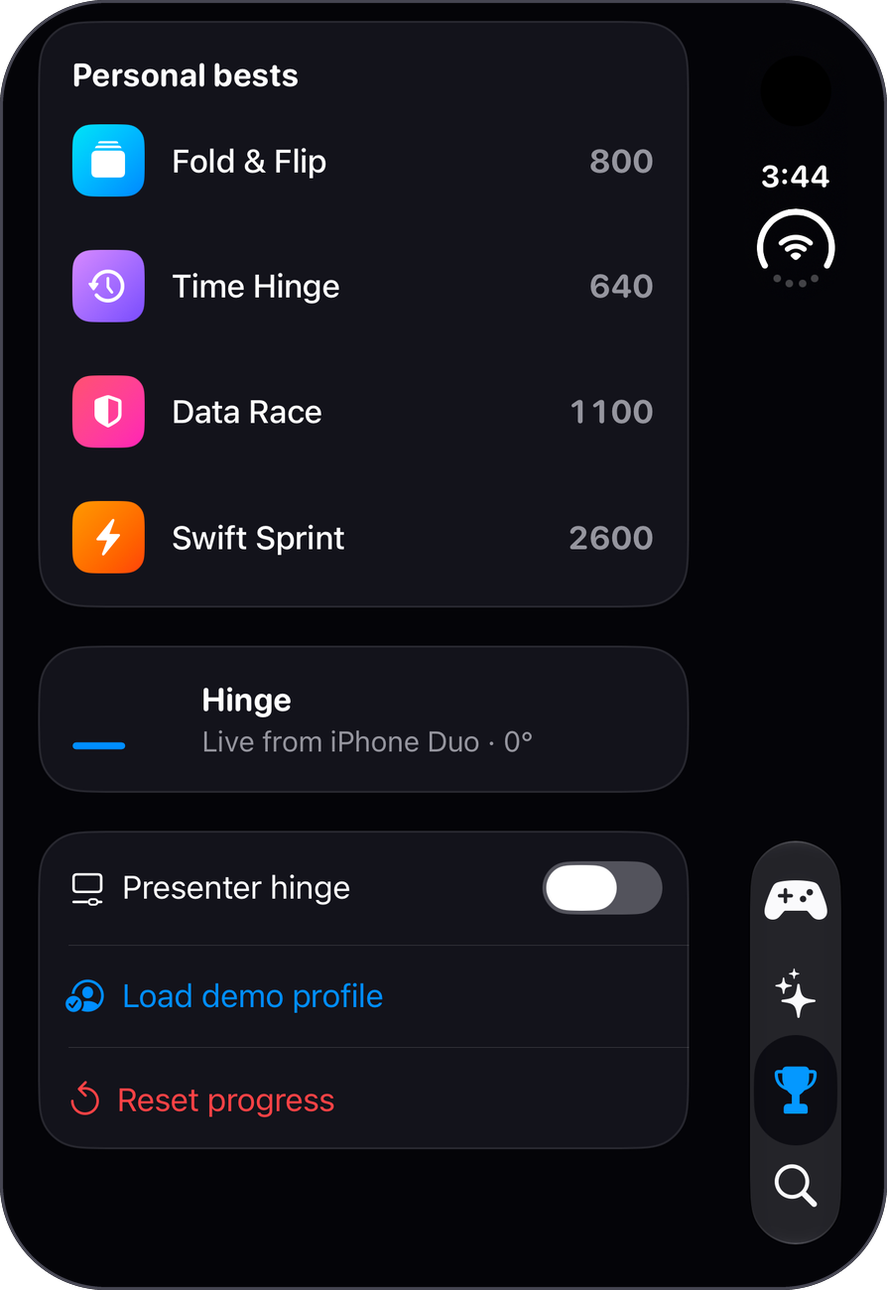


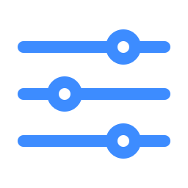
Built on Apple's real foldable APIs, not a fake slider
IPHONE DUO · iOS 27.1
.onHingeChange { _, context in
fold.hingeChanged(degrees: context.hinge?.angle.degrees)
}
geo.reservedRegions(kind: .division) // the crease
Live hinge angle and status
onHingeChange feeds one FoldState; the iPhone Duo Simulator reports it live (right).
Displacement on the crease
The fold is a reserved region, so content moves off it instead of being cut in half.
Presenter hinge
A Liquid Glass slider drives the same engine, so fold play can be shown on any iPhone.
Notes:
This is the most important technical point. Unfold doesn't simulate a foldable; it uses the iOS 27.1 SDK. onHingeChange gives the real angle and status, and on the right you can see the iPhone Duo Simulator reporting it live. The crease comes from reservedRegions, so content is moved off the fold, which is the HIG's displacement principle. When the phone is closed, games switch to touch on the cover display. And a presenter hinge drives the same state from a slider, which is how I'll demo it today.

Slide 4
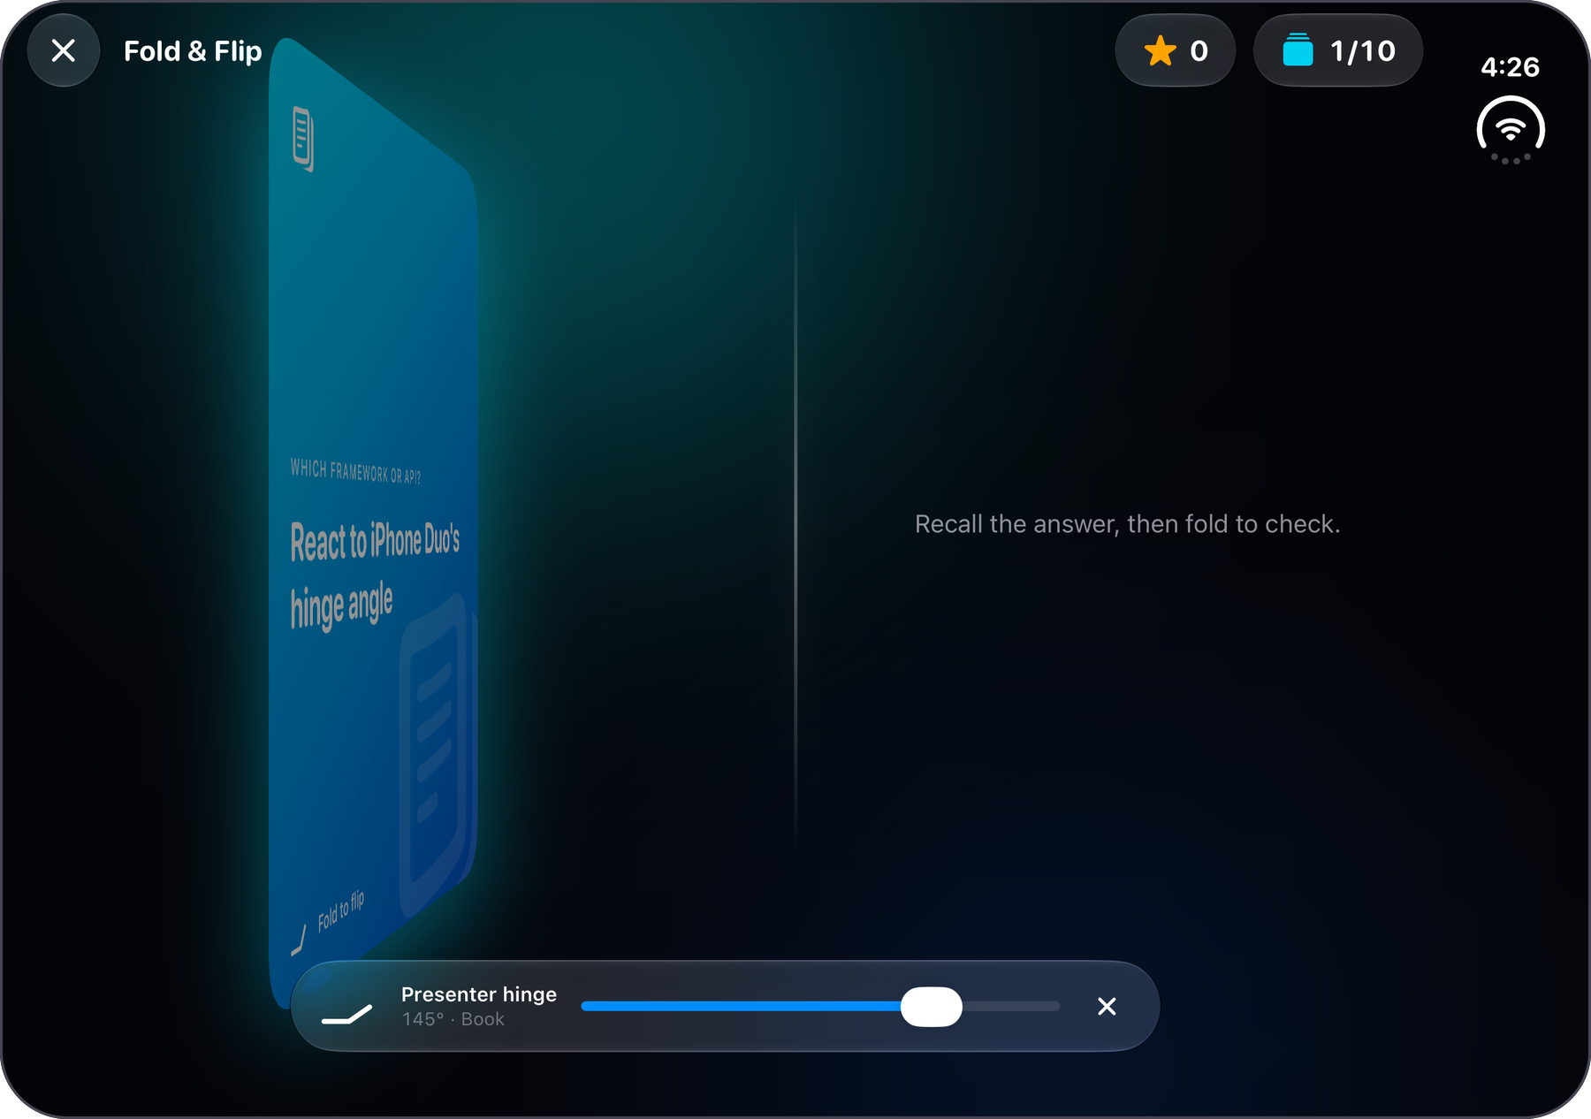
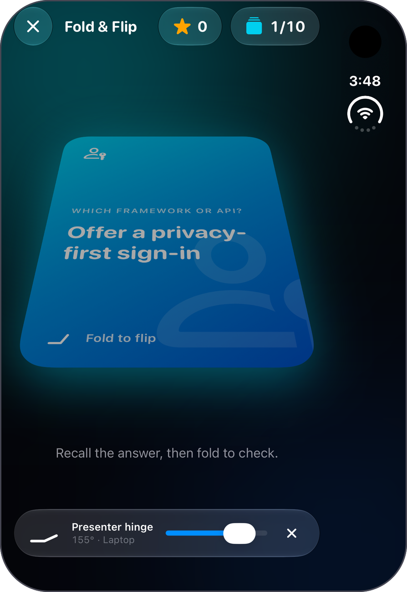
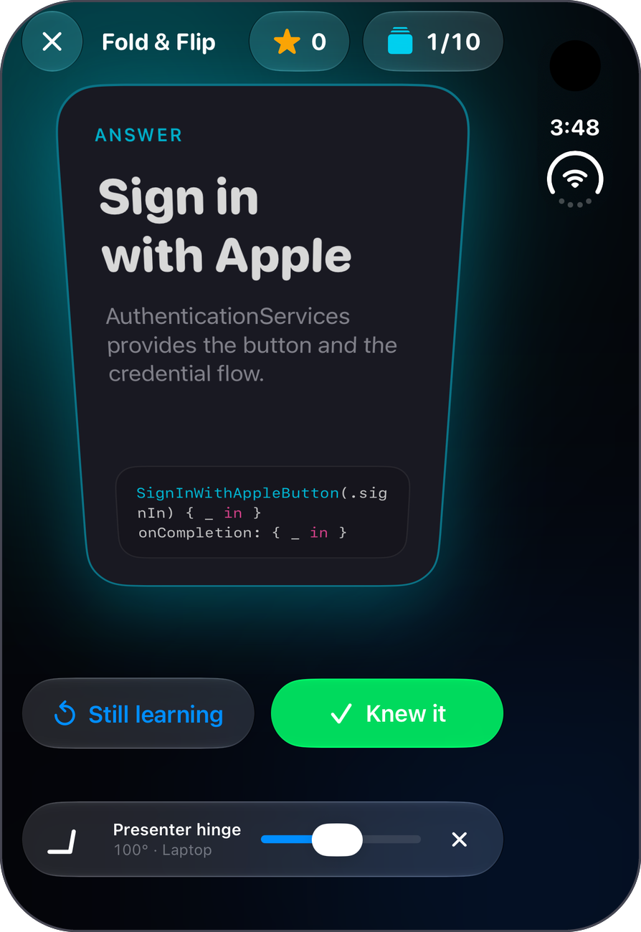
Fold & Flip: the card turns on the hinge's own axis
GAME 1 · FRAMEWORKS
Book pose · the card turns like a page
Laptop pose, 155° · tilts with the hinge
Past 90° · the answer, then unfold to deal
Notes:
Fold and Flip teaches which Apple framework does what. The flip is driven by the hinge angle. In laptop pose the card tilts back around a horizontal axis, exactly like the hinge; in book pose it turns like a page. Fold past 90 degrees and the answer appears; rate yourself, unfold flat, and the next card is dealt. Behind it is spaced repetition with Leitner boxes, so the cards you miss come back first. Without a hinge you tap or drag instead.

Slide 5
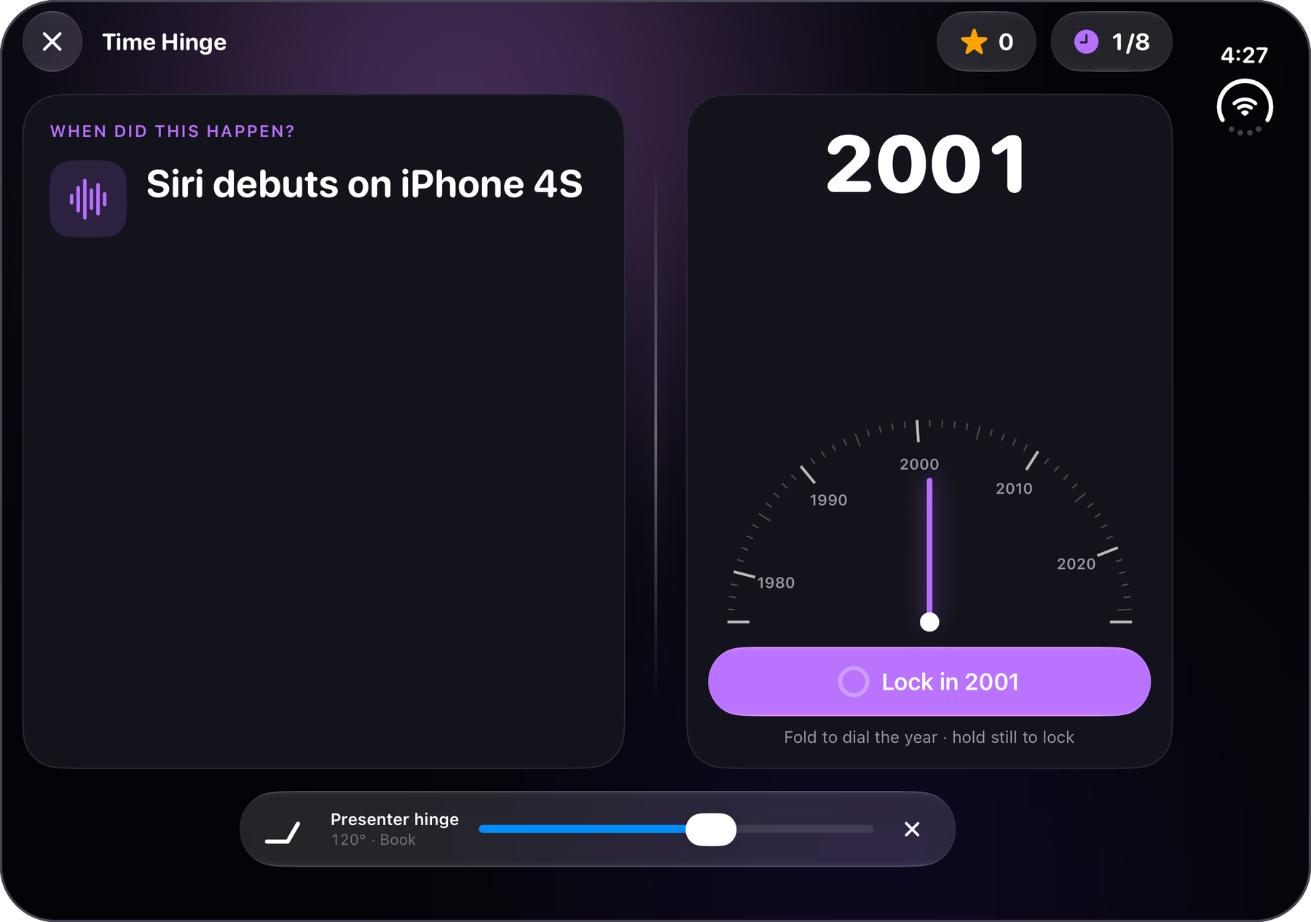
Time Hinge: the hinge is a dial through fifty years of Apple
GAME 2 · ECOSYSTEM
1
Read the moment
From Apple's founding in 1976 to iPhone Duo in 2026.
2
Fold to dial the year
The hinge's 40°–180° sweep maps onto 1976–2026, like a protractor.
3
Hold still to lock
After 1.3 seconds it locks. Exact scores 100; one year off scores 70.
Notes:
Time Hinge turns the hinge into a time machine. The usable hinge range maps onto fifty years, so folding the phone sweeps a protractor across Apple history. Hold still and it locks your guess; the green needle shows the real year and a short story. On the inner display the story sits on the left page and the dial on the right, split exactly at the crease.

Slide 6
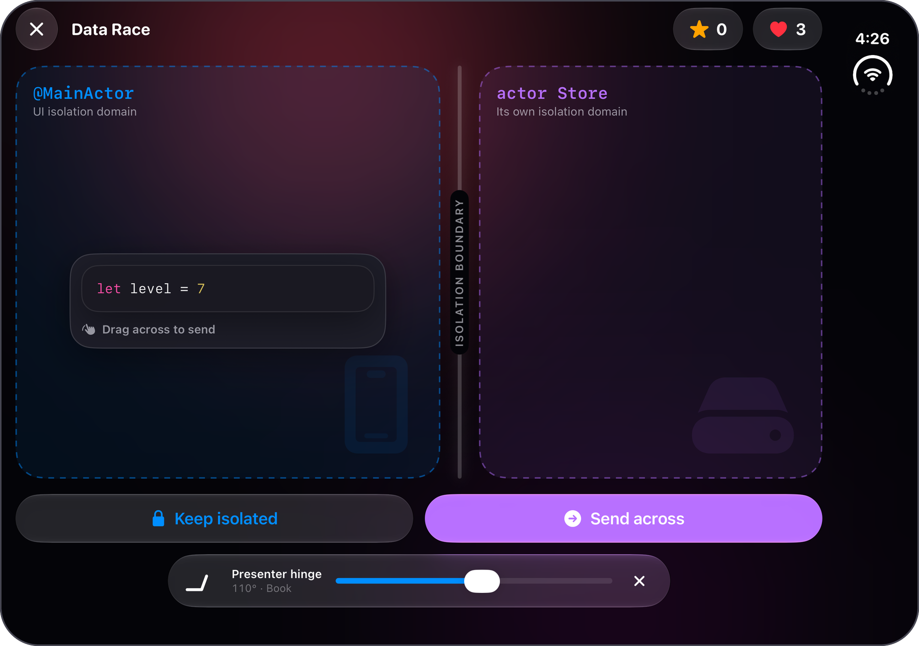
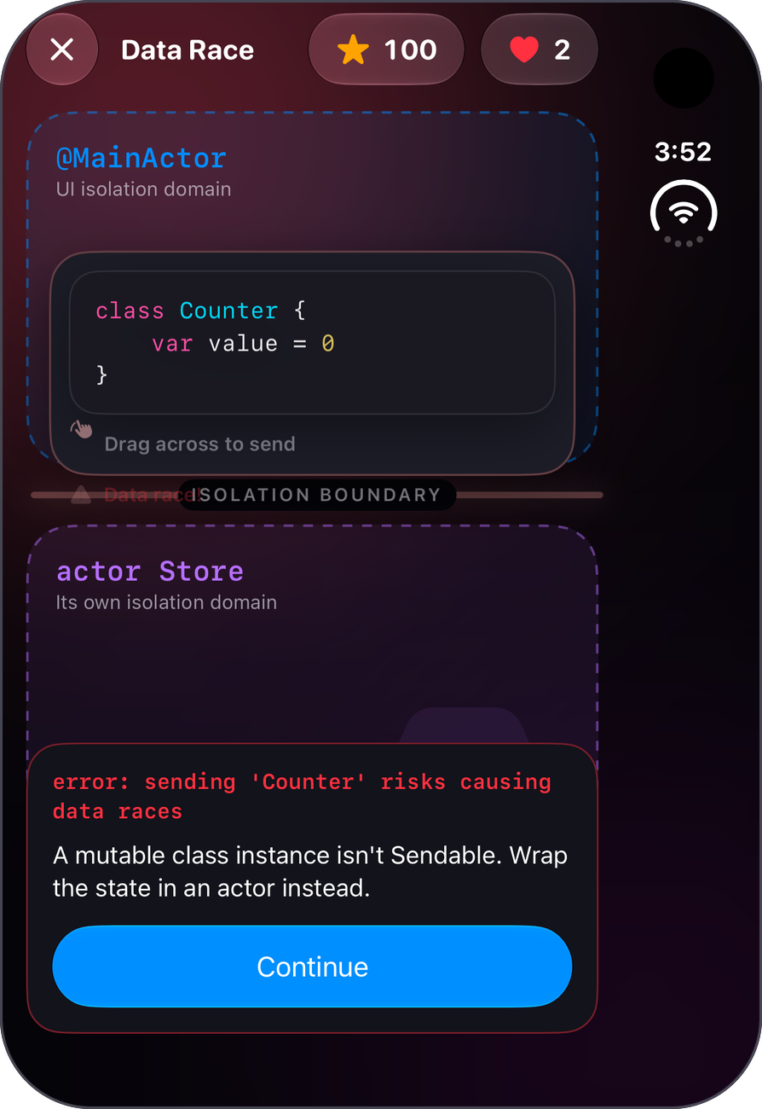
Data Race: the crease becomes Swift's isolation boundary
GAME 3 · SWIFT CONCURRENCY
Only Sendable crosses
Drag values from @MainActor to actor Store, or keep them home.
Real diagnostics
error: sending 'Counter' risks causing data races
Pro-level traps
@MainActor classes are Sendable; final immutable classes are not.
Book pose · the boundary sits exactly on the crease
Cover · a wrong move
Notes:
Data Race is Swift 6 concurrency made physical. The two halves of the screen are two isolation domains, the main actor and a Store actor, and the crease is the boundary between them. Drag Sendable values across; keep the rest home. Send a mutable class and you get the actual Swift 6 diagnostic and a plain-English fix. It includes the subtle cases an Apple engineer would ask about: main-actor classes are Sendable, but final immutable classes still need an explicit conformance.

Slide 7
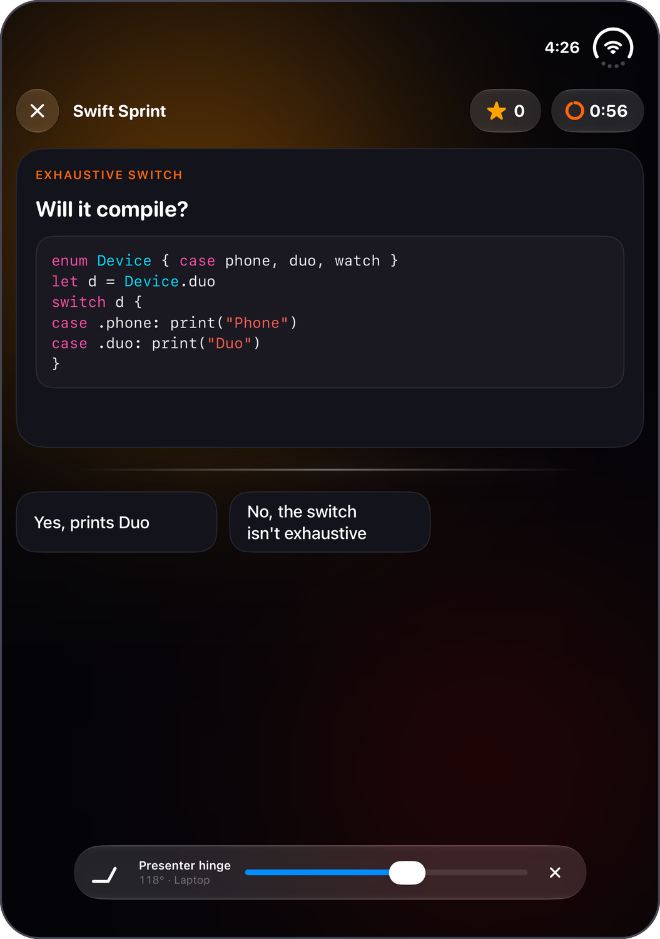
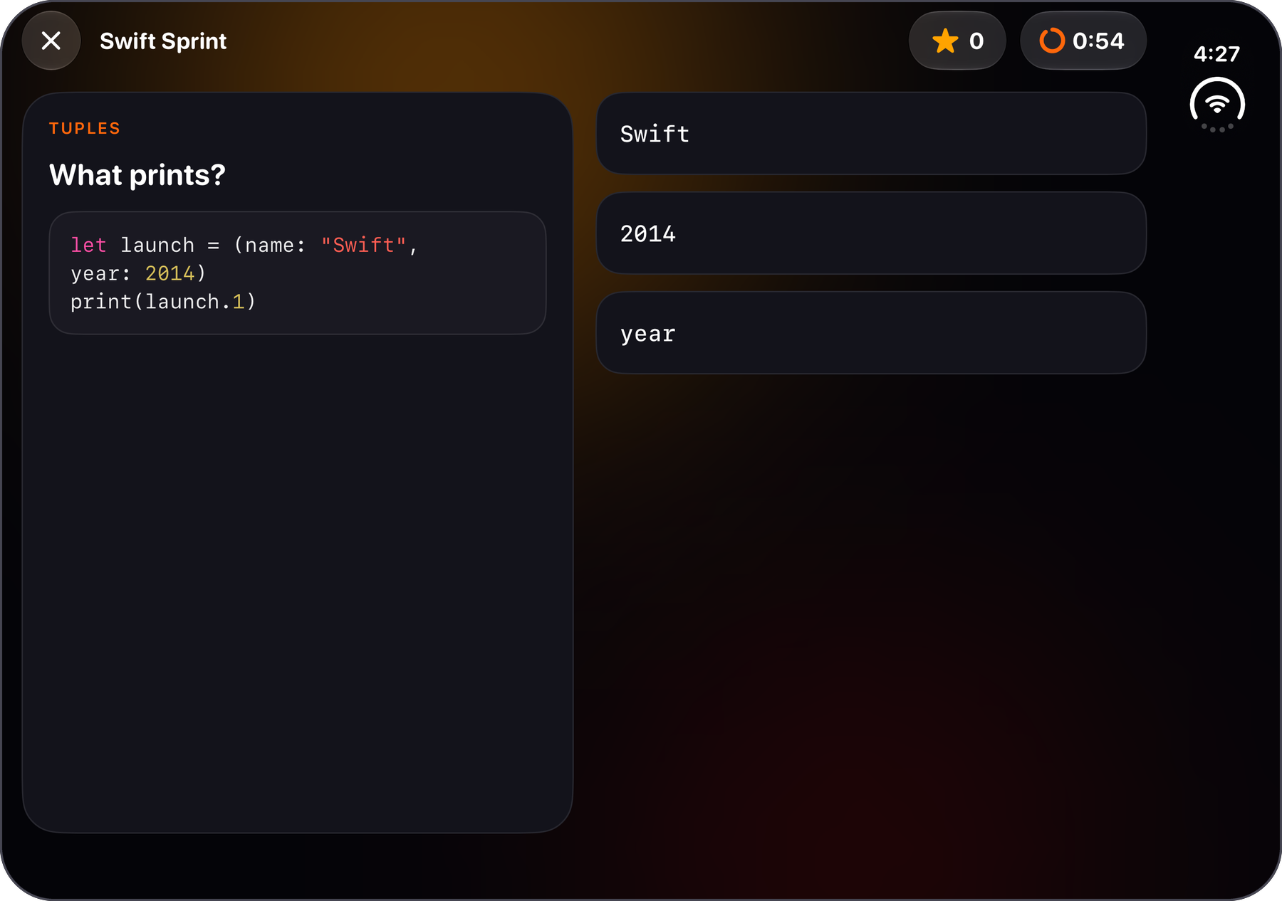
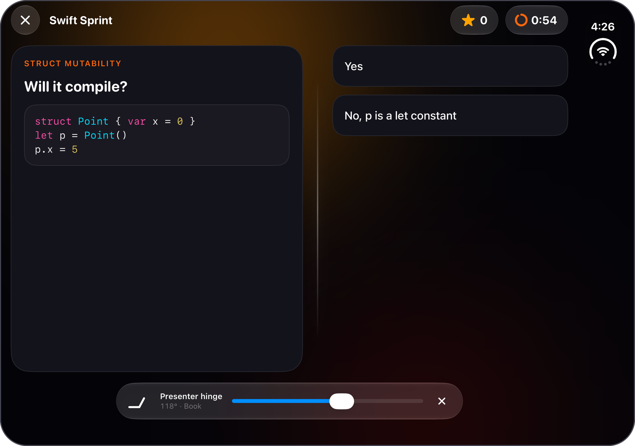
One layout, moved and never redesigned, in every pose
GAME 4 · SWIFT SPRINT · HIG DISPLACEMENT
Flat · side by side
Book · split on a vertical crease
Laptop · answers on the resting half
Notes:
Swift Sprint is sixty seconds of 'what prints?' and 'will it compile?'. It shows the layout principle behind every screen. Apple's guidance is displacement: move elements, don't redesign them. Flat, code and answers sit side by side. In book pose they split across the vertical crease. Rotate to laptop pose and the code rises to the raised half while the answers drop to the half resting on the table, like a keyboard. Same views, same state, just moved. A round carries on as you fold.

Slide 8
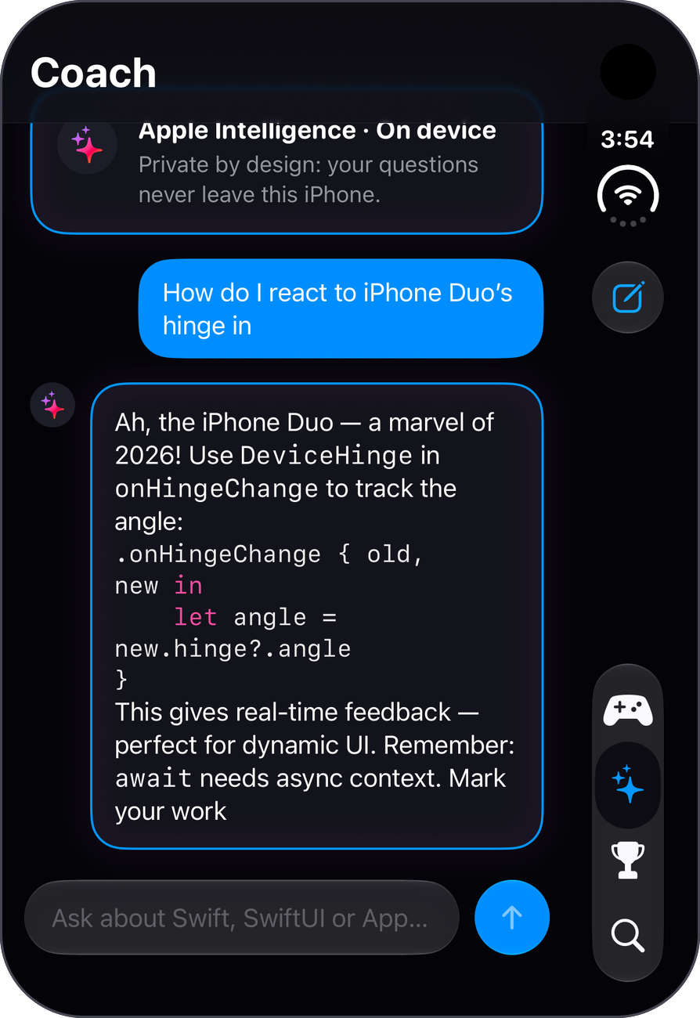



A private AI coach that knows what you got wrong
APPLE INTELLIGENCE · ON DEVICE
Your question or your mistakes
Retrieve the closest curriculum notes
FoundationModels, on device
Streamed answer and debrief
Grounded in Unfold's curriculum
The on-device model can explain APIs newer than its training, like onHingeChange.
A debrief after every round
Three sentences written from your actual mistakes: praise, the idea to fix, one tip.
Private and resilient
Nothing leaves the iPhone. Without Apple Intelligence, Coach answers offline from the same notes.
Notes:
Coach uses Apple's FoundationModels framework, so the language model runs on the phone and questions never leave it. On its own, the model didn't know the brand-new hinge API; it was trained before iOS 27.1. So before every question Coach retrieves the most relevant notes from Unfold's eighty-concept curriculum and grounds the prompt. Now it answers with the real onHingeChange code, as you can see. After every round it writes a short debrief from your actual mistakes. And on devices without Apple Intelligence, it falls back to answering from the same curriculum offline.

Slide 9
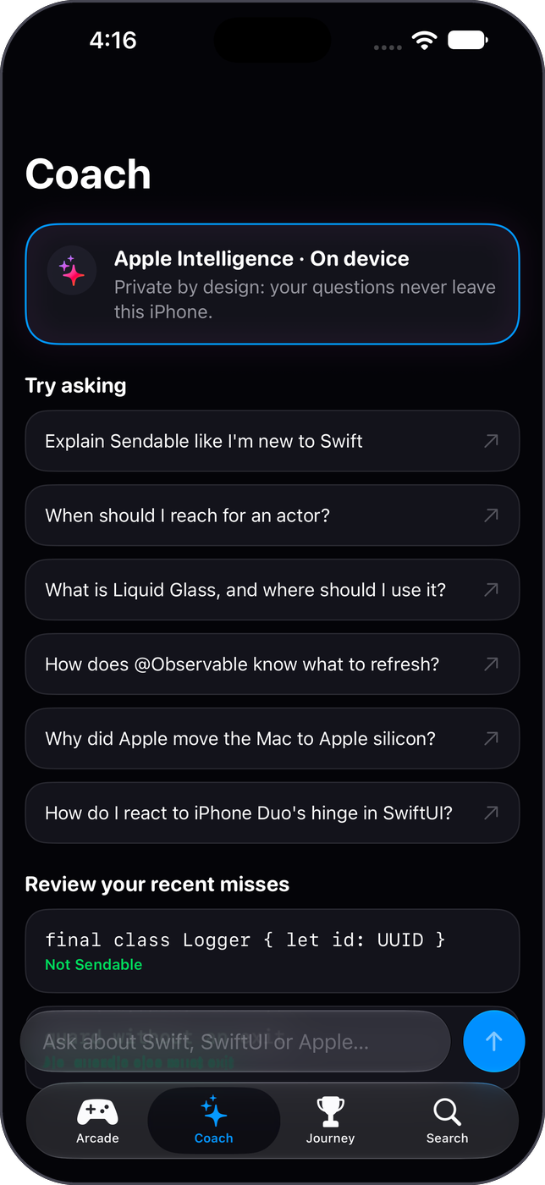


Liquid Glass only where Apple says it belongs
DESIGN RESEARCH · LIQUID GLASS
“A distinct functional layer for controls and navigation elements.”
Apple, Adopting Liquid Glass
Glass on
Never
Tab bar, which iOS moves to the right edge of the cover display
Game HUD in a GlassEffectContainer
Coach composer and the presenter hinge
.glass and .glassProminent buttons
On content cards: content stays solid
Glass on glass
Custom backgrounds behind system bars
Effects that ignore Reduce Motion
Notes:
We read Apple's Liquid Glass guidance before writing code. Apple says glass is a functional layer for controls and navigation, and warns against overusing it. So in Unfold glass appears only on that layer: the system tab bar, which iOS automatically moves to the right edge of the Duo's cover display; the game HUD, inside a GlassEffectContainer; the Coach composer; and the presenter hinge. Content cards stay solid, and there's never glass on glass. On the right is iPhone 18 Pro Max, with the composer and tab bar floating over the content.

Slide 10

Every colour in Unfold means exactly one thing
DESIGN RESEARCH · COLOUR PSYCHOLOGY
Blue
Only things you can tap
Orange
The Swift world: momentum
Cyan
Frameworks: calm building
What the research says
Red primes avoidance; blue primes approach.
Mehta & Zhu, Science, 2009
Brief red before a test lowered scores.
Elliot et al., J. Exp. Psych.: General, 2007
So red only flashes, then the explanation takes over. Dark-only, like Apple Fitness: P3 colour reads best on OLED black.
Purple
Ecosystem: heritage
Green + ✓
Correct
Red + ✕
Wrong, for a moment only
Intelligence gradient only when Apple Intelligence is speaking
Every colour is paired with a symbol, so colour is never the only signal.
Notes:
Apple's colour guidance is to use colour sparingly and give each colour one meaning. So Unfold has a semantic palette: blue only for things you can tap; one colour per world; green for correct; and the Apple Intelligence gradient only when the model is speaking. The research shaped the details. Mehta and Zhu showed red primes avoidance and blue primes approach. Elliot's team showed even brief red before a test lowers scores. So red only flashes for a moment, then the explanation takes over. Every colour also has a symbol, so colour is never the only signal.

Slide 11

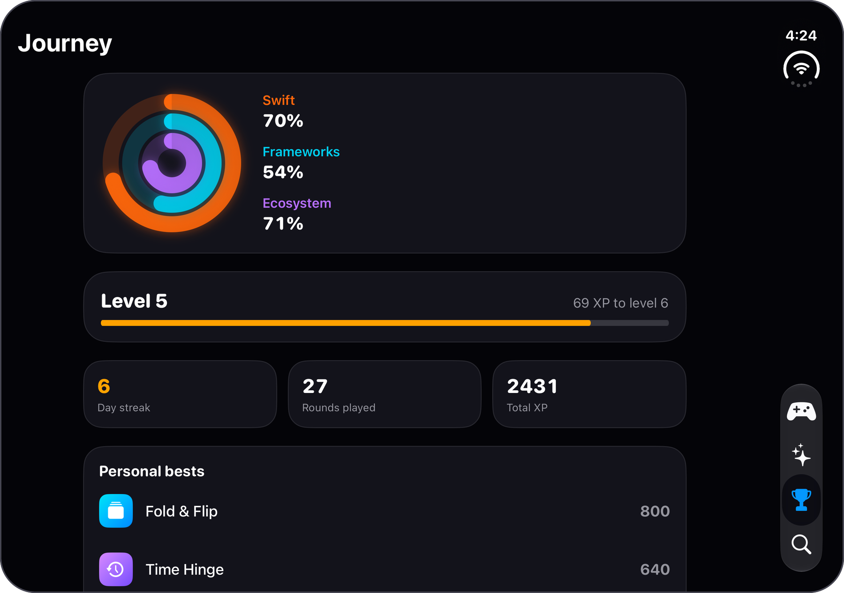



Built on how people actually learn
LEARNING DESIGN
Retrieval practice
Every game asks before it tells. Recalling builds memory faster than rereading.
Immediate, specific feedback
Each mistake shows the right answer and why, the moment it happens.
Spaced repetition
Leitner boxes bring back the flashcards you missed before the ones you know.
Mastery you can see
Activity-style rings track each world; streaks, XP and personal bests keep you coming back.
Journey · three mastery rings, one per world
Notes:
The games are fun, but the structure comes from learning science. Retrieval practice: every game asks before it tells. Immediate feedback: every mistake explains itself. Spaced repetition: the flashcards use Leitner boxes. And mastery you can see: three rings, one per world, modelled on Activity rings, plus streaks and personal bests.

Slide 12
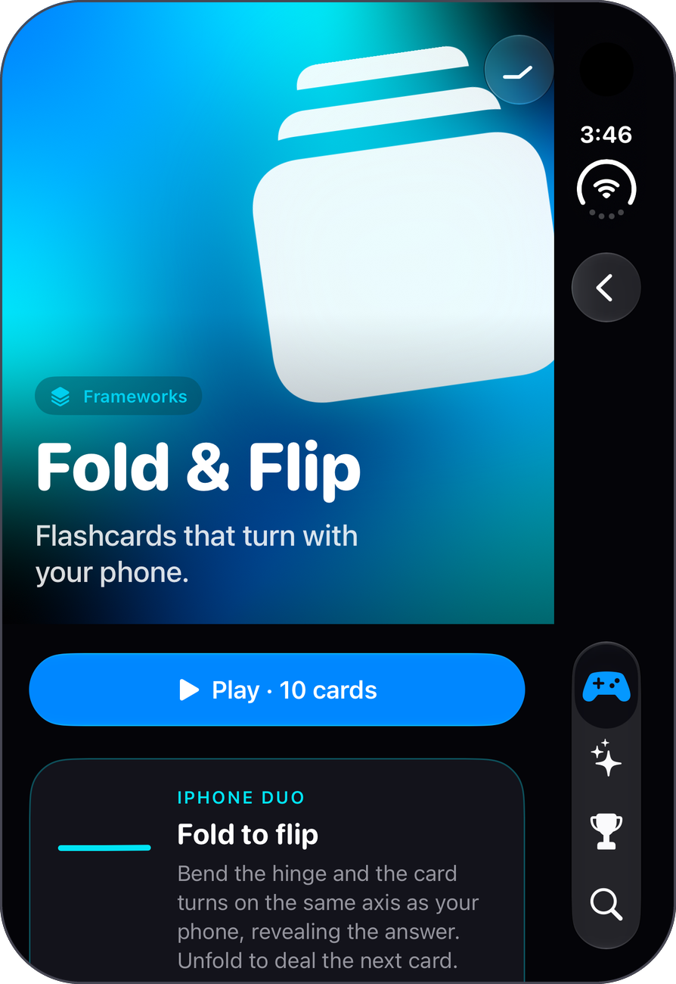
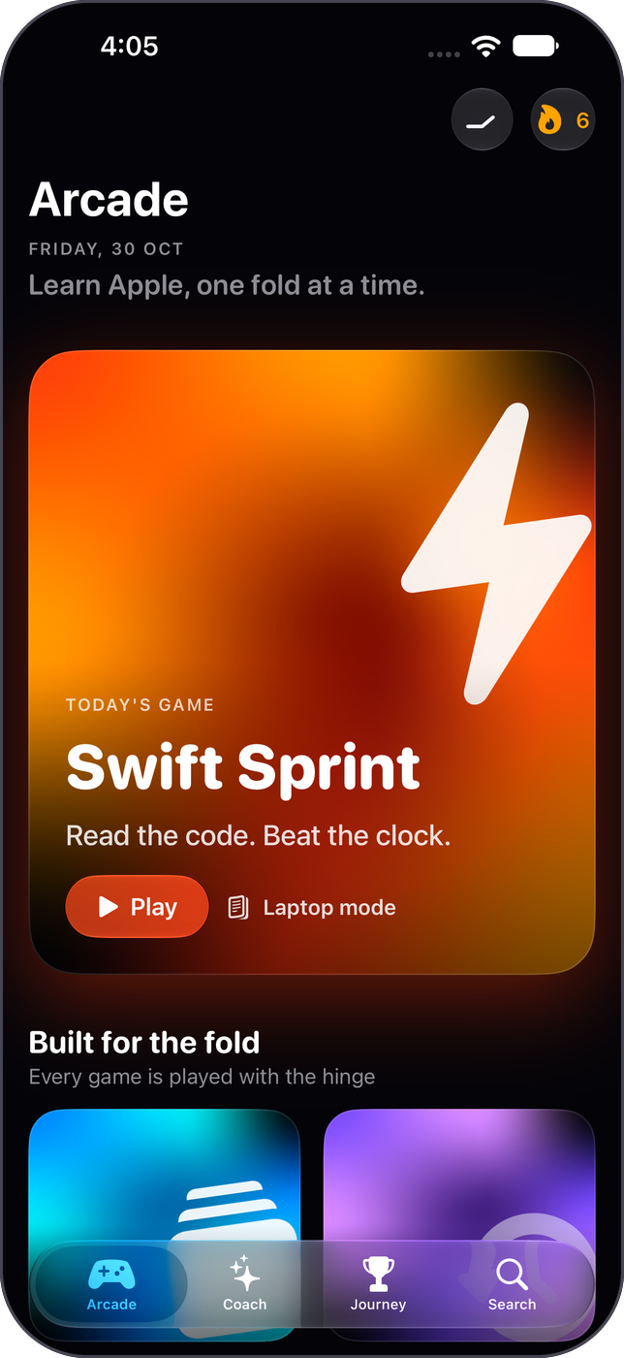
One codebase that adapts to every iPhone
IPHONE DUO + IPHONE 18 PRO MAX
SwiftUI + Observation
Swift default MainActor isolation
FoundationModels
DeviceHinge + ReservedRegion
GlassEffectContainer
MeshGradient · zoom transitions
No third-party code · 0 warnings
Duo cover · 466 × 678 pt
Duo inner · 951 × 669 pt
18 Pro Max · 440 × 956 pt
Notes:
One SwiftUI codebase runs on all three screens. On the Duo's cover display iOS moves the tab bar and back button to the right edge for us, because we used standard components. The inner display gets wider grids and fold-aware splits. iPhone 18 Pro Max gets the bottom tab bar and touch controls. Under the hood: Observation, Swift's default main-actor isolation, FoundationModels, the new hinge and reserved-region APIs, and no third-party code. It builds with zero warnings.

Slide 13
Unfold
Learn Apple, one fold at a time.
1
Fold & Flip
Bend the hinge; watch the card turn
2
Data Race
Send a class across: a data race
3
Coach
Ask how to read the hinge
4
Journey
See the mastery rings fill
Live demo · about 3 minutes
Notes:
Let me show you. One: Fold and Flip, bending the hinge to turn a card. Two: Data Race, deliberately sending a mutable class across the boundary to trigger a data race. Three: asking Coach how to read the hinge, with Apple Intelligence on device. Four: the Journey screen, where the mastery rings fill. Thank you.

