Slide 1
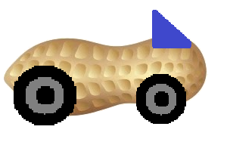
Guber
Demetri Clark Austin Seawell Matt Stackpole

Slide 2
Main Requirements
Webpage with persistent user information
User notification via email
Calendar widget with user scheduled events and details
Ability to calculate proximity based on address (map API)

Slide 3
Team Roles
Austin – Main page development
Demetri – Email notification integration
Matt – Calendar integration and distance calculation

Slide 4
Market Study
Let the exploitation begin…

Slide 5





Question one: How’s the competition ?

Slide 6
Poolup
● Sign up through Facebook
● Enroll your vehicle details (License Plate Number)
● Choose to enable or disable your car (available or not for pooling)
● Explore cars available around you
● Select a car and "Request a ride“
● "Respond to ride" and if all good - "Accept the ride" - mean while, they can communicate through inbuilt chat.

Slide 7
flinc
● Registration is unique to the app
● Enter a ride offer or ride search: Start, Destination and Time
● flinc will find someone nearby with the same destination
● Someone wants to share a ride with you – flinc will send you a message
● Confirm or Deny the request

Slide 8
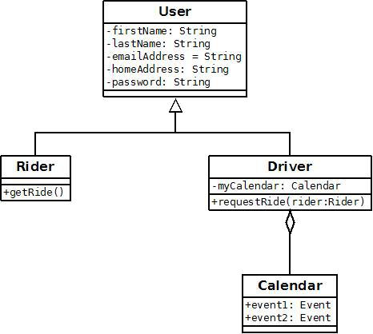
Data Model

Slide 9
USER INTERFACE: Home PAGE
LOGIN PAGE / REGISTER TO BE A USER
AFTER INITIAL LOGIN
SELECT TO BE A DRIVER OR RIDER
INPUT CURRENT LOCATION
EDIT PROFILE

Slide 10
USER INTERFACE: Main Activity
DRIVERS
INPUT YOUR TRAVEL ROUTE
ACCEPT RIDE REQUEST
DENY RIDE REQUEST
RIDERS
REQUEST RIDES
SEE AVALAIBLE DRIVERS
CONTACT DRIVERS

