Slide 1
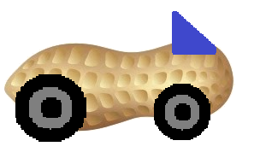
Guber
Demetri Clark Austin Seawell Matt Stackpole

Slide 2
Main Requirements
Technical Requirements
Webpage with persistent user information (Austin)
User notification via email (Demetri)
Calendar widget with user scheduled events and details (Matt)
Ability to calculate proximity based on address (map API) (Matt)
Nontechnical hurdle
Recruiting enough users to make system viable

Slide 3





Question one: How’s the competition ?

Slide 4
USER INTERFACE: Home PAGE
LOGIN PAGE / REGISTER TO BE A USER
AFTER INITIAL LOGIN
SELECT TO BE A DRIVER OR RIDER
INPUT CURRENT LOCATION
EDIT PROFILE

Slide 5
USER INTERFACE: Main Activity
DRIVERS
INPUT YOUR TRAVEL ROUTE
ACCEPT RIDE REQUEST
DENY RIDE REQUEST
RIDERS
REQUEST RIDES
SEE AVALAIBLE DRIVERS
CONTACT DRIVERS

Slide 6
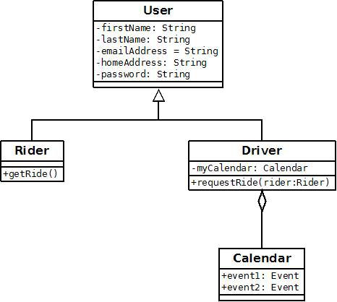
Data Model

Slide 7
Poolup
● Sign up through Facebook
● Enroll your vehicle details (License Plate Number)
● Choose to enable or disable your car (available or not for pooling)
● Explore cars available around you
● Select a car and "Request a ride”
● "Respond to ride" and if all good - "Accept the ride" - mean while, they can communicate through inbuilt chat.

Slide 8
flinc
● Registration is unique to the app
● Enter a ride offer or ride search: Start, Destination and Time
● flinc will find someone nearby with the same destination
● Someone wants to share a ride with you – flinc will send you a message
● Confirm or Deny the request

