Slide 1
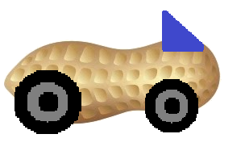
Guber
Demetri Clark Austin Seawell Matt Stackpole

Slide 2
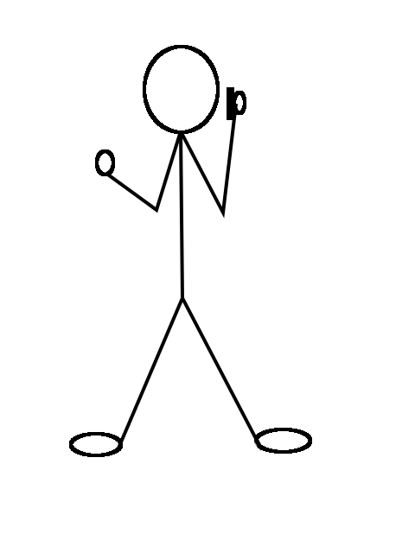
RIDER
I need a ride to school
GUBER
DRIVER
Do you want to give someone a ride?
Yes or no?
Log in
Choose to “Get a Ride”
Guber locates potential driver
Driver replies with decision
If yes, send contact info
If no, try again

Slide 3
Common Complaints
Would there be a background check for the people signing up to be drivers?
Text Message Never Arrived
Driver specific profiles
What is Guber? Lack of description on the site.

Slide 4
Current Answers
Require future users to sign a waiver against possible legal action against Guber.
Implementation of texting not yet implemented. We expect to fix that.
We’re not separating our base by driver/rider account (yet). A user can choose to be a driver on a given day.
Implementation of a landing page is currently being worked on with descriptions about Guber and what the site does.

Slide 5

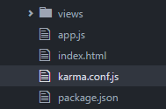

Unit TEsting
Need to install karma and init to create config file
karma start: run tests on every save of js file
karma start --single-run: run tests once
Continuous Integration Testing: running tests, yet to have one pass
Coverage report below

Slide 6
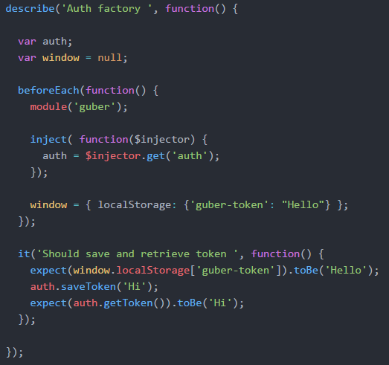
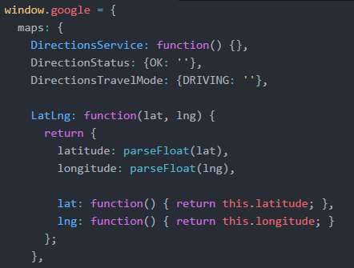
Jasmine Test File
Mock google object

Slide 7
SURVEY RESULTS
Guber Survey: Google Forms

Slide 8
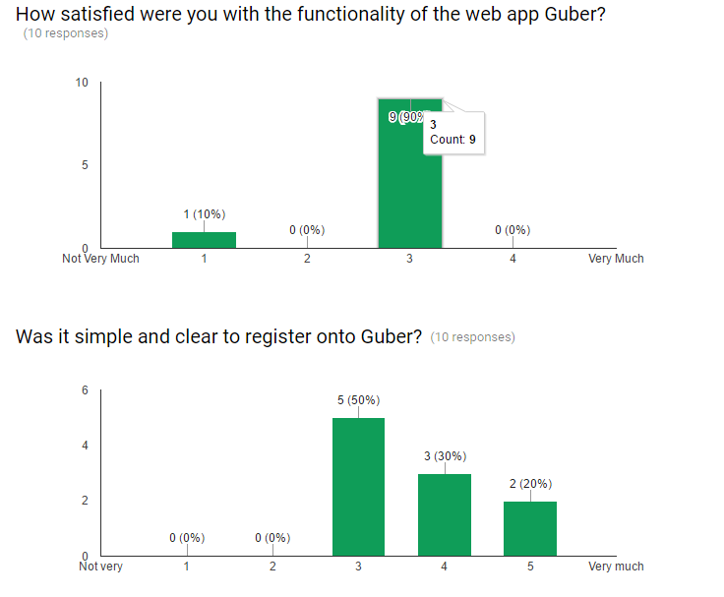

Slide 9
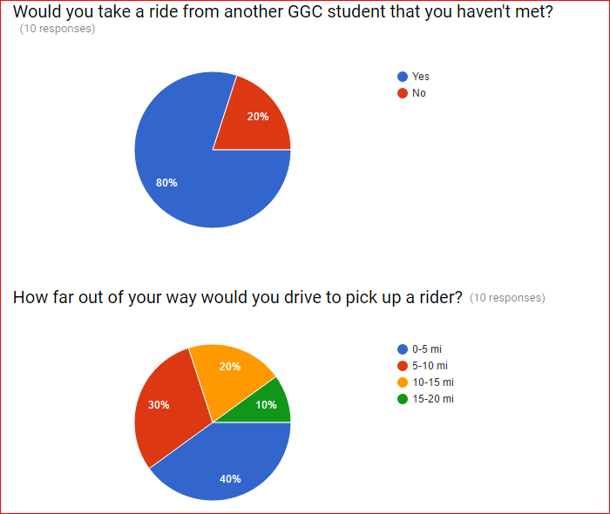

Slide 10
Other Statistics:
Possible Incentives: Inexpensive prizes, Reserved parking
Dislikes(not many): Design and Color, Email Implementation
Additions:Driver profile

Slide 11

Priority Features $\left(\frac{dx}{dt}\right)$
App description on landing page (1 week)
Additional text instructions (hover) for registration (1 week)
User can request a ride (1 week)
Potential driver gets contacted by text (2 week)
Potential driver responds (2-3 weeks)
Yes – driver and rider receive texts with each others’ contact info
No – user chooses to contact new potential driver

