Slide 1
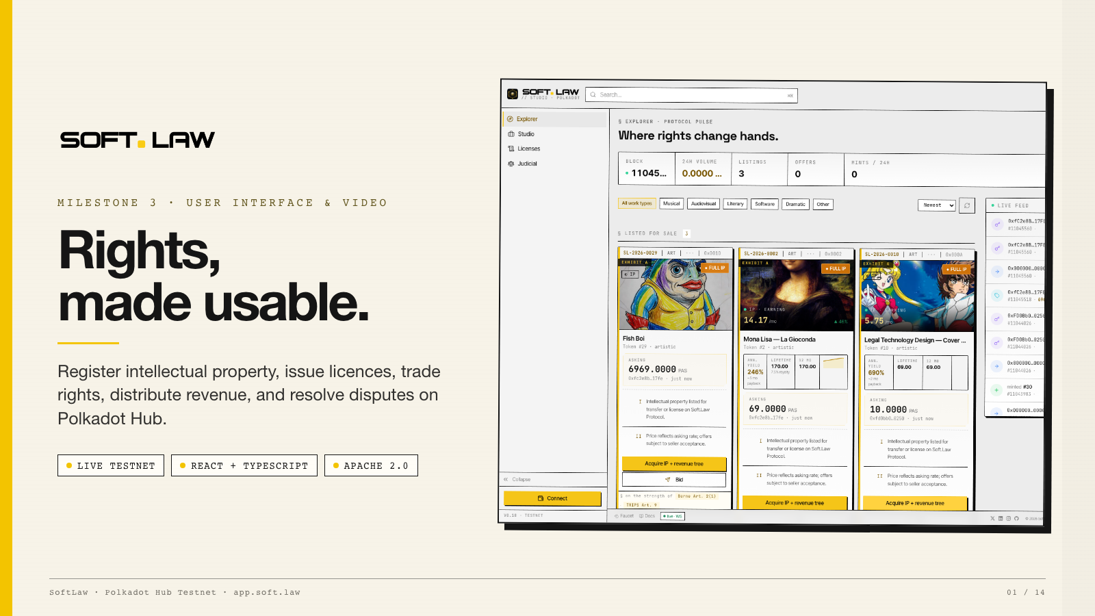
Notes:
Opening — 35 seconds SoftLaw is a working testnet application for managing intellectual-property rights on Polkadot Hub. Milestone 3 is specifically the user interface and video delivery. The interface brings five workflows into one product: register IP, issue licences, trade assets or licences, inspect revenue, and manage disputes. This deck is intentionally scoped to what evaluators can verify today. It does not claim that a token alone creates copyright, and it does not include any post-grant smart-contract upgrade.

Slide 2
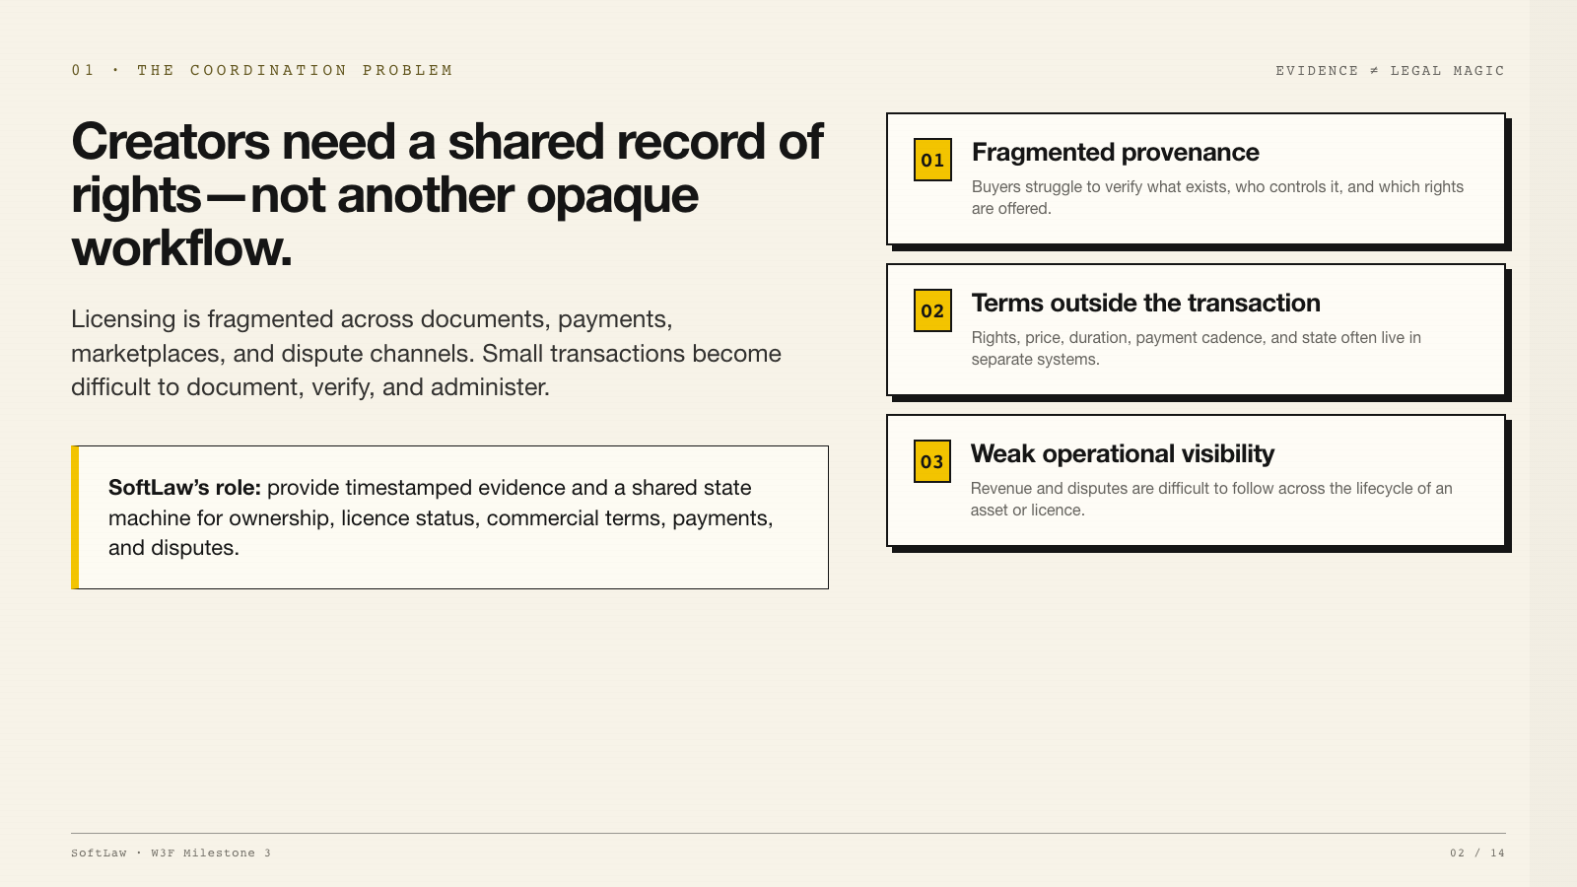
Notes:
Problem — 45 seconds The product starts from a practical coordination problem. Creators and buyers often have to reconcile separate documents, payment records, asset registries, and dispute processes. SoftLaw does not claim that blockchain replaces copyright law. The chain is used for timestamped evidence and shared state: who controls an asset, which licence terms were issued, what is listed, what has been paid, and whether a dispute is active. The UI makes that state legible to non-technical users.

Slide 3
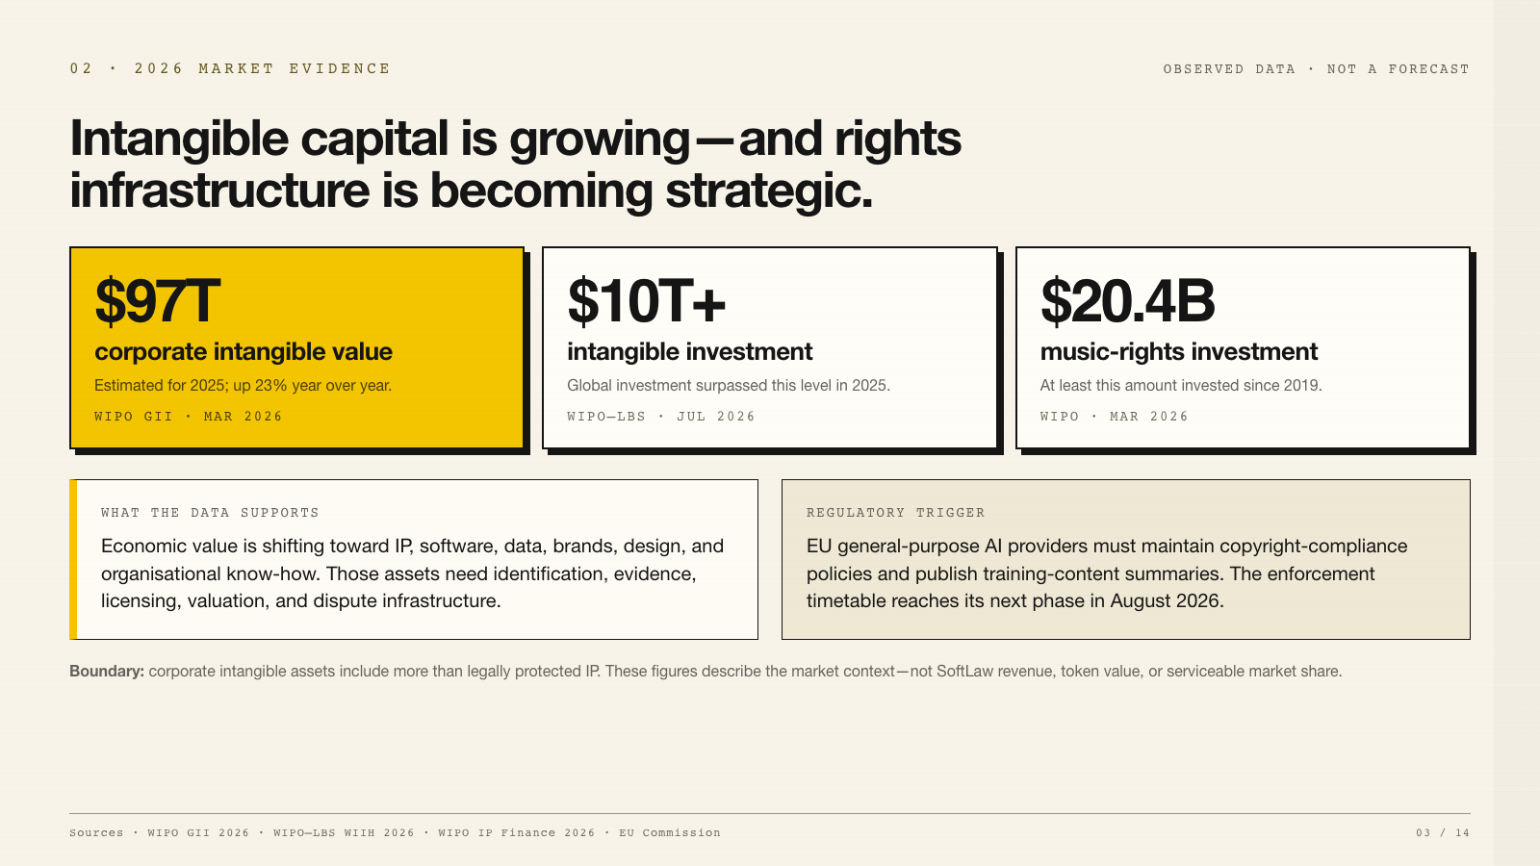
Notes:
Current market evidence — 65 seconds This replaces the older market estimates in the supplied report with current primary-source evidence. WIPO and Brand Finance estimate that corporate intangible assets crossed 97 trillion dollars in 2025, up 23 percent from 2024. A separate July 2026 WIPO–Luiss report says global intangible investment exceeded 10 trillion dollars in 2025 and has grown more than three times faster than tangible investment since 2008. WIPO also reports that at least 20.4 billion dollars has been invested in music rights since 2019. This is observed investment in copyright assets—not a projection for tokenisation. The regulatory driver is now concrete. EU general-purpose AI providers must maintain copyright-compliance policies and publish sufficiently detailed training-content summaries, with the enforcement timetable advancing in August 2026. Corporate intangible assets include IP, software, data, brands, and organisational capabilities. These numbers therefore establish context; they are not SoftLaw’s serviceable market or revenue forecast.

Slide 4
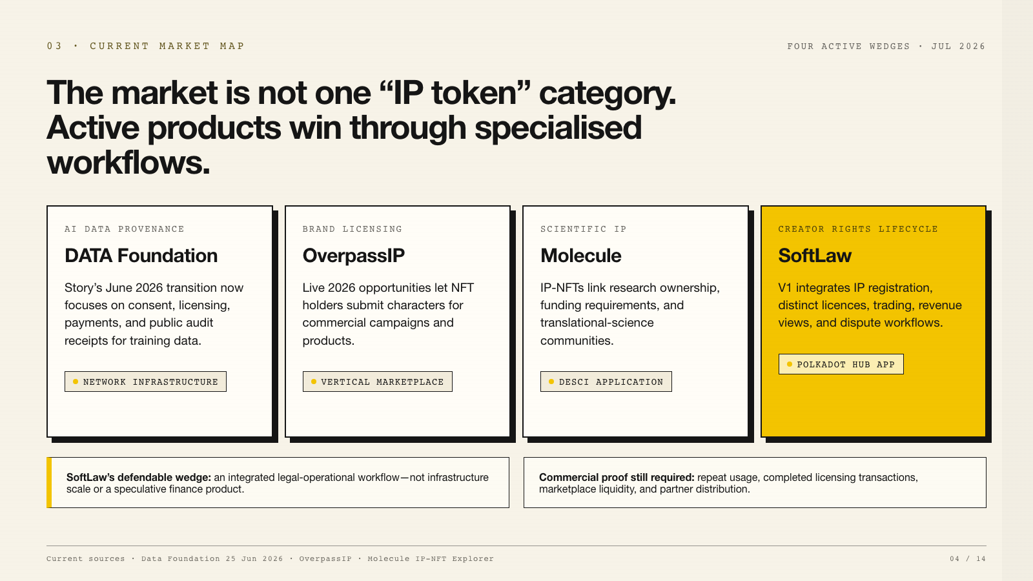
Notes:
Current market map — 65 seconds The competitive landscape changed after the original report was written. On June 25, 2026, Story announced that it is becoming the DATA Foundation, with a focused strategy around AI training-data provenance, consent, licensing, payments, and audit receipts. That is materially different from the report’s older broad programmable-IP framing. OverpassIP shows an active vertical marketplace: 2026 campaigns invite NFT holders to submit characters for commercial use. Molecule continues to apply IP-NFTs to scientific ownership and research funding. SoftLaw’s current position is an integrated creator and legal-operations application on Polkadot Hub. Its differentiation should be measured by completed licensing workflows and operational usefulness—not by claiming to be the only platform with a feature.

Slide 5
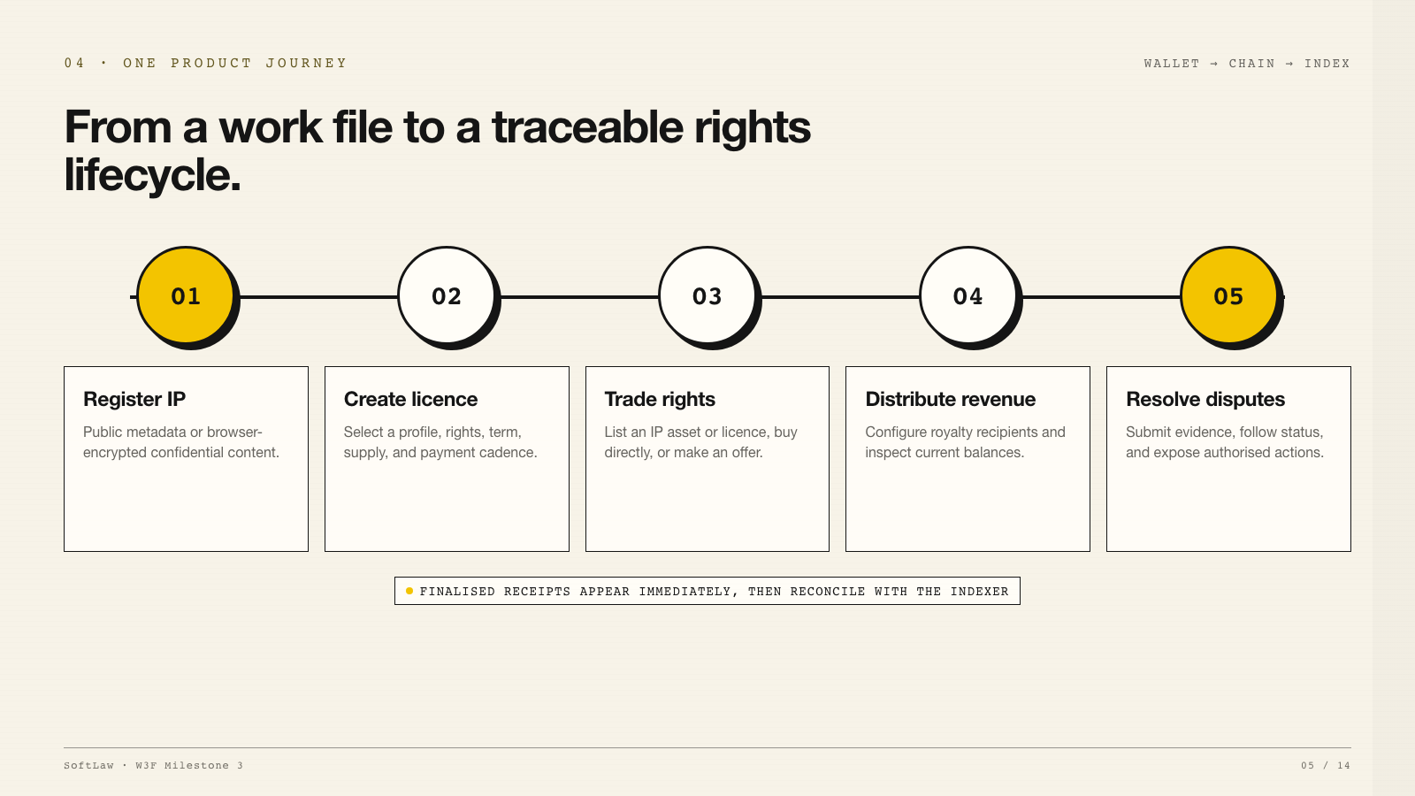
Notes:
Product journey — 55 seconds The evaluator can follow one coherent lifecycle. First, register an IP asset. Public assets use IPFS-backed metadata; confidential files are encrypted in the browser before upload. Second, create a distinct licence token with profile-specific rights and commercial terms. Third, list the asset or licence, buy it, or make an offer. Fourth, inspect royalties and current balances. Finally, submit a dispute and follow its status. Resolution and award execution are shown only to authorised arbitrators. After a wallet transaction finalises, the UI derives an optimistic entity from the receipt so the item appears immediately while the indexer catches up.

Slide 6
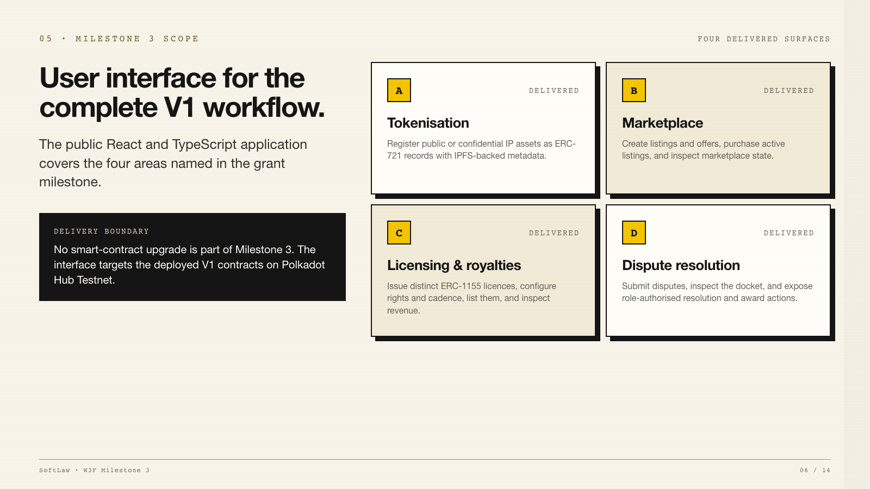
Notes:
Milestone scope — 45 seconds This slide maps the delivered UI directly to the four areas in the milestone: marketplace, tokenisation, licensing and royalties, and dispute resolution. The repository contains the self-contained frontend snapshot, lockfile, vendored PAPI descriptors, tests, CI workflow, testing instructions, and evaluator walkthrough. The licence deviation is disclosed: the delivered source uses Apache 2.0 instead of MIT. No smart-contract upgrade is included in this delivery. The product demonstrated here targets the already deployed V1 testnet contracts.

Slide 7
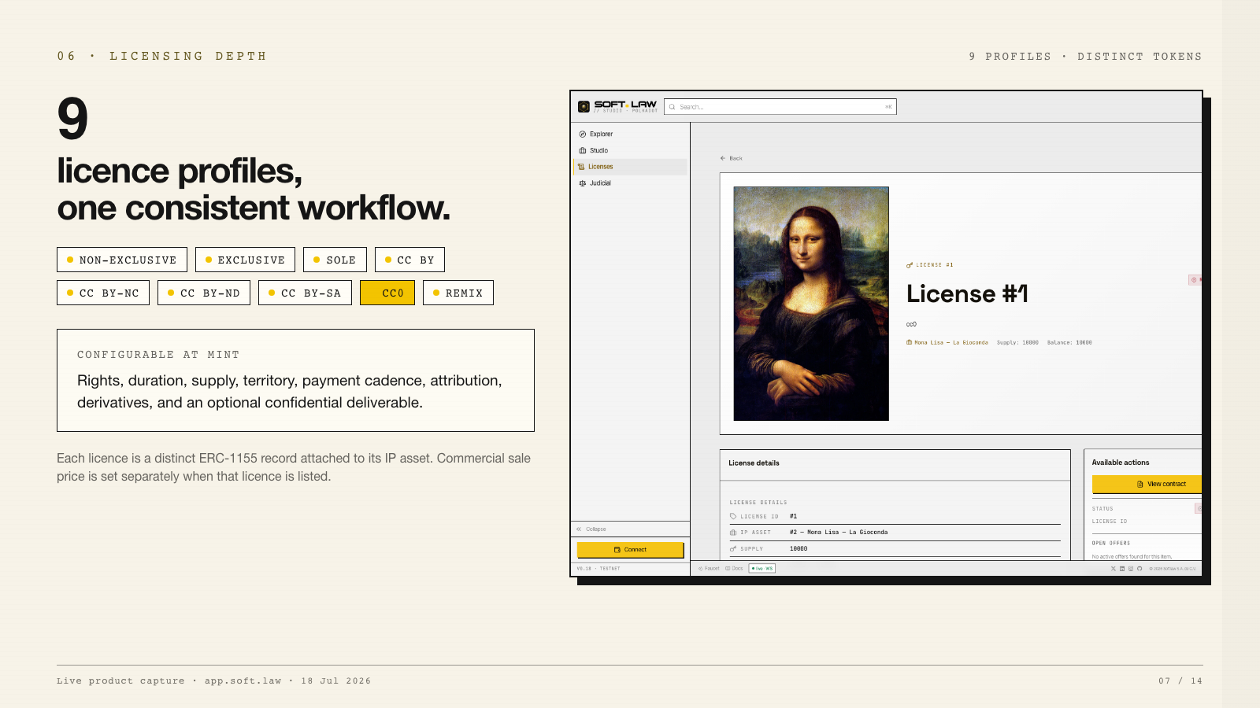
Notes:
Licensing — 55 seconds Licensing is the deepest product surface. The creation flow supports nine profiles: Non-Exclusive, Exclusive, Sole, CC BY, CC BY-NC, CC BY-ND, CC BY-SA, CC0, and Remix. The user can configure rights, duration, supply, territory, payment cadence, attribution, derivatives, and—where relevant—an encrypted deliverable. Every licence is a distinct ERC-1155 record attached to an IP asset. The V1 agreement is authorised at mint. The sale price is not baked into the licence metadata; it is set separately when the licence is listed. A future countersigned execution-attestation workflow is roadmap work and is not claimed here.

Slide 8
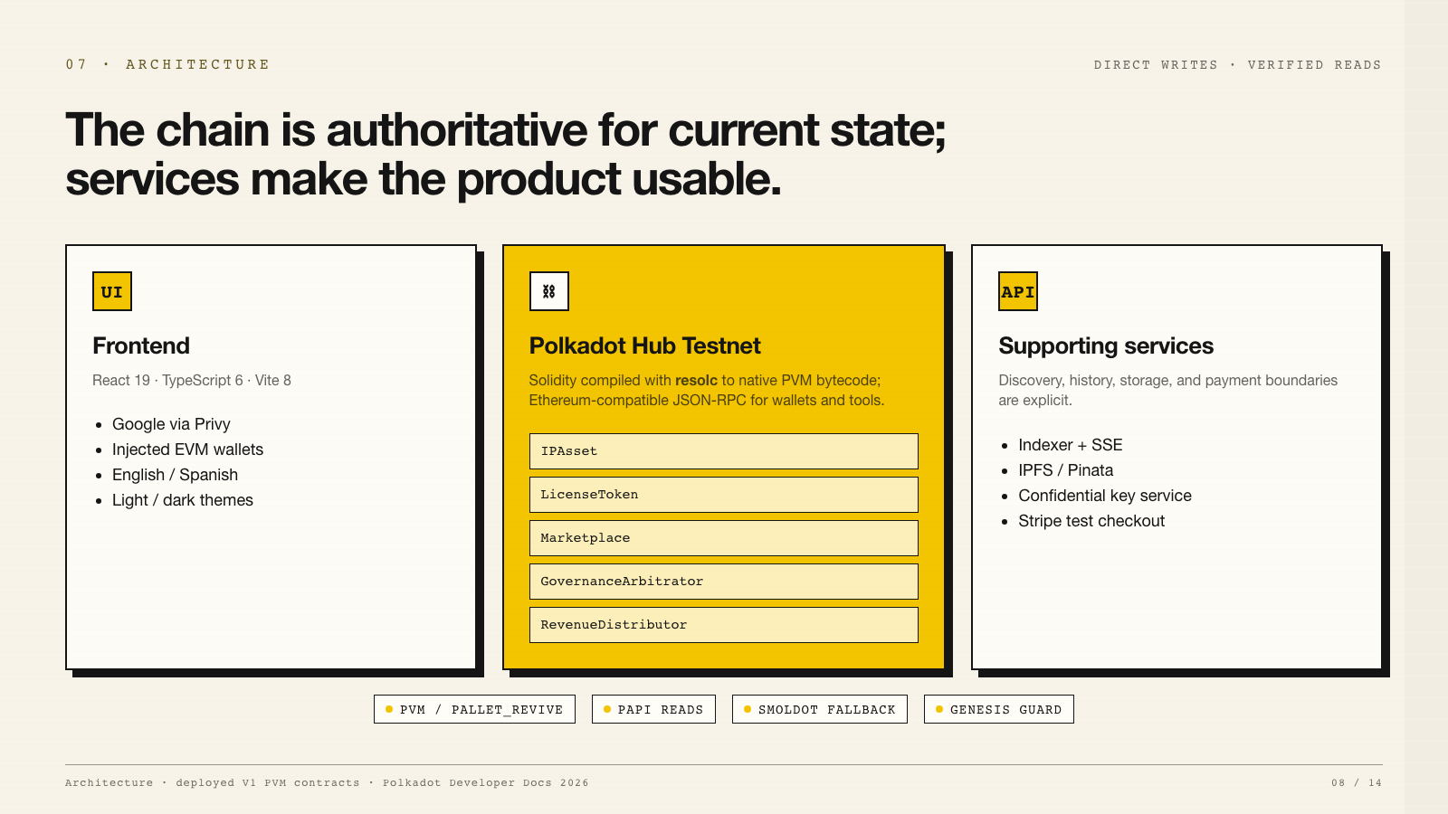
Notes:
Architecture — 60 seconds The architecture separates authority from convenience. Wallet-signed writes go directly to Polkadot Hub Testnet. Current ownership, licence state, listing state, disputes, and balances can be read directly from the deployed contracts through PAPI. The five V1 contracts were deployed as PVM bytecode, compiled from Solidity with resolc. They are not conventional EVM-bytecode deployments. Polkadot Hub’s Ethereum-compatible JSON-RPC layer allows familiar wallets and tooling to call the PVM contracts through pallet_revive. The indexer accelerates collection discovery, search, event history, and transaction history. Those historical surfaces cannot be reconstructed completely in the browser because the V1 contracts do not expose bounded historical enumeration. The confidential key service, IPFS signing, and Stripe checkout are explicitly presented as backend-dependent services rather than decentralised chain features. Before typed reads are enabled, the UI verifies the expected chain genesis hash. Polkadot’s developer documentation still describes PVM compatibility as evolving, which is why the delivery remains on testnet and includes explicit monitoring, pinned descriptors, and fail-closed chain verification.

Slide 9
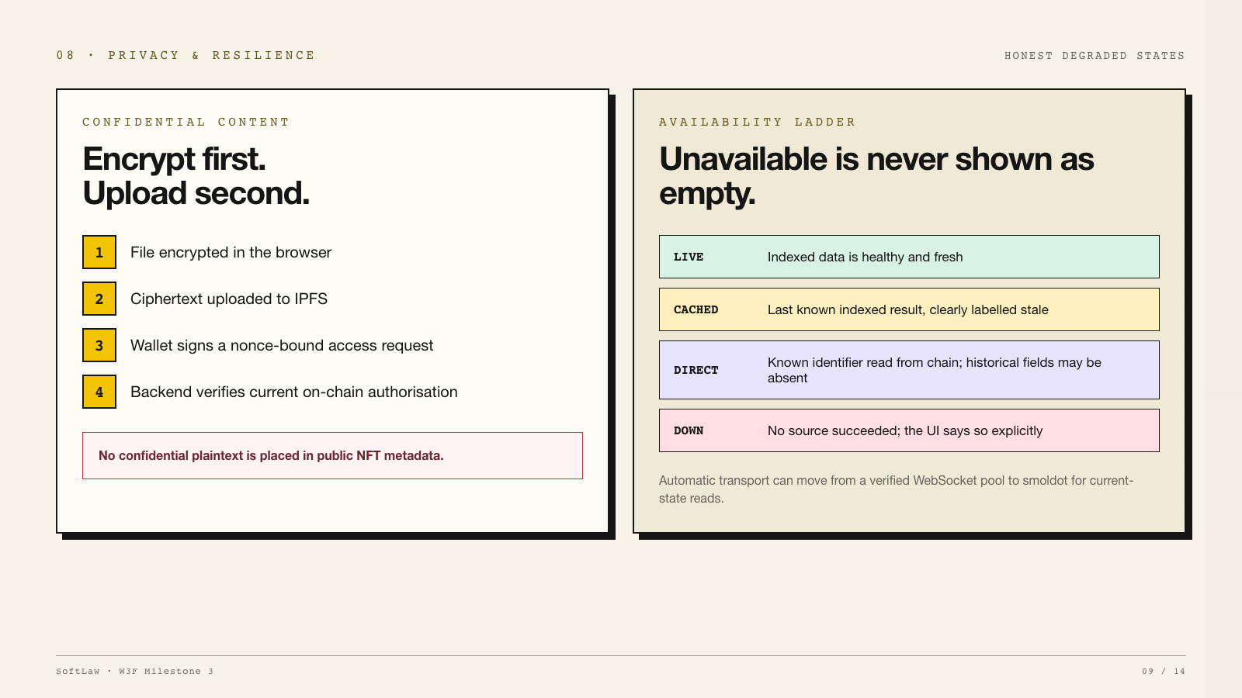
Notes:
Privacy and resilience — 60 seconds Confidential content is encrypted in the browser before upload. Public metadata contains no confidential plaintext. Decryption requires a wallet-signed, nonce-bound request, and the backend checks current on-chain access before returning the key. The resilience model is equally explicit. If the indexer is unavailable, the UI does not pretend the user owns nothing. It distinguishes four states: live indexed data, cached indexed data, chain-direct partial data, and unavailable. Known identifiers can still be checked through direct contract reads. Complete discovery and history still depend on the indexer, and confidential content still depends on the key service. The interface communicates those boundaries rather than masking them.

Slide 10
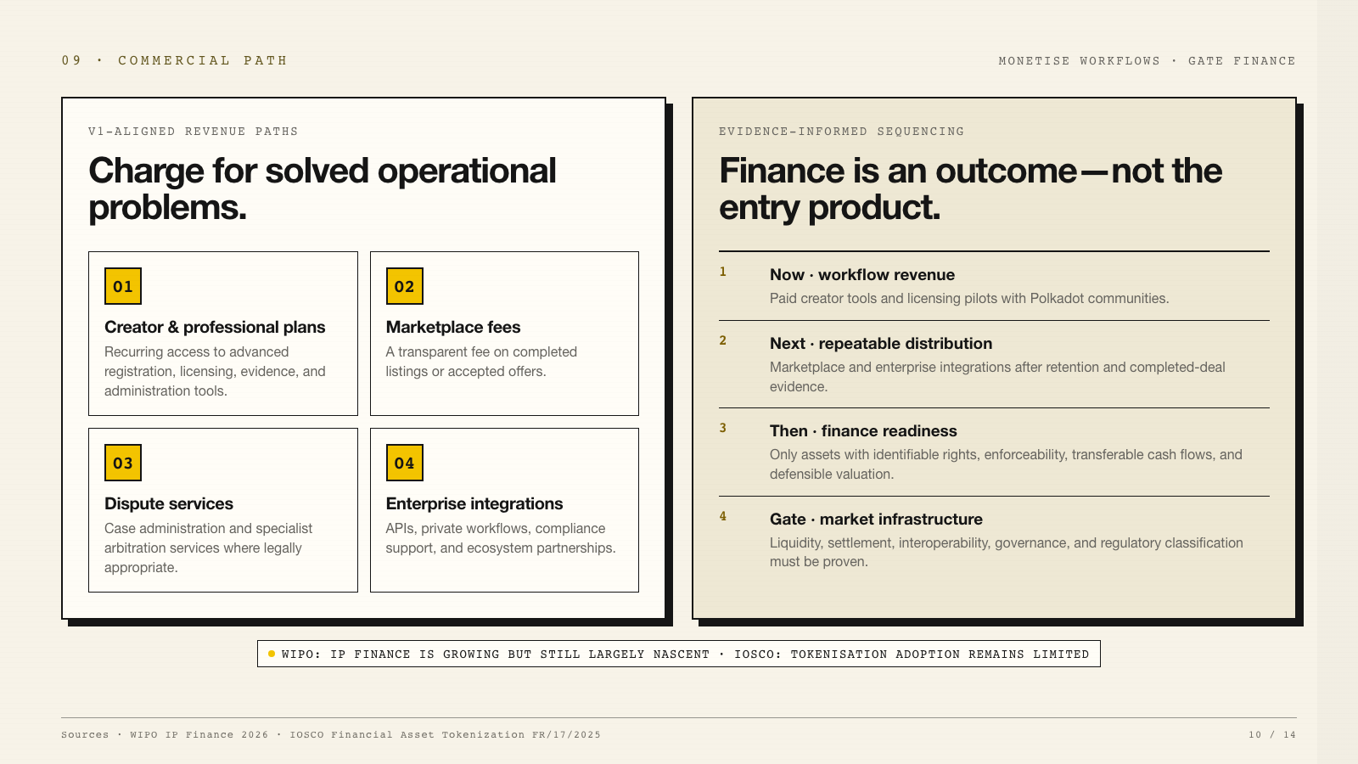
Notes:
Commercial path — 65 seconds The commercial plan now follows the evidence rather than the report’s aggressive growth projection. The most credible paths are recurring creator or professional plans, transparent marketplace fees, dispute-administration services where legally appropriate, and enterprise integrations. The sequence matters. Start with paid workflows and licensing pilots. Add marketplace and enterprise distribution only after repeat use and completed-deal evidence. WIPO’s current guidance says IP finance is growing but remains largely nascent. It also identifies prerequisites for finance: the asset must be separately identifiable, legally enforceable and transferable, and its income stream must be isolatable. IOSCO’s November 2025 report says financial-asset tokenisation is growing but adoption remains limited, with interoperability and credible settlement assets constraining scale. Therefore IP-backed liquidity stays gated until valuation, enforceability, liquidity, settlement, governance, and regulatory classification are proven. The V1 product is an operational rights layer, not an investment product.

Slide 11
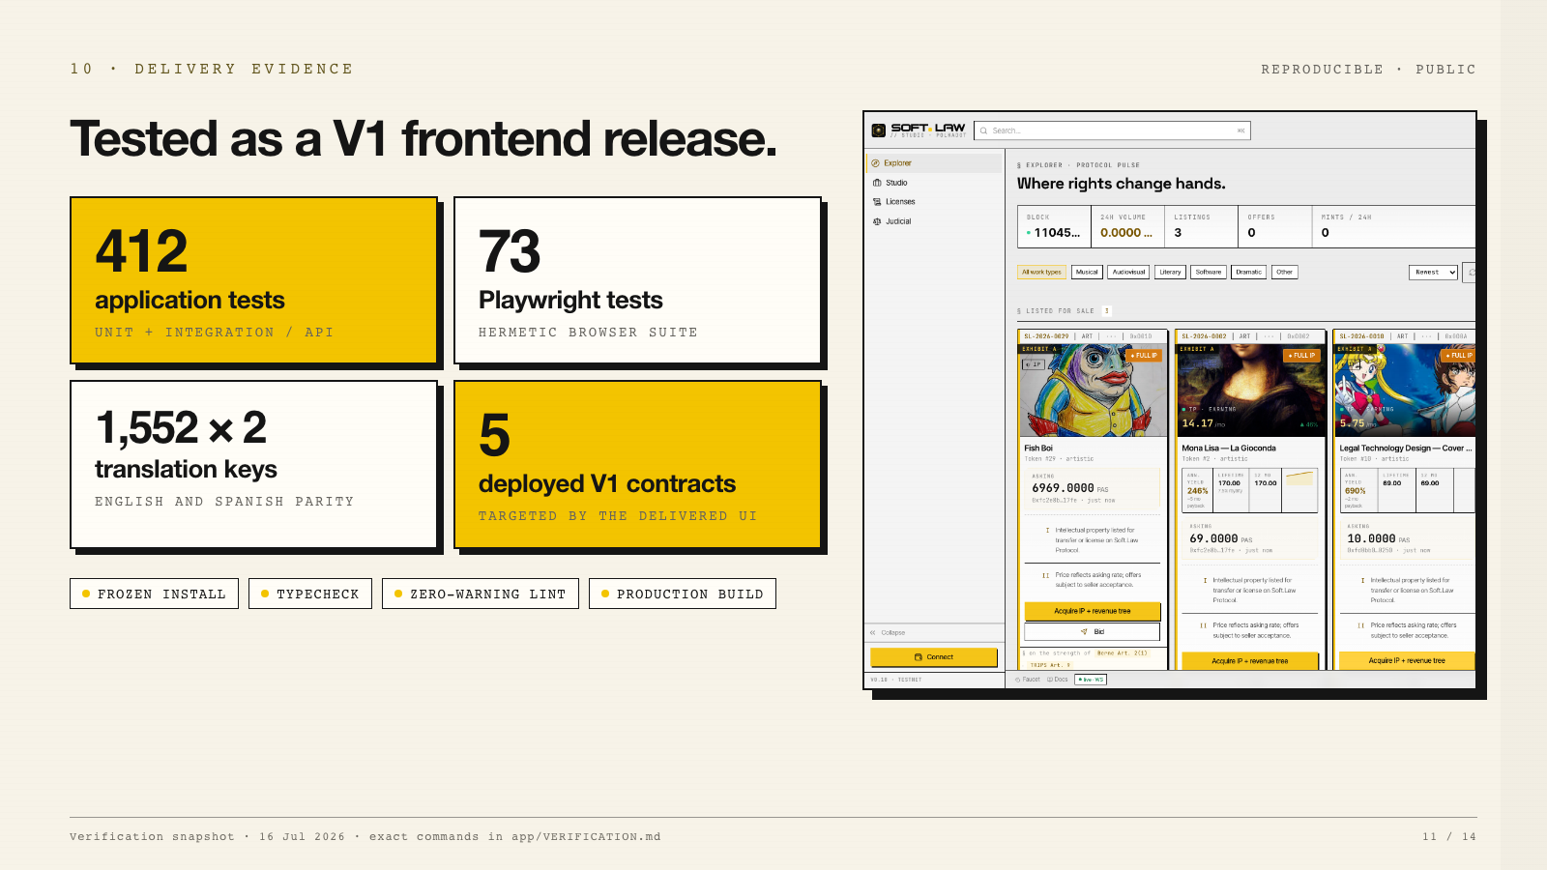
Notes:
Evidence — 50 seconds The public delivery snapshot is designed to be reproducible. The recorded verification passed a frozen dependency install, zero-warning lint, TypeScript typecheck, 412 application tests, a Vite production build, 73 hermetic Playwright tests, and translation parity with 1,552 English and 1,552 Spanish keys. The repository includes the lockfile, pinned Bun version, vendored PAPI descriptors, CI workflow, exact testing commands, and an evaluator walkthrough. The live application targets five deployed V1 contracts: IPAsset, LicenseToken, Marketplace, GovernanceArbitrator, and RevenueDistributor.

Slide 12
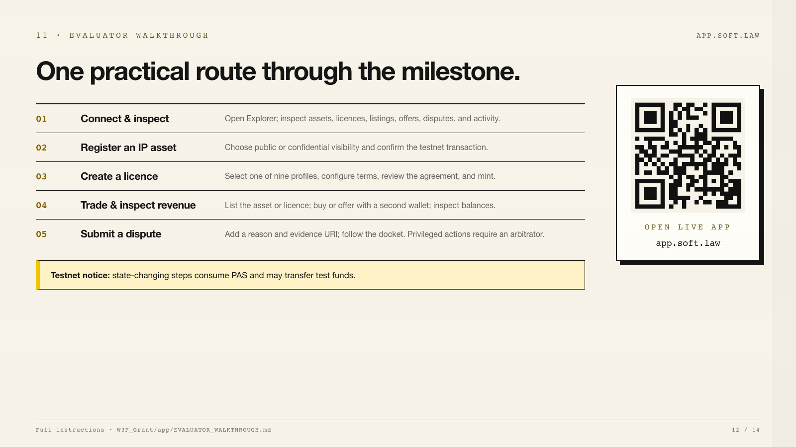
Notes:
Evaluator walkthrough — 65 seconds The recommended evaluation path is straightforward. Start read-only in Explorer. Then connect with Google through Privy or a compatible injected EVM wallet. Register a test IP asset, create one licence profile, list the resulting asset or licence, and—using a second wallet—buy it or make an offer. Inspect revenue and current state. Finally, submit a test dispute. Resolution and award execution should not be attempted from an unapproved wallet. State-changing steps consume PAS. The repository contains the full evaluator walkthrough and the live app is available through this QR code.

Slide 13
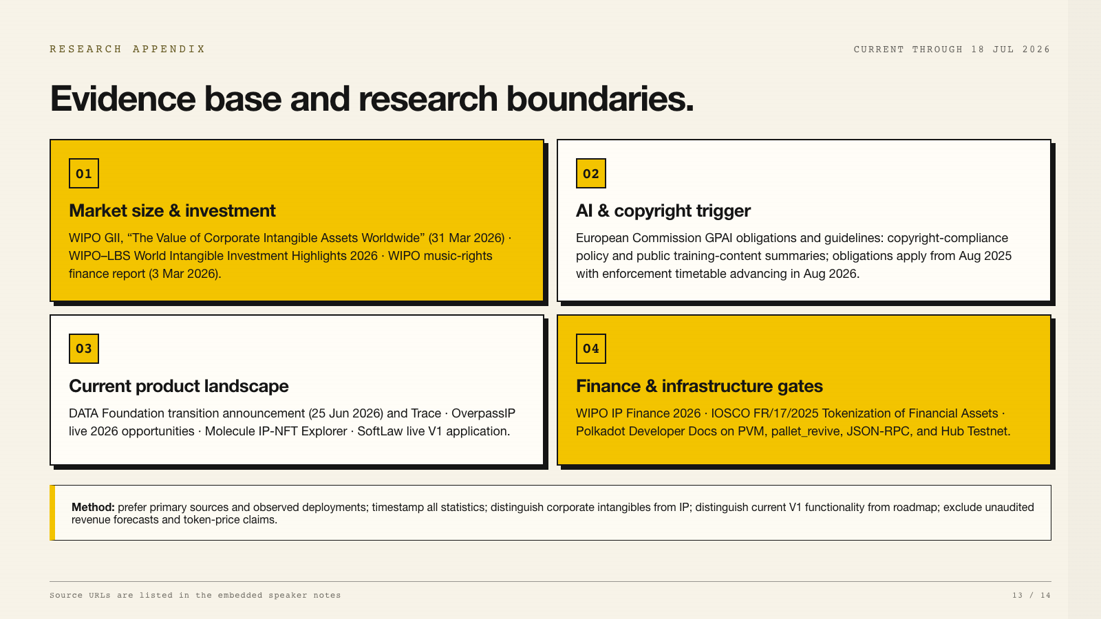
Notes:
Research appendix — reference slide Primary sources used: WIPO, The Value of Corporate Intangible Assets Worldwide Approaches USD 100 Trillion in 2025, published 31 March 2026: https://www.wipo.int/en/web/global-innovation-index/w/blogs/2026/the-value-of-corporate-intangible-assets-worldwide WIPO–Luiss Business School, World Intangible Investment Highlights 2026: https://www.wipo.int/publications/en/details.jsp?id=4860&plang=EN WIPO, New WIPO Reports Put Music Royalty Investment and IP Finance in Focus, published 3 March 2026: https://www.wipo.int/en/web/ip-financing/w/news/2026/new-wipo-reports-put-music-royalty-investment-and-ip-finance-in-focus European Commission, Guidelines on obligations for General-Purpose AI providers: https://digital-strategy.ec.europa.eu/en/faqs/guidelines-obligations-general-purpose-ai-providers DATA Foundation, We’re becoming The DATA Foundation, published 25 June 2026: https://www.datafdn.org/blog/were-becoming-the-data-foundation OverpassIP live opportunity marketplace: https://www.overpassip.com/ Molecule IP-NFT Explorer: https://molecule.xyz/ipnfts WIPO Intellectual Property Finance: https://www.wipo.int/en/web/ip-financing IOSCO Final Report FR/17/2025, Tokenization of Financial Assets: https://www.iosco.org/publications/?subsection=public_reports Polkadot Developer Docs, EVM vs PVM: https://docs.polkadot.com/smart-contracts/for-eth-devs/evm-vs-pvm/ Methodology: current primary sources were preferred. Company-reported product metrics were treated as company claims. Market context was separated from SoftLaw’s serviceable market, revenue, and roadmap.

Slide 14
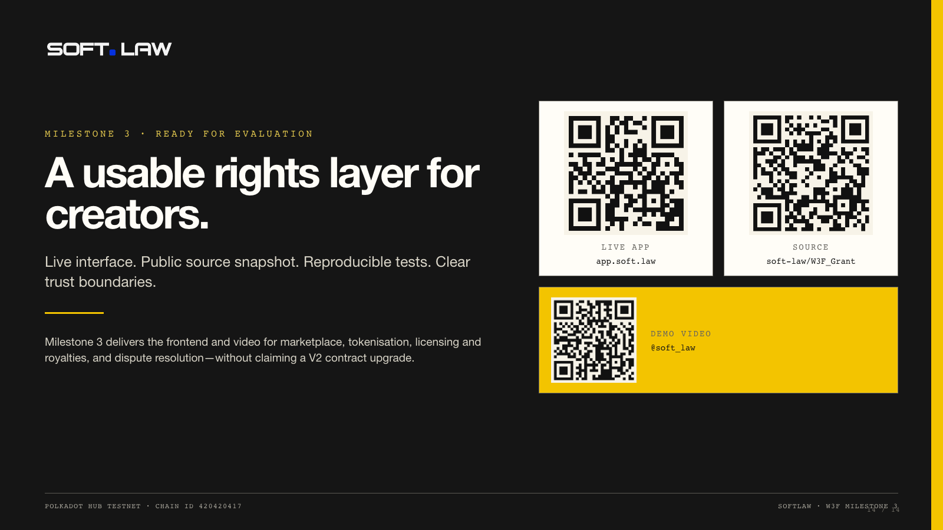
Notes:
Close — 35 seconds Milestone 3 is ready for evaluation as a tested V1 frontend release. The delivery includes the live application, public React and TypeScript source snapshot, demo video, reproducible verification, and evaluator instructions. The interface covers marketplace, tokenisation, licensing and royalties, and dispute resolution on Polkadot Hub Testnet. The three QR codes open the live product, source repository, and recorded demo. Thank you. I am ready to walk through any workflow or answer implementation questions.

