Slide 1








3 November 2026
LM2 · Team 3 · Section 2
Critical Assumption & Hypothesis
The assumption we tested (A1)
UDST students and faculty will go back to a central event platform on their own, without reminders, to check upcoming events.
Testable hypothesis
We believe UDST students and faculty who have missed events will return to a central event listing on different days, because it saves searching Outlook, Instagram and asking friends.
We will know this when ≥ 60% of participants return on 2+ separate days (days 3–10), without reminders.
Why it matters
    The venture only works if people come back. If they open it once and forget it, they keep missing events, like with Navigate360.
    Other assumptions depend on it: organizers won’t post (A3) and UDST won’t support it (A4) if no one uses it.
    Our evidence was weak: survey answers show what people say, not what they do.
Success
≥ 60% (5+ of 8) return on 2+ separate days
Failure
≤ 30% (2 or fewer of 8) return on 2+ days
Inconclusive
3–4 of 8, or anyone drops out, or tracking fails
Set in Lab 07 for 10 people. Only 8 students joined (no faculty replied), so the same percentages apply. The 10-day window was set in Lab 08, before any data.

Slide 2
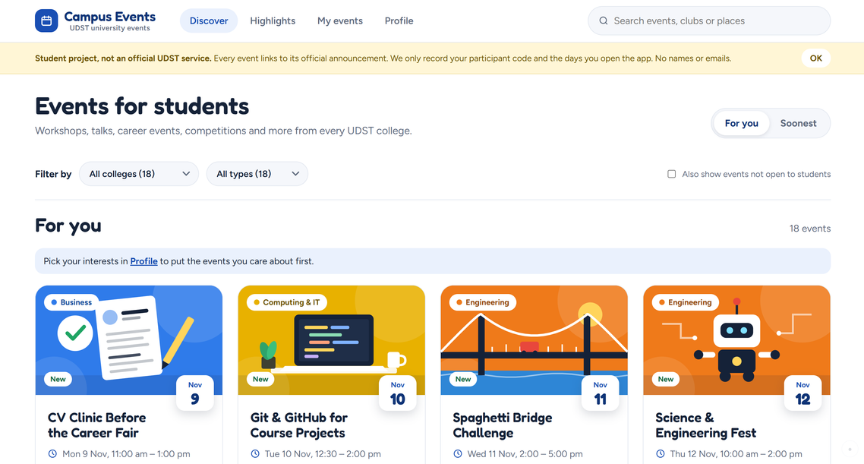


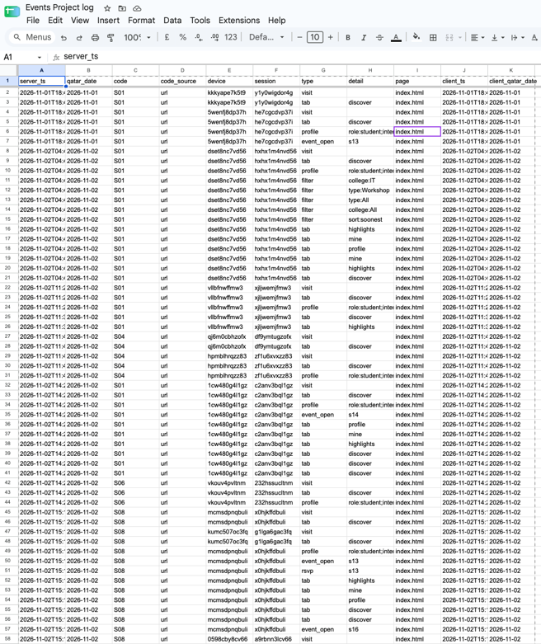
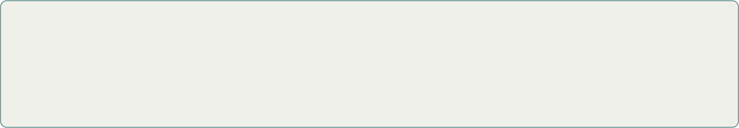
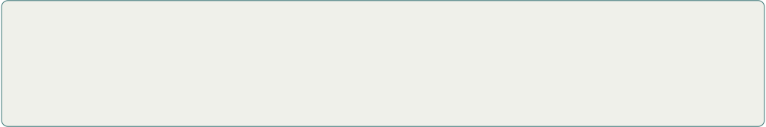
LM2 · Team 3 · Section 2
3 November 2026
Experiment Execution
[Screenshot: Discover page of the live site]
1 · App pilot (10 days, still running)
  Launched Sun 1 Nov (planned 8 Nov); Day 10 = 10 Nov. Returns count on days 3–10.
  Each student got a personal link (?p=S02…) and the same short message. No reminders after that.
  Real UDST events plus some mock events (to show search and filters); updates planned 3 times a week.
  Visits are logged automatically (code + Qatar date, no names). One visit = one day per code.
[Screenshot: visit log sheet (codes only)]
Participants
8 UDST students (S02–S09). No faculty: 3 contacted, 0 replied. Recruited from classmates, friends and WhatsApp groups. The screening question was not asked, and fewer than 5 are from outside our circle.
2 · Past-behaviour interviews
8 students, 27 Oct – 2 Nov, by call or text, with the same 6 questions. Our app was not mentioned.
Evidence: github.com/soft4102-fall2026/soft4102-fall2026-section2-team-03

Slide 3
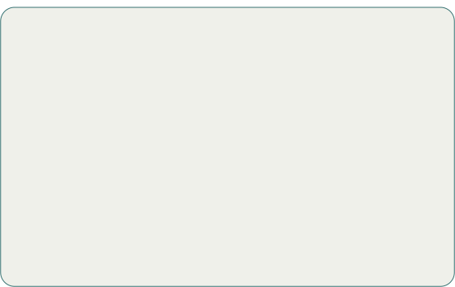

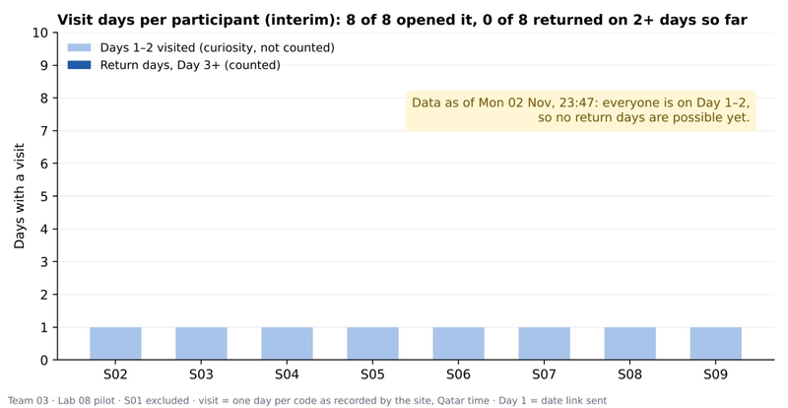


LM2 · Team 3 · Section 2
3 November 2026
Evidence & Learning
Interviews: what 8 students actually did
  First heard about their last event from Instagram or friends: 6 of 8 (others: an instructor, campus booths). Outlook first: 0.
  Look for events on their own: 5 of 8, mostly on the UDST Instagram. 3 never do, or only by chance.
  Used Navigate360 events: 2 of 8. Only one checks it regularly.
  Pilot so far (chart): 14 visits on Days 1–2 (6 event pages, 7 filter uses, 1 registration). Not comparable with the criteria yet: returns count on days 3–10 (to 10 Nov).
7 of 8
interviewees missed an event because they found out too late. Only 2 of 8 have used Navigate360’s events section.
What we learned
  The problem is real: 7 of 8 missed events by finding out late.
  A1 is only partly supported: most students do look for events, but on Instagram, not an events platform. Our site has to compete with Instagram.
Still uncertain
  Whether students come back to our site (days 3–10 not done).
  Small, mostly known sample; no screening; students only; mock events listed.
  The interview scoring rule was set on 2 Nov, after the interviews, so it is exploratory only.

Slide 4



LM2 · Team 3 · Section 2
3 November 2026
Founder Decision
Why: the pilot is on Day 3 of 10, so there is no return data to compare with our criteria yet. The interviews are mixed: 5 of 8 look for events on their own, but mostly on Instagram, and only 2 of 8 use Navigate360. That is not enough to persevere or pivot.
Investigate Further
Next steps
  Finish the pilot (10 Nov), ask the exit question (~11 Nov) and complete the tally. Criteria unchanged.
  Decide by ~12 Nov using the criteria (30–60% → longer or larger test).
  Update GitHub with the results and decision.
≥ 60%: Persevere
≤ 30%: Pivot
Next test A3: can we keep events collected and updated on time?
Keep the platform, add a push channel.
A weekly Instagram post or email roundup that links back to our event list. Then test whether that brings students back.

