Slide 1
Project scope
CPSC 594 – (Fall 2018)
Omar Abdelwahab
BenKun Chen
Paul Wang
Kim Xie

Slide 2
Introduction
On average, each corporate job offer attracts 67 - 250 resumes per day. Some can even have over 300.
Time consuming to process all the applications for a high-volume of applicants.
Able to identify qualified applicants without manually checking.

Slide 3
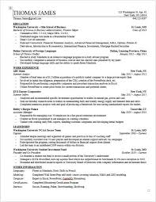
Resume parsing
1. Convert to text
2. Extract Sections (Work
Experience, Education..)
3. NLP Unit, extract
keywords, n-gram
4. Generate Feature
Vector

Slide 4
Objective
To increase the accuracy of the matching algorithm from 60% to upwards of 80%
Display the resulting information in a visually clear, concise and appealing format

Slide 5
constraints
Securing the privacy and integrity of the resumes
Limited experience in neural networks
Limited access to the database due to confidentiality

Slide 6
assumption
Security policy will be dictated by HireGround
We have full access to the algorithm and its implementation
We do not need special accommodations for mobile
Sample inputs provided by HireGround

Slide 7
TEAm & role definition
Team
Pairs of two
Strengths and interests
Role
To be determined

Slide 8
Deliverables
All of the historical data needs to be migrated to fit the new Postgres DB
Resume will be separated into their sections for parsing individually
Output needs to be displayed on their web service in a visually appealing format
Apply the deep learning algorithm developed by University of Alberta

Slide 9
requirements
Non-Functional
Visually appealing
80% accuracy
Reasonable run-time
Non-Functional
Visually appealing
80% accuracy
Reasonable run-time

Slide 10
Questions?

