Slide 1

yass ? Yet Another Service Solution
client processes
(initiator)
a small software library for efficient peer-to-peer communication (FastSerializer)
Kotlin/Java (3500 LOC, 150KB jar)
TypeScript (900 LOC)
Python 3 (with support for type hints, 700 LOC)
high throughput, low latency, reactive services
explicit type-safe contract with DTOs and interfaces
session based, bidirectional message streaming (sync/async, oneway/rpc)
Open Source (BSD-style license)
https://github.com/softappeal/yass
Maven Central: groupId=ch.softappeal.yass
Client
Application
Contract
yass
session
yass
Contract
Server
Application
server process
(acceptor)

Slide 2
Design
yass
Service
maps contract (DTOs and interfaces) to messages
Serialize
transforms messages to byte chunks
Transport
transports byte chunks between (distributed) processes
TCP/IP socket (650 LOC)
SSL/TLS
WebSocket (200 LOC)
“socket over http”
Java (JSR 356, Java API for WebSocket)
TypeScript (Browser WebSocket)

Slide 3
Service ?
service contract (interface)
interface Calculator {
int add (int a, int b);
int multiply(int a, int b);
}
service implementation (server side)
class CalculatorImpl implements Calculator {
int add (int a, int b) { return a + b; }
int multiply(int a, int b) { return a * b; }
}
service usage (client side)
Calculator calculator = new CalculatorImpl();
int a = calculator.add(1, 2);
int m = calculator.multiply(2, 3);

Slide 4
Interceptor (AOP, around advice)
printing calculator
class Printer implements Calculator {
int add(int a, int b) {
System.out.println("add");
return a + b;
}
int multiply(int a, int b) {
System.out.println(“multiply");
return a * b;
}
}
logging interceptor
Interceptor LOGGER =
(method, arguments, invocation) -> {
System.out.println(method.getName());
return invocation.proceed();
};
service usage
usage
Calculator calculator = Interceptor.proxy(
Calculator.class,
new CalculatorImpl(),
LOGGER // , PROFILER, AUTHORIZATOR
);
int a = calculator.add(1, 2);
int m = calculator.multiply(2, 3));
output
add
multiply

Slide 5
Contract
interfaces
DTOs
interface StockService {
List<Stock> getStocks();
}
class Stock {
int id;
String name;
Rating rating;
}
Acceptor
interface PriceService {
void subscribe (List<Integer> stockIds);
void unsubscribe(List<Integer> stockIds);
}
enum Rating { AAA, AA, A }
Initiator
class Price {
int stockId;
int bid;
int ask;
}
interface PriceListener {
@OneWay void notify(List<Price> prices);
}
implements
uses

Slide 6
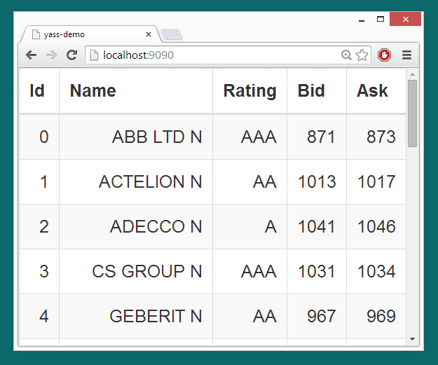
Tutorial
Browser (TypeScript)
UI
Contract
generated
yass
WebSocket
yass
Contract
by hand
Simulation
WebServer (Java)
Stock (static)
Price (dynamic)

Slide 7
Serialize
message (graph in process memory)
Stock stock = new Stock();
stock.id = 31;
stock.name = "ABB";
stock.rating = Rating.AAA;
transforms messages
to byte chunks
XML serializer
FastSerializer (1000 LOC)
<Stock>
<id>31</id>
<name>ABB</name>
<Rating>AAA</Rating>
</Stock>
01 01 1F 02 03 41 42 42 03 00 00
Tags, Base 128 Varints
UTF-8 strings
Optional fields
Custom BaseTypes
11 bytes
Dumper
Stock(
id = 31
name = "ABB"
rating = AAA
)
78 bytes

