Slide 1
The world has changed.
Different devices
Apps
Functionality isn’t enough anymore

Slide 2
The world has changed.
Different devices
Apps
Functionality isn’t enough anymore

Slide 3
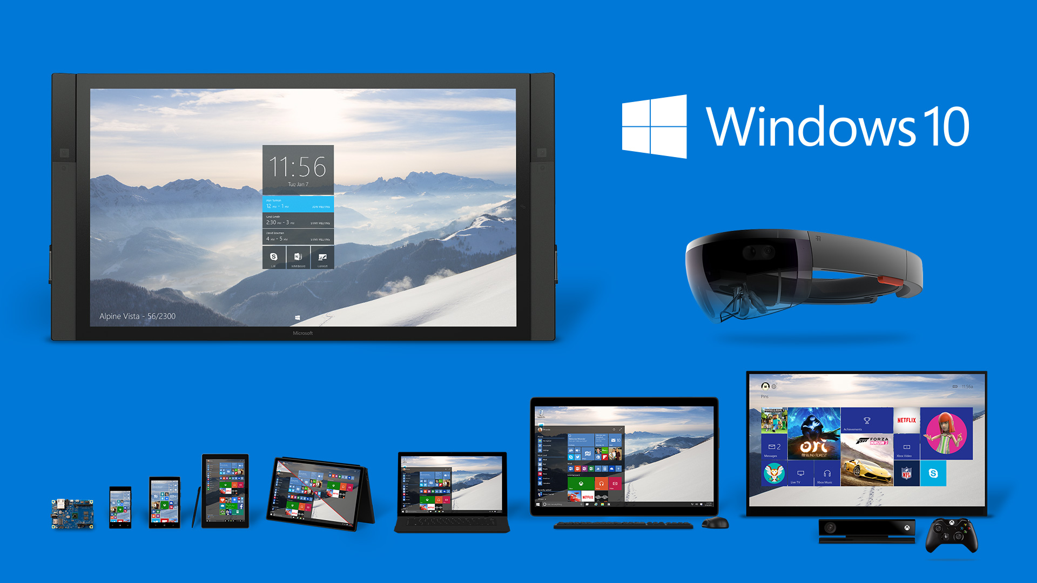

Slide 4
“
UWP becomes the one platform for developers.
Learn one set of core APIs for all devices.
„

Slide 5
1 API for all platforms
1 App-Package for all platforms
1 Store for all platforms

Slide 6
Requirements
Cheaper devices
ARM processors
Storage
Battery awareness
Focus on performance

Slide 7
Requirements
Different input options
Touch
Mouse, Keyboard
Handwriting
Speech
Gamepad
…
Provide options, fast response

Slide 8
Requirements
Different display sizes
Responsive Design

Slide 9
Requirements
Hardware capabilities
Back-Button
Sensors (Camera, Microphone, GPS, Bluetooth, NFC, …)
Capabilities checks instead of device checks

Slide 10
“
From a UI standpoint, we believe a large majority of these decisions/challenges can be answered by pivoting on window size and, if necessary, capabilities.
„

Slide 11
Requirements
Mobility
Mobile Internet
Offline
Device roaming
Services

Slide 12
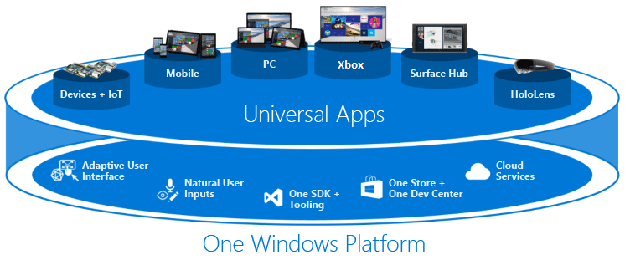

Slide 13
Windows Runtime
Base for Universal Windows Platform
Enhancement of COM
Language-independent APIs
Modern API Design (testready, …)
Enhancements for each platform
Asynchronism

Slide 14
The world has changed
Different devices
Apps
Functionality isn’t enough anymore

Slide 15
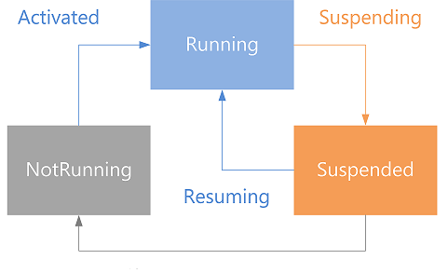
Apps
Isolated
Controlable (Un-)Install (Registry, AppData, …)
Dependencies
Rights and permissions
Life cycle

Slide 16
Apps
Deployment through App-Store
Different programming languages
Common Design (Guidelines)

Slide 17
The world has changed
Different devices
Apps
Functionality isn’t enough anymore

Slide 18
“
The value of design has changed:
from luxury to critical
„
-Surya Vanka, Director of User Experience, Microsoft
2007

