Slide 1

Challenge 1 Team Nofinger Inc.
Chris, Fred, Guang, Robin, Ryan
PharmaHacks 2019

Slide 2

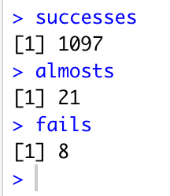
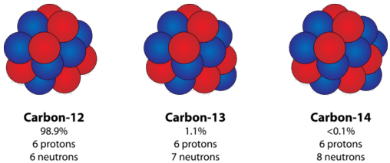
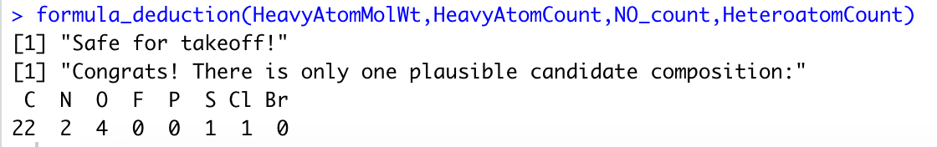
CHOPIN: Composition Hack On Properties of Isotopic Nuclei
Compound_set_1, id 1:
# Heavy Atoms = 30
MW = 423.772
Possible compositions: 10295472
Average MW: 12.0107 u
NO_count = 6
Heteroatoms = 8
Combinatorics increase exponentially, 40 atoms take 2 min on laptop
www.chem.libretexts.org

Slide 3

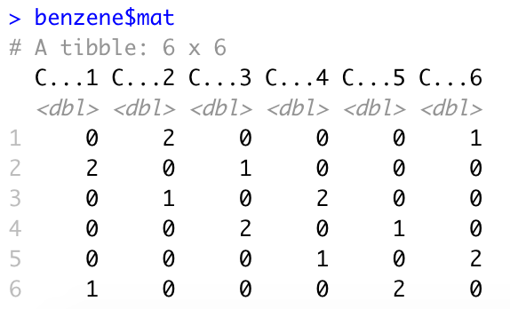
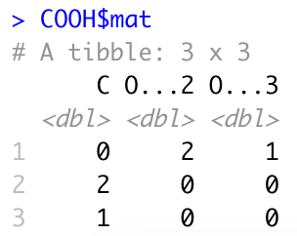
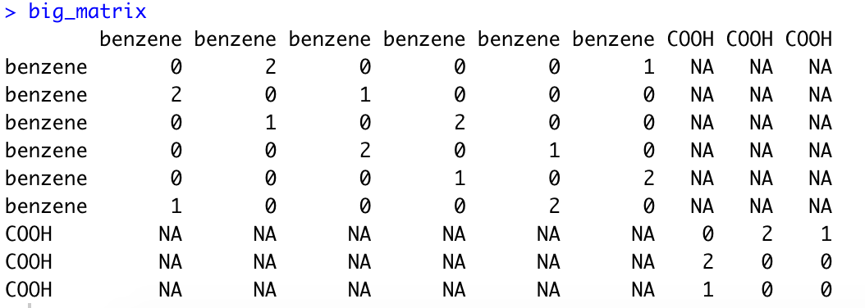
AMADEUS: Adjacency Matrix Analysis to DEdUce Structure
+
Zeros
Zeros
(Inspired by Sudoku)
5 combinations to assemble molecule
Limited by rings and chiral centers

Slide 4
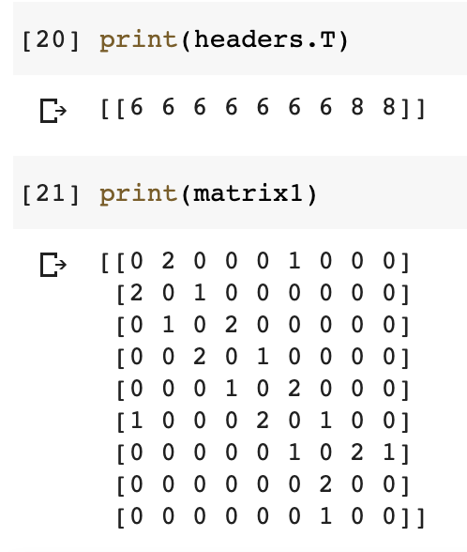
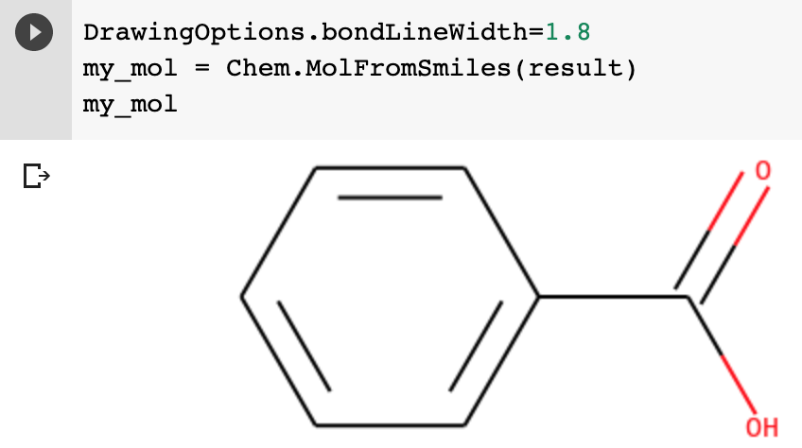

TCHAIKOVSKY: That Crazy Hacky “AI” Knocking Out Various Structure KeYs

Slide 5
Team Nofinger Inc.
C.
A.
T.
HOPIN
MADEUS
CHAIKOVSKY
Chris, Fred, Guang, Robin, Ryan
PharmaHacks 2019

