Slide 1
Big Data & IOT
Welcome to Our Project Proposal
presentation
Notes:
Assalamualaikum, Welcome to Our Project proposal presentation

Slide 2

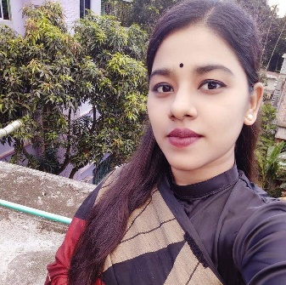
Team
Md. Bariul Munshi
ID: 201-15-3314
Hosne Ara Bithi
ID: 201-15-3738
Notes:
I am Bariul Munshi. Id: 201-15-3314 & my another team member Bithi

Slide 3
Tentative Discussion Topics
1. Project Title
3. Objective
4. Dataset Collection
5. Project Plan
6. Proposed Workflows
Notes:
In this project proposal, we will describe about …

Slide 4
Rose Leaf Disease Detection with Transformed Images and Convolutional Neural Networks
Notes:
Our project Title Name is …..

Slide 5
Objective
1. Problem Statement
2. Traditional Identification Challenges
3. Application of CNNs
4. Disease Identification
5. Value for Plant Pathology
6. Sustainable Cultivation
7. Revolutionizing Disease Identification

Slide 6
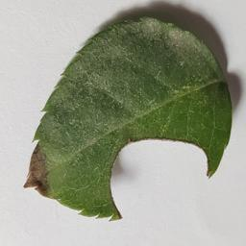
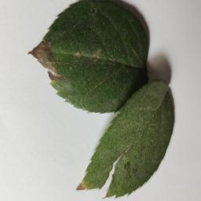
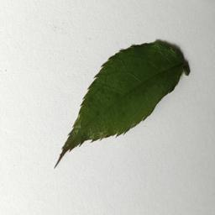
Data Collection
Rose_sawfly_Rose_slug
Rose_Rust
Healthy_Leaf_Rose
More Details

Slide 7
Project Plan
1. Add More Classes (New Disease Detection)
2. Model Development
3. Identifying Most efficient Deep Leaning Algorithm
Notes:
Identification of the most accurate and efficient Deep learning algorithm for Rose Leaf Disease Detection

Slide 8
Proposed Workflows

Slide 9
Any Question?

Slide 10
Thank You Everyone

