Slide 1
Entity Framework
Christoffer Noring

Slide 2
About me
Chris Noring, Swedish Developer since 10 years.
Londoner for the last month
Full stack developer. Educator, lecturer
London Javascript meetup group organizer
.NET on the backend, angular on the frontend, and other js frameworks
Google developer expert ( MVP in webtechnologies )
Twitter : chris_noring
Linked in: christoffer noring
Blog: softchris.github.io

Slide 3
What is it
ORM, Object relational mapper
- Maintains a connection with a database - Create & Executes commands - Create and execute queries - Process results - And most importantly, lets you use POCOS, plain old CLR objects when talking to the database.

Slide 4
Versions and history
First version was called 3.5
Database first
Model first ( Schema )
Code first
Currently in version 6.0
4.3 migrations
POCOs
The coming version will be called EF Core
For more info on EF Core
see https://github.com/aspnet/EntityFramework/wiki/Roadmap

Slide 5

What problems does it solve?
select ... from table
insert into table values(...)
update table set a=b...
delete from table where...
*
Number of entities in the database
Imagine having to do this for every entity in the database
- Lots and lots of stored procedures.
- Time consuming and boring to write
Also one language for both the
application and the database

Slide 6

Install
In visual studio go
Tools / Nuget Package Manager / Package manager console
1
2
Install-Package Entity Framework
Using nuget is by far the easiest way. You get the right .dll files added to
your project

Slide 7
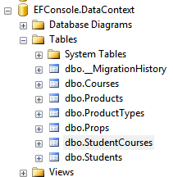
The database class
Inherits from DbContext
using System.Data.Entity;
public class DataContext : DbContext
{
}
Becomes <ProjectName>.<DbContextSubClass>
In our case this becomes
EFConsole.DataContext

Slide 8

A table
Key, Default makes anything called ProductId or Id into primary key
public class Product
{
public int Id { get; set; }
public string Name { get; set; }
public double Price { get; set; }
}
Is translated to suiting database types
public class DataContext : DbContext
{
public DbSet<Product> Products { get; set; }
}
Make the table queryable

Slide 9
Convention vs Annotations vs Fluent API
public class Course
{
[Key]
public int Counter { get; set; }
[Key]
[Column(Order=1)]
public int Id { get; set; }
[Key]
[Column(Order = 2)]
[Index(IsUnique = true)]
public string Name { get; set; }
[Required]
[MaxLength(10), MinLength(5)]
public string Description { get; set; }
[NotMapped]
public string FullName {
get
{ return string.Format("{0} {1}", this.Name, this.Description)
}
}
}
Normal primary key
Composite primary key
Setting constraints on column
Not persisted in database

Slide 10
Fluent API
Don’t start with this but once a bit more experienced this is what you will use, so learn it
It gives you fine grained control that outshines the annotations
public class DataContext : DbContext
{
public DbSet<Product> Products { get; set; }
public DbSet<ProductType> ProductTypes { get; set; }
public DbSet<Course> Courses { get; set; }
public DbSet<Student> Students { get; set; }
protected override void OnModelCreating(DbModelBuilder modelBuilder)
{
modelBuilder.Entity<Student>().HasKey(x => x.Id);
modelBuilder.Entity<Student>().HasKey( x => new { x.Id, x.Name } );
modelBuilder.Entity<Student>().Property(t => t.Name).HasMaxLength(50);
// etc..
base.OnModelCreating(modelBuilder);
}
}
Primary key
Composite key
Max Length on a property
https://msdn.microsoft.com/en-us/data/jj591617.aspx#1.1

Slide 11
Create a connection
App.config
using (var db = new DataContext())
{
}
Depending on what is specified here it will either create a
- Sql database in sql express,
- the real Sql server
- or an in memory database
<entityFramework>
<defaultConnectionFactory type="System.Data.Entity.Infrastructure.SqlConnectionFactory, EntityFramework" />
…
</entityFramework>

Slide 12
ToList vs IQueryable
We have a connection, now what..
1
Grabs the data for real
using (var db = new DataContext())
{
var products = db.Products.ToList();
var deferredQuery = db.Products;
var deferredSpecificQuery = db.Products.Select(x => x.Price > 400);
}
2
This only creates a question of type
Iqueryable, does NOT execute on db.

Slide 13
Persisting data
using (var db = new DataContext())
{
db.Products.Add(new Product { Name = "tomato", Price = 200 });
db.SaveChanges();
}
Add data in listlike manner
Persist by calling .SaveChanges()

Slide 14
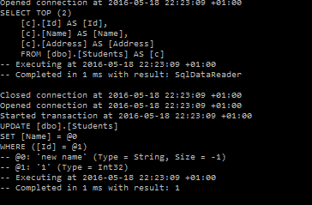
Update data
var student = db.Students.SingleOrDefault();
student.Name = "new name";
db.SaveChanges();
Select entity
Only update the property
in question

Slide 15
States
Detached, aka EF does not know about it, will do nothing if saved
using (var db = new DataContext())
{
db.Database.Log = Console.Write;
var student = new Student { Name = "Detached" };
var stateOfStudent = db.Entry(student).State;
There are different states that track
wether something is
Added
Modified
Detached
Etc..
Added, aka EF will run INSERT
var addedStudent = new Student{ Name="Added"};
db.Students.Add(addedStudent);
var stateOfAddedStudent = db.Entry(addedStudent).State;
Modified, aka EF will run UPDATE
var modifiedStudent = db.Students.SingleOrDefault();
modifiedStudent.Name = "modified";
var stateOfModifiedStudent = db.Entry(modifiedStudent).State;
The state basically tells EF what to do when someone calls .SaveChanges()

Slide 16
States example
State MODIFIED
using (var db = new DataContext())
{
studentOld = db.Students.SingleOrDefault();
studentOld.Name = "Change value";
var studentOldState = db.Entry(studentOld).State;
}
using (var db = new DataContext())
{
var studentOldStateInNewContext = db.Entry(studentOld).State;
db.SaveChanges();
}
State DETACHED = I don’t know you
This will do NOTHING

Slide 17
State fixed
using (var db = new DataContext())
{
studentOld = db.Students.SingleOrDefault();
studentOld.Name = "Change value";
var studentOldState = db.Entry(studentOld).State;
}
using (var db = new DataContext())
{
var studentOldStateInNewContext = db.Entry(studentOld).State;
db.Entry(studentOld).State = EntityState.Modified;
db.SaveChanges();
}
Force a STATE change to modified
So the context knows about it
Now this row runs an UPDATE

Slide 18
Lazy loading vs Eager loading
Lazy loading, means as soon as you poke at property it is loaded from the database.
using (var db = new DataContext())
{
var lazyStudent = db.Students.SingleOrDefault();
lazyStudent
.RegisteredCourses
.ToList()
.ForEach(student => Console.WriteLine(student.Name));
}
”Poking” RegisteredCourses
This behaviour is controlled by a setting, recommended is turn in off as you loose control
over the methods execution time in a refactoring situation or the size of the dataset can make for
very unpredictable behaviour
db.Configuration.LazyLoadingEnabled = false;

Slide 19
Eager loading with Navigation properties and .Include
Ok so now we have our product, our product type, but how get the data?
public class Product
{
public int Id { get; set; }
public string Name { get; set; }
public double Price { get; set; }
public int TypeId { get; set; }
public ProductType Type { get; set; }
}
var product = db.Products
.Include("Type")
.SingleOrDefault( x => x.Name == "Carrot" );
This will load the product and our navigation property Type
If .Include is not used the navigation property Type will have value null

Slide 20
Navigation properties cont.
Loading more than one Navigation property is simply done by adding a .Include row
var product = db.Products
.Include("Type")
.Include(”SomeOtherType")
.SingleOrDefault( x => x.Name == "Carrot" );
More than one property to load
If the depth is bigger than one. Let’s say a product has a type and the type has navigationproperty in turn, what then?
Increased depth
var product = db.Products
.Include("Type.SubType")
.SingleOrDefault( x => x.Name == "Carrot" );
There is also a fluent version on .Include looking like this
var product = db.Products
.Include( t => t.Type.Prop )
.SingleOrDefault( x => x.Name == "Carrot" );

Slide 21
Initializer
One solution ot the problem is using an
initializer
Sooner or later you want to add another table…
Data.SetInitializer( new Strategy() );
And you get this error
InvalidOperationException
Drop database on every
application startup
Drop database only if
there has been a change
The model backing the 'DataContext' context has changed since the database was created. Consider using Code First Migrations to update the database
Database.SetInitializer(new DropCreateDatabaseAlways<DataContext>());
So the problem is it won’t change our database for os unless we drop it first
or we use an incremental approach and create database scripts for our changes
like EF migrations would do for us.
Database.SetInitializer(new DropCreateDatabaseIfModelChanges<DataContext>());

Slide 22
Initializers continued
Now it works again but all my data is gone… this is time consuming
Enter seed data
Subclass a chosen strategy
class MyInitializer : DropCreateDatabaseAlways<DataContext>
{
protected override void Seed(DataContext context)
{
context.Products.Add(new Product { Name = "always here", Price = 100 });
context.SaveChanges();
base.Seed(context);
}
}
Override the seed method and put all your startup data there
As the first line in your program, run this
Database.SetInitializer(new MyInitializer());

Slide 23
Relations, 1- n, n-m

Slide 24
One to many
A product has a poduct type.
A Product type can belong to many products.
public class Product
{
public int Id { get; set; }
public string Name { get; set; }
public double Price { get; set; }
public int TypeId { get; set; }
public ProductType Type { get; set; }
}
The foreign key, can have another name
but then we need an annotation class
Navigation property
public class ProductType
{
public int Id { get; set; }
public string Name { get; set; }
}
public class ProductType
{
public int Id { get; set; }
public string Name { get; set; }
public int FKPropId { get; set; }
[ForeignKey("FKPropId")]
public Prop Prop { get; set; }
}

Slide 25

Many to many
A many to many situation is where example a Student
is registered to a lot of courses and a Course
has many students.
public class Student
{
public int Id { get; set; }
public string Name { get; set; }
public virtual ICollection<Course> RegisteredCourses { get; set; }
}
public class Course
{
public int Id { get; set; }
public string Name { get; set; }
public virtual ICollection<Student> Participants { get; set; }
}
By creating a collection at each entity we will create
a many-to-many relation

Slide 26
QUERIES

Slide 27
Method based vs query based syntax
db.Courses.Where(course => course.Name.Equals("Math"));
var query = from c in db.Courses
where c.Name.Equals("Math")
select c.Period;
More sql like

Slide 28
Grouped, Sum
var differentCities = from s in db.Students
group s by s.City into grouped
select new {
cityName = grouped.Key,
no = grouped.Count()
};
var registedPoints = ( from s in db.Students
from c in s.RegisteredCourses
select c.CoursePoints
).Sum();

Slide 29
Raw sql
1
Sometimes EF might not be the best candidate to write certain queries like report questions, then you can
Either write raw sql or stored procedures
var students = db.Students.SqlQuery("select * from Students").ToList();
2
Stored procedure
var transcripts = db.Students.SqlQuery("dbo.Transcripts @p0",studentId).ToList();
3
Non query, entities needs to see any change caused by this command
db.Database.ExecuteSqlCommand("insert into something");

Slide 30
TOOLS

Slide 31
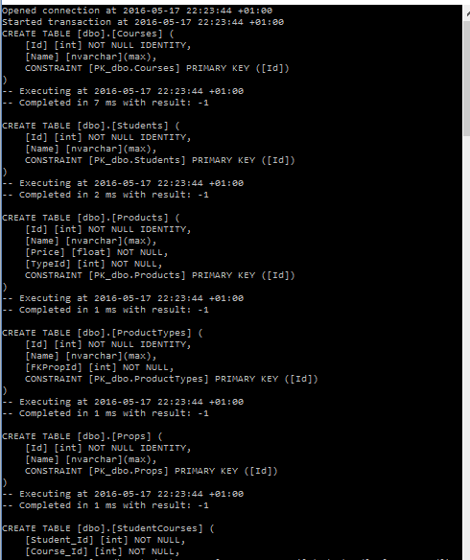
Logging
using (var db = new DataContext())
{
db.Database.Log = Console.Write;
}
Verything that happens
CREATE, QUERIES, INSERTS etc..

Slide 32
MIGRATIONS

Slide 33

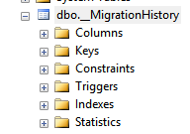
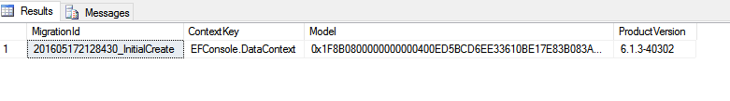
Migrations
Enable-Migrations ( in nuget, package manager console )
Wether to create manual migrations
or create automatic ones when model changes
public Configuration()
{
AutomaticMigrationsEnabled = false;
ContextKey = "EFConsole.DataContext";
}
Initial creation
Our migration has been run in DB
Created this table

Slide 34


Adding a migration
public partial class Student_Updated : DbMigration
{
public override void Up()
{
AddColumn("dbo.Students", "Address", c => c.String());
}
public override void Down()
{
DropColumn("dbo.Students", "Address");
}
}
1
Make change
public class Student
{
public int Id { get; set; }
public string Name { get; set; }
public string Address { get; set; }
public virtual ICollection<Course> RegisteredCourses { get; set; }
}
2
Add-Migration <Name>
3
Update-Database
Upgrades the database
You can run it forward ( up) to upgrade or backwards ( down)
to downgrade

Slide 35

Upgrade to specific version
Normally you want to upgrade to the latest version but sometimes you want to jump to a specific
point. This can be anywhere in all of your migrations. Either before OR after your specific point
Upgrade-Database -TargetMigration <migration name, only name part>
Example
Upgrade-Database –TargetMigration Student_Updated
Reverting migration – when it goes backwards

Slide 36
Customizing a migration
General tip is to think 1 2 aaaand 3 times before doing this. Ensure up = down method.
Use cases are adding index for example that EF doesn’t detect
public partial class Updated : DbMigration
{
public override void Up()
{
AddColumn("dbo.Courses", "Description", c => c.String());
AddColumn("dbo.Students", "City", c => c.String());
}
public override void Down()
{
DropColumn("dbo.Students", "City");
DropColumn("dbo.Courses", "Description");
}
}

Slide 37
Getting sql version of the migration
Update-Database -Script -SourceMigration:0
Will get you a sql script from the beginning
Update-Database -Script -SourceMigration:<migration>
Specific version
Update-Database -Script -SourceMigration:<migration> -TargetMigration <migration>
From specific to specific

Slide 38
Working in a team – beware of snapshots
https://msdn.microsoft.com/en-us/data/dn481501.aspx
1 Generate migration and apply, for testing puposes = >
2 Update-Database –TargetMigration < to the point before you started >
3 Get Latest
4 Generate migration
5 Check In

