Slide 1
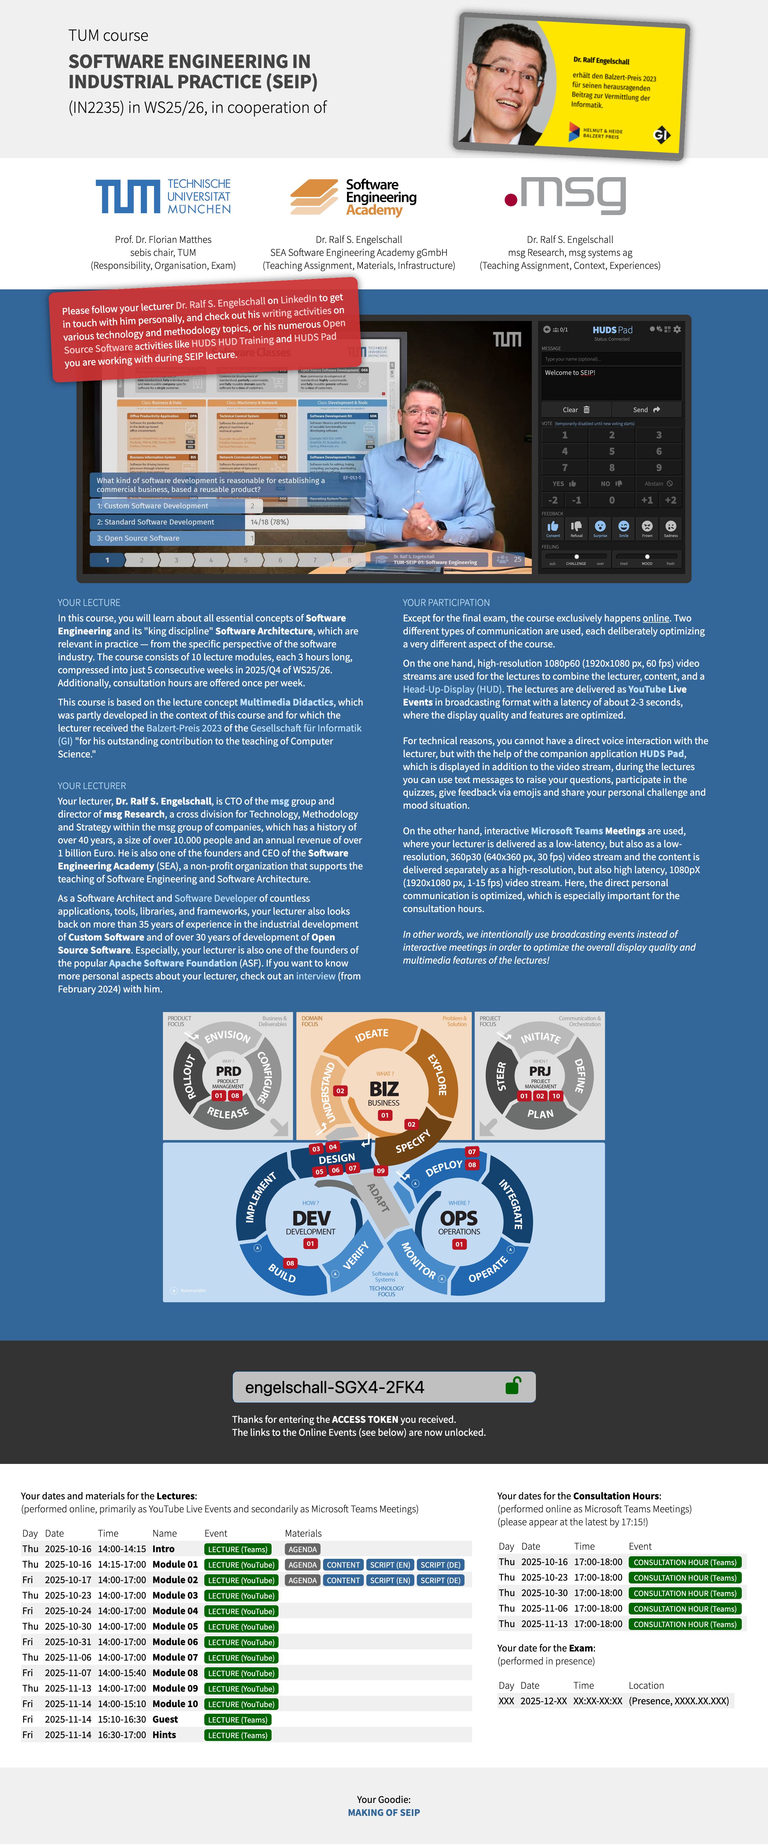
Your access to the course:
https://seip.direct/#
engelschall-SGX4-2FK4

Slide 5
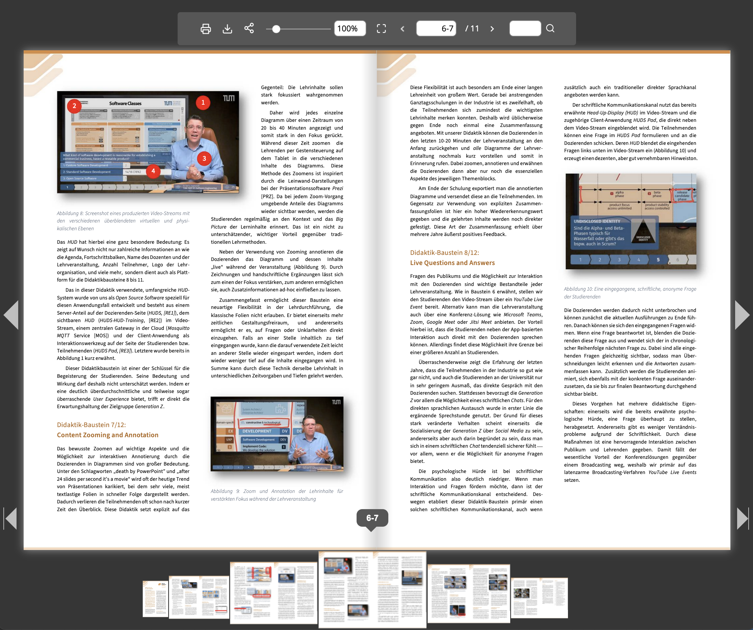
https://multimediale-didaktik.de/

Slide 8
Your access to the course:
https://seip.direct/#
engelschall-SGX4-2FK4

Slide 9
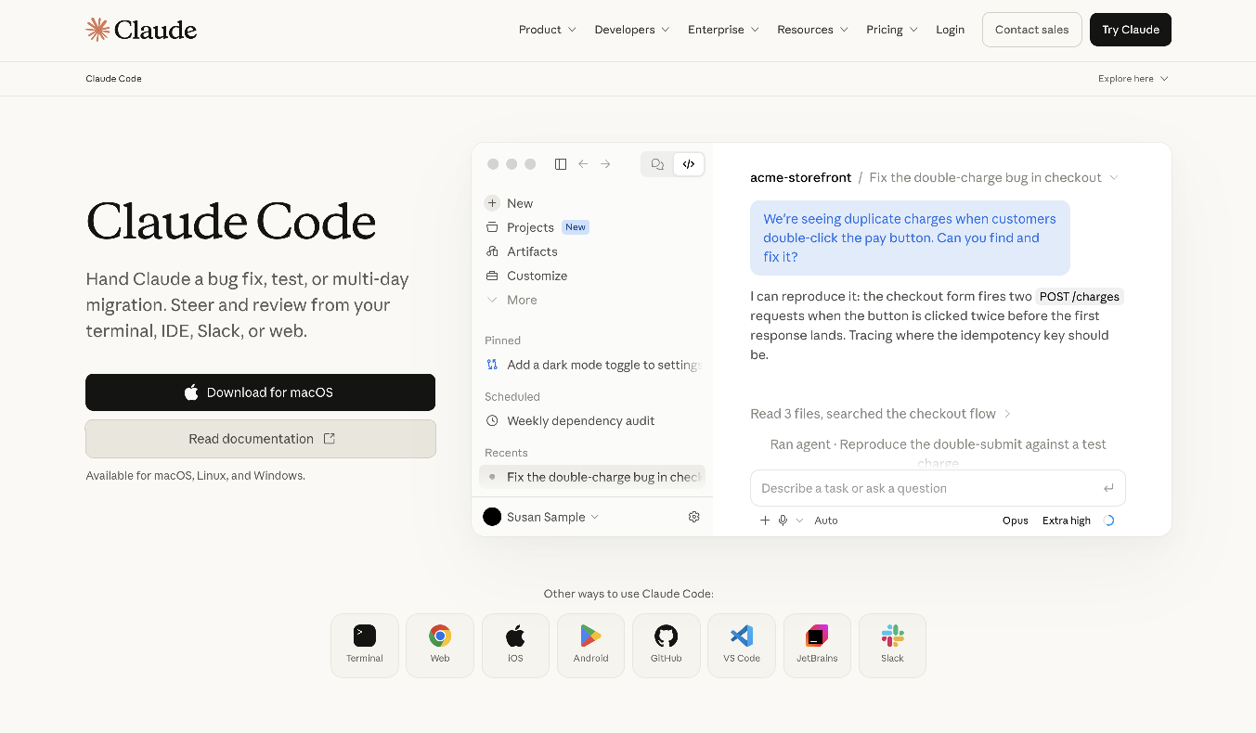
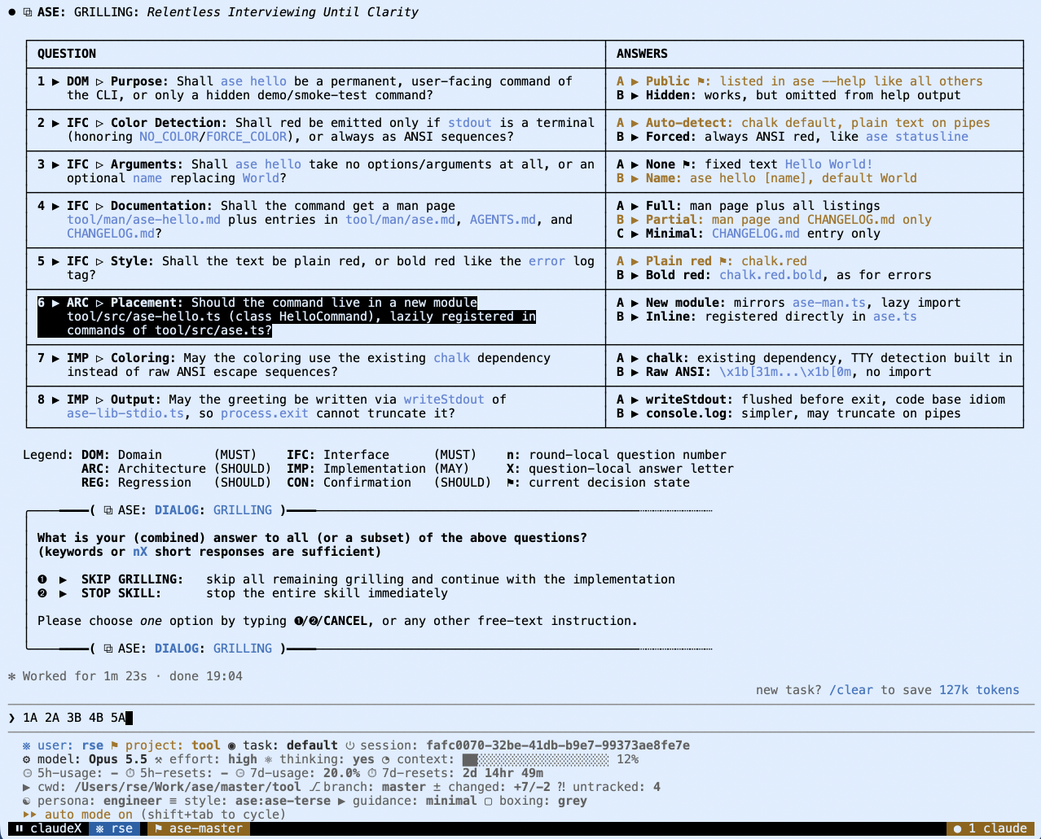
Anthrophic Claude Code (CLI)
https://claude.com/product/claude-code

Slide 10
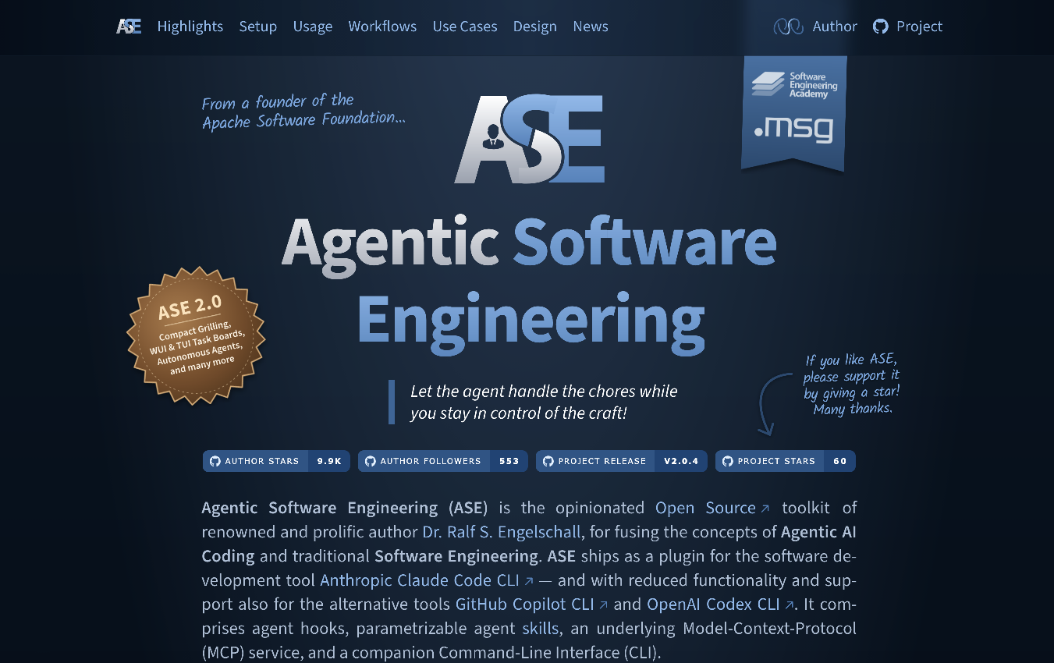
Agentic Software Engineering (ASE)
https://ase.tools

Slide 11
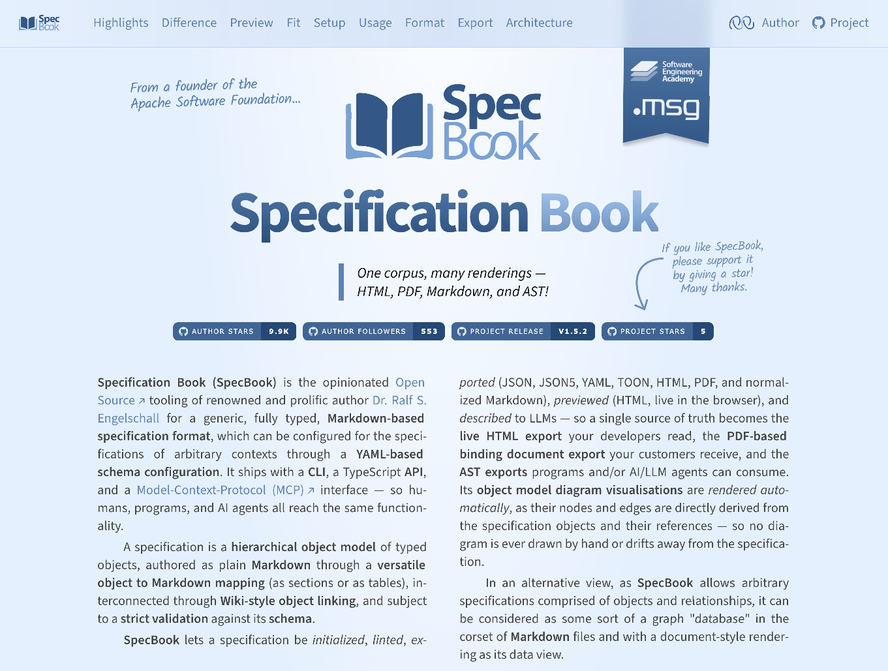
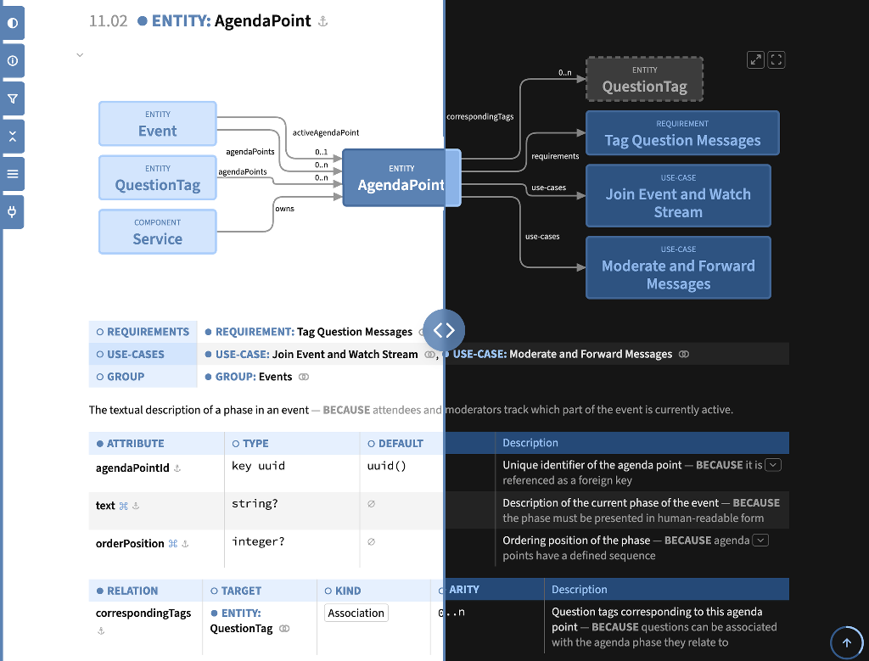
Specification Book (SpecBook)
https://specbook.tools

