Slide 1
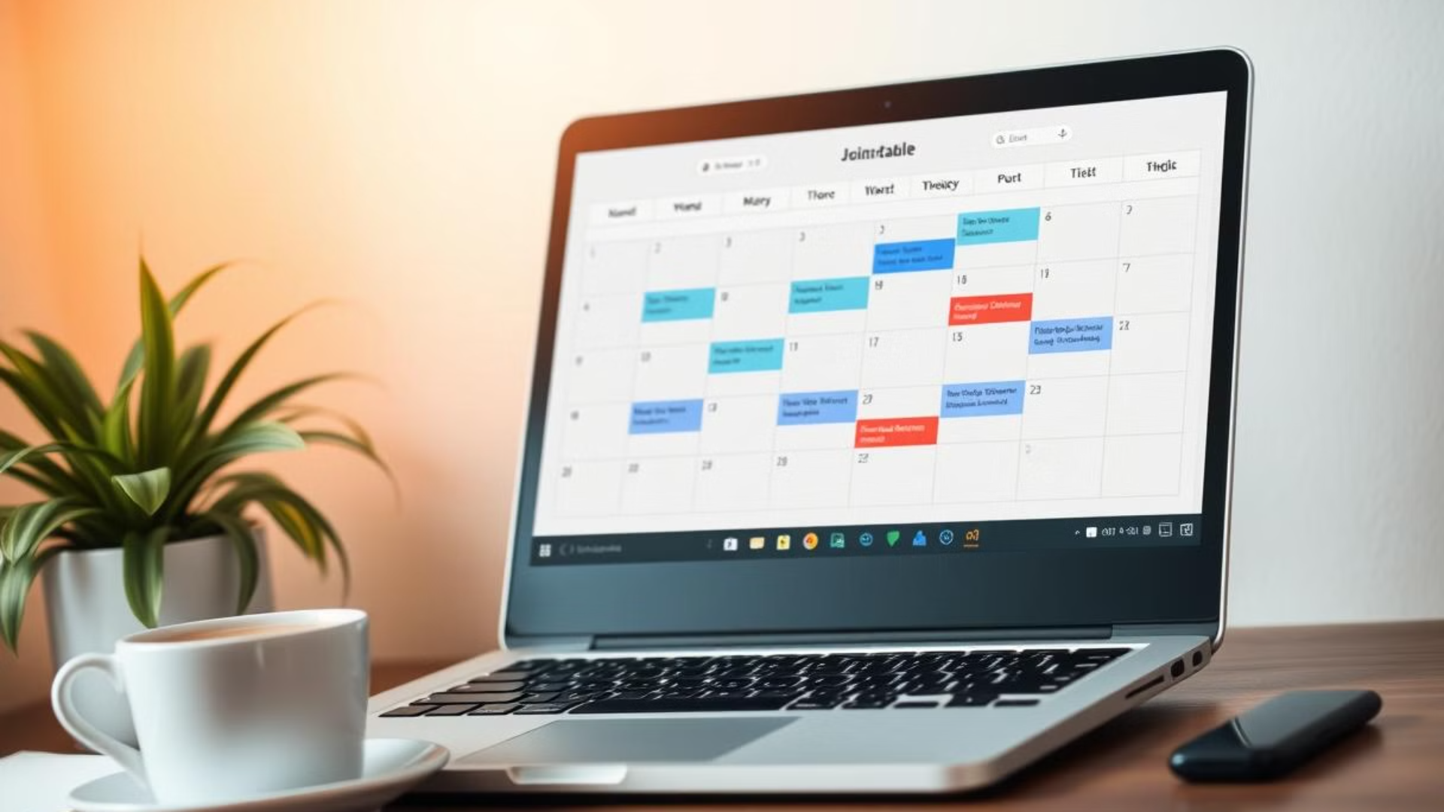

SYNOPSIS REPORT
On
AI-Powered Auto Timetable Generator
Submitted in partial fulfillment of the requirements of the degree of
BACHELOR OF TECHNOLOGY
by Raj Software Engineer

Slide 2
1. Group Details
Name
Enrollment Number
Branch/Semester
Mobile No.
College Email ID
Raj
2338511
CSE / 4th Semester
8360206237
23CSE1072@cgcjhanjeri.in
2. Title of the Project
AI-Powered Auto Timetable Generator Using Next.js & Google Gemini AI
3. Problem Statement
Scheduling tasks manually can be inefficient and time-consuming, especially for students, professionals, and educators. Creating optimized timetables that balance productivity, breaks, and priorities is a complex task. Existing scheduling tools lack AI-based automation that can intelligently generate schedules based on user preferences.
This project aims to develop a web-based AI-powered timetable generator that automates schedule creation using Google Gemini AI. The system will generate customized, optimized schedules instantly without requiring manual planning.

Slide 3
4. Objective and Scope of the Project
Objectives:
To develop an AI-based web application that automates timetable generation.
To integrate Google Gemini AI for intelligent schedule optimization.
To create a responsive, user-friendly, and SEO-optimized web application using Next.js.
To provide real-time schedule generation without storing data in a database.
Scope:
Students – Get AI-generated study plans.
Professionals – Manage meetings and tasks efficiently.
Educators – Automate lecture and class scheduling.
Freelancers – Plan projects with AI-driven automation.

