Slide 1
Steam Web API 분석
Web API

Slide 2
contents
FORMAT
Interfaces and method
GetNewsForApp
GetGlobalAchievementPercentagesForApp
GetPlayerSummaries
GetFriendList
GetPlayerAchievements
GetUserStatsForGame
GetOwnedGames
GetRecentlyPlayedGames
IsPlayingSharedGame

Slide 3
formats
API 요청을 JSON / XML / VDF 방식으로 가져올 수 있음.
JSON
AID : App ID
GID : Game ID
SID : Steam ID

Slide 4

Api (1)
GetGlobalAchievementPercentagesForApp
Param | GID
return | GID에 해당하는 업적목록과 총 유저수가 클리어한 비율.
Name : 업적이름
Percent : 이 게임을 가지고 있는 모든 사람들 중 이 업적을 클리어한 비율

Slide 5
Api (2)
GetPlayerSummaries
Param | SID
return | SID, name, profileurl, avatar(32x32, 64x64, 184x184) ,상태(offline,online,busy,away,snooze,trade,play) 커뮤니티공개상태(on,off), 프로필공개상태(on,off) ,마지막 로그인 시점 , 실제이름, 주소 게임중일경우현재플레이중인게임이름, 게임서버IP, 게임서버port

Slide 6
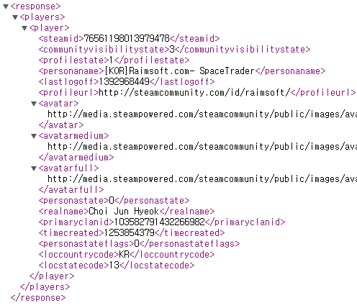
Api (2)
http://api.steampowered.com/ISteamUser/GetPlayerSummaries/v0002/?key=DE028A2732887BCDB1CCE803B9A1A24D&steamids=76561198013979478&format=xml
GetPlayerSummaries

Slide 7
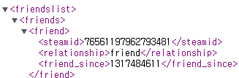
Api (3)
http://api.steampowered.com/ISteamUser/GetFriendList/v0001/?key=DE028A2732887BCDB1CCE803B9A1A24D&steamid=76561198013979478&relationship=all&format=xml
GetFriendList
Param | SID, Relationship (all, friend)
return | 친구목록…
Stamid : 아이디
Relationship : 관계
Friend_since : 언제부터 친구였는지 (unix time)

Slide 8
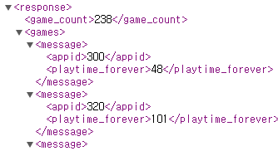
Api (4)
http://api.steampowered.com/IPlayerService/GetOwnedGames/v0001/?key=DE028A2732887BCDB1CCE803B9A1A24D&steamid=76561198013979478&format=xml
GetOwnedGames
Param | SID, AID(=all), include_played_free_games (=x)
return | 가지고 있는 게임 개수 AID 플레이타임
Game_cound : 게임 개수
Appid :
Playtime_forever : 총 플레이타임

