Slide 1
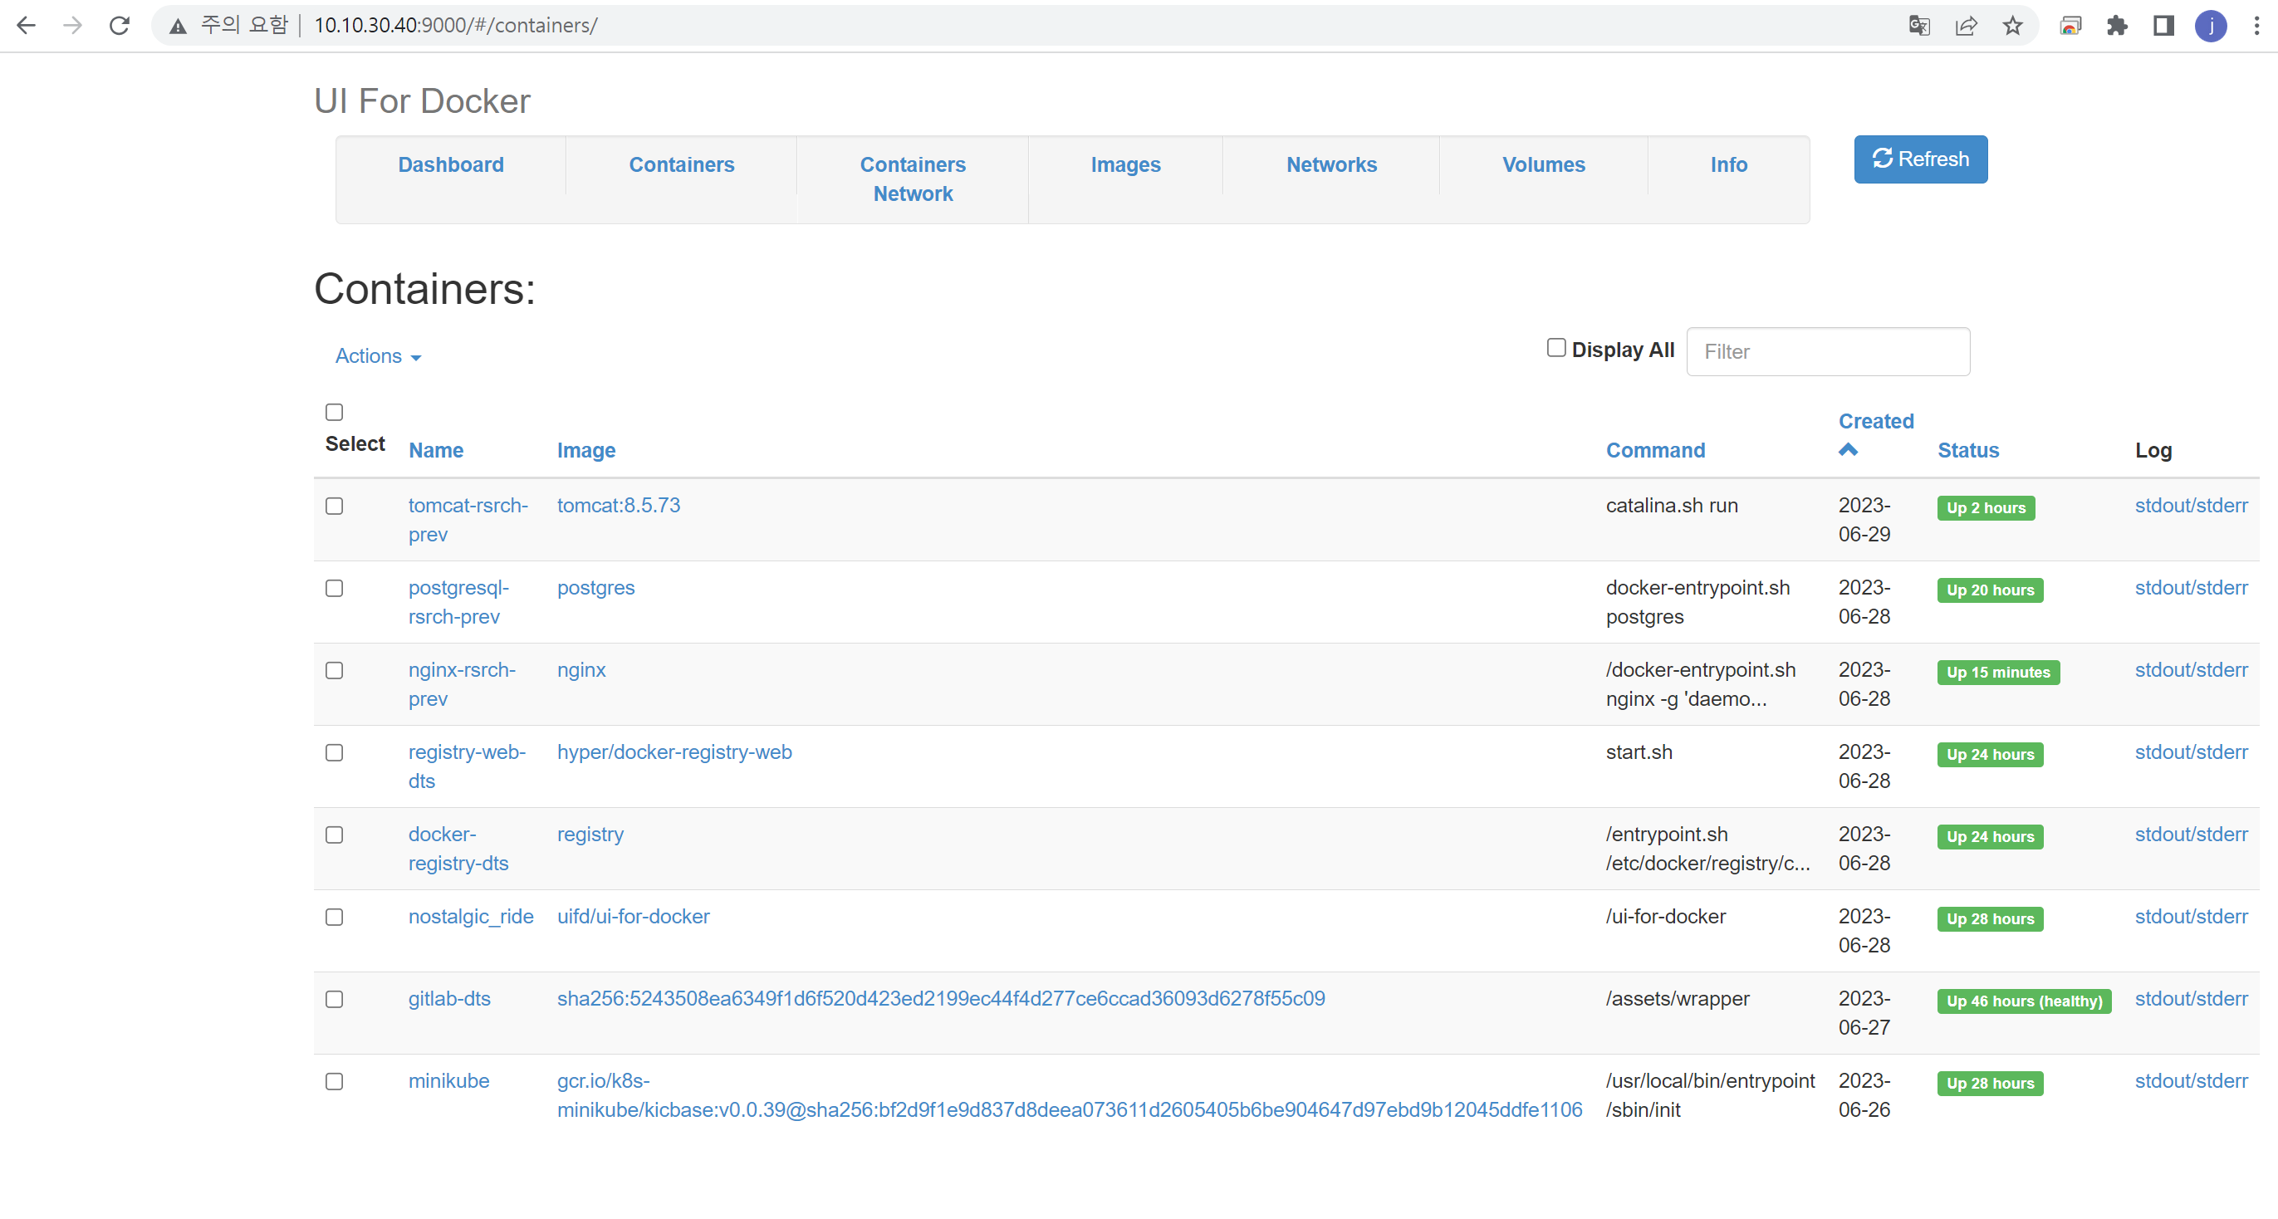
Docker UI Tool

Slide 2
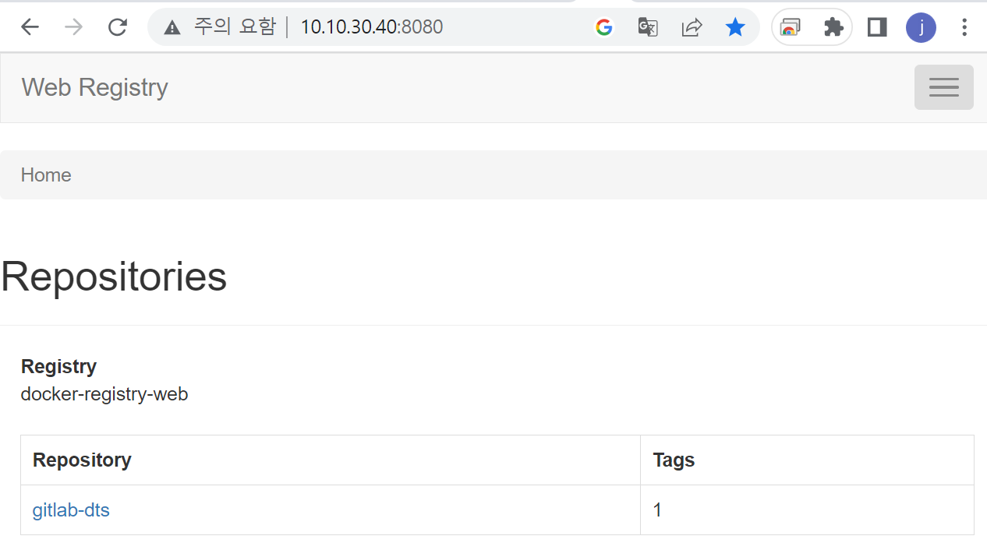
Centos7 에 Docker-ce 설치

Slide 3
Centos7 에 Docker-ce 설치
yum update
yum-config-manager --add-repo https://download.docker.com/linux/centos/docker-ce.repo
yum install -y docker-ce docker-ce-cli containerd.io docker-compose-plugin
systemctl enable docker
systemctl start docker

Slide 4
Gitlab 설치(docker)
docker run --detach \
--hostname 10.10.30.40 \
--publish 11090:80 --publish 2224:22 \
--name gitlab-dts \
--restart always \
--volume ~/gitlab-dts/config:/etc/gitlab:Z \
--volume ~/gitlab-dts/logs:/var/log/gitlab:Z \
--volume ~/gitlab-dts/data:/var/opt/gitlab:Z \
--volume ~/gitlab-dts/backups:/var/opt/gitlab/backups \
--volume /etc/localtime:/etc/localtime:ro \
-e TZ=Asia/Seoul \
gitlab/gitlab-ce:latest
docker ps
(status 가 healthy 로 보인 후 조금 더 기다려야 접속이 가능하다)
참고 url : https://dncjf64.tistory.com/384

Slide 5
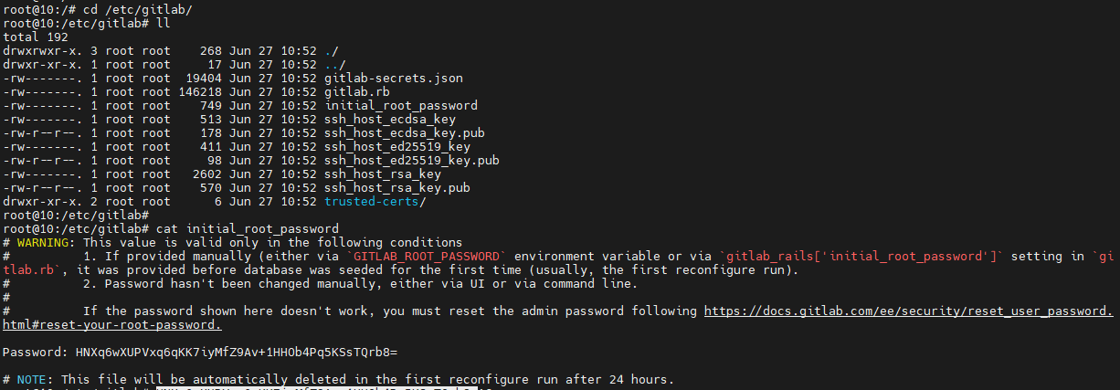
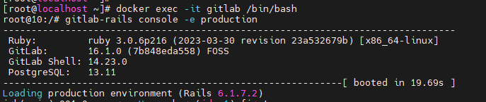
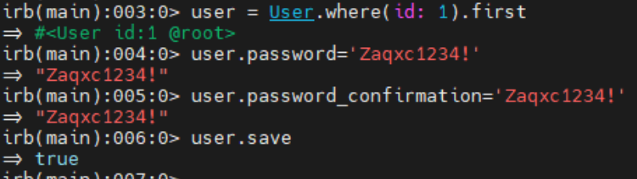
Gitlab 설치(docker)
* Root 패스워드 확인
docker exec -it gitlab-dts /bin/bash
cat /etc/gitlab/initial_root_password
예: HNXq6wXUPVxq6qKK7iyMfZ9Av+1HHOb4Pq5KSsTQrb8=
http://10.10.30.40:11090/
http://112.217.210.138:11090/
docker logs –f –n 200 gitlab-dts
root/Zaqxc1234!
[로그인 안되는 경우 아래 실행]
gitlab-rails console -e production
user = User.where(id: 1).first
user.password='Zaqxc1234!'
user.password_confirmation='Zaqxc1234!'
user.save
참고 url : https://dncjf64.tistory.com/384

Slide 6
Docker 관리 UI Manager Tool
docker run -d -p 9000:9000 --privileged -v /var/run/docker.sock:/var/run/docker.sock uifd/ui-for-docker
http://10.10.30.40:9000/

Slide 7
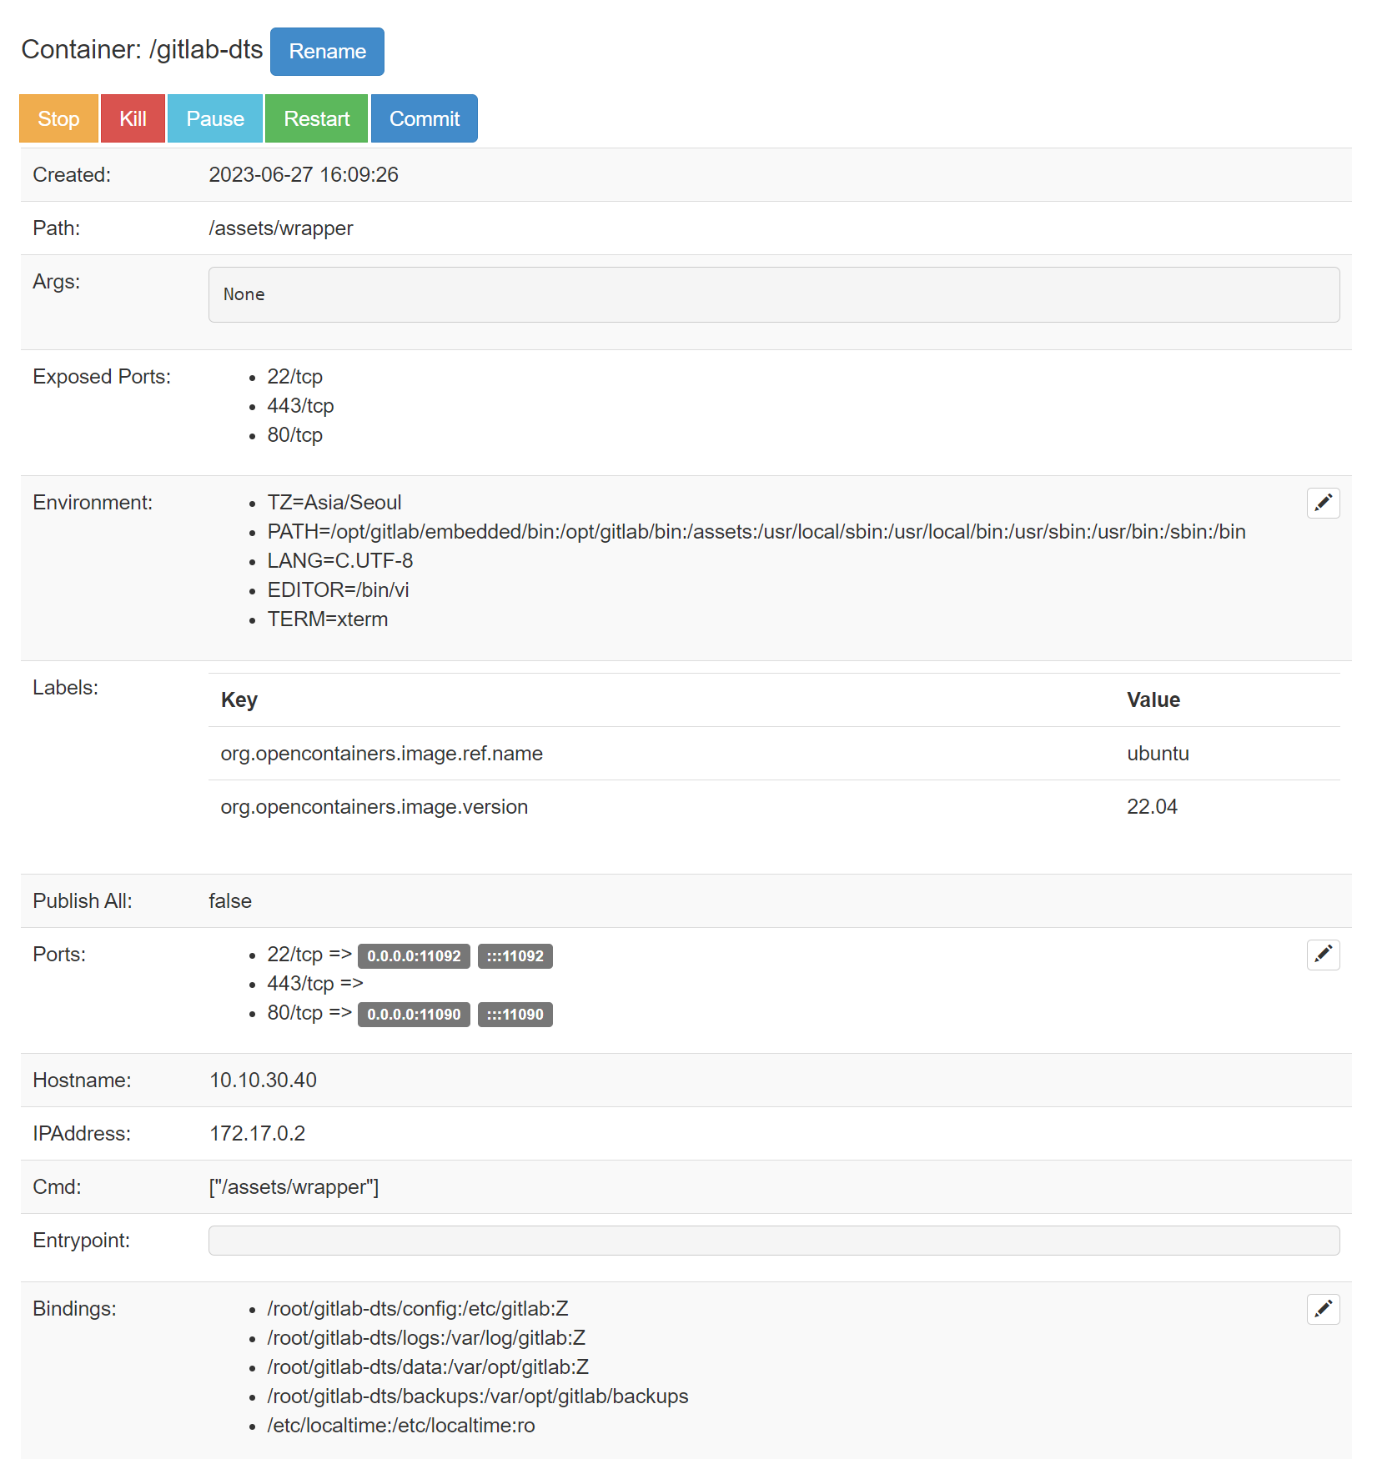
Docker 관리 UI Manager Tool

Slide 8
방역공조 Gitlab project
http://10.10.30.40:11090/ 에서 회원가입(register) 및 관리자(root) 승인 후 사용가능
#. 사용자 Front
http://10.10.30.40:11090/dts-dev-team/map.git
(branch : research_prev)
#. 관리자 Front
http://10.10.30.40:11090/dts-dev-team/korea-front.git
(branch : research_prev)
#. Admin Manager Back
http://10.10.30.40:11090/dts-dev-team/admin-manager.git
(branch : research_prev)
#. Space Manager Back
http://10.10.30.40:11090/dts-dev-team/space-manager.git
(branch : research_prev)

Slide 9
Docker hub 구축(local registry)
docker pull registry
docker pull hyper/docker-registry-web
docker container run -d -p 5000:5000 --restart=always --name docker-registry-dts -v /root/registry:/var/lib/registry registry
docker commit a7770939b4db gitlab-dts:1.0
docker tag gitlab-dts:1.0 localhost:5000/gitlab-dts:1.0
docker push localhost:5000/gitlab-dts:1.0
curl -XGET localhost:5000/v2/_catalog
참고 url : https://velog.io/@lijahong/0%EB%B6%80%ED%84%B0-%EC%8B%9C%EC%9E%91%ED%95%98%EB%8A%94-Docker-%EA%B3%B5%EB%B6%80-Private-Registry-%EA%B5%AC%ED%98%84

Slide 10
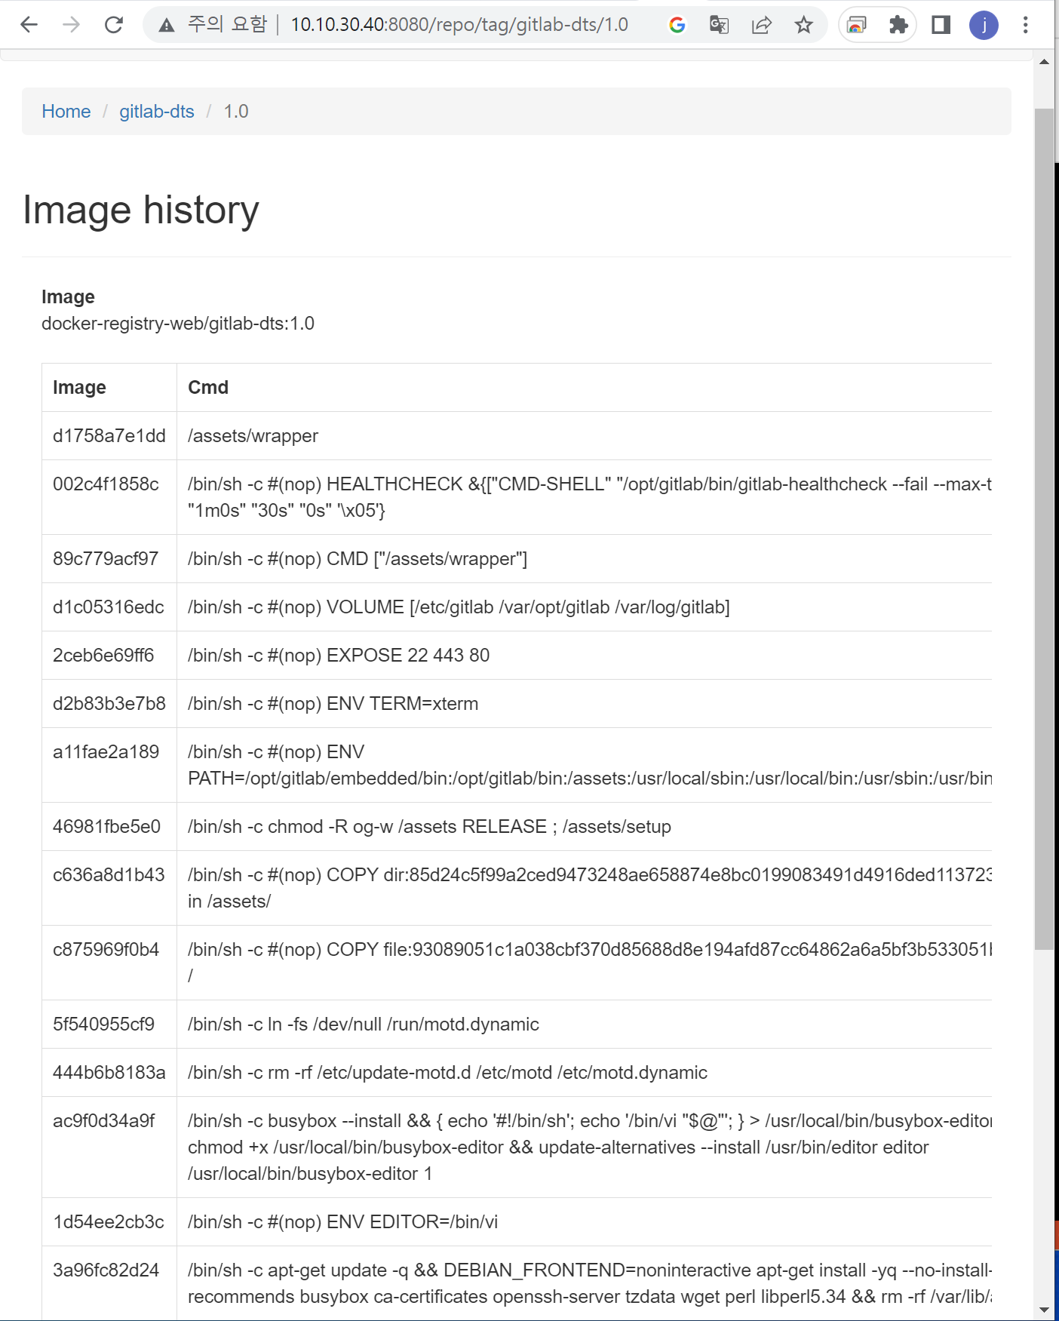
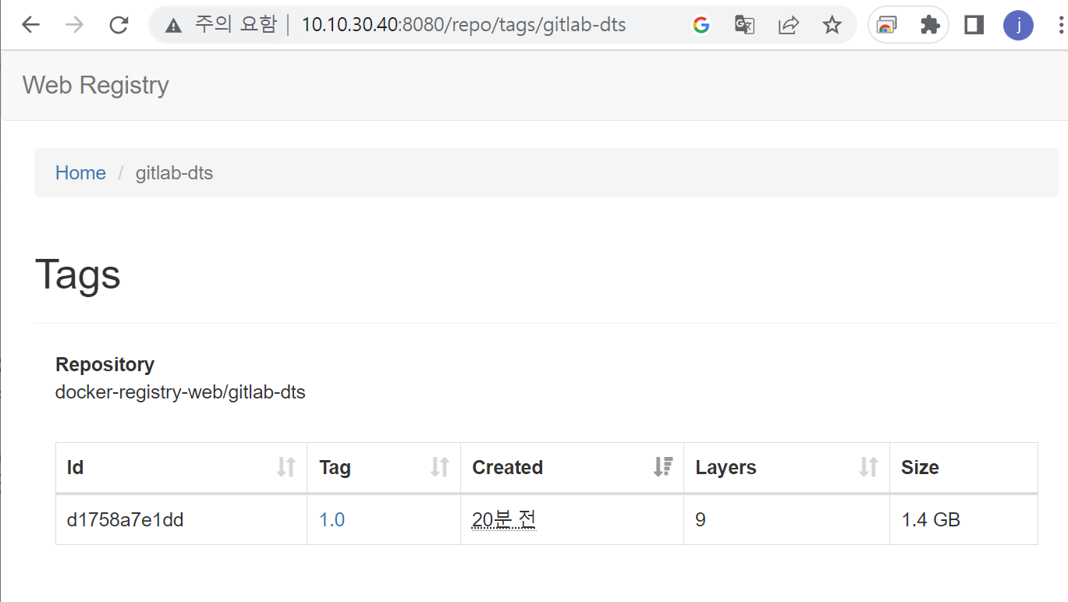
Docker hub Web GUI 구축
docker run -d -p 8080:8080 --name registry-web-dts --link docker-registry-dts:private -e REGISTRY_URL=http://10.10.30.40:5000/v2 -e REGISTRY_NAME=docker-registry-web --restart=always hyper/docker-registry-web
참고 url : https://velog.io/@lijahong/0%EB%B6%80%ED%84%B0-%EC%8B%9C%EC%9E%91%ED%95%98%EB%8A%94-Docker-%EA%B3%B5%EB%B6%80-Private-Registry-%EA%B5%AC%ED%98%84

Slide 11
Nginx 설치(docker)
docker pull nginx
docker run –it \
--name nginx-rsrch-prev \
-d \
-p 80:80 \
-p 443:443 \
--restart=always \
-e TZ=Asia/Seoul \
nginx
#docker update –restart=always nginx-rsrch-prev
#docker update –p 443:443 nginx-rsrch-prev
docker exec -it nginx-rsrch-prev /bin/bash
vim /etc/nginx/conf.d/default.conf
vim /usr/shqre/nginx/html/index.html
도커 컨테이너에 vi 설치
#docker exec -it [container_id] bash
#apt-get update
#apt-get upgrade
#apt-get install vim
포트 추가 오픈하는 방법
docker stop nginx-rsrch-prev
docker commit nginx-rsrch-prev nginx-rsrch-prev:v0.1
docker run -p 80:80 –p 443:443 nginx-rsrch-prev:v0.1
docker run -it --name nginx-rsrch-prev -d -p 80:80 -p 443:443 --restart=always -e TZ=Asia/Seoul -v /root/rsrch-prev/nginx/html:/usr/share/nginx/html nginx-rsrch-prev:v0.1
참고 url : https://juhpark.tistory.com/20

Slide 12
Nginx SSL 설치(docker) : whois 인증서 적용
openssl rsa -des3 -in Private.key -out Private_pass.key
openssl rsa -in Private_pass.key -out Private_nopass.key
docker cp /root/ssl/Private_nopass.key nginx-rsrch-prev:/etc/nginx/
cat dt-hub_co_kr_crt.pem ChainCA.crt RootCA.crt > dt-hub_co_kr_bundle.pem
docker cp /root/ssl/dt-hub_co_kr_bundle.pem nginx-rsrch-prev:/etc/nginx/
docker cp /root/ssl/Private.key nginx-rsrch-prev:/etc/nginx/
인증서 비밀번호: onpoomdts0628
참고 url : https://cs.whois.co.kr/manual/ssl_nginx.pdf

Slide 13
Nginx SSL 설치(docker) : config 파일 설정
docker cp nginx-rsrch-prev:/etc/nginx/conf.d/default.conf ./
vi default.conf
server {
listen 80;
listen [::]:80;
listen 443 ssl;
server_name dt-hub.co.kr;
ssl_certificate /etc/nginx/dt-hub_co_kr_bundle.pem;
ssl_certificate_key /etc/nginx/Private_nopass.key;
ssl_protocols TLSv1.2;
location / {
root /usr/share/nginx/html;
index index.html index.htm;
}
}
docker cp default.conf nginx-rsrch-prev:/etc/nginx/conf.d/
docker restart nginx-rsrch-prev
인증서 비밀번호: onpoomdts0628
참고 url : https://cs.whois.co.kr/manual/ssl_nginx.pdf

Slide 14
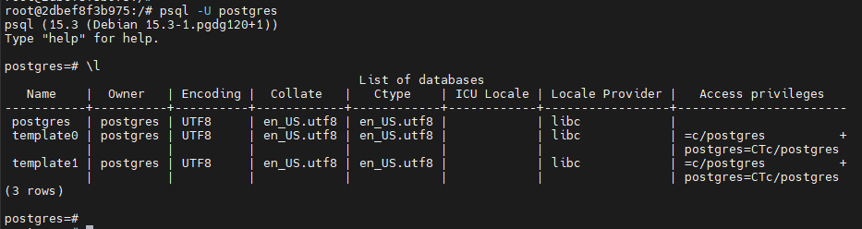
Postgresql 설치(docker)
docker run \
-dp 5432:5432 \
--name postgresql10-rsrch-prev \
-e POSTGRES_PASSWORD=Zaqxc1234! \
-e TZ=Asia/Seoul \
-v ~/rsrch-prev/postgres/data:/var/lib/postgres/data postgres:10
docker update --restart=always postgresql10-rsrch-prev
docker exec -it postgresql10-rsrch-prev /bin/bash
psql -U postgres
\l
참고 url : https://devfunny.tistory.com/906

Slide 15
Tomcat 설치(docker)
cd /root/rsrch-prev/tomcat
docker run -d --name tomcat-rsrch-prev -p 8686:8080 --restart=always -e TZ=Asia/Seoul tomcat:8.5.73-jdk8
[백업된 설정파일이 있는 경우 Jenkins 연동 계정 적용]
docker cp ./conf/tomcat-users.xml tomcat-rsrch-prev:/usr/local/tomcat/conf/
docker cp ./webapps/manager tomcat-rsrch-prev:/usr/local/tomcat/webapps/
docker restart tomcat-rsrch-prev
docker exec -it tomcat-rsrch-prev /bin/bash
[test]
http://10.10.30.40:8686/manager
참고 url : https://velog.io/@sherlockid8/Docker%EC%97%90-Tomcat-%EC%BB%A8%ED%85%8C%EC%9D%B4%EB%84%88-%EC%8B%A4%ED%96%89-%EB%A1%9C%EC%BB%AC-%ED%8C%8C%EC%9D%BC-%EB%B3%B5%EC%82%AC%ED%95%B4%EC%84%9C-%EC%8B%A4%ED%96%89%EC%8B%9C%ED%82%A4%EA%B8%B0

Slide 16
Tomcat 설치(docker) : jenkins 계정 연동 설정 : tomcat-users.xml 수정 - 백업된 설정파일이 없는 경우
cd /root/rsrch-prev/tomcat
docker cp tomcat-rsrch-prev:/usr/local/tomcat/conf/tomcat-users.xml ./
vim tomcat-users.xml
docker cp tomcat-users.xml tomcat-rsrch-prev:/usr/local/tomcat/conf/
docker cp manager.zip tomcat-rsrch-prev:/usr/local/tomcat/webapps/
docker exec -it tomcat-rsrch-prev /bin/bash
cd /usr/local/tomcat/webapps/
unzip manager.zip
exit
docker restart tomcat-rsrch-prev
<role rolename="tomcat"/>
<role rolename="manager"/>
<role rolename="manager-gui" />
<role rolename="manager-script" />
<role rolename="manager-jmx" />
<role rolename="manager-status" />
<role rolename="admin"/>
<user username="tomcat" password="Zaqxc1234!" roles="tomcat,manager,manager-gui,manager-script,manager-jmx,manager-status,admin"/>
참고 url :

Slide 17
Tomcat 설치(docker) : jenkins 계정 연동 설정 : context.xml 수정- 백업된 설정파일이 없는 경우
http://10.10.30.40:8686/manager
403 오류 발생시
cd /root/rsrch-prev/tomcat
docker cp tomcat-rsrch-prev:/usr/local/tomcat/webapps/manager/META-INF/context.xml ./
vim context.xml # Valve 태그 주석처리
docker cp context.xml tomcat-rsrch-prev:/usr/local/tomcat/webapps/manager/META-INF/
docker restart tomcat-rsrch-prev
<Context antiResourceLocking="false" privileged="true" >
<!--
<Valve className="org.apache.catalina.valves.RemoteAddrValve"
allow="127\.\d+\.\d+\.\d+|::1|0:0:0:0:0:0:0:1" />
-->
<Manager sessionAttributeValueClassNameFilter="java\.lang\.(?:Boolean|Integer|Long|Number|String)|org\.apache\.catalina\.filters\.CsrfPreventionFilter\$LruCache(?:\$1)?|java\.util\.(?:Linked)?HashMap"/>
</Context>
참고 url : https://hongku.tistory.com/196

Slide 18
Jenkins 설치(docker) : openjdk8
docker run -d --name jenkins-jdk8-dts -p 8888:8080 \
--restart=always \
-e TZ=Asia/Seoul \
-v /root/jenkins_home:/var/jenkins_home \
-v /var/run/docker.sock:/var/run/docker.sock \
-u root \
jenkins/jenkins:2.346.1-jdk8
docker exec -it jenkins-jdk8-dts /bin/bash
cat /var/jenkins_home/secrets/initialAdminPassword # 초기 비밀번호 617afc726dda41bd92f7faa9a973c878
http://10.10.30.40:8888/
http://112.217.210.138:8888/
초기 비밀번호로 로그인 후 기본 Plug-in 설치
첫번째 사용자 추가는 건너띄기
패스워드 변경
Id: admin
Pw : Zaqxc1234!
기본 Plug-in install
Maven Integration Plugin
Deploy to container Plugin
NodeJS Plugin
NPM and Yarn Wrapper and StepsVersion0.4.0
Publish Over SSH
openJDK-native-plugin
참고 url : https://seosh817.tistory.com/287

Slide 19
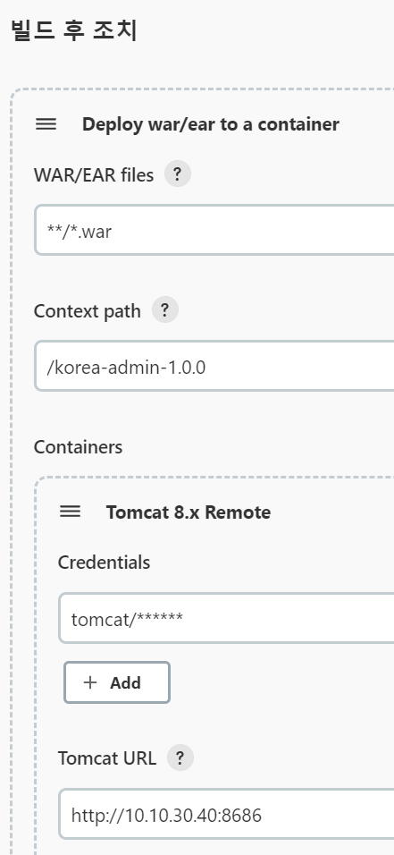
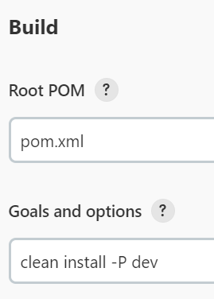
Jenkins Tomcat 배포
참고 : LX_소스빌드배포_20230213.ppt

Slide 20
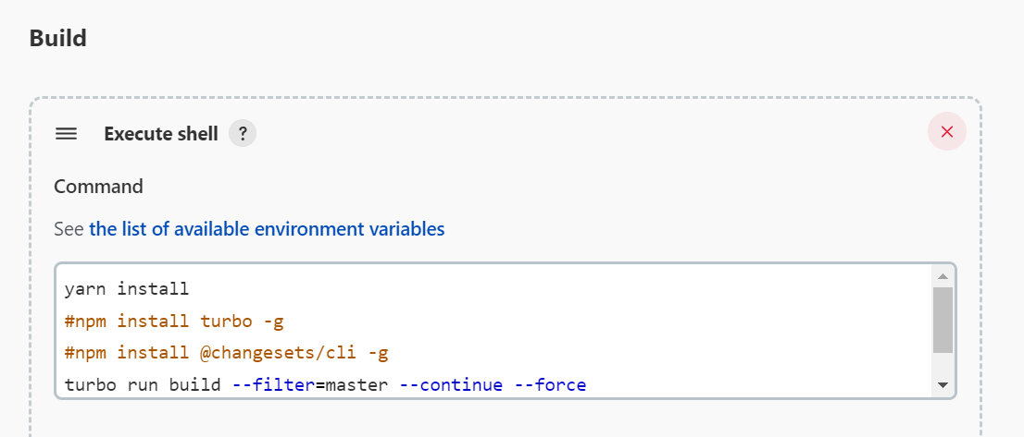
Jenkins nginx 배포 : build script
아이템 생성 후 Map 빌드 실행 전에 Jenkins docker shell 에서 아래 실행
docker exec -it jenkins-jdk8-dts /bin/bash
cd /var/jenkins_home/workspace/preventative-map # item workspace path
apt update
apt upgrade
apt install nvm
nvm install 18.0.0
nvm use 18.0.0
npm login --registry='http://106.245.249.226:4873/‘
npm install max -g
npm install yarn –g
yarn install
npm install turbo –g
npm install @changesets/cli –g
npm install micro-cli --registry=http://106.245.249.226:4873/
참고 : LX_소스빌드배포_20230213.ppt

Slide 21
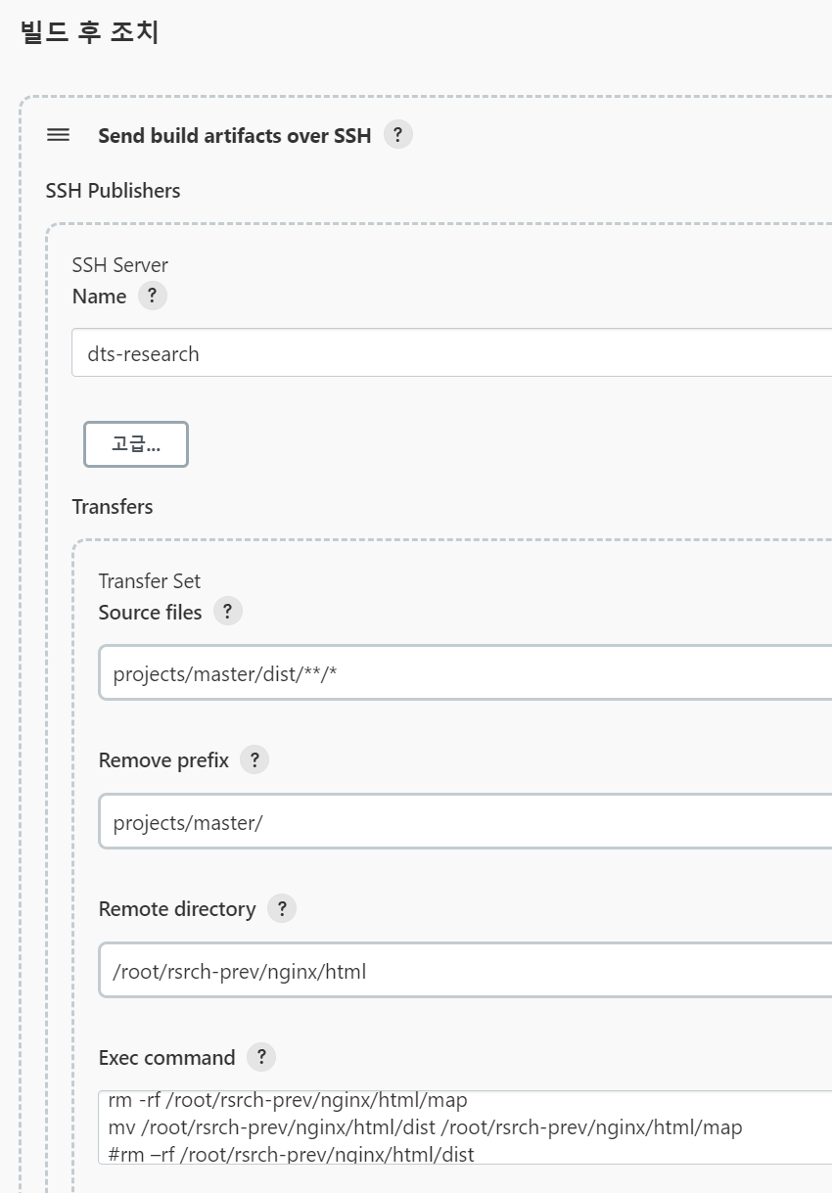
Jenkins nginx 배포 : 빌드 결과를 SSH 를 통해 nginx 로 전송
Source files : projects/master/dist/**/*
Remote directory : /root/rsrch-prev/nginx/html
Remove prefix : projects/master/
Exec command:
rm -rf /root/rsrch-prev/nginx/html/map
mv /root/rsrch-prev/nginx/html/dist /root/rsrch-prev/nginx/html/map
참고 : LX_소스빌드배포_20230213.ppt

Slide 22
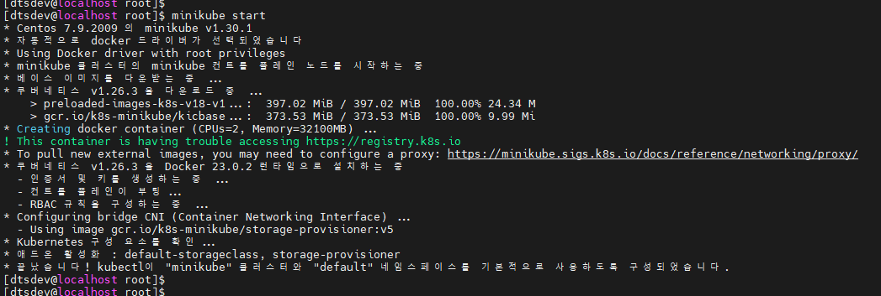
Centos7 에 Minikube 설치
curl -LO https://storage.googleapis.com/minikube/releases/latest/minikube-linux-amd64
sudo install minikube-linux-amd64 /usr/local/bin/minikube
cat <<EOF > /etc/yum.repos.d/kubernetes.repo
[kubernetes]
name=Kubernetes
baseurl=https://packages.cloud.google.com/yum/repos/kubernetes-el7-x86_64
enabled=1
gpgcheck=1
repo_gpgcheck=1
gpgkey=https://packages.cloud.google.com/yum/doc/yum-key.gpg https://packages.cloud.google.com/yum/doc/rpm-package-key.gpg
EOF
yum install -y kubectl
adduser dtsdev
passwd dtsdev
usermod -aG wheel dtsdev
usermod -aG docker dtsdev
su dtsdev
minikube start

Slide 23
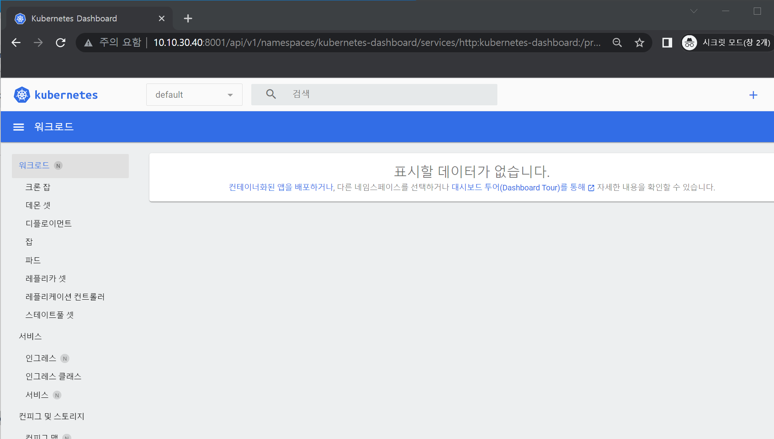
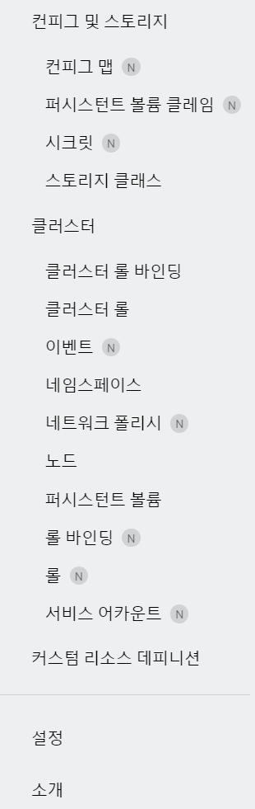
minikube dashboard 활성화
su dtsdev
minikube addons enable dashboard
nohup minikube dashboard 1> /dev/null 2>&1 &
nohup kubectl proxy --address='0.0.0.0' --disable-filter=true 1> /dev/null 2>&1 &
http://10.10.30.40:8001/api/v1/namespaces/kubernetes-dashboard/services/http:kubernetes-dashboard:/proxy

Slide 24
LX-Test Nginx 설치(docker)
docker run -it --name nginx-lx-1 -d -p 8087:80 --restart=always -e TZ=Asia/Seoul -v /root/lx/nginx/html:/usr/share/nginx/html -v /root/lx/nginx/conf.d:/etc/nginx/conf.d nginx-rsrch-prev:v0.1
(행정망용 proxy)
docker run -it --name nginx-lx-2 -d -p 8085:80 --restart=always -e TZ=Asia/Seoul -v /root/lx/nginx-ex/html:/usr/share/nginx/html -v /root/lx/nginx-ex/conf.d:/etc/nginx/conf.d nginx-rsrch-prev:v0.1
docker cp nginx-lx-2:/etc/nginx/nginx.conf /root/lx/nginx-ex/
docker cp /root/lx/nginx-ex/nginx.conf nginx-lx-2:/etc/nginx/
docker exec -it nginx-lx-2 /bin/bash

Slide 25
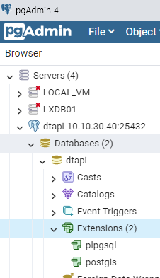
LX_API(임시) : Postgresql, postgis 설치(docker)
docker run \
-dp 25432:5432 \
--name postgresql10-dtapi \
--restart=always \
-e POSTGRES_PASSWORD=Zaqxc1234! \
-e TZ=Asia/Seoul \
-v ~/rsrch-prev/postgres/data:/var/lib/postgres/data (확인필요) postgis/postgis:11-3.3
docker exec -it postgresql10-dtapi /bin/bash
psql -U postgres
\l (database 목록조회)
alter user postgres with password 'postgres1357!';
\q (exit)
create database dtapi;
create user dtapi with encrypted password 'dtapi1357!';
grant all privileges on database dtapi to dtapi;
(user 제거)
REASSIGN OWNED BY dtapi TO postgres;
DROP OWNED BY dtapi;
DROP USER dtapi;
생성한 DB 에 postgre 계정으로 접속한 후
create extension postgis;

Slide 26
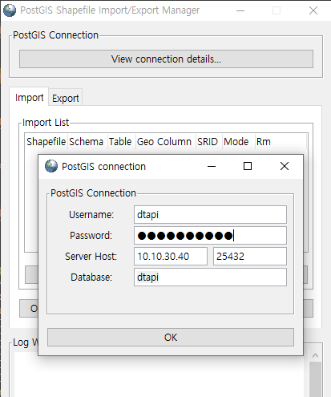
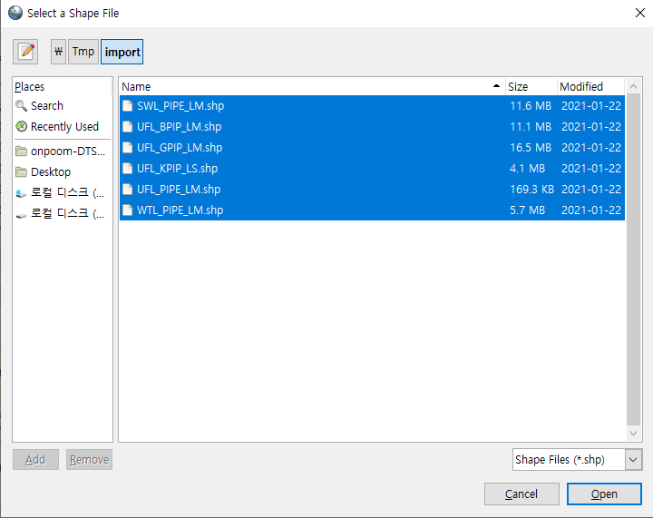
LX_API(임시) : Postgis import
"C:\Program Files\PostgreSQL\10\bin\postgisgui\shp2pgsql-gui.exe"
https://blog.naver.com/ilsan_ilsan/221483634939

Slide 27
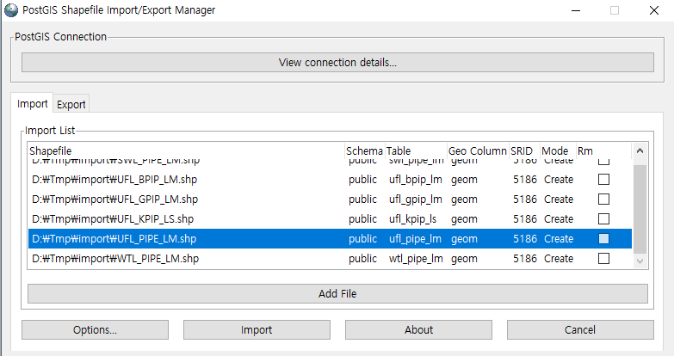
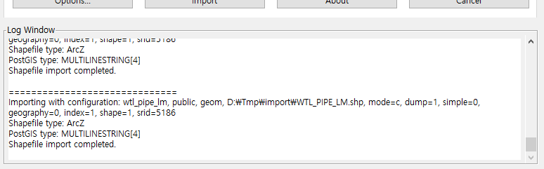
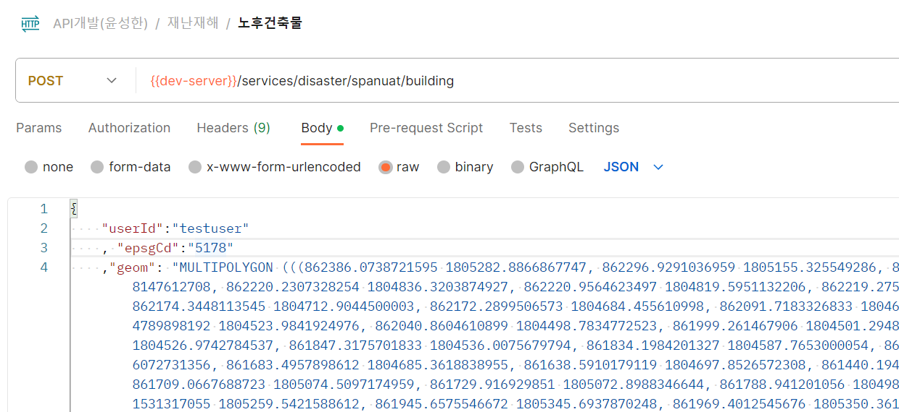
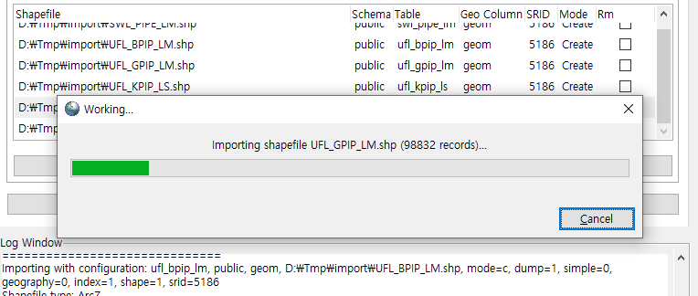
LX_API(임시) : Postgis import
Import 파일경로에 한글이나 특수문자가 있는 경우 실패할 수 있음
SRID 는 데이터에 맞는 좌표계를 확인하여 입력해줘야 함
기존 API 샘플
https://blog.naver.com/ilsan_ilsan/221483634939

Slide 28
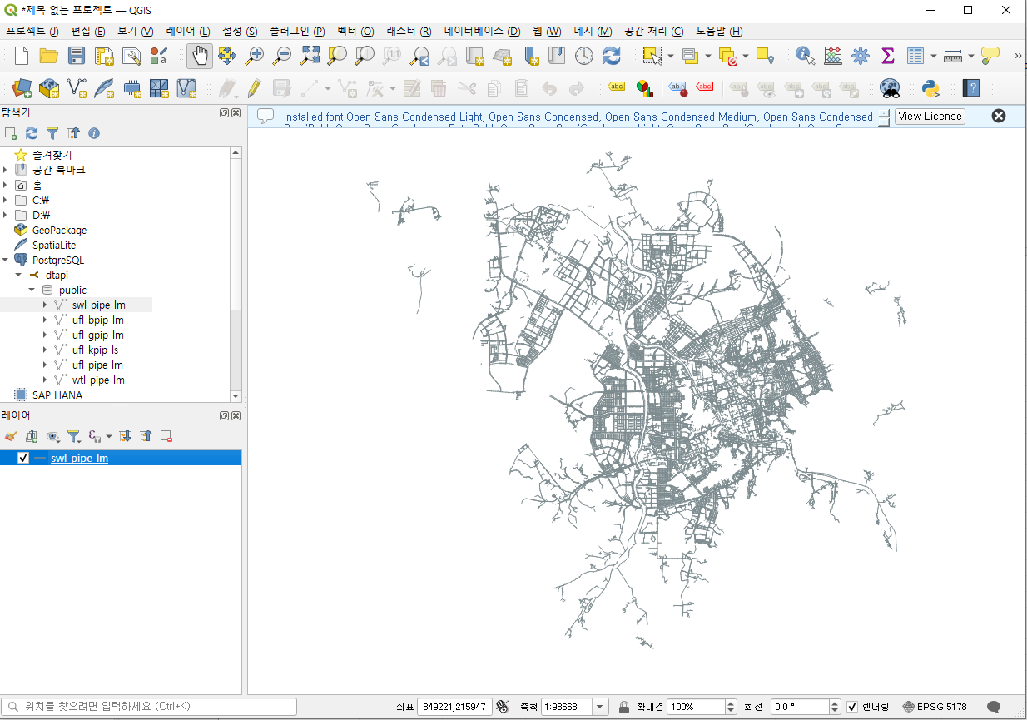
LX_API(임시) : Postgis 확인 - QGIS
https://www.qgis.org/ko/site/forusers/download.html

Slide 29
LX_API(임시) : Tomcat 설치(docker)
docker commit tomcat-rsrch-prev tomcat-rsrch-prev:1.0
docker run -d --name tomcat-dtapi -p 28686:8080 --restart=always -e TZ=Asia/Seoul tomcat-rsrch-prev:1.0
[test]
http://10.10.30.40:28686/manager
Tomcat/Zaqxc1234! 로 로그인 후 korea-admin-10.0.0 application 삭제

Slide 30
LX 균형발전 테스트 서버(임시) : Nginx 설치(docker)
docker run -it --name nginx-lx-special-service -d -p 28888:80 --restart=always -e TZ=Asia/Seoul -v /root/lx-special-service/nginx/html:/usr/share/nginx/html -v /root/lx-special-service/nginx/conf.d:/etc/nginx/conf.d nginx-rsrch-prev:v0.1

Slide 31
LX 균형발전 테스트 서버(임시) : Tomcat 설치(docker)
docker run -d --name tomcat-lx-special-service -p 28989:8080 --restart=always -e TZ=Asia/Seoul tomcat-rsrch-prev:1.0
[test]
http://10.10.30.40:28989/manager
Tomcat/Zaqxc1234! 로 로그인 후 korea-admin-10.0.0 application 삭제

Slide 32
LX_Rhino_Scheduler(임시) : Tomcat 설치(docker)
docker run -d --name tomcat-rhino-schd -p 28787:8080 --restart=always -e TZ=Asia/Seoul tomcat-rsrch-prev:1.0
[test]
http://10.10.30.40:28787/manager
Tomcat/Zaqxc1234! 로 로그인 후 korea-admin-10.0.0 application 삭제
Jenkins 배포 후 테스트
http://112.217.210.138:28787/lx/dt/reg

Slide 33
LX_Rhino_Scheduler(임시) : Postgresql 설치(docker)
docker run \
-dp 25433:5432 \
--name postgresql11-rhino-scheduler \
--restart=always \
-e POSTGRES_PASSWORD=1qaz@wsx \
-e TZ=Asia/Seoul \
postgres:11
docker exec -it postgresql11-rhino-scheduler /bin/bash
psql -U postgres
\l (database 목록조회)
\q (exit)
create database automatic;

