Slide 1
Security for REST and Web 2.0
Richard Mooney - Senior Solution Architect

Slide 2
About the speaker :
Senior Solution Architect, Vordel
Architecting and implementing best of breed SOA security
infrastructures for leading Fortune 1000 and public sector
organizations in Europe and North America.
Clients include: Allianz, Bell Canada, Badenia, BAT, Dubai Police, EBS,
Ericsson, EU Council, Fortis, Spanish Government, Telefonica,
Telecom Italia Mobile
Ex-Oracle, Sun Microsystems, LogicaCMG
Like rugby and Irish whiskey

Slide 3
Agenda
Part 1: What is “REST” anyway? How is it different from SOAP?
  In theory
  In practice
Part 2: Applying security to REST
  Security vulnerabilities in REST
  How Amazon and Google approach REST security
Part 3: Reference architecture to protect both REST and SOAP
  Why “XML Firewalls” are not enough
  Unified protection for REST and SOAP

Slide 4
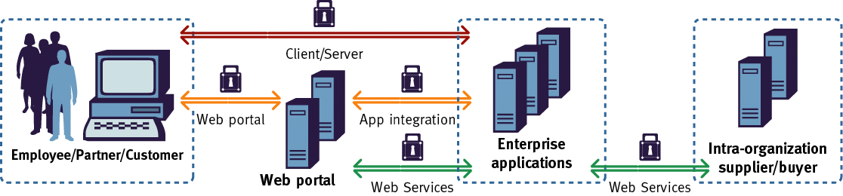
Definition of Web Services
What is a “Web Service” ?
Everyone would agree with a general definition like this:
“A Web service is a software system designed to support interoperable machine-to-machine interaction over a network.” (Source: W3C)
But once you drill into the technical details, differences of opinion emerge...

Slide 5
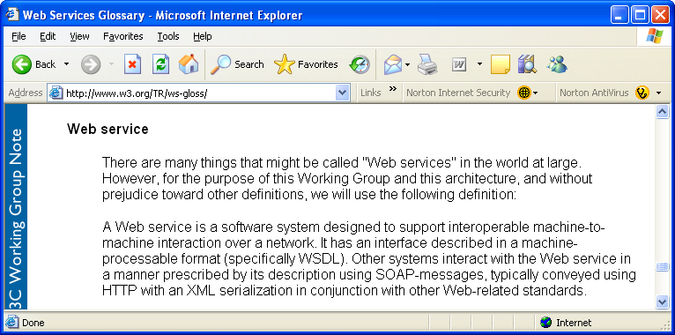
SOAP-based Web Services
Web Services” and “SOAP” are often treated interchangeably
[ W3C Web Services Glossary http://www.w3.org/TR/ws-gloss/ ]

Slide 6

SOAP, WSDL and UDDI
Most people understand Web Services to be the “triumvirate” of SOAP, WSDL, and UDDI
SOAP
Envelope
Platform A
Payload
Platform B
Application
A
SOAP
Client
Security
Token
Web
Service
Application
B
SSL
WSDL
(Web Services
Description Language)
UDDI
Web Services
Directory

Slide 7
REST
But, SOAP is not the only kind of Web Service communication
REST stands for REpresentational State Transfer
Described in a thesis by Roy Fielding (Day Software, co-founder of the Apache Software Foundation, co-author of HTTP and URI RFCs)
REST applies the architecture of the Web to Web Services
  - Each URI is a distinct resource, as in the browser-based Web
  - URIs be bookmarked and cached
  - Don’t reinvent the wheel”
Used by Amazon, Google, Flickr, and many others

Slide 8
REST
In REST, everything is a resource
Resource Modelling” is required at the outset. Model each document, and each process, as a “resource” with a distinct URI
Then use the standard HTTP “verbs” to interact with the resource:
  - GET: Retrieve a representation of a resource. Does not modify the server state. A GET must have no side effects on the server side
  - DELETE: Remove a representation of a resource
  - POST: Create or update a representation of a resource
  - PUT: Update a representation of a resource

Slide 9
Example of a REST Web Service
GET /weatherforecast/02110 HTTP/1.1
  Get the weather forecast for Boston
POST /weatherforecast HTTP/1.1
  - Upload a new weather forecast for San Jose by sending up an XML document which conforms to the appropriate Schema
  - Response is a “201 Created” and a new URI
    201 Created
    Content-Location: /weatherforecast/95101
PUT /weatherforecast/95101 HTTP/1.1
  Update an existing resource representation
DELETE /weatherforecast/02110 HTTP/1.1
  - Delete the resource representation

Slide 10
Contrast with a SOAP weather service
POST /weatherforecast.asmx HTTP/1.1
  Send a SOAP message to get the weather in Boston
POST /weatherforecast.asmx HTTP/1.1
  - Send a different SOAP message to create a forecast for San Jose
  Response is a custom SOAP response message
POST /weatherforecast.asmx HTTP/1.1
  -Send another SOAP message to update the San Jose weather forecast
POST /weatherforecast.asmx HTTP/1.1
  - Send another SOAP message to delete the Boston weather forecast
Notice anything?
  - Everything is a POST. All the details are in the SOAP messages

Slide 11
Contrast with a SOAP weather service
The information is in the SOAP message
POST /weatherforecast.asmx HTTP/1.1
<?xml version="1.0" encoding="UTF-8" standalone="no"?>
<SOAP-ENV:Envelope xmlns:SOAP-ENV="http://schemas.xmlsoap.org/soap/envelope/" xmlns:soap="http://schemas.xmlsoap.org/wsdl/soap/" xmlns:xsd="http://www.w3.org/2001/XMLSchema" xmlns:soapenc="http://schemas.xmlsoap.org/soap/encoding/" xmlns:wsdl="http://schemas.xmlsoap.org/wsdl/" xmlns:xsi="http://www.w3.org/2001/XMLSchema-instance" >
<SOAP-ENV:Body>
<wns:getWeather xmlns:wns="urn:weather" SOAP-ENV:encodingStyle="http://schemas.xmlsoap.org/soap/encoding/">
<zipCode xsi:type="xsd:string">02110</zipCode>
</wns:getWeather>
</SOAP-ENV:Body></SOAP-ENV:Envelope>

Slide 12
Contrast with a SOAP weather service
The information is in the SOAP message
POST /weatherforecast.asmx HTTP/1.1
<?xml version="1.0" encoding="UTF-8" standalone="no"?>
<SOAP-ENV:Envelope xmlns:SOAP-ENV="http://schemas.xmlsoap.org/soap/envelope/" xmlns:soap="http://schemas.xmlsoap.org/wsdl/soap/" xmlns:xsd="http://www.w3.org/2001/XMLSchema" xmlns:soapenc="http://schemas.xmlsoap.org/soap/encoding/" xmlns:wsdl="http://schemas.xmlsoap.org/wsdl/" xmlns:xsi="http://www.w3.org/2001/XMLSchema-instance" >
<SOAP-ENV:Body>
<wns:createForecast xmlns:wns="urn:weather" SOAP-ENV:encodingStyle="http://schemas.xmlsoap.org/soap/encoding/">
<zipCode xsi:type="xsd:string">95101</zipCode>
<forecast xsi:type="xsd:string">Sunny</forecast>
</wns:createForecast>
</SOAP-ENV:Body></SOAP-ENV:Envelope>

Slide 13
Reinventing protocols
In REST, HTTP is the protocol
  Well known, simple, and established
  Only four methods: GET, POST, PUT, DELETE
  A network admin can look at something like “GET /weatherforecast/02110” and understand what it is doing
  Requests can be bookmarked
  Responses can be cached
By contrast, in SOAP, developers effectively create their own protocols
  Everything is a POST
  Rather than using “GET, POST, PUT, and DELETE”, the methods and operations are in the SOAP messages themselves
  A network admin just sees POSTs and cannot understand the purpose of the traffic without looking into the SOAP messages themselves

Slide 14
More differences between SOAP and REST
SOAP is transport neutral
  - SOAP can be used across FTP, SMTP, Message Queues
  - But REST is tied to HTTP only
SOAP includes a whole stack of “composable” WS-* specifications
  - WS-Security for inserting security tokens into SOAP headers, WS-ReliableMessaging, WS-Transactions, etc etc etc
  - But since WS-* builds on top of SOAP, it does not apply to REST
  Proponents of REST would argue “use HTTP infrastructure for reliable messaging and security. Don’t reinvent the wheel”
  Paul Prescod argues that REST is “as safe as HTTP”

Slide 15
What SOAP and REST have in common
WSDL 2.0 (formerly known as WSDL 1.2) allow services to be defined as both REST and SOAP style services
SOAP 1.2 supports both REST (HTTP GET) and SOAP style services
Vendor tools such as Microsoft Visual Studio .NET create Web Services that have both REST and SOAP interfaces
Public Web Service providers such as Amazon and Google provide both REST and SOAP style Web Services

Slide 16
SOAP, WSDL and UDDI
Vendors have put their weight behind SOAP Web Services
No platform vendor or tools vendor is “pushing” REST, in the same way that SOAP/WSDL/UDDI gets vendor backing
REST can therefore be called “grassroots”, developer-led

Slide 17
Developing REST Web Services
From a product perspective, REST is almost invisible. If the REST people want to have their day, they're going to have to get it into the tools that create or consume Web services."
Ronald Schmelzer, a senior analyst with ZapThink
There are a whole lot of REST tool kits available, it's just that people don't know what they are.” [Servlet tools] “follow the HTTP specification, and by following it, they implicitly are following the constraints of the REST style.”
Mark Baker, IBM
MONSIEUR JOURDAIN: Oh, really? So when I say: "Nicole bring me my slippers and fetch my nightcap," is that prose? PHILOSOPHY MASTER: Most clearly. MONSIEUR JOURDAIN: Well, what do you know! These forty years now, I've been speaking in prose without knowing it! [Moliere - The Bourgeois Gentleman – Act Two, Scene Four]

Slide 18
REST in practice
We’ve looked at the theory of REST
  Resource modeling. GET, POST, PUT, and DELETE verbs
The practice tends to be quite different
  - Most “REST style” Web Services make heavy use of HTTP GET, and often do not use the other HTTP verbs.
  - Many violate the REST theory by having GET operations that have “side effects” on the server, by changing the resource representation
    e.g. Dare Obasanjo from Microsoft has pointed out that Flickr has a “delete” operation that is invoked by a HTTP GET
This means that, in practice, REST tends to mean “Web Services that are invoked by HTTP GETs with parameters in QueryStrings”

Slide 19
REST in practice
REST-style Web Services tend to be invoked by building up URL QueryStrings programmatically, as strings:
This Visual Basic .NET code uses Amazon Web Services to search for used copies of my “Web Services Security” book:
  Dim xdoc As New DOMDocument, search As String
  search = "xml.amazon.com/onca/xml3?" & _
  "?t=" & “Mark O’Neill" & _
  "&dev-t=" & "1CEZP746WMP1Y3GWJBG2" & _
  "&AsinSearch" & “0072224711” & _
  "&type=heavy&offer=Used&offerpage=1&f=xml&sort=+salesrank&locale=us"
  xdoc.Load search
  ' Display the search results
  Debug.Print xdoc.XML

Slide 20
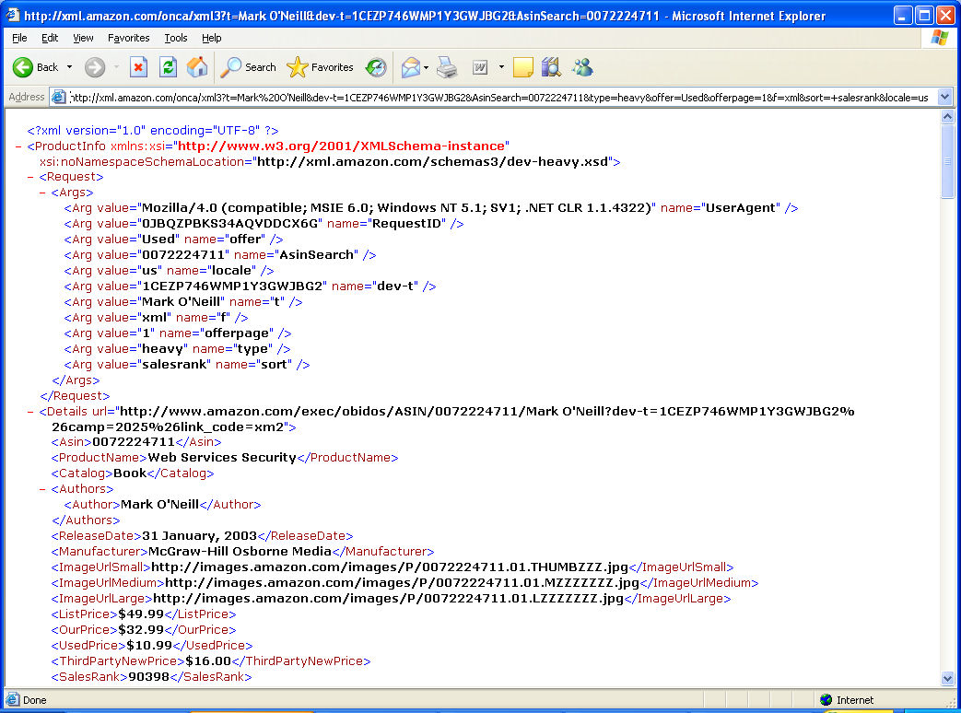
REST Web Service Invocation

Slide 21
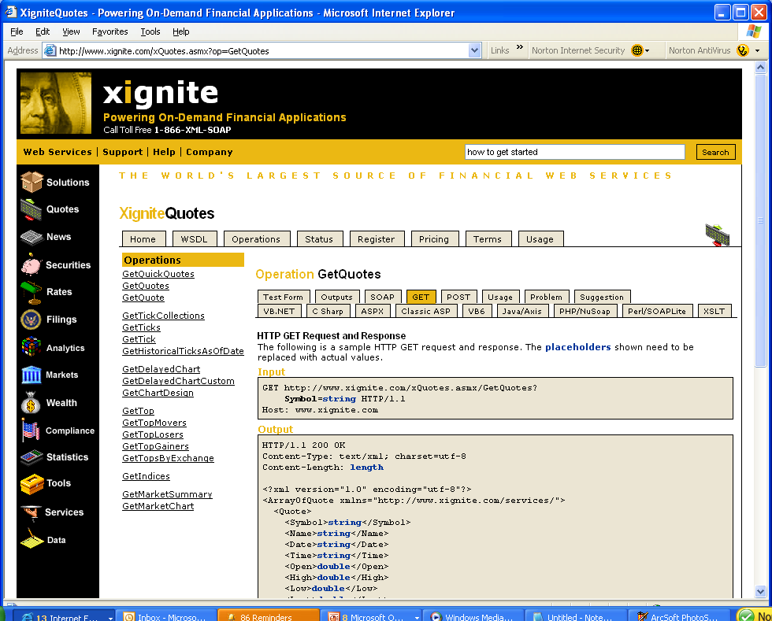
Another example: Xignite
Xignite provides both SOAP and “GET” interfaces for its commercial Web Services

Slide 22
Another example: “Diane” Phone Service
GET /NotifyWS/phonenotify.asmx/NotifyPhoneEnglishBasic?PhoneNumberToDial=string&TextToSay=string&LicenseKey=string HTTP/1.1
Host: ws.cdyne.com

Slide 23
REST in practice
REST is seen as “more simple to develop than SOAP” because you can create a QueryString just by concatenating strings together
Most developers find it easier to concatenate strings together and then do a “GET” to a URI like Google’s “doGoogleSearch”, rather than to create a SOAP request
  SOAP products are getting easier to use though, the gap is closing…
This simplicity is the main reason for REST’s popularity

Slide 24
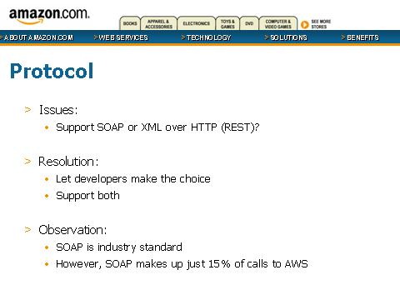
REST’s popularity – a famous data point
Source: Jeff Barr, Web Services Evangelist at Amazon.com

Slide 25
Summary of Part 1
The theory of REST is that Web Services should be modelled as resources which use HTTP GETs, POSTs, PUTs, and DELETEs
The practice of REST is that HTTP GETs are almost always used, with parameters being passed in QueryStrings
REST is popular because it is simple
Part 2: Applying security to REST
  - Security vulnerabilities in REST
  - How Amazon and Google approach REST security

Slide 26
Part 2
Applying ACLs to REST methods (GET, POST, PUT, DELETE)
Filtering QueryStrings
  How REST security is similar to Web Application Security
Logging and keeping an audit trail of REST data
How Google and Amazon apply security to their REST interfaces

Slide 27
Applying security to REST
We have seen that in “pure” REST, a GET has no side effects, and is purely for retrieving information, whereas POSTs, PUTs, and DELETEs change the resource representations
So why not treat the URI as a resource and apply an ACL to each of its four methods?
  e.g. anyone can “GET” a Weather Forecast but only certain users can “POST” a Weather Forecast
The problem is that this approach only works where developers have strictly adhered to the REST principles.
  - Most developers create GET interfaces that change the resource representations [e.g. Flickr’s delete method is invoked with a GET]
  - Therefore, filtering on REST methods is a naïve approach

Slide 28
QueryStrings and Web Application Security
We’ve seen that in practice, REST means:
“HTTP GETs with the parameters passed in the QueryString”
This means that many standard Web Application Security techniques are applicable to REST Web Services
  - Validating the size of parameters on the QueryString
  - Validating the content of parameters on the QueryString
  - Examining parameters in the QueryString for known attacks such as SQL Injection
  - Applying regular expressions (RegEx’s) to QueryString parameters

Slide 29
Vulnerabilities
Plenty of scope for attacks like SQL Injection when URLs are being built up on the fly
  Dim xdoc As New DOMDocument, search As String
  search = "xml.amazon.com/onca/xml3?" & _
  "?t=" & “Mark O’Neill" & _
  "&dev-t=" & "1CEZP746WMP1Y3GWJBG2" & _
  "&AsinSearch" & “0072224711” & _
  "&type=heavy&offer=Used&offerpage=1&f=xml&sort=+salesrank&locale=us"
  xdoc.Load search
  ' Display the search results
  Debug.Print xdoc.XML

Slide 30
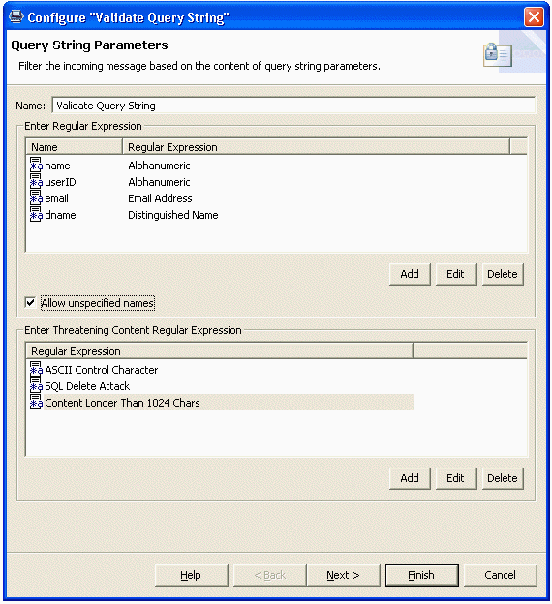
Protecting REST based Web Services
Countermeasure: Configuring filtering rules for the URL QueryString

Slide 31
Logging and audit trail
With REST, the URIs are the audit trail
Unless SSL is used, network infrastructure can cache, or log, information that is contained in HTTP QueryStrings
  Has privacy implications, e.g. for Google searches
All the information is contained in the method and the URI.
  - This means that the URI can be “replayed”
  Sequences of URIs can be “replayed” to replay a transaction
With SOAP, the invocation data is in the SOAP message contained in the POST, not in the URI
  - The POST itself may not be logged, depending on your Web server logging configuration

Slide 32
Amazon and Google Web Services
Both started with the concept of the “Developer Token”
This token is passed as a parameter to the Web Service
  In the REST model, it is passed within a name-value pair in the URL QueryString
The token is used to limit developers to a certain amount of Web Service requests per day
  e.g. 1000 calls per day for Google’s Developer ID
Developer tokens are an unsophisticated security device
  - Can be discovered and used by other parties
  - No “proof of possession”

Slide 33
Amazon Web Services
Amazon’s “Developer token” model is more sophisticated than Google’s, because Amazon has a growing number of commercial Web Services for which users are billed via credit cards
Developers apply for an “Access Key ID” and a “Secret Access Key” in order to use Amazon Web Services
  These two keys replaced the single “SubscriberID” in October 2005
The “Access Key ID” is used to identify the developer whose code is accessing the Web Service
  Not a “public key”, since it can be used for impersonation to Web Services that do not need authentication
The “Secret Access Key” is used to generate a HMAC signature which is used by Amazon to authenticate requests

Slide 34
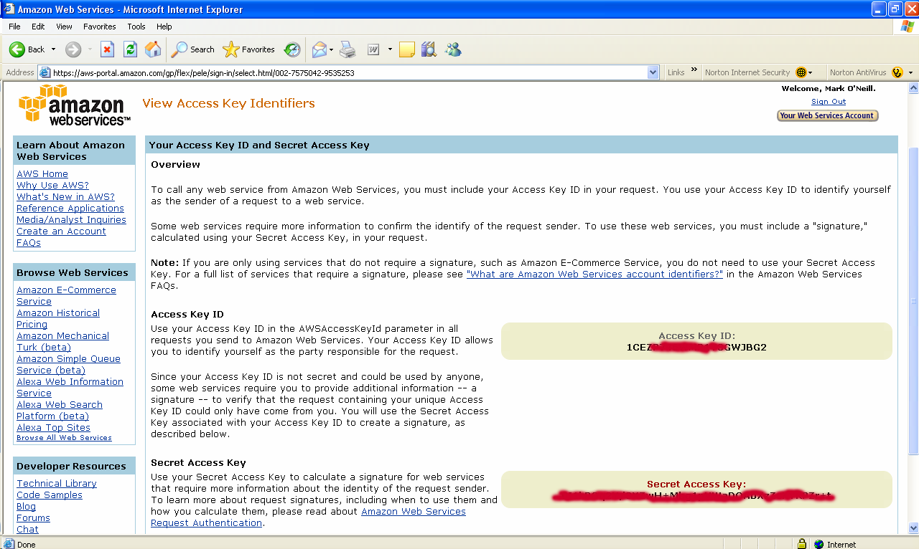
My Amazon Web Services keys

Slide 35
Amazon Web Services
The “Access Key ID” is used to identify the developer whose code is accessing the Web Service
  - Sent as a request parameter
  Not secret, could be used by anyone who gets their hands on it
The “Secret Access Key” is used to generate a HMAC signature which is used by Amazon to authenticate requests
  - The signature is calculated over service, operation, and timestamp
  - The timestamp is used in order to prevent replay attacks
  - The Access Key ID is sent with the request to identify the developer, so Amazon Web Services (AWS) can look up their Secret Access Key’
  - So the Secret Access key is a “shared secret”, not a private key

Slide 36
This time it’s REST “reinventing the wheel”
With the “Developer Token” and the “Secret Access Key”/”Access Key ID” schemes, we see that Amazon has reinvented functionality that is already present in SOAP/WS-Security
  - WS-Security UsernameTokens, with timestamp support, for sending username tokens
  WS-Security’s support for XML Signature
This reinvention was required because Amazon must support REST (in their case, HTTP GETs) as well as SOAP
But the functionality is much more limited than what you get with WS-Security [certificate support], WS-Trust [translation of tokens], WS-SecureConversation [creation of a session for trusted messages], etc.

Slide 37
End of Part 2
In part 2, we’ve seen that:
  - Applying ACLs to REST methods (GET, POST, PUT, DELETE) is a naïve approach, since there is no guarantee that a developer’s “GET” method won’t modify data on the server.
  - Filtering QueryStrings is important
    In this respect, REST security is similar to Web Application Security
  - Logging and keeping an audit trail is more simple with REST than with SOAP, since in REST, all the information is in the URI
  Google and Amazon apply security to their REST interfaces using developer tokens. Amazon’s model is much more sophisticated, since they charge for many of their Web Services. But it reinvents WS-Security, to some extent
In Part 3, we look at unified security for both REST and SOAP

Slide 38
REST under the radar?
Tools such as Microsoft .NET automatically make HTTP GET versions of SOAP Web Services
If you’re putting a lot of effort into defending the SOAP interfaces, don’t forget about the REST interfaces!!!
  Remember that your Web Services may also be invoked using HTTP GETs
When looking for a XML security vendor, choose one that filters both SOAP and REST
Conversely, if your Web Services don’t support REST now, consider a vendor whose products can do the “protocol conversion” from REST to SOAP for you
  - “Service Virtualization” at the gateway

Slide 39
Developer awareness
By now, developers should know “Never trust your input”, whether that input comes via SOAP parameters or via HTTP QueryStrings.
Educate your developers about REST, and ensure that the parameters used to invoke REST Web Services are documented and known.
Configure rules for these parameters in your XML Gateway.
If the parameters are the same as those used in your SOAP services, make sure you don’t create duplicates which then need to be updated together.

Slide 40
When to use SOAP instead of REST
WS-Security defines how to encrypt just part of an XML message
  - e.g. to encrypt search strings into a search engine
  - Rather than reinventing the wheel, use SOAP for this
WS-* includes reliable messaging and transaction support
SOAP can be applied to FTP traffic and MQ, REST can’t
  - So, use SOAP for these applications
SOAP supports attachments, although there are three different specifications for how to do attachments right now (MIME, DIME, MTOM).
  - Nevertheless, use SOAP when you need to send around binary data or large attachments

Slide 41
The problem with “Just filtering XML”
If you use an XML Gateway which is just looking for incoming XML on the network, then REST traffic will sail right through
Don’t assume that an “XML Firewall” is enough. REST Web Services are almost always not invoked by sending them XML.
Use a vendor who filters both REST and SOAP.
Choose someone who filters all of the following:
  “HTTP GET in, XML Out”
  “XML POST in, XML Out”
  SOAP POST in, SOAP Out”

Slide 42
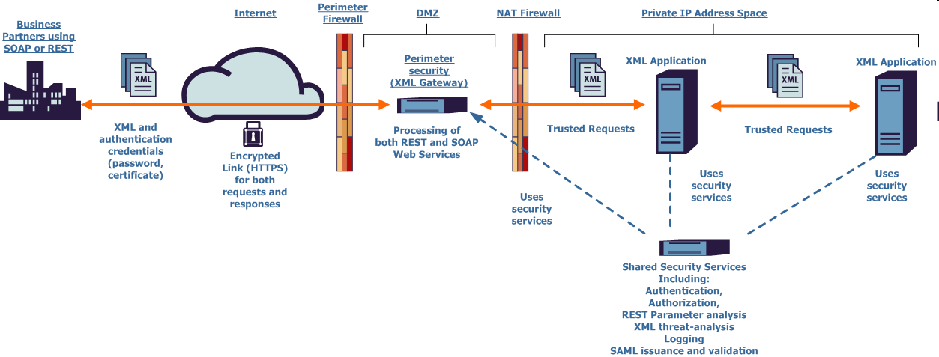
Sample Architecture
Protects both SOAP and REST Web Services using shared security services
See my talk on Thursday afternoon for 10 customer case studies

Slide 43
Conclusions
REST theory is quite complex and academic
Rest practice is simple, allowing quick-and-dirty Web Service creation and deployment
Many principals of Web Application Security apply
  Never trust your input
Amazon and Google, amongst others, have REST Web Services
  Developers expect the option of SOAP or REST
Plain “XML Firewalls” don’t filter traffic to REST Web Services, since in practice REST is almost always “HTTP GET in, XML out”
Consider a unified approach that protects both SOAP and REST

Slide 44
Thank You!
Richard Mooney
Email: richard.mooney@vordel.com
Direct: +353 (1) 6031700 or Mobile: +353 (0) 876845472

