Slide 1
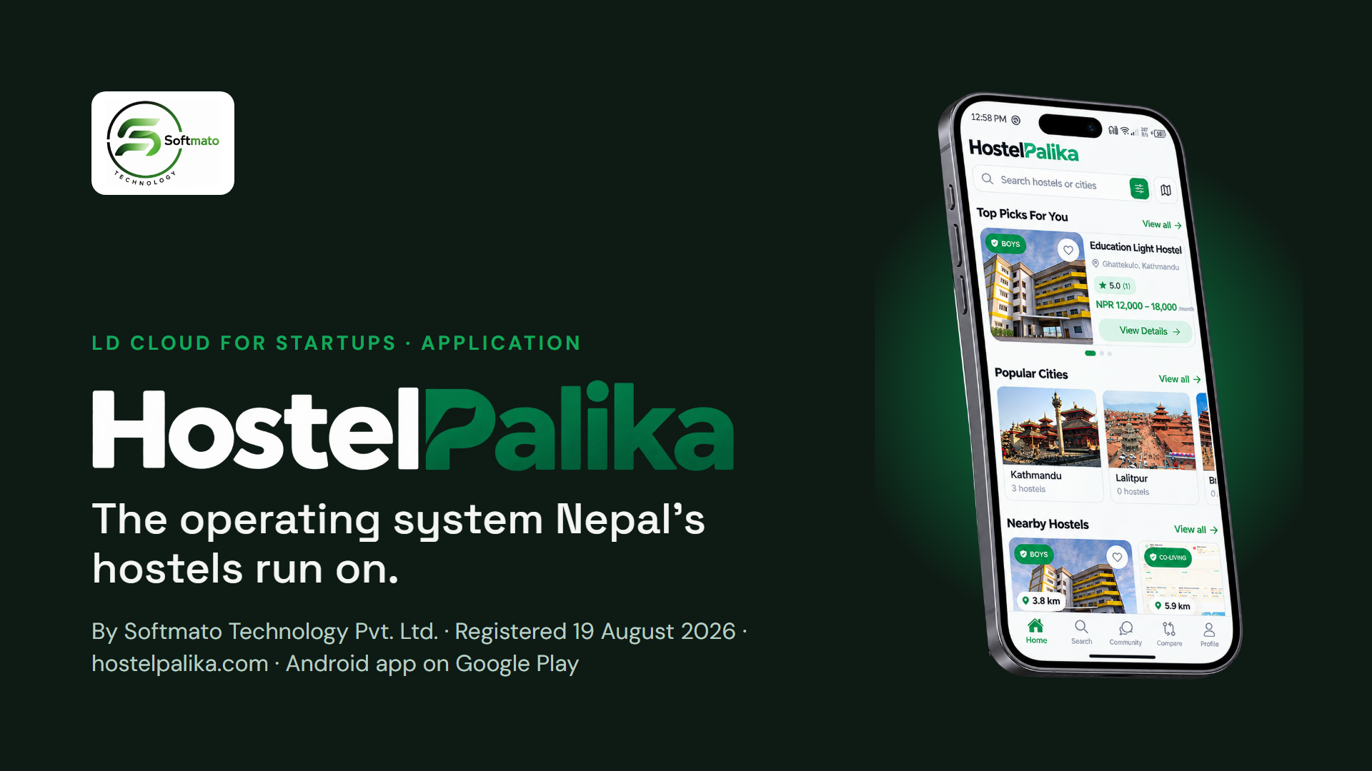
Notes:
We are Softmato Technology Pvt. Ltd., registered in Nepal on 19 August 2026. Our flagship product is HostelPalika: one platform that runs a hostel end to end — admissions, rent, food, attendance and safety — with a public site where students find hostels. It is live at hostelpalika.com and on Google Play. We are applying to LD Cloud for Startups to move it onto production-grade infrastructure.

Slide 2
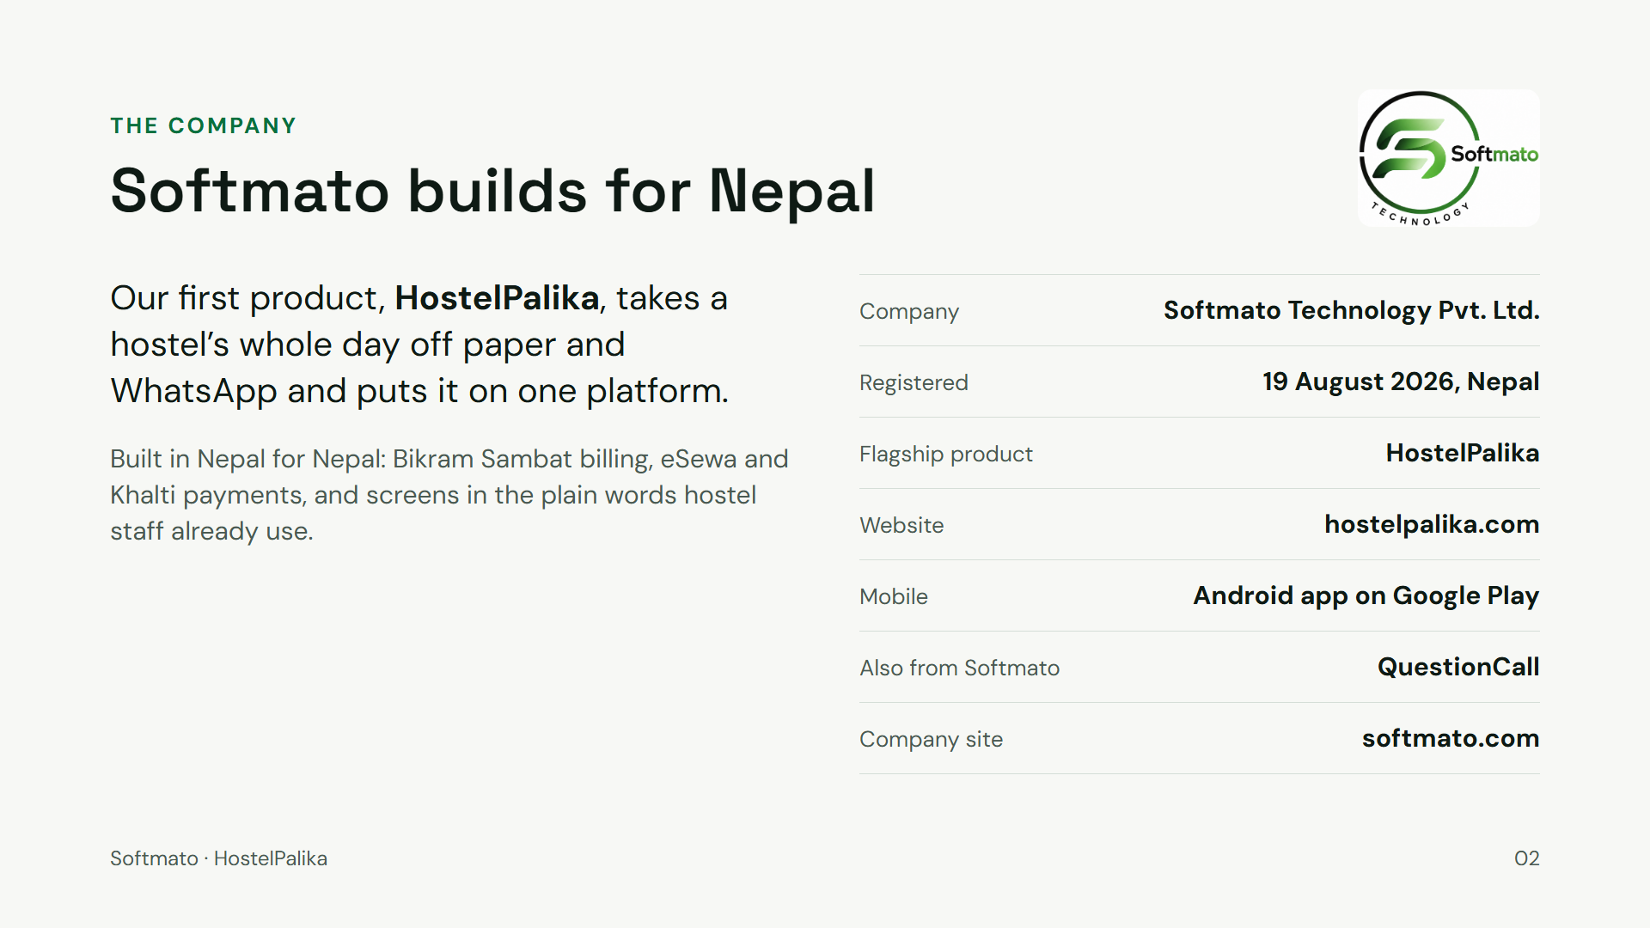
Notes:
Softmato Technology Pvt. Ltd. was registered on 19 August 2026. HostelPalika is our flagship and is already in production: the website at hostelpalika.com and the Android app on Google Play. QuestionCall is another Softmato product, and softmato.com is our company site. Everything on this slide is verifiable from the documents attached to the application.

Slide 3
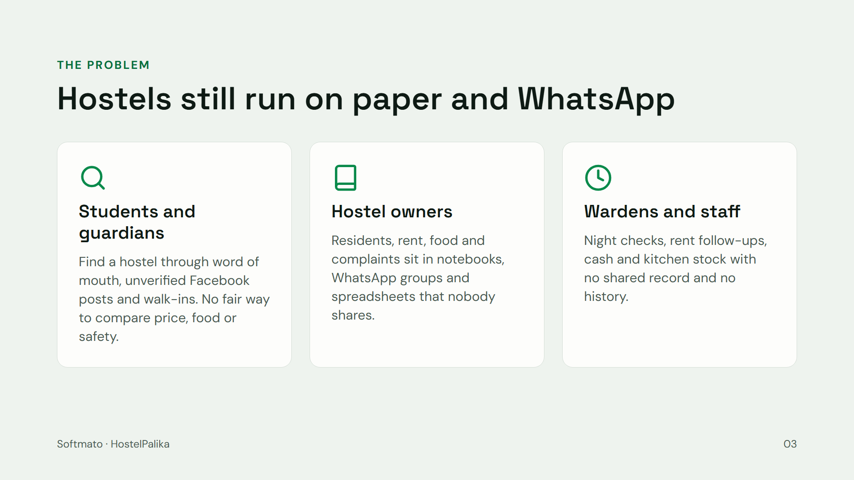
Notes:
Three groups feel this every day. Students and their parents choose a hostel with almost no reliable information. Owners run residents, rent, food and complaints on paper and WhatsApp. Wardens on the ground have no shared record of who is in, who has paid, or where the cash and stock went.

Slide 4
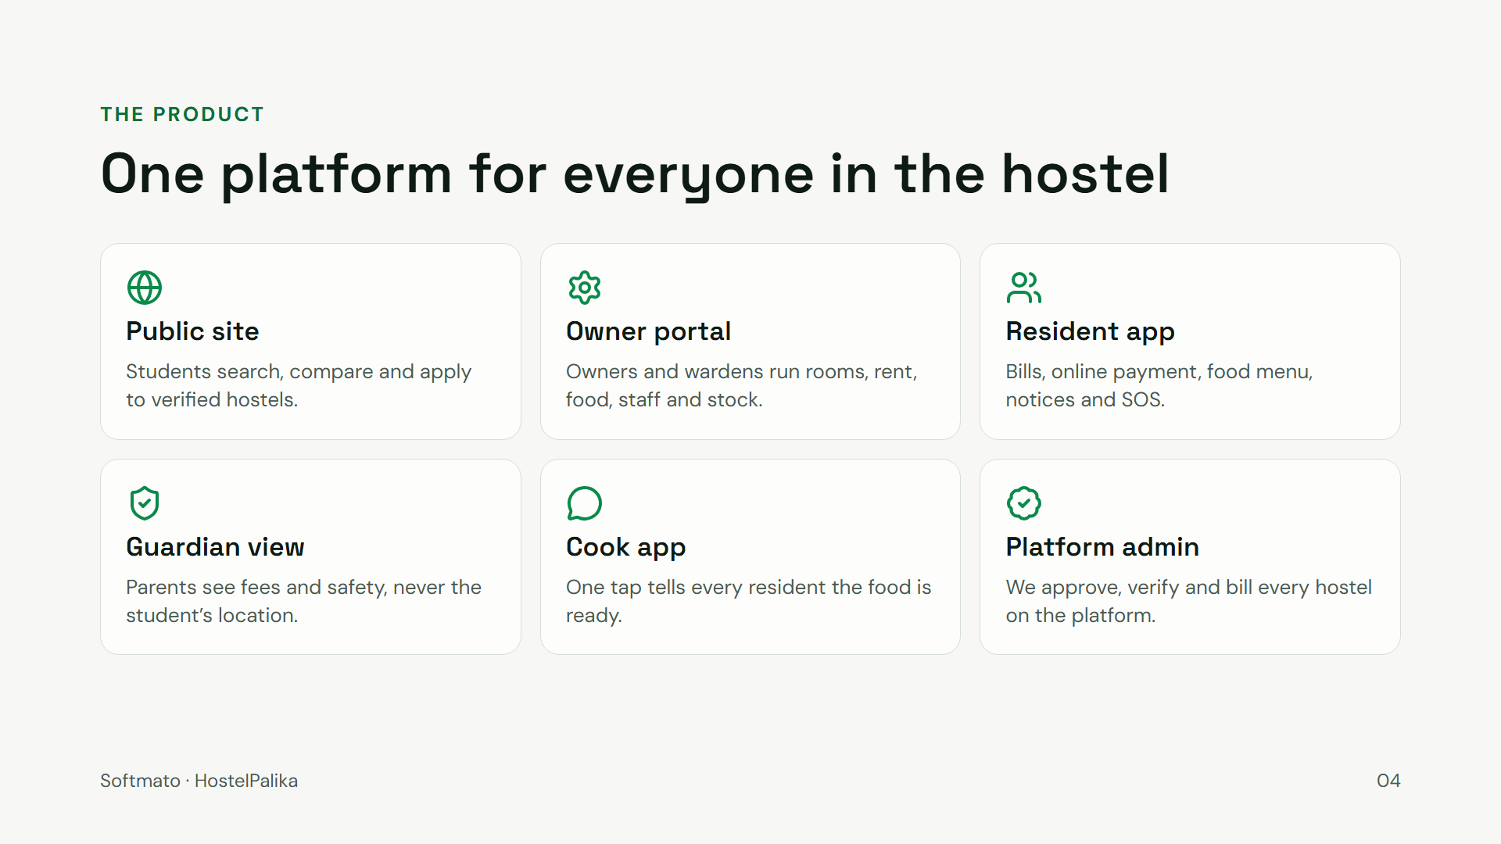
Notes:
HostelPalika is one multi-tenant platform with a portal for each person: the public discovery site, the owner and warden portal, the resident app, a guardian view that shows fees and safety without tracking the student, a cook app, and our own platform admin that approves, verifies and bills hostels. Web, Android app and an installable web app all run on the same backend.

Slide 5
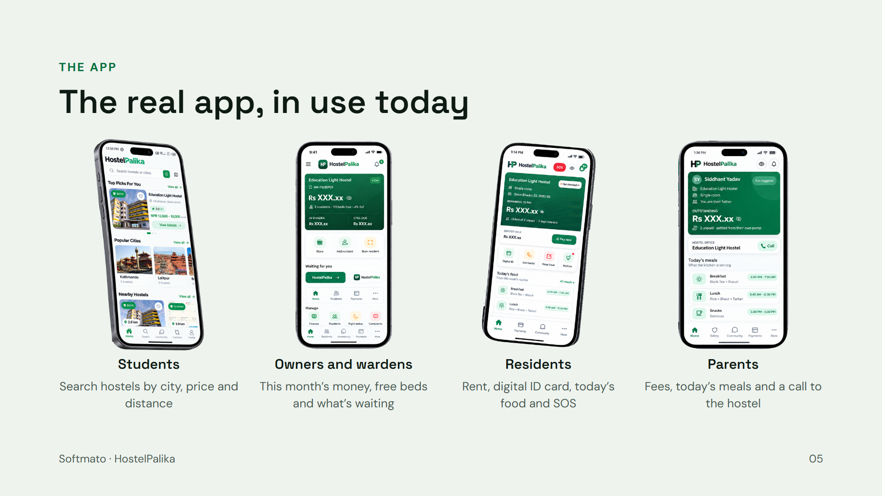
Notes:
These are screens from the production app, not mockups. A student searching for a hostel, an owner’s home screen with this month’s money and free beds, a resident’s home with rent, digital ID card and SOS, and a parent’s view with fees and today’s meals. Same backend, same data, every role.

Slide 6
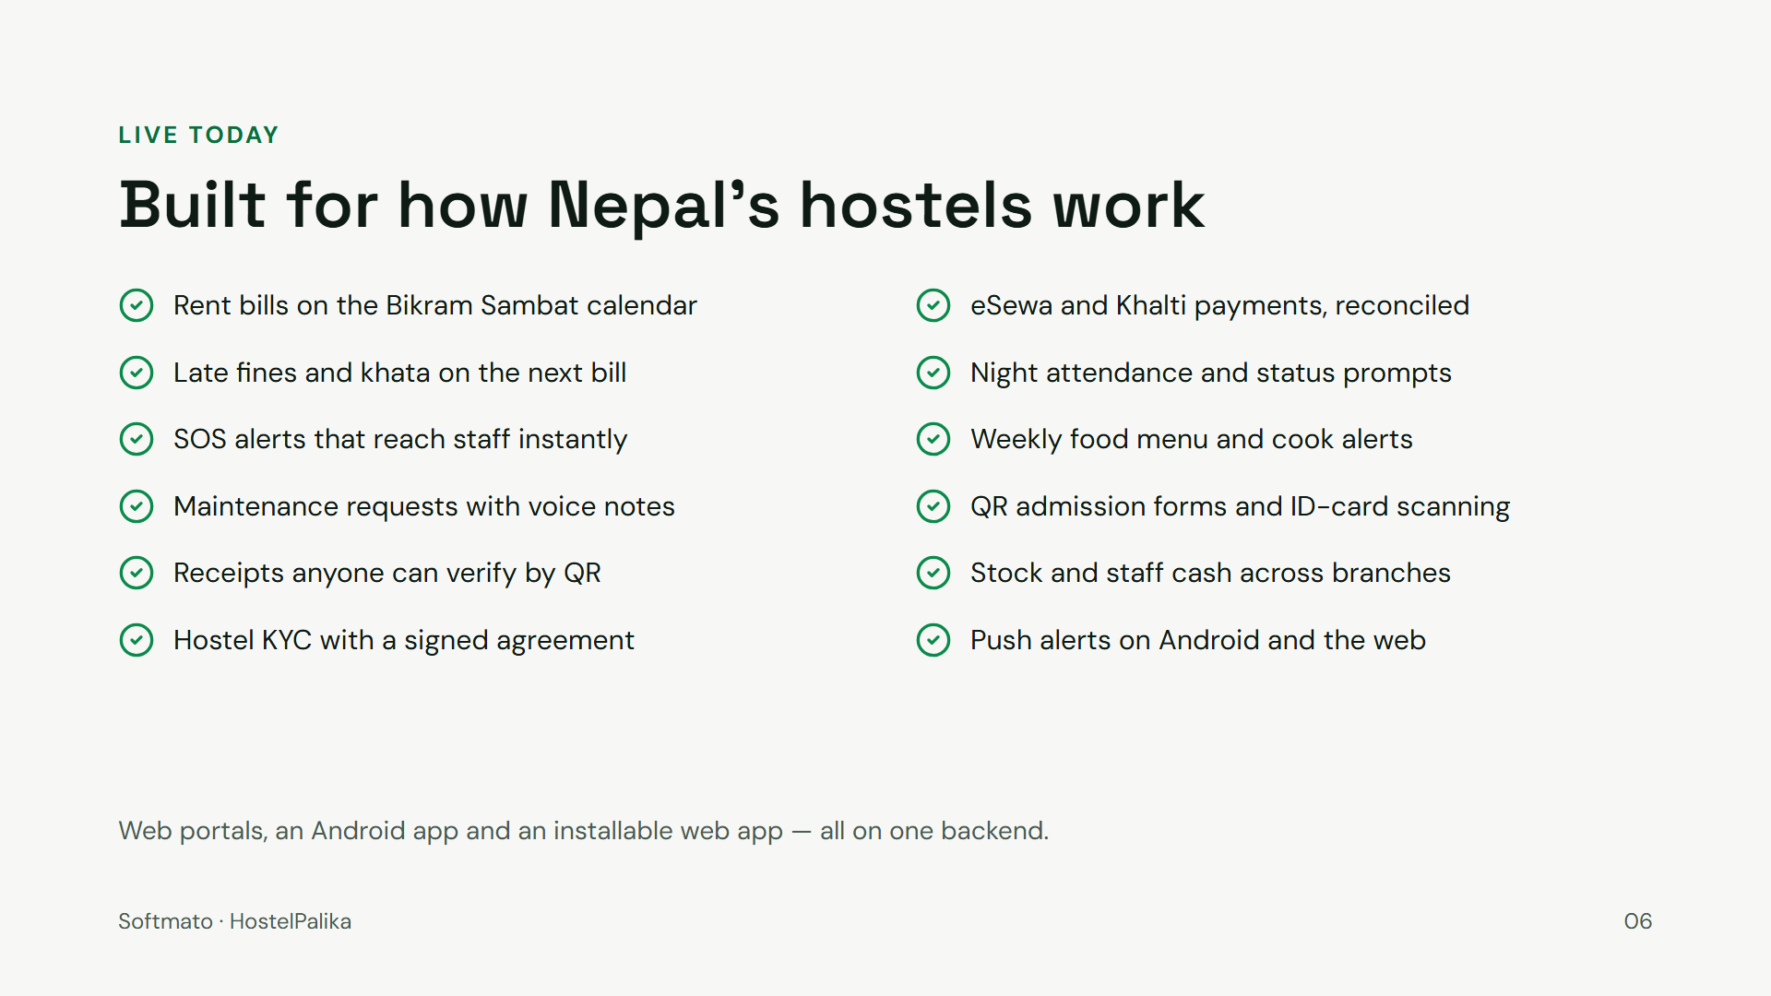
Notes:
This is not a prototype. Every item here is shipped and running: rent billed by Nepali month, eSewa and Khalti payments that are settled and reconciled, fines and khata, night attendance, SOS, food menus with cook alerts, maintenance with voice notes, QR admission forms, receipts verifiable by QR, stock and staff cash across branches, and hostel KYC with a signed digital agreement.

Slide 7
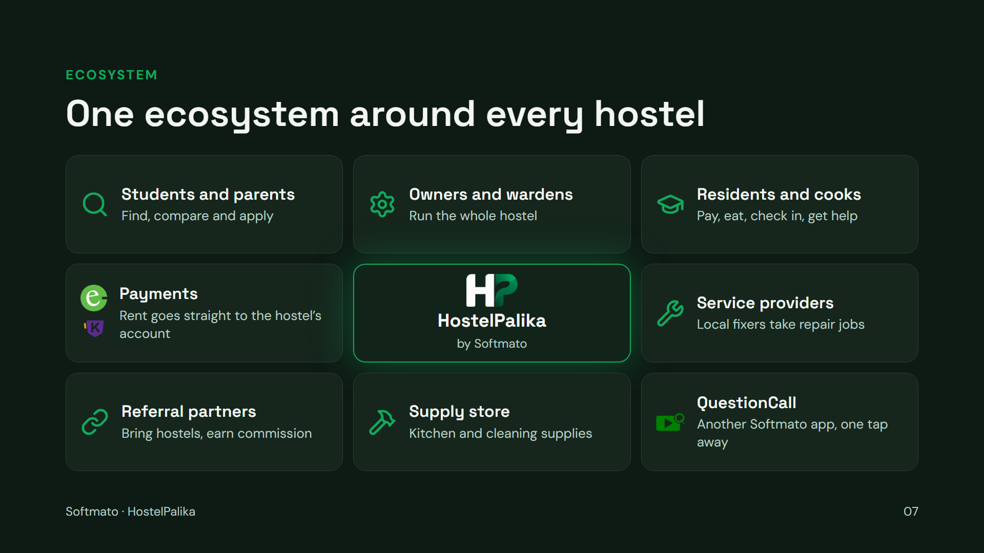
Notes:
HostelPalika is not one app, it is the hub of a small ecosystem. Students and parents find hostels. Owners and wardens run them. Residents and cooks use it every day. Rent moves through eSewa and Khalti straight to the hostel’s own account. Local service providers pick up repair jobs, referral partners bring new hostels in for a commission, our supply store sells to hostels, and QuestionCall — another Softmato product — is one tap away for students. Every new hostel brings all of these sides with it.

Slide 8
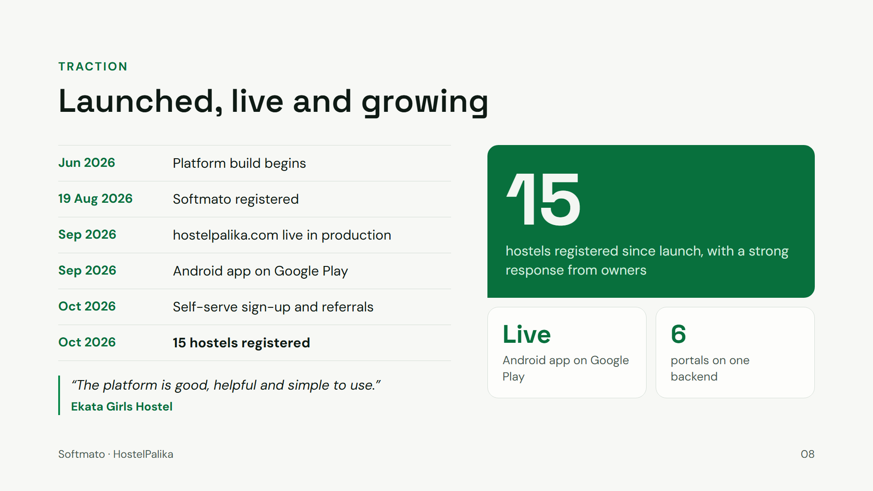
Notes:
From the first commit in June to a registered company in August and a live product in September: hostelpalika.com in production and the Android app on Google Play. In October we opened self-serve sign-up and referral partners, so hostels can join without us onboarding each one by hand. About 15 hostels have registered so far and owners are responding well — Ekata Girls Hostel told us the platform is good, helpful and simple to use. That response is what tells us it is time to go wide.

Slide 9
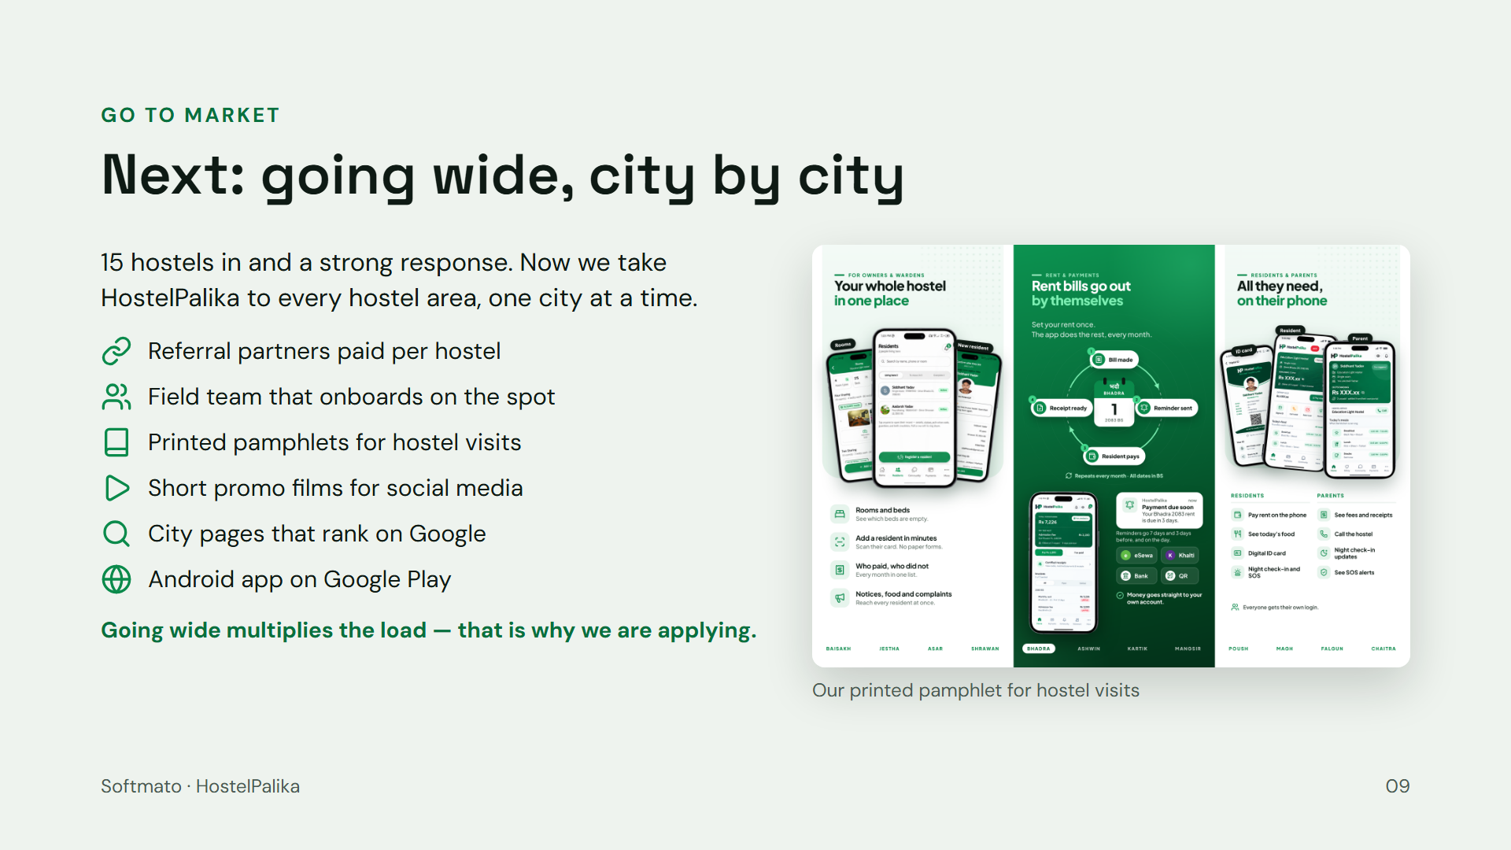
Notes:
The first 15 hostels told us the product works and owners want it. The next step is a wide launch: referral partners who earn per hostel, a field team that can onboard a hostel and take payment on the spot, printed pamphlets for hostel visits, short promo films for social media, city pages that rank on Google, and the Android app on Google Play. Every one of these channels already exists. Going wide multiplies traffic, data and documents — which is exactly why we need production-grade cloud now.

Slide 10
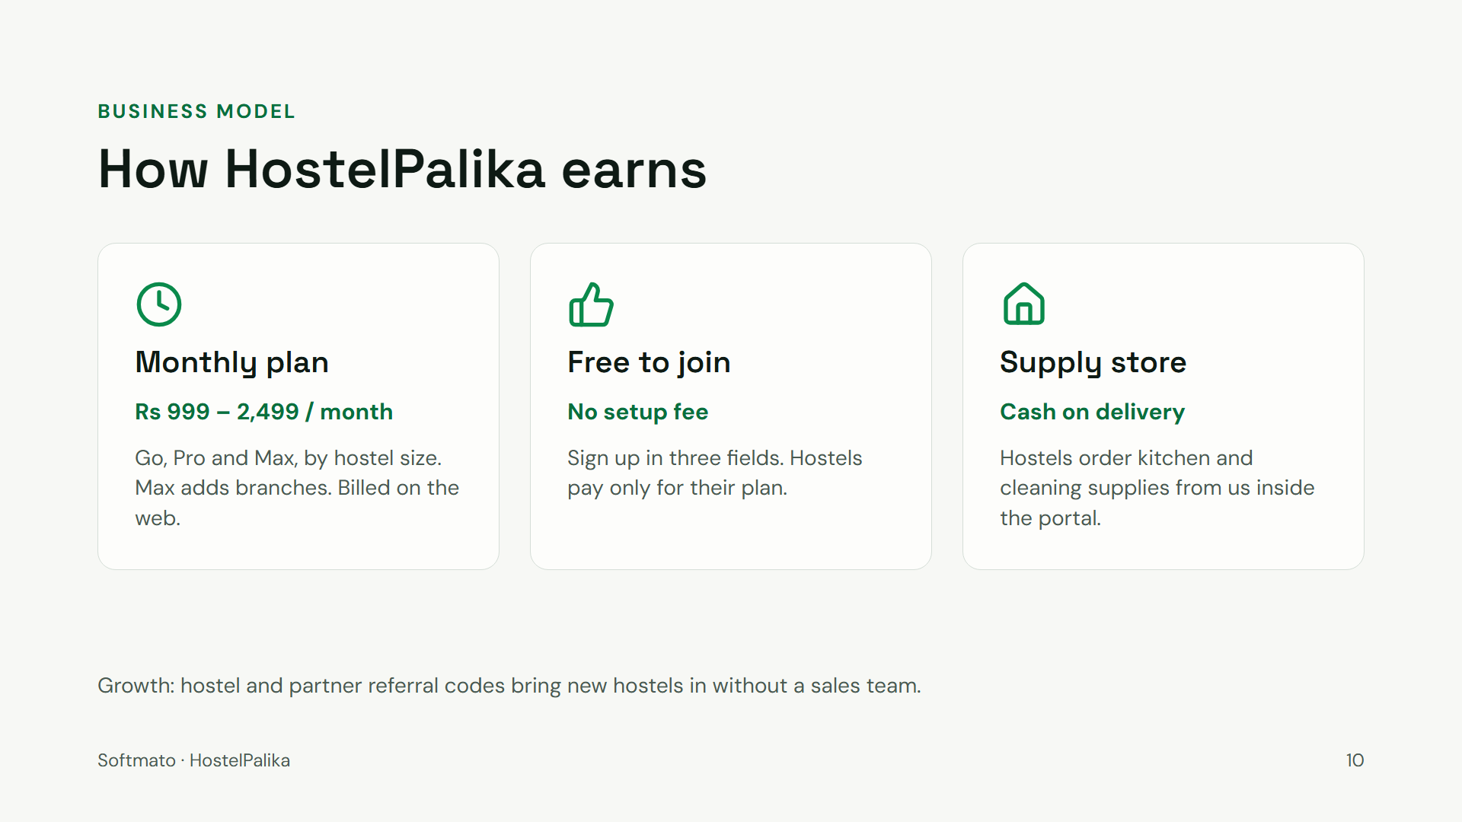
Notes:
Revenue comes from the monthly plan every hostel pays on the web — Go at Rs 999, Pro at Rs 1,699 and Max at Rs 2,499, with Max adding branches — and from our supply store, where hostels order kitchen and cleaning supplies. There is no setup fee: joining is free and takes three fields. Referral codes, from other hostels and from partners who earn a commission, bring hostels in.

Slide 11
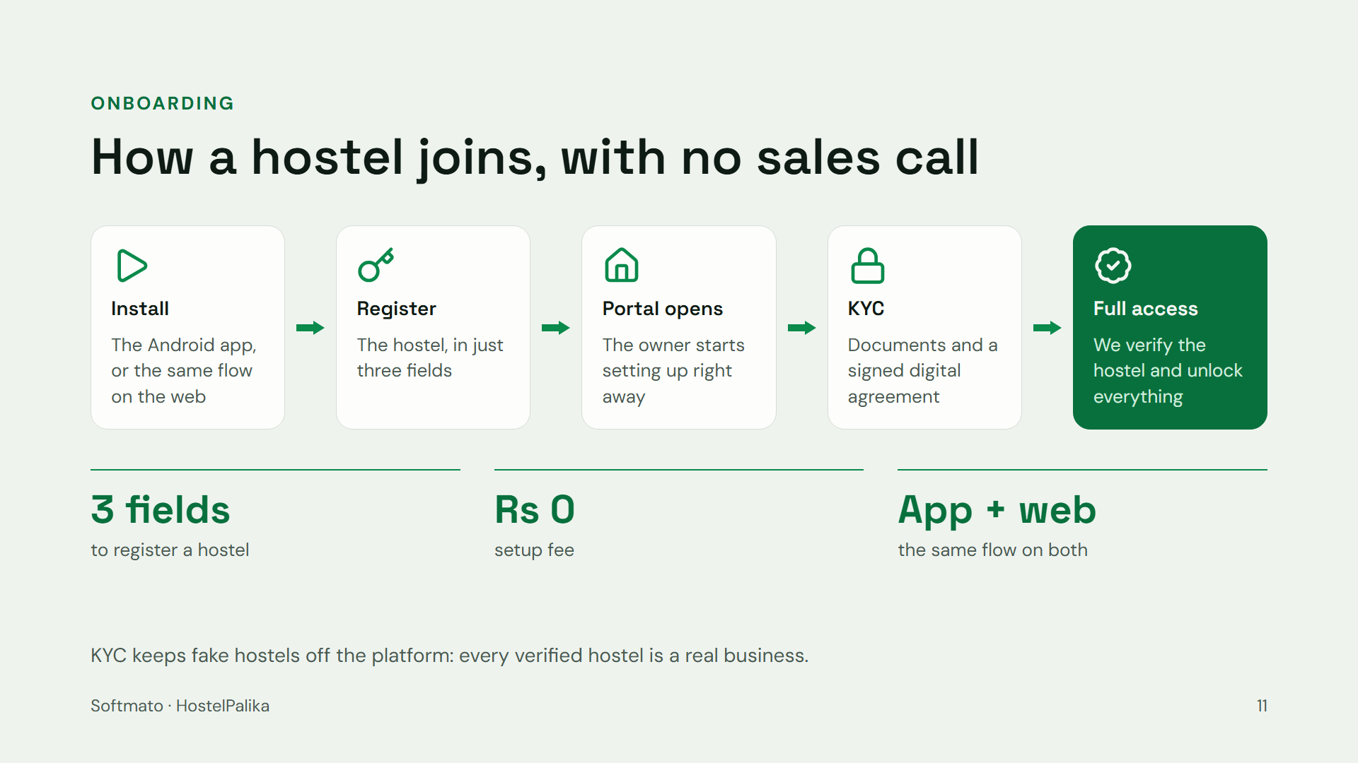
Notes:
Joining needs no sales call and no setup fee. An owner installs the app — or does the same on the web — and registers the hostel in three fields. The portal opens straight away so they can start setting up. They then complete KYC with their documents and a signed digital agreement; we verify it, and the portal unlocks fully. This is what lets us grow without a large sales team, and KYC keeps fake hostels off the platform.

Slide 12
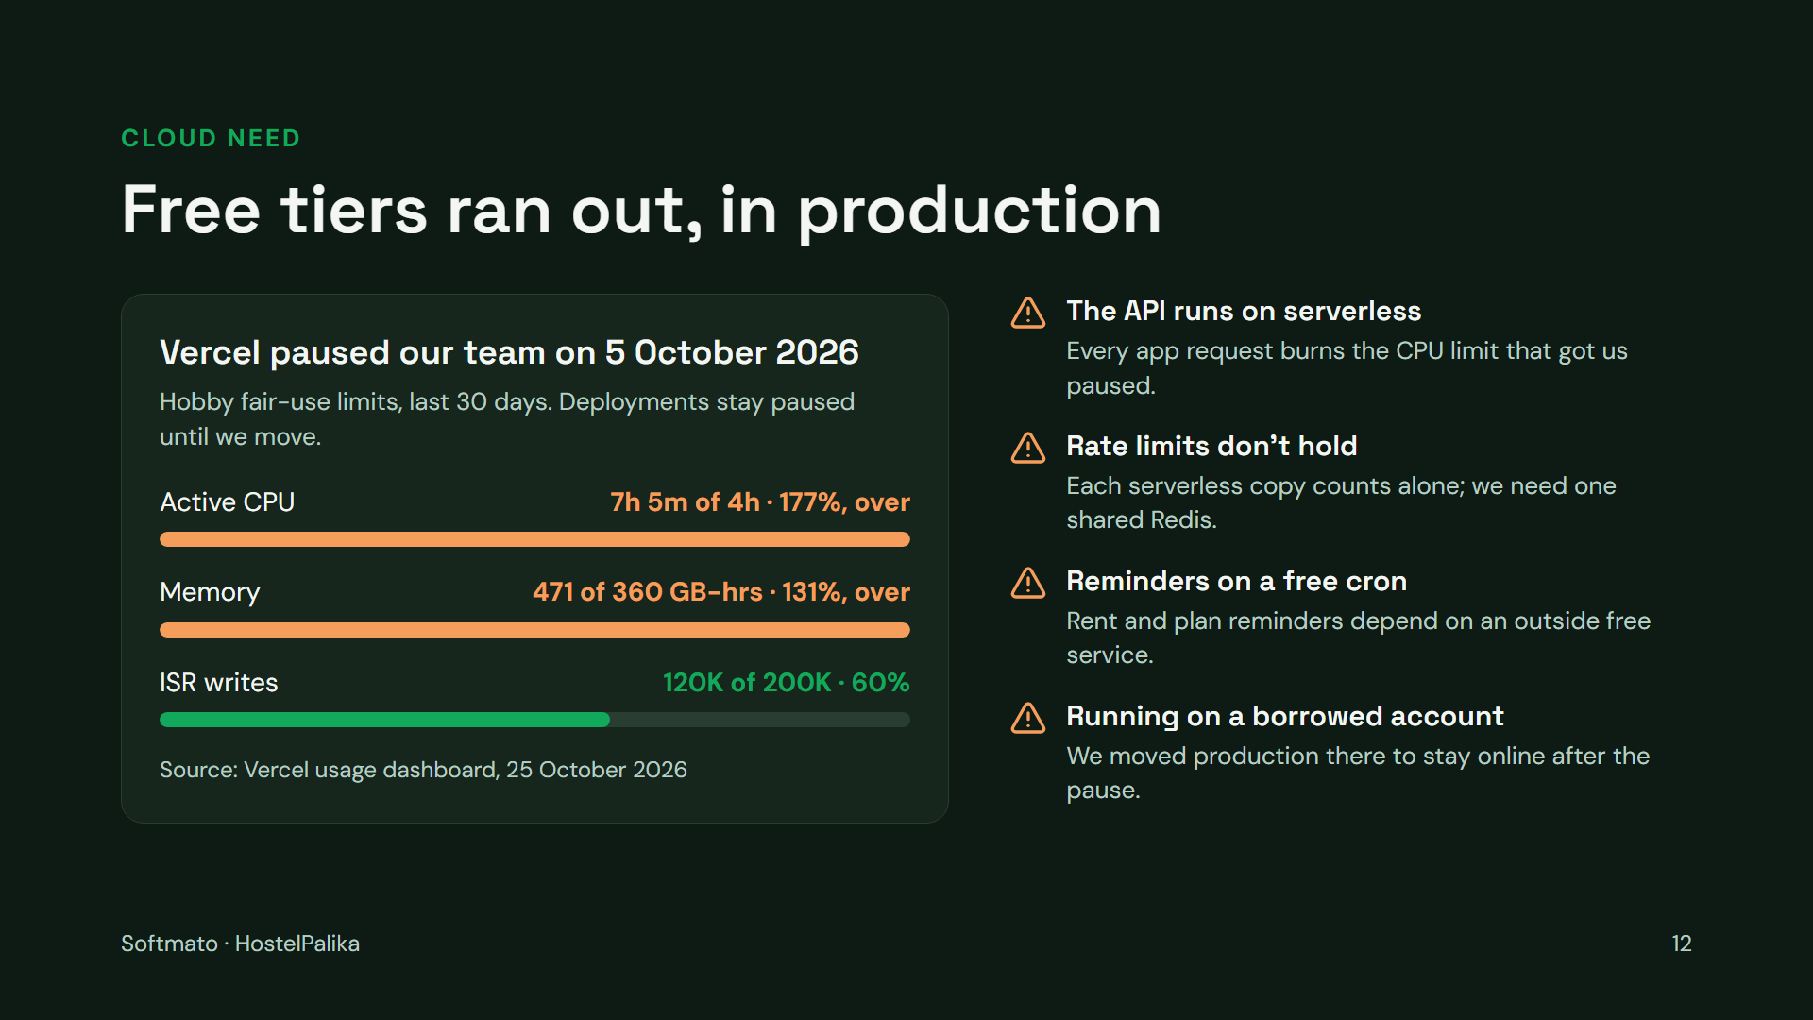
Notes:
This is the genuine cloud requirement. Real usage pushed us past the free tier: on 5 October 2026 Vercel paused our team for exceeding Hobby fair-use limits — 7 hours 5 minutes of active CPU against a 4-hour allowance, and 471 GB-hours of memory against 360. To keep hostels running we moved production to a borrowed account. The root cause is that our whole API runs as serverless functions: every request from the app burns that CPU allowance, rate limits are counted separately in each serverless copy, and our reminders depend on an outside free cron. A real server fixes all three.

Slide 13
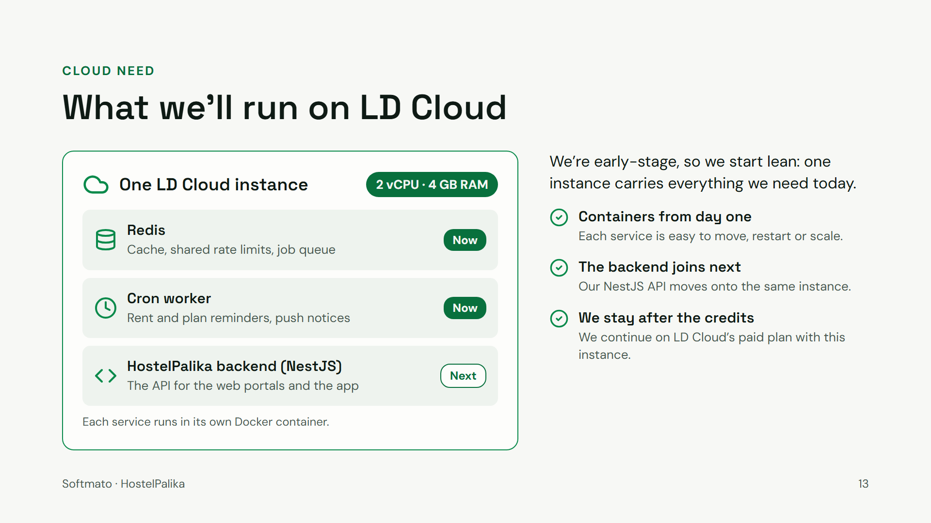
Notes:
Our requirement is deliberately small. We are early-stage and our budget is tight, so we are asking for one instance: 2 vCPU and 4 GB of RAM. On it we run everything in Docker containers — Redis for cache, shared rate limits and the job queue, and a cron worker for rent and plan reminders and push notices. Next, the HostelPalika backend, rebuilt in NestJS, moves onto the same instance and takes the API off serverless. When the credits end, we continue on LD Cloud’s paid plan with this same instance.

Slide 14
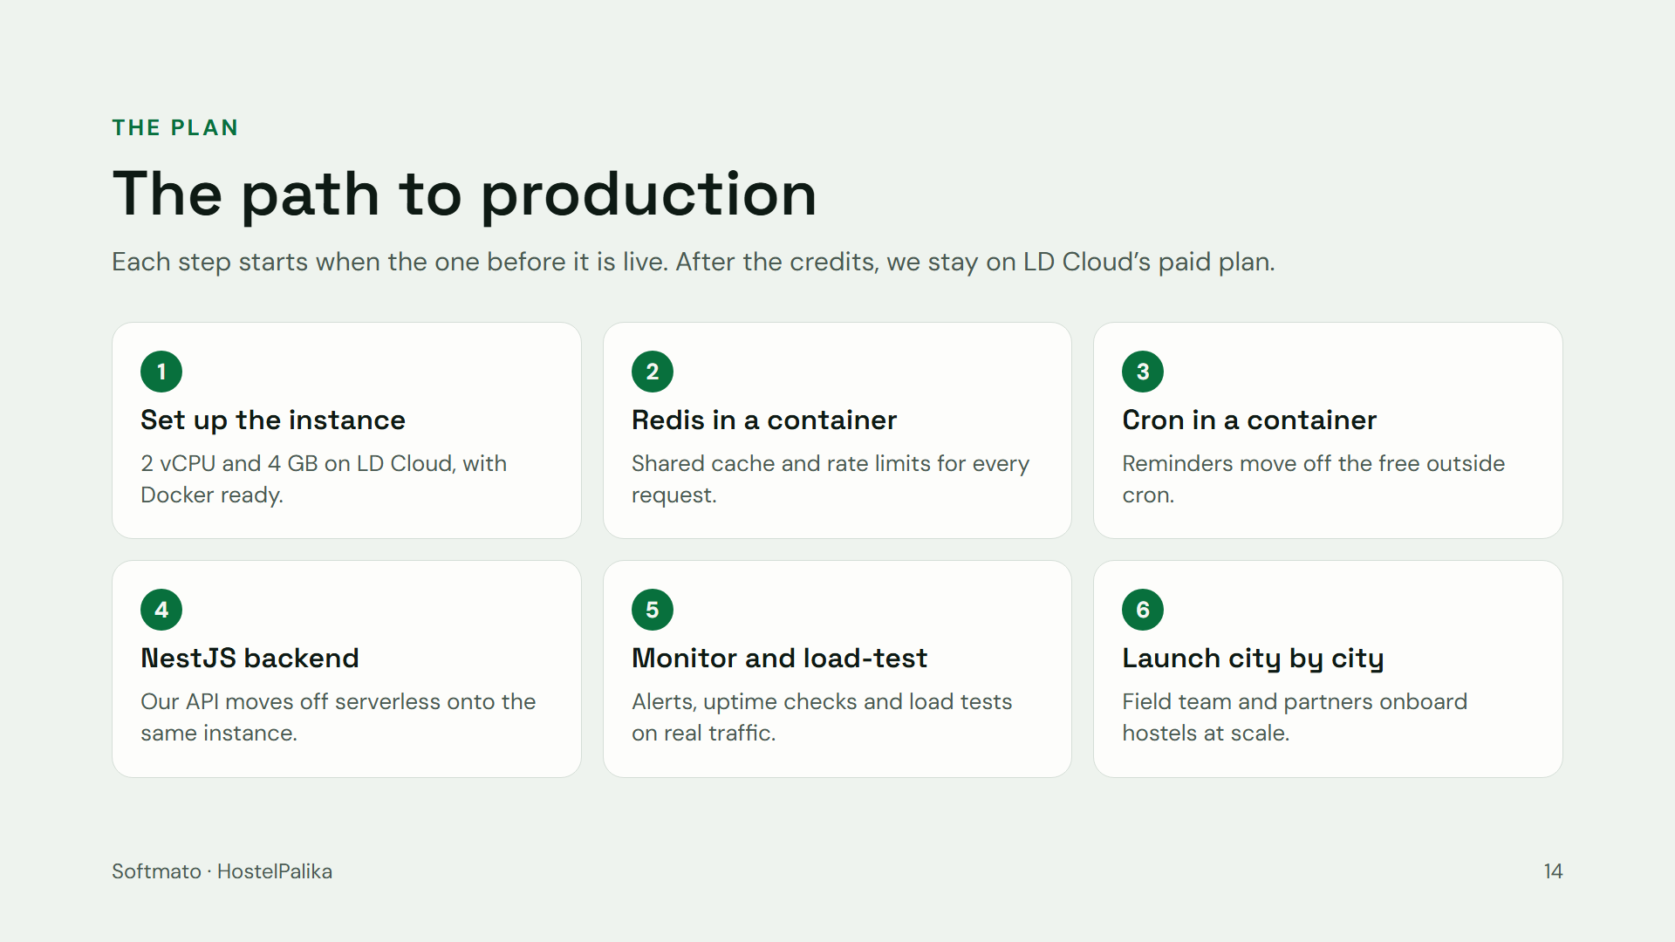
Notes:
The order matters more than the dates. First we set up the instance with Docker. Then Redis goes into its own container, so every request shares one cache and one set of rate limits. Then the cron worker, so reminders stop depending on an outside free service. Then the HostelPalika backend, rebuilt in NestJS, moves onto the same instance and takes the API off serverless. Then monitoring and load tests on real traffic, and only then do we open city by city with the field team and partners. After the credits, we continue on LD Cloud’s paid plan.

Slide 15
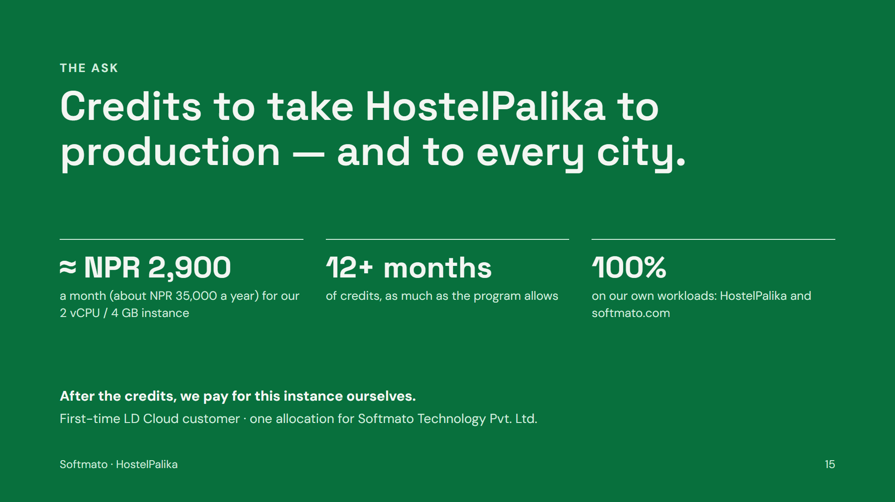
Notes:
Our ask is simple: startup credits that let us move HostelPalika onto production-grade infrastructure now, and carry it through the wide launch. Every credit goes to our own workloads — HostelPalika and softmato.com. We have never received LD Cloud credits before, and this is one allocation for one company. Our instance — 2 vCPU and 4 GB of RAM — costs about NPR 35,000 a year, roughly NPR 2,900 a month. We are asking for as many months of credits as the program allows, at least twelve, and when they end we will keep paying for the same instance on LD Cloud’s paid plan.

Slide 16
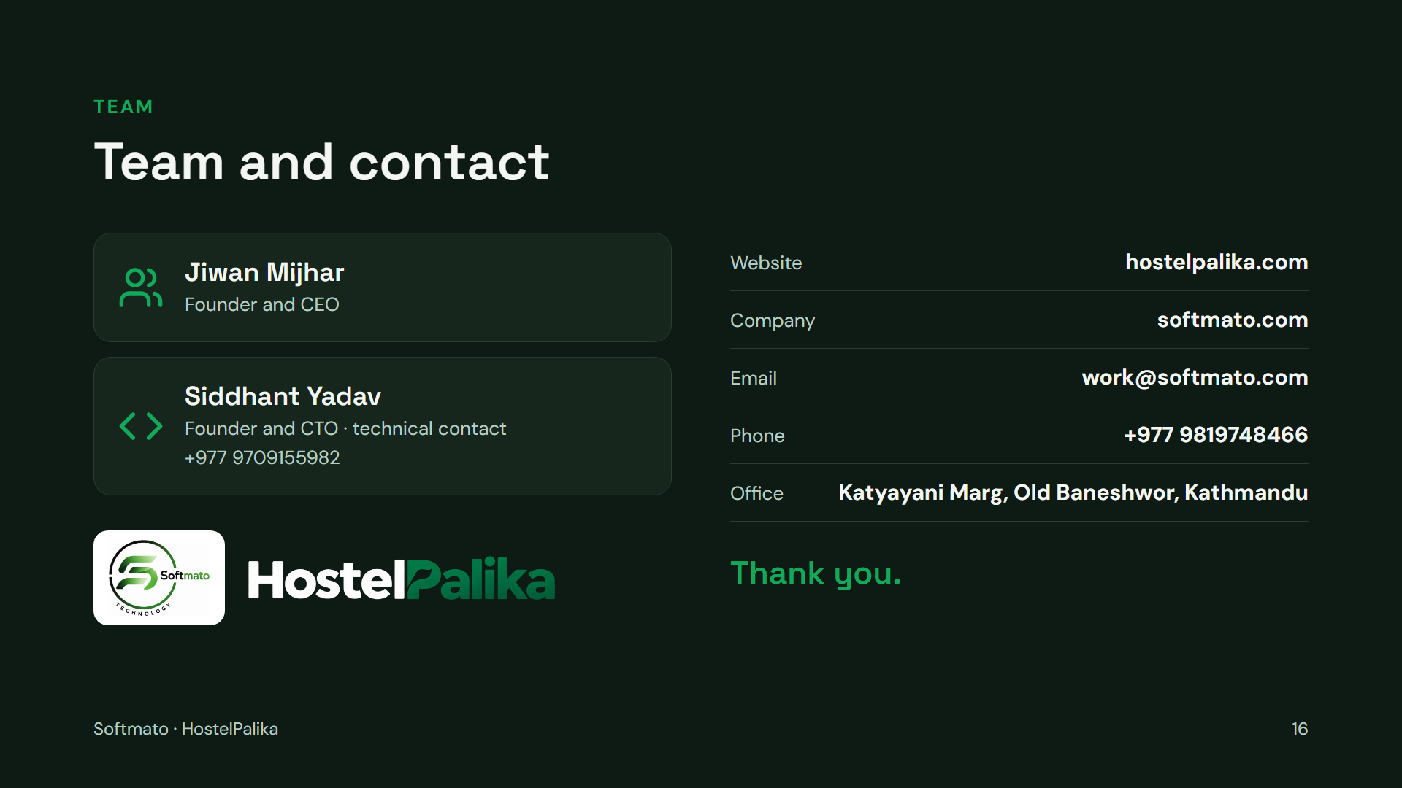
Notes:
Softmato is led by its two founders: Jiwan Mijhar, Founder and CEO, and Siddhant Yadav, Founder and CTO, who is also our technical contact on +977 9709155982. Reach the company at work@softmato.com or +977 9819748466; our office is on Katyayani Marg, Old Baneshwor, Kathmandu.

