Slide 1
  Part1 : Cryptography
  (hash function)
1

Slide 2
Roadmap
Cryptographic hash function
Birthday attack
Message Authentication Code
One Time Password

Slide 3
Cryptographic hash function
mapping an arbitrary-length message to a fixed-length output (message digest)
  message digest function
  one-way function
    m cannot be guessed from H(m)
For an arbitrary change in the input, every bit in the output has 50% chance to change
Computationally impractical to find two messages with the same digest

Slide 4
Cryptographic hash function
MD5
  Message digest5
    Input: arbitrary number of bits
    Output: 128 bits
  MD2, MD4
SHA-1
  Secure Hash Algorithm-1
    Input: arbitrary number of bits
    Output: 160 bits
RIPEMD-160, Whirlpool, etc

Slide 5
Cryptographic hash function
Step 1: Pad the message to be a multiple of 512 bits (16 words, 64 octets)
Step 2: Process the message, 512 bits at a time, to produce the message digest

Slide 6
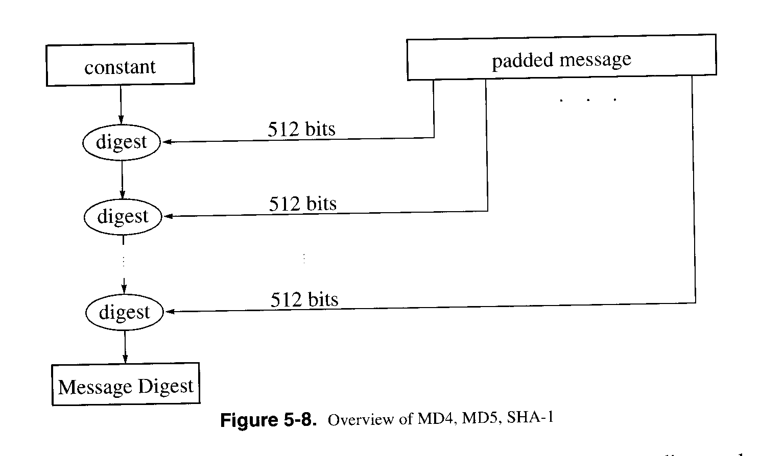
Cryptographic hash function

Slide 7
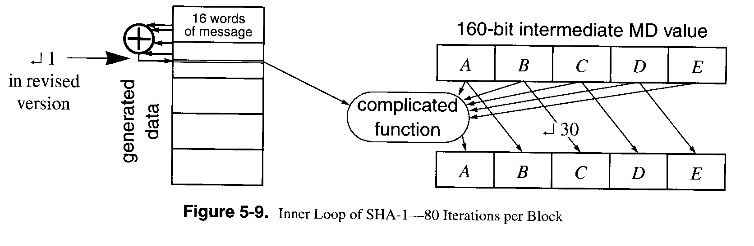
Cryptographic hash function

Slide 8
Birthday attack
Birthday paradox
  P : probability that there are a pair of people whose birthdays are same (month and day)
  A meeting of two people
    1-1/(365-1)=0.0027, 0.27%
  A meeting of three people
    1-1/364*1/363=0.008, 0.8%
  …

Slide 9
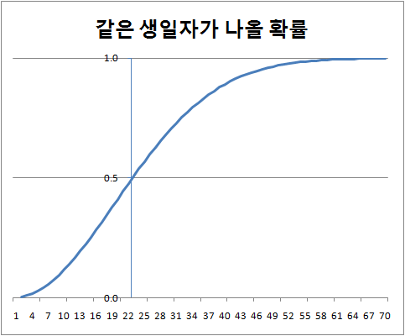
Birthday attack

Slide 10
Birthday attack
Conclusion
  Hash collisions happen more than expected
  64bit cipher is not a good choice for message digest
  Output of Hash functions should be larger than 128bits

Slide 11
Message authentication code
message authentication is concerned with:
  protecting the integrity of a message
  validating identity of originator
  non-repudiation of origin
Message Authentication Code (MAC)
  fixed sized authenticator for some message
  to provide authentication for message
  by using block cipher mode or hash function

Slide 12
Message authentication code
Keyed hash function
  MAC based on a hash function
    because hash functions are generally faster
    code for crypto hash functions widely available
  hash includes a key along with message
  original proposal:
    H(Key | m)
    some weaknesses were found with this
  eventually led to development of HMAC
    Use H(m | Key) instead of H(Key | m)

Slide 13
Message authentication code
Other applications
  File integrity check
    Tripwire (http://www.tripwire.org/)
  OS image check
  Source code integrity

Slide 14
One Time Password
Hash function can be used to generate one time password
  http://en.wikipedia.org/wiki/One-time_password
  A new password is used for each login
Time-synchronized
Mathematical algorithms
  Hash chain
  Challenge-response

Slide 15
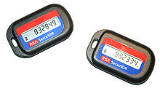
One Time Password
Time-synchronized
  a hardware called a security token
    Internet banking in Korea
  Client and server share a key, the serial number of the hardware token
  Both of them compute f(key, serial #, time)
    If the values match, the authentication is completed successfully
    “time” should be loosely synchronized

Slide 16
One Time Password
Hash chain (also known as S/Key)
  Preparation phase
    Client generates secret s and keep it confidential
    The client computes f(s), f(f(s))=f₂(s), f(f(f(s)))=f₃(s), …, f_{n}(s)
    The client shares f_{n}(s) with the server. The server stores f_{n}(s).
  Login phase
    Client computes f_{n-1}(s) and presents it to the server
      Only client knows s and can compute f_{n-1}(s). Note that f_{n-1}(s) can never be computed from f_{n}(s)
    The server computes f(f_{n-1}(s) ) from the given f_{n-1}(s), and compares it with the stored value of f_{n}(s)
    The server stores f_{n-1}(s)
    For the next login, the client presents f_{n-2}(s)

Slide 17
One Time Password
Challenge-response
  A client and a server share secret s
  Client wants to login the server
  The server presents a random number R to the server
  Client computes H(R|s) and presents it to the server
  The server computes H(R|s). If they match, the login is allowed

Slide 18
Security of hash function
Security strength
  MD5 << SHA-1 < SHA-224/256/384/512
  MD5
    1996: 중대하지 않은 결함 발견
    2004: 심각한 결함 발견
    2006: PC로 수십 시간 안에 충돌을 찾아내는 알고리즘 발견

Slide 19
Reference
Cryptography and network security, W. Stallings, Prentice Hall, 2011
Network security: private communication in a public world, C. Kaufman, etc., Prentice Hall, 2002
Computer networking: a top-down approach, J. Kurose and K. Ross, Pearson, 2008
Lecture notes from “computer and network security”, S. Chen, University of Florida
http://en.wikipedia.org/wiki/One-time_password

