Slide 1
  Part1 : Cryptography
  (applied cryptography)
1

Slide 2
Roadmap
Secret sharing algorithms
Blind signatures

Slide 3
Secret sharing algorithms
a method for distributing a secret amongst a group of participants
  each participant is allocated a share of the secret
The secret can only be reconstructed when the shares are combined together
  individual shares are of no use on their own

Slide 4
Secret sharing algorithms
Why needed?
  Gives tight control and removes single point vulnerability
  Individual key share holder cannot change/access the data
Goal is to divide secret S into n pieces S1,S2….Sn in such a way that:
  Knowledge of any k or more pieces makes S
  Knowledge of any k -1 or fewer pieces cannot make S
  Called (k, n) threshold scheme

Slide 5
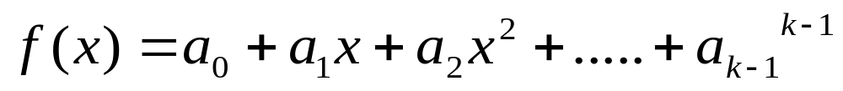
Secret sharing algorithms
Shamir's Secret Sharing
  Choose at random (k-1) coefficients a1,a2,a3…ak-1 , and let S be the a0
  Construct n points (i,f(i)) where i=1,2…..n
  Given any subset of k of these pairs, we can find the coefficients of the polynomial, and then evaluate a0(=S)
    Recall high school math!

Slide 6
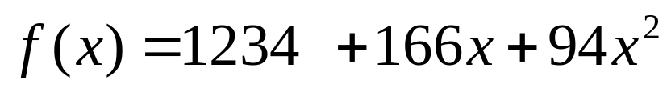
Secret sharing algorithms
Example
  Let S=1234, n=6 and k=3
  obtain random integers
    a1=166 and a2=94
  n secret share points
    (1,1494),(2,1942)(3,2598)(4,3402)(5,4414)(6,5614)
  We give each participant a different single point (x, f(x))

Slide 7
Secret sharing algorithms
Example
  Reconstruction
    In order to reconstruct the secret any 3 points will be enough

Slide 8
Blind signatures
Alice wants Bob to sign m blindly
Invented by David Chaum using the RSA algo.
  Bob’s public key (e, n), private key (d, n)
  Alice chooses a random value, k, between 1 and n
  Alice Binds m : t=mk^{e} mod n
    k^{e} : blinding factor
  Bob signs t : t^{d}=(mk^{e})^{d} mod n = m^{d}k mod n
  Alice unblinds t^{d} by multiplying 1/k : t^{d} X k⁻¹ = m^{d} mod n

Slide 9
Blind signatures
A great deal of use in applications where sender privacy is important
Ex) electronic voting protocol
  each ballot should be certified by an election authority before it can be accepted for counting
  this authority should not learn the voter's selections

Slide 10
Reference
Cryptography and network security, W. Stallings, Prentice Hall, 2011
Computer networking: a top-down approach, J. Kurose and K. Ross, Pearson, 2008
Lecture notes from “computer and network security”, S. Chen, University of Florida
Applied cryptography, B. Schneier, Wiley, 1996

