Slide 1
  Part3 : Attack & Defense
  (Network Security 1/3)
1

Slide 2
Roadmap
ARP level
TCP/IP level
Firewall
High Availability
Intrusion Detection System
DDoS
Intrusion Prevention System

Slide 3
ARP level
ARP spoofing
man in the middle attack
Smurf attack
Packet sniffing
MAC flooding

Slide 4
ARP spoofing
allows an attacker to sniff data frames on an LAN, modify the traffic, or stop the traffic altogether
  aka ARP poisoning, ARP flooding, ARP poison routing

Slide 5
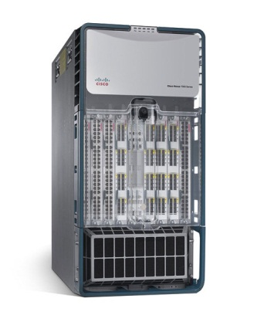
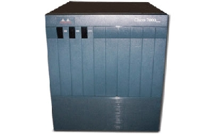
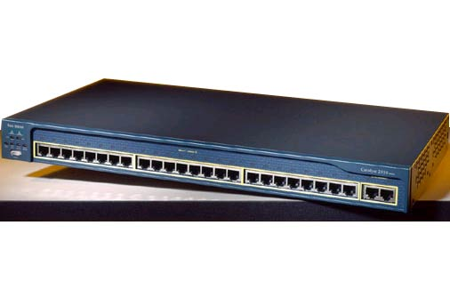



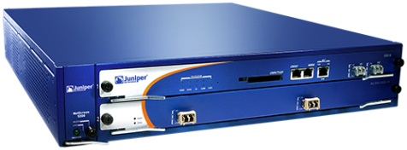

ARP spoofing
Enterprise network
R
Internet
R
SW
SW
R
SW
web
FW
DB

Slide 6
ARP spoofing
ARP request/reply
  A : Who is R?
  B (attacker) : it’s me
    spoofing at ARP level, called ARP spoofing
    Incorrect MAC address, called ARP poisoning
  B should send the fake ARP reply consistently
    Called ARP flooding
R
SW
B
A

Slide 7
ARP spoofing
Traffic flows through B
  B sees all the contents for A, images, messages, phone conversation (VOIP), etc.
Popular attacks
  So many free tools announced
2
R
SW
B
1
A

Slide 8
Man-in-the-middle-attack (MITM)
a general problem resulting from the presence of intermediate parties acting as proxy for clients on either side
How strong MITM?
  Diffie-Hellman is vulnerable to this attack
2
R
SW
B
1
A

Slide 9
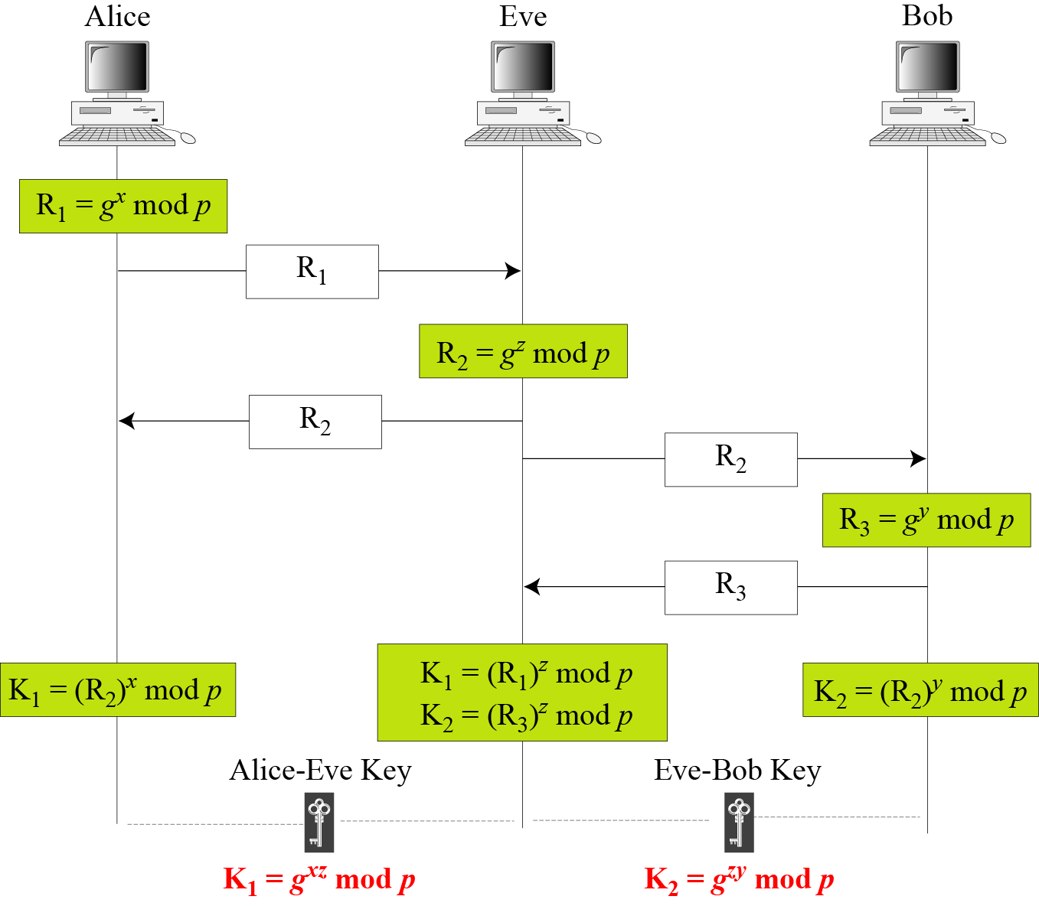
Man-in-the-middle-attack (MITM)

Slide 10
Man-in-the-middle-attack (MITM)
Countermeasure
  PKI
  One-time pad
  Strong mutual authentication
  Second channel verification

Slide 11

Smurf attack
Causes a large number of ICMP echo reply messages to the victim
  The aggregated messages can stop the normal operation of the victim
  Denial of Service attack

Slide 12
Smurf attack
Smurf attack scenario
  The attacker sends an ICMP echo request (PING) packet with the source IP address of the victim and the destination IP address of broadcast address
    IP spoofing is also required
  ICMP echo reply messages are generated by all the hosts that have received the ICMP echo request packet
  The victim receives too many packets to continue the normal service

Slide 13
Smurf attack
Countermeasure
  Configure individual hosts and routers not to respond to ping requests or broadcasts
    In Linux, echo "1" > /proc/sys/net/ipv4/icmp_echo_ignore_broadcasts
  Configure routers not to forward packets directed to broadcast addresses
  Security may restrict convenience.

Slide 14

Packet sniffing
Layer 1
  network tap
    a hardware device which provides a way to access the data flowing across a computer network

Slide 15
Packet sniffing
Layer2
  Hub v.s. network switch (switching hub)
  Port mirroring
Hub
  a device for connecting multiple twisted pair or fiber optic Ethernet devices together and making them act as a single network segment
  Hubs work at the physical layer (layer 1) of the OSI model

Slide 16

Packet sniffing
Hub
  A packet is copied to every other port
  The device is a form of multiport repeater
  Attackers can see all the packets inside the segment
twisted pair
hub

Slide 17
Packet sniffing
Network switch (switching hub)
  Collision happens when using Hub
  Using MAC address information, a network switch solves the problem

Slide 18
Packet sniffing
A network switch has a switch table
entry in switch table:
  (MAC Address, Interface, Time Stamp)
  stale entries in table dropped (TTL can be 60 min)
switch learns which hosts can be reached through which interfaces
  when frame received, switch “learns” location of sender: incoming LAN segment
  records sender/location pair in switch table

Slide 19
Packet sniffing
Network switch is perfect for anti-sniffing?
  ARP request packets still reach any host in the segment
  What if the attacker makes the switch table overflowed?
  MAC flooding attack

Slide 20
MAC flooding
Attackers send out packets with arbitrary values of source MAC addresses
This overflows the switch table of (MAC Address, Interface, Time Stamp)

Slide 21
MAC flooding
Countermeasure
  MAC-level access control
  Detecting (IP:MAC) relationship
    ARP watch, intrusion detection system
      ARP watch: a tool that monitors ethernet activity and keeps a database of ethernet/ip address pairings
    Routers cause false-positive errors
      false positive v.s. false negative

Slide 22
Reference
wikipedia

