Slide 1
  Part3 : Attack & Defense
  (Network Security 3/3)
1

Slide 2
Roadmap
ARP level
TCP/IP level
Firewall
High Availability
Intrusion Detection System
DDoS
Intrusion Prevention System

Slide 3
Firewall
a part of a computer system or network that is designed to block unauthorized access while permitting authorized communications
configured to permit or deny network transmissions based upon a set of rules (rule-set, policy)
  Firewall is safe only if its rules are configured correctly

Slide 4




Firewall
Example (rules)
  Inbound session : 210.123.36.100/TCP/80
  Outbound session : 210.123.37.10,11/TCP/UDP/all
Internet
R
210.123.36.1/24
SW
R
SW
web
210.123.36.100/24
210.123.37.11/24
FW
DB
210.123.37.10/24
210.123.36.200/24

Slide 5
Firewall
Example
  Usually behind the access router
  Traditionally firewalls work at layer-3, but layer-2 also possible → “transparent”
Internet
R
210.123.36.1/24
FW
SW
R
SW
web
210.123.36.100/24
210.123.37.11/24
DB
210.123.37.10/24
210.123.36.200/24

Slide 6
Firewall
Example
  Firewall rule-set
    A rule := (s_ip, s_port, d_ip, d_port, protocol, action, interface), simply (s_ip, s_port, d_ip, d_port, protocol, action)
      Action : drop/accept, NAT, IPSec,…
no | S_ip | S_port | D_ip | D_port | Prot. | action
1 | * | * | 210.123.36.100/32 | 80 | TCP | accept
2 | 210.123.36.100/32 | 80 | * | * | TCP | accept
3 | 210.123.37.0/24 | 1024:65535 | * | * | * | accept
4 | * | * | 210.123.37.0/24 | 1024:65535 | * | accept
5 | * | * | * | * | * | deny

Slide 7
Firewall
Firewall is safe only if its rule-set is correct
  The order is important
    First-rule first-first
      (210.123.37.2, 2000, 164.210.293.17, 443, TCP) → accepted by the 3rd rule
    called packet filtering, or packet classification
      Generalization of traditional routing
no | S_ip | S_port | D_ip | D_port | Prot. | action
1 | * | * | 210.123.36.100/32 | 80 | TCP | accept
2 | 210.123.36.100/32 | 80 | * | * | TCP | accept
3 | 210.123.37.0/24 | 1024:65535 | * | * | * | accept
4 | * | * | 210.123.37.0/24 | 1024:65535 | * | accept
5 | * | * | * | * | * | deny

Slide 8
Firewall
  Stateless firewall v.s. stateful firewall
  Stateless firewall
    Rule-set is looked up for every packet
no | S_ip | S_port | D_ip | D_port | Prot. | action
1 | * | * | 210.123.36.100/32 | 80 | TCP | accept
2 | 210.123.36.100/32 | 80 | * | * | TCP | accept
3 | 210.123.37.0/24 | 1024:65535 | * | * | * | accept
4 | * | * | 210.123.37.0/24 | 1024:65535 | * | accept
5 | * | * | * | * | * | deny

Slide 9
Firewall
Weakness of stateless firewall
  Performance disadvantage
    if the rules accept one packet, they are also going to accept all the subsequent packets in the same connection.
    But, stateless firewall doesn’t take advantage of this fact

Slide 10
Firewall
Weakness of stateless firewall
  Security hole
    What happens if an attacker try to establish TCP session of (His IP, His port, 210.123.37.10, 12345)
    12345 : port # of a backdoor SW
no | S_ip | S_port | D_ip | D_port | Prot. | action
1 | * | * | 210.123.36.100/32 | 80 | TCP | accept
2 | 210.123.36.100/32 | 80 | * | * | TCP | accept
3 | 210.123.37.0/24 | 1024:65535 | * | * | * | accept
4 | * | * | 210.123.37.0/24 | 1024:65535 | * | accept
5 | * | * | * | * | * | deny

Slide 11
Firewall
Stateful firewall
  Rule-set is looked up only for the first packet of each session
  Keeping a session table in memory and looking up the table first before the rule-set → performance advantage
    Old entry timed-out, issue of keepalive message
      http keepalive, TCP keepalive
  Rule-set simplified
no | S_ip | S_port | D_ip | D_port | Prot. | action
1 | * | * | 210.123.36.100/32 | 80 | TCP | accept
2 | 210.123.37.0/24 | 1024:65535 | * | * | * | accept
3 | * | * | * | * | * | deny

Slide 12
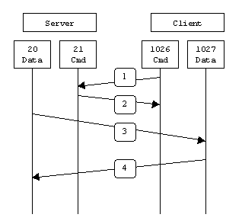
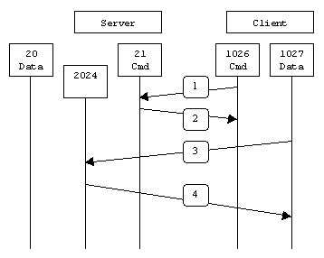
Firewall
Stateful inspection
  Better than normal stateful firewalls
  FTP example : Active mode vs Passive mode

Slide 13
Firewall
Security hole to client when active-mode used
  Firewall at client side
no | S_ip | S_port | D_ip | D_port | Prot. | action
1 | client_ip | * | * | 21 | TCP | Accept
2 | * | * | client_ip | 20 | TCP | Accept
3 | * | * | * | * | * | deny

Slide 14
Firewall
Stateful inspection
  Aware of the context of a protocol
  When a packet matches the first rule, the firewall interprets the ftp message and temporarily adds the rule for the data session
  Knowledge of application protocol required
no | S_ip | S_port | D_ip | D_port | Prot. | action
1 | client_ip | * | * | 21 | TCP | Accept
2 | * | * | * | * | * | deny

Slide 15
Firewall
Challenges to stateful inspection
  Application port dynamically changes
  HTTP encapsulation and tunneling
  →Protocol reverse engineering

Slide 16
Firewall
DMZ (demilitarized zone)
  a physical or logical subnetwork that contains and exposes an organization's external services to a larger untrusted network, usually the Internet
  Rule of thumb
    Servers for E-mail, DNS, web should be located at DMZ so that they are separated from more critical servers like database

Slide 17
Firewall
DMZ
  Confine the damage to the DMZ
Internet
Internet
R
R
210.123.35.100/24
DMZ
FW
FW
SW
web
web
SW
SW
210.123.36.100/24
210.123.36.100/24
DB
DB
210.123.36.200/24
210.123.36.200/24

Slide 18

Firewall
Subnetworks separated by multiple firewalls
Internet
R
DMZ
FW
SW
Email/DNS
SW
FW
SW
DB servers
Web servers

Slide 19
High Availability
What happens if the firewall stops?
High Availability
  Enterprise network should prepare for unexpected system failure
  Redundancy required for fault-tolerant network, including any networking devices

Slide 20
High Availability
HA for firewall
  Layer 4/7 switch
  session synchronization at kernel-level

Slide 21
High Availability
  Firewall HA
    Layer 4/7 switch
    A session should go through one FW consistently.
      Use hash algorithm
      Which FW to send?
        H(s_ip XOR d_ip) mod (# of firewall)
    Disadvantage
      L4/L7 cost
      Established sessions lost when an FW fails
R
L4/L7
FW
FW
L4/L7
SW

Slide 22
High Availability
  Firewall HA
    session synchronization at kernel-level
    Two firewalls are synchronized for rule-set, session table, etc.
R
SW
FW
FW
SW
SW

Slide 23
High Availability
Switch
  L2 switch
  L3 switch
  L4/L7 switch
  Switch v.s. Router
    metro-ethernet

Slide 24
High Availability
High Availability for router
  Router fails?
  VRRP(Virtual Router Redundancy Protocol)
    RFC3768
    designed to increase the availability of the default gateway servicing hosts on the same subnet
    Hot Standby Router Protocol (HSRP)
      Cisco informational RFC 2281 ( March 1998)

Slide 25
High Availability
VRRP
  an election protocol that dynamically assigns responsibility for a virtual router to one of the VRRP routers on a LAN (the master router)
  The election process provides dynamic fail over in the forwarding responsibility should the Master become unavailable.
  allows any of the virtual router IP addresses on the LAN to be used as the default first hop router by end-hosts.

Slide 26
High Availability
When is the master router considered down?
  The master router periodically sends out an advertisement message that contains an advertisement interval.
  Each backup router uses a timer to decide when the master router is down.
The election process:
  When a backup router detects that the master router is down, it sends an advertisement message with its own priority value in it.
  The backup router with the highest priority value becomes the new master router.

Slide 27
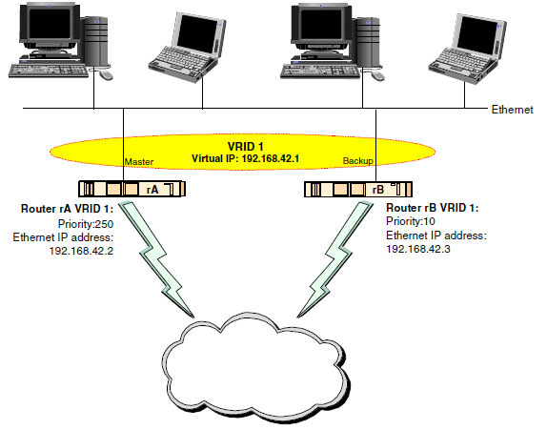
High Availability
VRRP
  Tricky technique at ARP

Slide 28
High Availability
How if an attacker injects a fake VRRP advertisement message (possibly with very high priority value) into the network? Would it then be elected to be the new master router?
VRRP security features
  Three authentication methods
    No authentication
    Simple clear-text passwords
    Strong authentication (using IP authentication with MD5 HMAC)
  A mechanism that protects against VRRP packets being injected from a remote network

Slide 29
High Availability
VRRP : Active/passive(standby)
How to turn into active/active?
  Use two virtual IP addresses

Slide 30
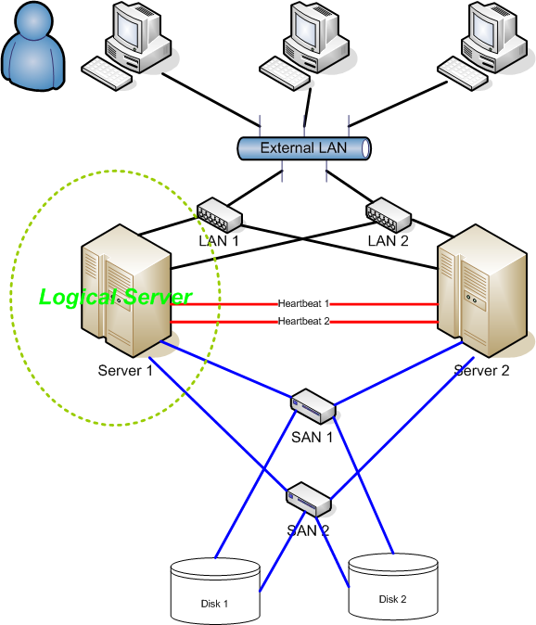
High Availability
HA for server clusters
  Special application installed to check the status of the server through the heartbeat lines
  If the active server fails, the passive server takes over the service and the virtual IP also moved

Slide 31
High Availability
A case study in practical business
DB system → single point of failure
  redundant configuration
  p : probability of availability
  n : # of servers
  What is the probability that service can continue?
    Probability that at least one server works normally!
    Denoted by ‘q _{n} ’
…
Server 1
Server 2
Server n

Slide 32
High Availability
2 servers
  server 1 : p or (1-p), server 2 : p or (1-p) → 4 scenarios, but the last one fails
  q₂ = pp + p(1-p) + (1-p)p = 2p-p²
3 servers
  q₃ = ppp + pp(1-p)+ p(1-p)p + p(1-p)(1-p) +…
  too complicated!

Slide 33
High Availability
From different angle,
  2 servers
    q₂ : 1- {probability of service fail}
    q₂ = 1- { (1-p)(1-p) } = 1- (1-p)²
  3 servers
    q₃ : 1- {probability of service fail}
    q₃ = 1- { (1-p)(1-p)(1-p) } = 1- (1-p)³
Generalization
  n servers
  q_{n} = 1- (1-p)^{n}

Slide 34
High Availability
Why is “n=2” popular?
  Generally, p approaches 1 (HW, SW technology)
  p=0.9999 means that the system fails less than 53 minutes for one year
  If n=2,
    q₂ = 1- (1-p)² = 0.99999999 , which means less than 0.006 minutes for one year

Slide 35
High Availability
HA network & server
  No single point of failure
Internet
R
R
SW
SW
Email/DNS
DMZ
FW
FW
SW
SW
FW
SW
SW
SW
FW
DB servers
Web servers

Slide 36
High Availability
Disaster Recovery (DR) Center
  main/backup data center
Internet
R
R
R
R
SW
SW
SW
SW
Email/DNS
Email/DNS
DMZ
DMZ
FW
FW
SW
FW
FW
SW
SW
SW
SW
SW
Web servers
Web servers

Slide 37
High Availability
Load balancing
  Smart DNS, called Global Server Load Balancing(GSLB), checks each server’s status (ex. response time)
  GSLB returns the IP address of the most appropriate server to a DNS request
  When the main center fails, the failover to DR center should happen immediately.
    Minimize DNS TTL(Time to Live)
      What about Browser DNS cache?

Slide 38
Intrusion Detection System
a device or software application that monitors network and/or system activities for malicious activities or policy violations and produces reports to a management station
  Network-based / Host-based
  Signature-based / anomaly-based

Slide 39
Intrusion Detection System
terminology
  Alert/Alarm: A signal suggesting that a system has been or is being attacked
  True Positive: A legitimate attack which triggers an IDS to produce an alarm
  False Positive: An event signaling an IDS to produce an alarm when no attack has taken place
  False Negative: A failure of an IDS to detect an actual attack
  True Negative: When no attack has taken place and no alarm is raised
  Alarm filtering: The process of categorizing attack alerts produced from an IDS in order to distinguish false positives from actual attacks

Slide 40
Intrusion Detection System
Host-based IDS
  an intrusion detection system that monitors and analyzes the internals of a computing system rather than the network packets on its external interfaces
    checksum database: HIDS checks files and memory contents using MD5/SHA-1. ex) tripwire
    Detecting unusual events: system resource overuse
      Anomaly detection

Slide 41
Intrusion Detection System
Network-based IDS
  tries to detect malicious activity such as DoS attacks, port scans or even attempts to crack into computers by monitoring network traffic
  Passive monitoring
    Switch mirroring port, network tap
  reads all the incoming packets and tries to find suspicious patterns known as signatures or rules
    String(pattern) matching, signature-based
  learns usual traffic pattern, volume, and identifies abnormal phenomena
    Anomaly detection

Slide 42
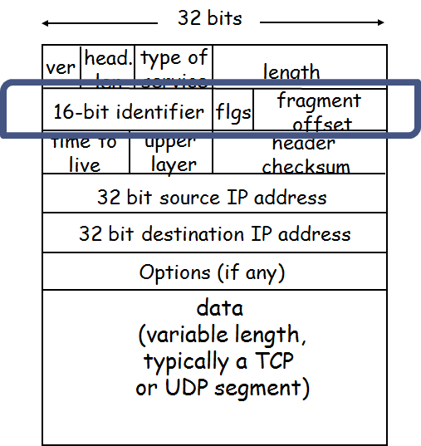
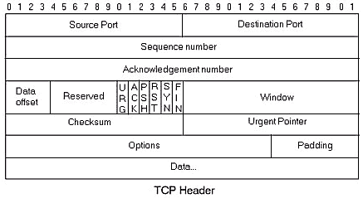
Intrusion Detection System
Network-based IDS
  Evasion technique
    string over multiple packets, fragmented packets, TCP segment overwriting
    Ex) string matching “attack”
  Stateful inspection required

Slide 43
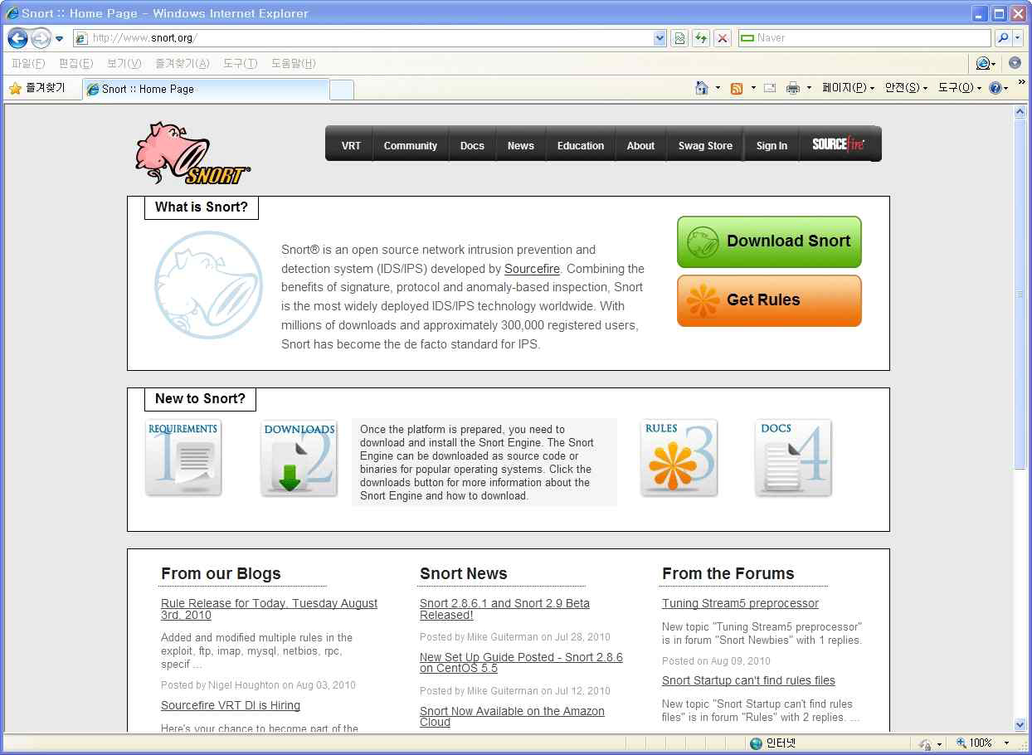
Intrusion Detection System
Snort
  Most famous NIDS, cost-free
  Download: software, rules

Slide 44

Intrusion Detection System
Users can define their own rules
  refined.rules
내용 | 의미
alert | 경고를 남김
tcp | tcp 패킷만 검사
any any -> any any | any(모든) 출발지 IP와 any 출발지 포트(port)로부터 any 도착지 IP와 any 도착지 포트로 향하는 패킷만 검사
msg:"Someone try to act admin"; | "Someone try to act admin" 이라는 제목으로 경고를 남김
flow:to_server; | 들어오는 패킷만 검사
content:"admin"; | "admin"이라는 스트링 발견 시 경고를 남김
sid:99999; | 유일한 값을 가지는 id로 다른 룰과 겹치지 않게 99999를 사용
rev:1; | 룰의 버전을 의미하는데 여기서는 큰 의미가 없음

Slide 45
DDoS
Distributed Denial of Service attack
  Denial of Service attack (DoS): an attempt to make a computer resource unavailable to its intended users
  DDoS is a DoS with distributed attacker systems involved (called zombie or bot)

Slide 46
DDoS
DoS v.s. DDoS
  An example of DoS
    Land attack
      One packet can stop the service
      involves IP packets where the source and destination address are set to address the same device
      found in services like SNMP and Windows 88/tcp (kerberos/global services) which were caused by design flaws where the devices accepted requests on the wire appearing to be from themselves and causing replies repeatedly

Slide 47
DDoS
DoS v.s. DDoS
  An example of DDoS
    7.7. DDoS, 2010.7.7. in Korea
      More than 200,000 zombie PCs involved
      Sending HTTP request packets to the victim site
      30Gbps traffic congested at the perimeter of the victim

Slide 48



DDoS
DDoS

Slide 49
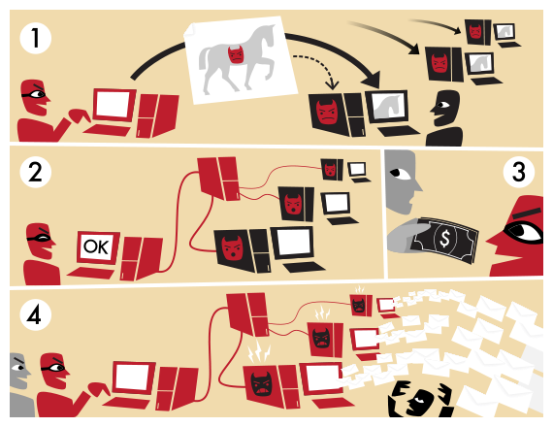
DDoS
Botnet changed the paradigm of DDoS attack
  pursuing financial profit rather than fame
  Botnet: bot master, bots, C&C(command & control) server

Slide 50
DDoS
1. A botnet operator sends out viruses or worms, infecting ordinary users' computers, whose payload is a malicious application—the bot.
2. The bot on the infected PC logs into a particular C&C server (often an IRC server, but, in some cases a web server).
3. A spammer purchases the services of the botnet from the operator.
4. The spammer provides the spam messages to the operator, who instructs the compromised machines via the IRC server, causing them to send out spam messages.

Slide 51
DDoS
Difficulty in mitigating DDoS
  Traffic of recent DDoS attack is very similar to normal traffic
  Each bot generates only small amount of traffic, seemingly normal
  Flash crowd
    describes a network phenomenon where a network or host suddenly receives a lot of traffic
    When Michael Jackson died in 2009, websites such as Google and Twitter slowed down or even crashed.

Slide 52
DDoS
Limitations to increase scalability
  Normal traffic bandwidth 2Gbps
  Under attack, 30Gbps traffic congested at perimeter network
  What can we do?
    Increase number of web servers
    Increase network bandwidth

Slide 53
DDoS
Mitigation strategy
  Campaign against virus/malware infection
  Early detection and filtering out suspicious packets
  Anti-DDoS systems (aks intrusion prevention system)
  Botmaster traceback
    P2P C&C
  Until now, unsolved problem

Slide 54
Intrusion Prevention System
identify malicious activity, log information about said activity, attempt to block/stop activity, and report activity
considered extensions of intrusion detection systems because they both monitor network traffic and/or system activities for malicious activity
  Intrusion Prevention System = IDS + Firewall
intrusion prevention systems are placed in-line and are able to actively prevent/block intrusions that are detected

Slide 55
Intrusion Prevention System
DDoS mitigation, anti-DDoS system
  IP-spoofing test
  Traffic management

Slide 56
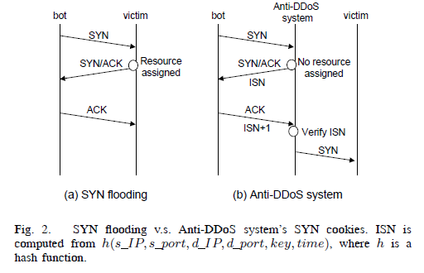
Intrusion Prevention System
IP-spoofing test
  Using SYN-cookie

Slide 57
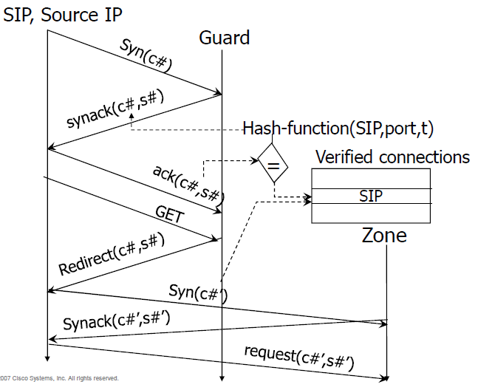
Intrusion Prevention System
IP-spoofing test
  http-level test (CISCO guard and traffic anomaly detector)

Slide 58
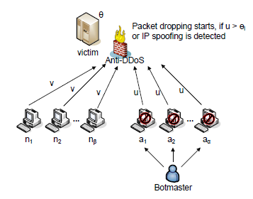
Intrusion Prevention System
Traffic management
  Learning normal traffic pattern
    Ex) a normal client sends traffic to a web server less than 1Mbps

Slide 59
Intrusion Prevention System
Case study
  A real IPS brochure
  UTM (Unified Threat Management)
  www.secui.com

Slide 60
Reference
Lecture notes from “computer and network security”, S. Chen, University of Florida
wikipedia
Using Whitelisting to Mitigate DDoS Attacks on Critical Internet Sites, M. Yoon, IEEE Comm. Mag., pp 110 - 115, 2010.7
Insertion, Evasion, and Denial of Service: Eluding Network Intrusion Detection, T. Ptacek and T. Newsham, Technical Report, Secure Networks, Inc., January 1998.
www.cisco.com
www.secui.com

