Slide 1
  Security Protocol
  (Secure Socket Layer)
1

Slide 2
Roadmap
Secure Socket Layer
SSL Handshake protocol
Transport Layer Security
Case Study of JAVA SSL

Slide 3
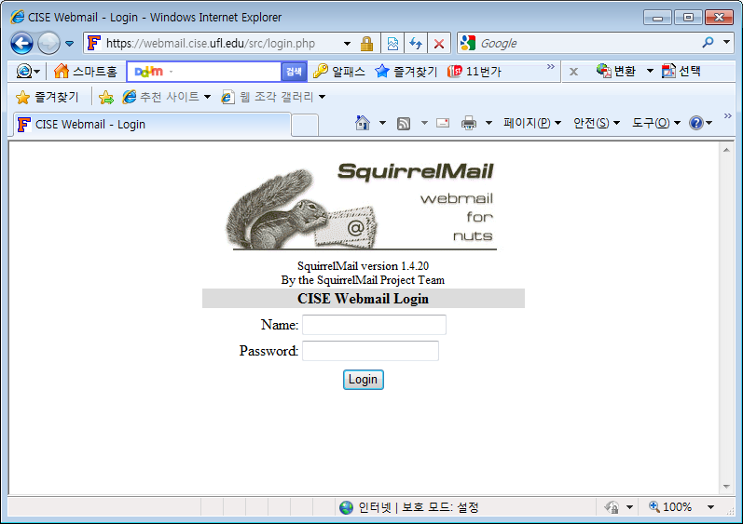
Secure Socket Layer
HTTPS

Slide 4
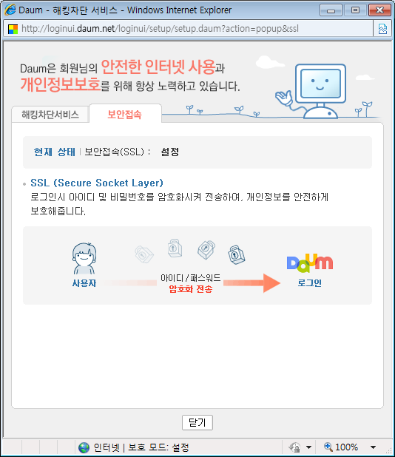
Secure Socket Layer
SSL

Slide 5
Secure Socket Layer
transport layer security service
originally developed by Netscape
version 3 designed with public input
subsequently became Internet standard known as TLS (Transport Layer Security)
uses TCP to provide a reliable end-to-end service
SSL has two layers of protocols

Slide 6
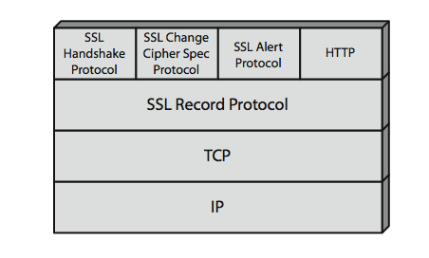
Secure Socket Layer
SSL architecture

Slide 7
Secure Socket Layer
Runs on top of TCP
Has its own units, called records, consisting of headers and payloads
Four types of records: user data, handshake messages, alerts, change cipher spec

Slide 8
Secure Socket Layer
SSL session
  an association between client & server
  created by the Handshake Protocol
  define a set of cryptographic parameters
  may be shared by multiple SSL connections

Slide 9
Secure Socket Layer
message integrity
  using a MAC with shared secret key
  similar to HMAC but with different padding
confidentiality
  using symmetric encryption with a shared secret key defined by Handshake Protocol
  AES, IDEA, RC2-40, DES-40, DES, 3DES, Fortezza, RC4-40, RC4-128
  message is compressed before encryption

Slide 10
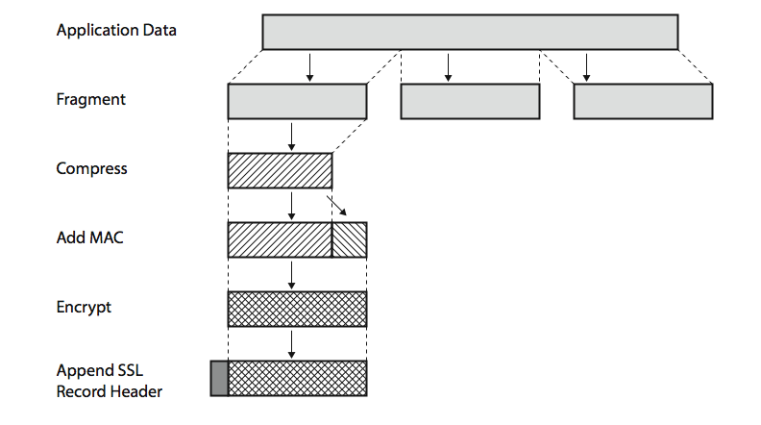
Secure Socket Layer
SSL Record Protocol Operation

Slide 11
Secure Socket Layer
SSL Change Cipher Spec Protocol
  a single message
  causes pending state to become current
  hence updating the cipher suite in use
Alert protocol
  conveys SSL-related alerts to peer entity
    fatal: unexpected message, bad record mac, decompression failure, handshake failure,…
    warning: close notify, no certificate, bad certificate, certificate revoked, certificate expired,…
SSL Handshake Protocol

Slide 12
SSL Handshake Protocol
allows server & client to:
  authenticate each other
  to negotiate encryption & MAC algorithms
  to negotiate cryptographic keys to be used
comprises a series of messages in phases
  Establish Security Capabilities
  Server Authentication and Key Exchange
  Client Authentication and Key Exchange
  Finish

Slide 13
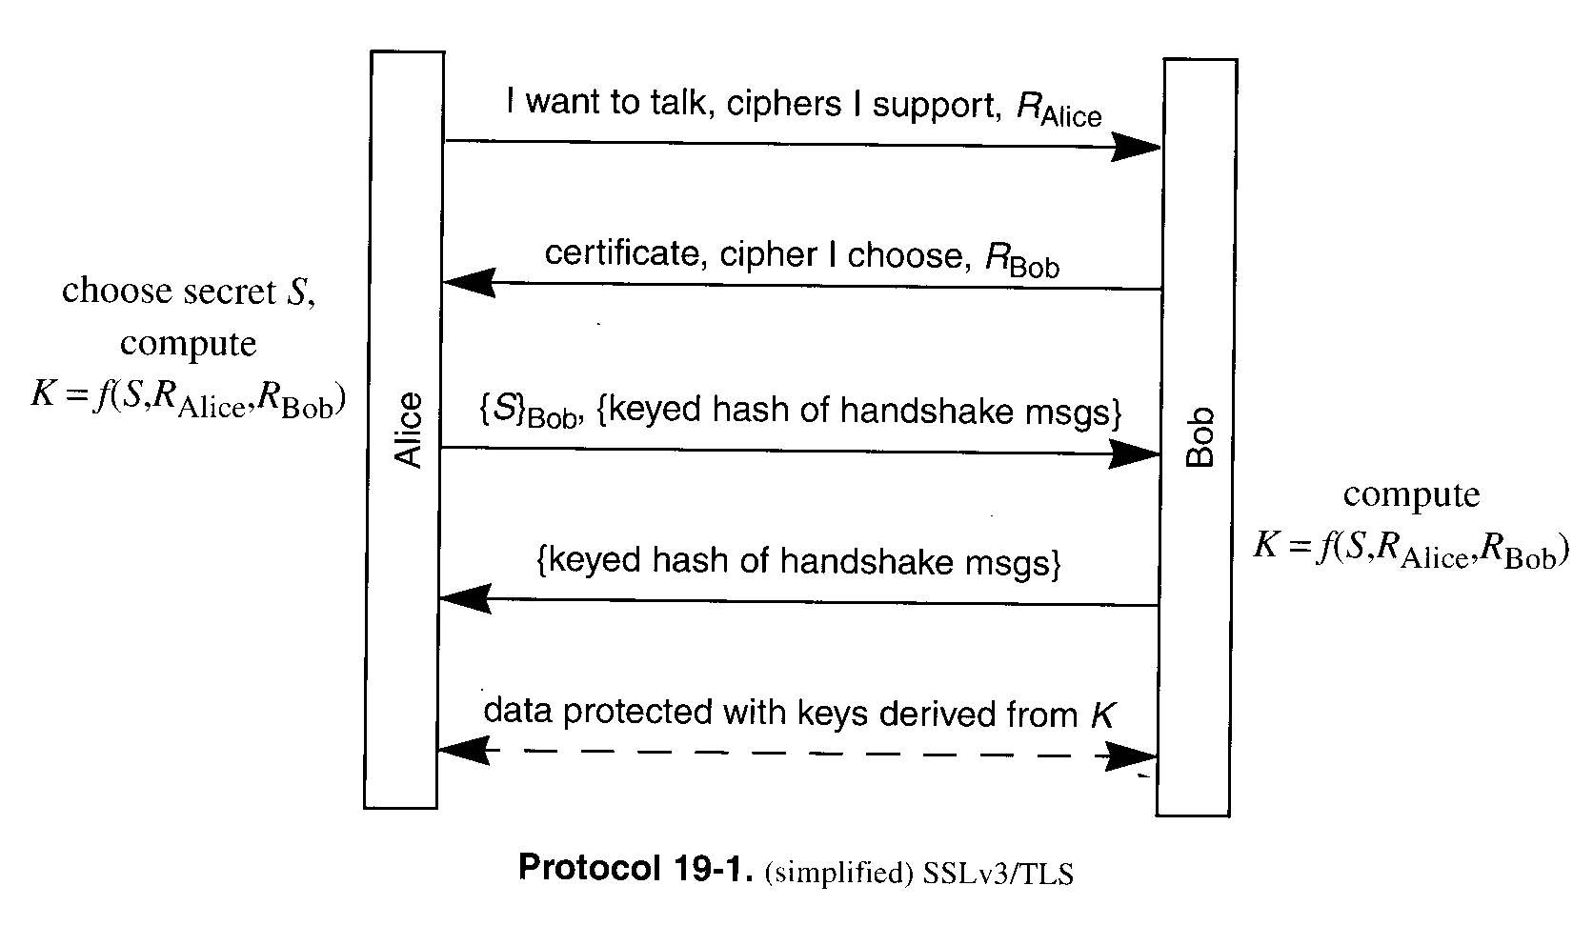
SSL Handshake Protocol
client_hello
server_hello
client_key_exchange
finished
finished

Slide 14
SSL Handshake Protocol
client_hello
  Version
    the highest SSL version understood by the client
  random #
  session ID
  cipher suite
    Key exchange method : RSA, Diffie-Hellman,…
    Cipher spec.: cipher algorithm, MAC algorithm(MD5 or SHA-1), ciphertype(stream or block), …
    Ex) RSA_3DES_MD5

Slide 15
SSL Handshake Protocol
server_hello
  Certificate (optional)
  Random #
  a cipher suite selected

Slide 16
SSL Handshake Protocol
Client_key_exchanged
  Pre-master key S
    Pre-master secret
  Master key K = f ( S, R_{Alice}, R_{bob})
    Note that how S is shared safely
    Master secret
  Six session keys (for each direction, encryption key, integrity-protection key, IV), which are the hash results of K, R_{Alice}, and R_{bob.}

Slide 17
SSL Handshake Protocol
finished
  Concatenation of two hash values
    MD5(master_secret || pad2 || MD5(handshake_messages || sender || master_secret || pad1))
    SHA(master_secret || pad2 || SHA(handshake_messages || sender || master_secret || pad1))
  Verity the keys are shared correctly

Slide 18
SSL Handshake Protocol
Normally the clients send name/password to the server as application data
The server has the option to send a “certificate” request in message 2 of the handshaking
  Internet banking

Slide 19
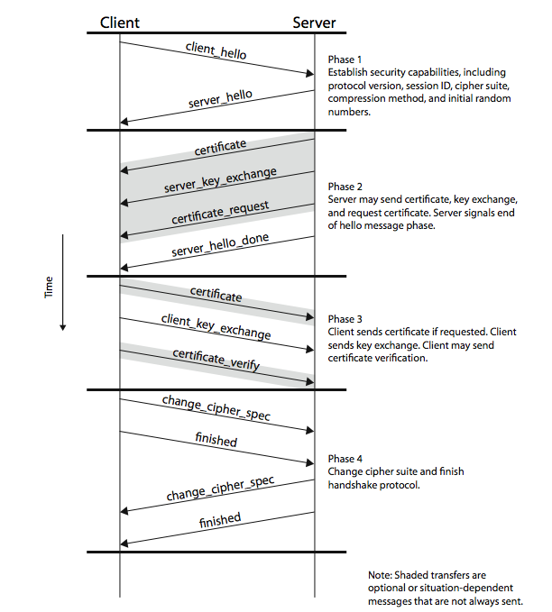
Extended version

Slide 20
Transport Layer Security
IETF standard RFC 2246 similar to SSLv3
with minor differences
  in record format version number
  uses HMAC for MAC
  a pseudo-random function expands secrets
  has additional alert codes
  some changes in supported ciphers
  changes in certificate types & negotiations
  changes in crypto computations & padding

Slide 21
Case Study of JAVA SSL
Server certificate + SSL
Chatting program (client-server)

Slide 22
Case Study of JAVA SSL
Source code for the client
SSL_EchoClient.java
import javax.net.ssl.SSLSocket;
import javax.net.ssl.SSLSocketFactory;
import java.io.*;
public class SSL_EchoClient {
private static final int PORT_NUM=6789;
public static void main(String[] arstring) {
try {
SSLSocketFactory sslsocketfactory = (SSLSocketFactory) SSLSocketFactory.getDefault();
SSLSocket sslsocket = (SSLSocket) sslsocketfactory.createSocket("210.123.39.217", PORT_NUM);
InputStream inputstream = System.in;
InputStreamReader inputstreamreader = new InputStreamReader(inputstream);
BufferedReader bufferedreader = new BufferedReader(inputstreamreader);
OutputStream outputstream = sslsocket.getOutputStream();
OutputStreamWriter outputstreamwriter = new OutputStreamWriter(outputstream);
BufferedWriter bufferedwriter = new BufferedWriter(outputstreamwriter);
String string = null;
System.out.println("first line: ");
while ((string = bufferedreader.readLine()) != null) {
bufferedwriter.write(string + '\n');
System.out.println("Got BACK: " + string);
System.out.println("Next line: ");
bufferedwriter.flush();
}
} catch (Exception exception) {
exception.printStackTrace();
}
}
}

Slide 23
Case Study of JAVA SSL
import javax.net.ssl.SSLServerSocket;
import javax.net.ssl.SSLServerSocketFactory;
import javax.net.ssl.SSLSocket;
import java.io.BufferedReader;
import java.io.InputStream;
import java.io.InputStreamReader;
public class SSL_EchoServer {
private static final int PORT_NUM=6789;
public static void main(String[] arstring) {
try {
SSLServerSocketFactory sslserversocketfactory = (SSLServerSocketFactory) SSLServerSocketFactory.getDefault();
SSLServerSocket sslserversocket = (SSLServerSocket) sslserversocketfactory.createServerSocket(PORT_NUM);
System.out.println("wait connectied");
SSLSocket sslsocket = (SSLSocket) sslserversocket.accept();
System.out.println("client IP address : " sslsocket.getInetAddress().getHostAddress());
InputStream inputstream = sslsocket.getInputStream();
InputStreamReader inputstreamreader = new InputStreamReader(inputstream);
BufferedReader bufferedreader = new BufferedReader(inputstreamreader);
String string = null;
while ((string = bufferedreader.readLine()) != null) {
System.out.println(string);
System.out.flush();
}
} catch (Exception exception) {
exception.printStackTrace();
}
} }
Source code for the server
SSL_EchoServer.java

Slide 24
Case Study of JAVA SSL
Implementation model
  Alice : client, Bob : server
client_hello
server_hello
client_key_exchange
finished
finished

Slide 25
Case Study of JAVA SSL
Server side
  Create a certificate
  Export the certificate
Client side
  Import server’s certificate
Study “keytool” command

Slide 26
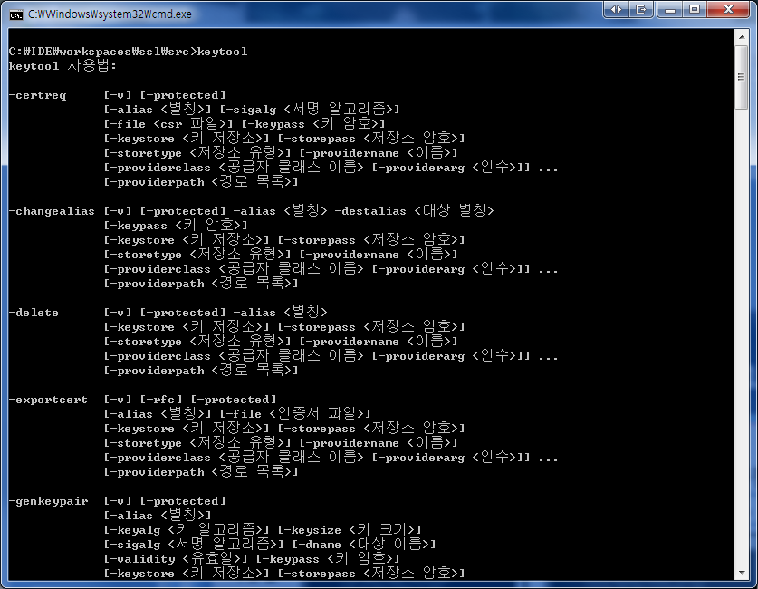
Case Study of JAVA SSL
keytool

Slide 27
Case Study of JAVA SSL
The server generates a pair of private/public key and exports the certificate
  private/public Key generation
    keytool –genkey –keystore name –keyalg RSA
      name: server keystore name. storing private/public key.
      keystore password : needed whenever accessing the keystore, private key
      need to feed information on the server
  Public key export
    Keytool -export –keystore name –file filename

Slide 28
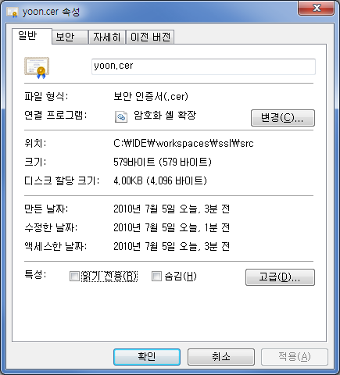
Case Study of JAVA SSL
certificate

Slide 29
Case Study of JAVA SSL
The client only creates truststore
  truststore: stores public keys trusted by the client
  use import option
    keytool –import –keystore name –file filename
      name : client truststore name
      filename : filename of server’s certificate

Slide 30
Case Study of JAVA SSL
How keystore and truststore different?
  keystore : private key
  truststore : public key
Why export/import rather than the basic implementation model?
  Should trust the self-signed server certificate

Slide 31
Case Study of JAVA SSL
Compile
  Javac SSL_EchoServer.java
  Javac SSL_EchoClient.java
Execution
  Server
    java -Djavax.net.ssl.keyStore=keyStoreName -Djavax.net.ssl.keyStorePassword=pwd SSL_EchoServer
  Client
    java -Djavax.net.ssl.trustStore=trustStoreName SSL_EchoClient

Slide 32
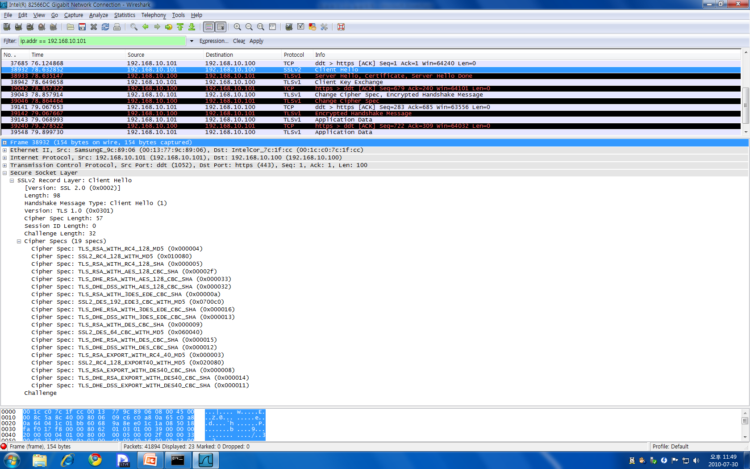
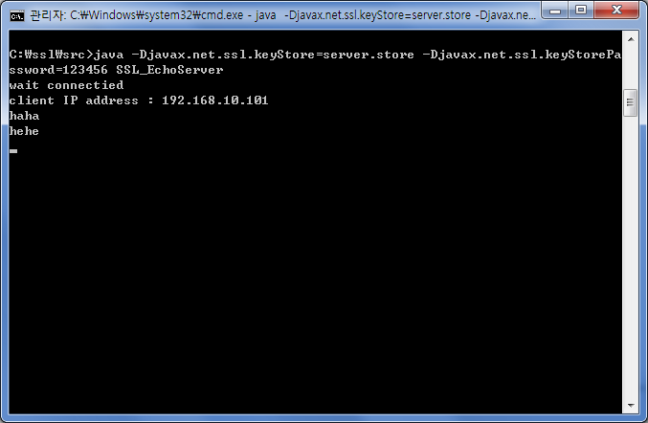
Case Study of JAVA SSL
클라이언트의 주소로 필터링. 즉 저 주소는 클라이언트의 주소이다.
패킷분석
클라이언트가 가능한 암호화 알고리즘의 목록.
총 19개로서 위에 숫자와 일치한다.

Slide 33
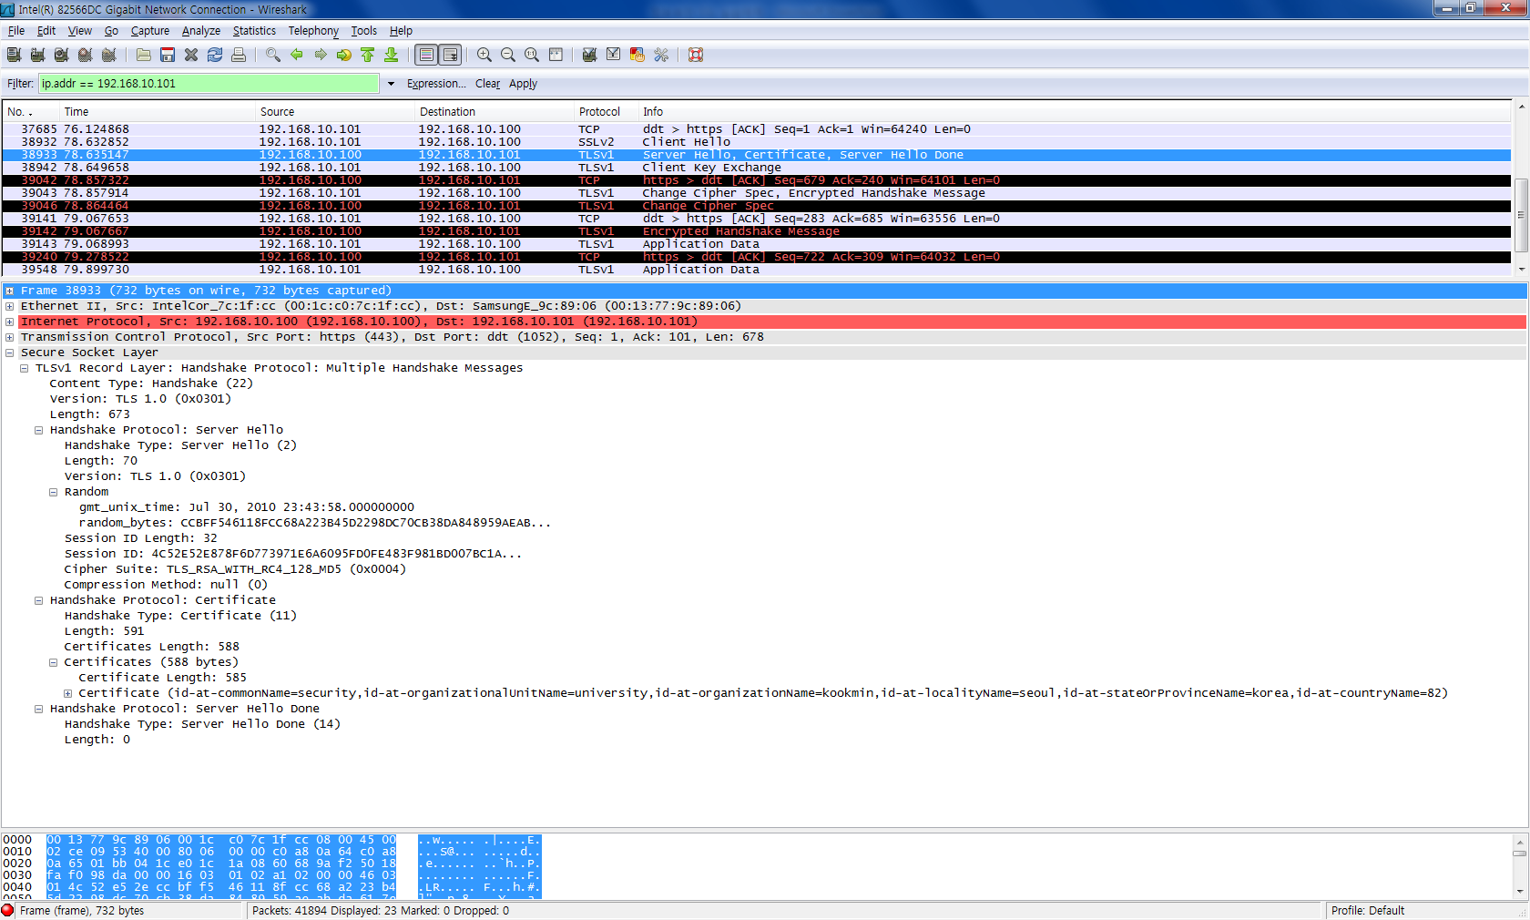
Case Study of JAVA SSL
세션키 생성에 사용될 랜덤수
클라이언트가 보내준 암호화 알고리즘 목록 중에서 한 개를 선택한 결과.
생성한 인증서의 정보가 보여진다.
아까 입력한 내용이 보인다.

Slide 34
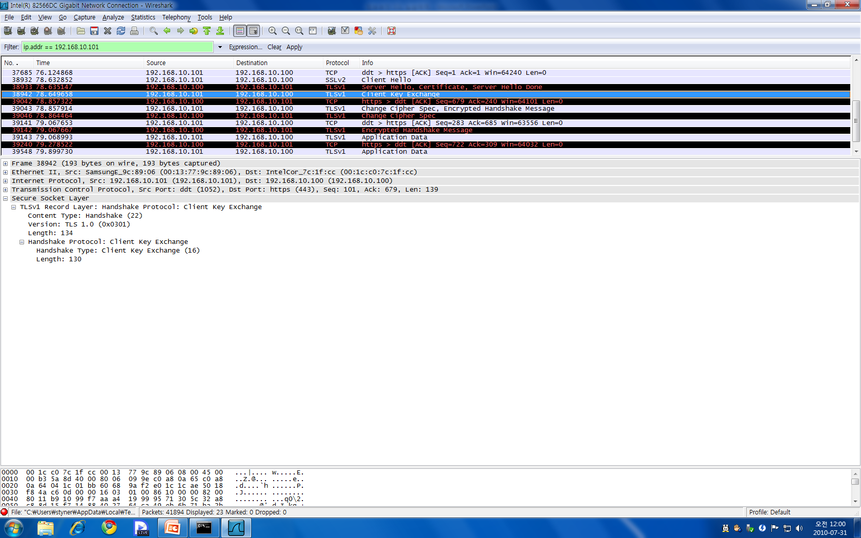
Case Study of JAVA SSL
클라이언트가 생성된 세션키를 서버에게 전송하는 단계.

Slide 35
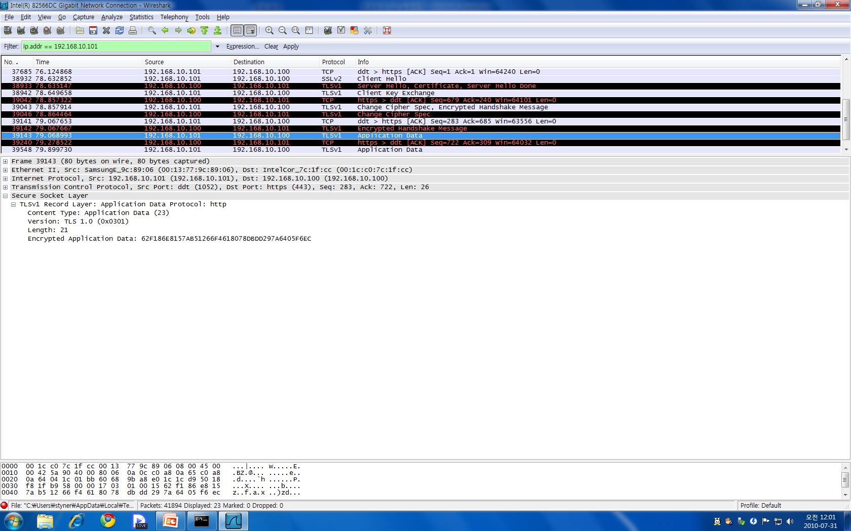
Case Study of JAVA SSL
haha라는 데이터가 암호화 된 결과이다.
실제로 데이터가 교환되는 부분.
암호화 되어있다.

Slide 36
Reference
Cryptography and network security, W. Stallings, Prentice Hall, 2011
Network security: private communication in a public world, C. Kaufman, etc., Prentice Hall, 2002
Computer networking: a top-down approach, J. Kurose and K. Ross, Pearson, 2008
Lecture notes from “computer and network security”, S. Chen, University of Florida

